Slide 1
Consideration on EDCA operation for low latency traffic delivery
Date: 2023-05-10
Authors:
Name | Affiliation | Address | Phone | Email
Liuming Lu | OPPO |  |  | luliuming@oppo.com
Liuming Lu (OPPO)

Slide 2
Introduction
New applications besides AR/VR have been expected to be supported in UHR, such as robotics, industrial automation for industrial IoT, logistics and smart agriculture.
UHR takes enhanced low latency with high reliability and efficient use of the medium as main Objectives
enhance WLAN reliability by enabling, in scenarios of an isolated Basic Service Set (BSS) or of overlapping BSSs:
improving the tail of the latency distribution and jitter
improving efficient use of the medium
This contribution points out the limitation of existing EDCA operation for low latency traffic delivery, and proposes that enhanced EDCA operation is specified in UHR

Slide 3
Summary of existing EDCA operation
EDCA Operation updates mainly include:
EDCA backoff, such as the events which causes an EDCAF to invoke the backoff procedure, rules for deferring transmission
The management of EDCA parameters, such as the update of the CWmin[AC], CWmax[AC], AIFSN[AC], and TXOP Limit [AC] state variables for STAs.
EDCA operation
HE
EHT
UHR
EDCA backoff update
EDCA backoff procedures for NSTR operation to avoid expected inferences
EDCA backoff rules for R-TWT SP by deferring transmission for particular STAs for some time
The management of EDCA parameters :
EPCS EDCA parameters: for EPCS priority access that provides prioritized access to medium for authorized devices(EPCS-enabled STAs)
EDCA backoff update
EDCA backoff procedures for trigger-based transmission.
OBSS PD-based/PSR-based spatial reuse backoff procedure for the medium to be reused more often between OBSSs by interference management
The management of EDCA parameters :
MU EDCA parameters : to control the use of EDCA by non-AP HE STAs following particular UL MU HE TB PPDU transmissions
?

Slide 4
Limitations of existing EDCA operation
Currently specified R-TWT prefers trigger-based transmission initiated by the scheduling AP using trigger-enabled R-TWT SPs, and the EDCA operation (i.e. backoff rules) has been specified to provide prioritized access to medium for AP at the start time of R-TWT SPs.
Applications limitation
The applications of R-TWT operation are limited to schedulable services with latency sensitive traffic which shows periodic pattern with burst arrival of packets in each interval
For non-schedulable services which require low latency with high reliability, it is difficult for AP to know the QOS characteristics of the services in advance so that AP cannot immediately schedule the transmission of the traffic for the services.
Some industrial IoT application expected to be supported in UHR belong to non-schedulable services.

Slide 5
Limitations of existing EDCA operation (cont.)
Currently specified R-TWT prefers trigger-based transmission initiated by the scheduling AP using trigger-enabled R-TWT SPs, and the EDCA operation (i.e. backoff rules) has been specified to provide prioritized access to medium for AP at the start time of R-TWT SPs.
Excessive overhead for trigger-based transmission
Major sources of overhead include resource allocation (TF and DL MU PPDUs) , and SCS signaling for QoS characteristics of the traffic to be scheduled for transmission.
Overhead prevents shorter cycles and/or leaves less time to serve latency sensitive traffic
Performance is severely affected by OBSS Interference
If the scheduling AP or member STAs incur OBSS interferences during R-TWT trigger-enabled SPs, AP cannot schedule the downlink and/or uplink transmission for the member STAs and the member STAs cannot initiate the uplink transmission by EDCA operation.
This would cause unexpected scheduled transmission and low-efficient use of the medium

Slide 6
Requirements of EDCA operation for UHR
EDCA operation for low latency traffic delivery
Applications to be supported
Not limited to schedulable services
Non-schedulable services need to be considered
Low overhead for the transmission of low latency traffic
Not limited to trigger-enabled SPs
Non-trigger-enabled SPs need to be considered.
Flexible selection of trigger-enabled or non-trigger-enabled SPs based on QoS characteristics of services and network scenario and condition.
High efficient use of the medium
Spatial reuse to be considered for the medium to be reused more often between OBSSs
Reduce invalid transmissions
Management of OBSS interference
Multi-AP coordination needs to be considered.

Slide 7
Candidate EDCA operation for UHR
EDCA operation for low latency traffic delivery
1. The optimization of EDCA operation for spatial reuse during SPs by multi-AP coordination
for the medium to be reused more often between OBSSs by interference management
Coordination of SR parameters among multiple APs, such as the interfering APs/STAs and/or their allowed transmit power/RSSI.
2. EDCA operation during or outside of SPs for non-trigger-enabled SPs
provide prioritized access to medium in use of EDCA operation for member SATs during SPs.
control the use of EDCA operation by non-member STAs during SPs

Slide 8
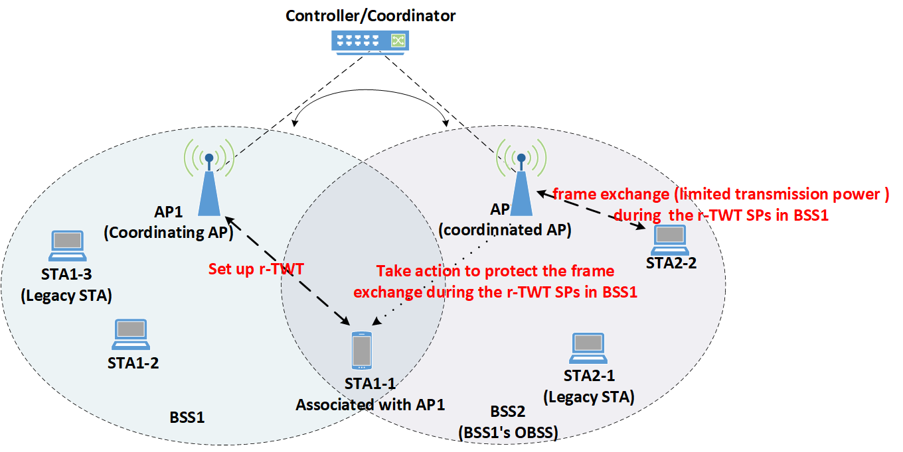
EDCA operation for spatial reuse
An example: for the coordination of SR parameters, after the r-TWT setup the TX. power constraint and allowed RSSI of STA1-1 and/or AP1 can be exchanged or negotiated between AP1 and AP2. AP2 can determine which STAs associated with it satisfy the transmission requirements by sounding mechanism or other inter-PPDU sensing method.

Slide 9
EDCA operation for SPs
Enhanced EDCA operation considered to be used for member STAs and non-member STAs during SPs:
Option 1:
prioritized EDCA parameters for member STAs: to provide prioritized access to medium in use of EDCA operation for member STAs during SPs
Option 2:
deprioritized EDCA parameters for non-member STAs: to control the use of EDCA operation by non-member STAs during SPs
Option 3:
Enhanced EDCA backoff rules for SPs: to provide enhanced medium access protection and resource reservation mechanisms for delivery of latency sensitive traffic, such as defer the transmission of non-member STAs by EDCA for a time duration during SPs

Slide 10
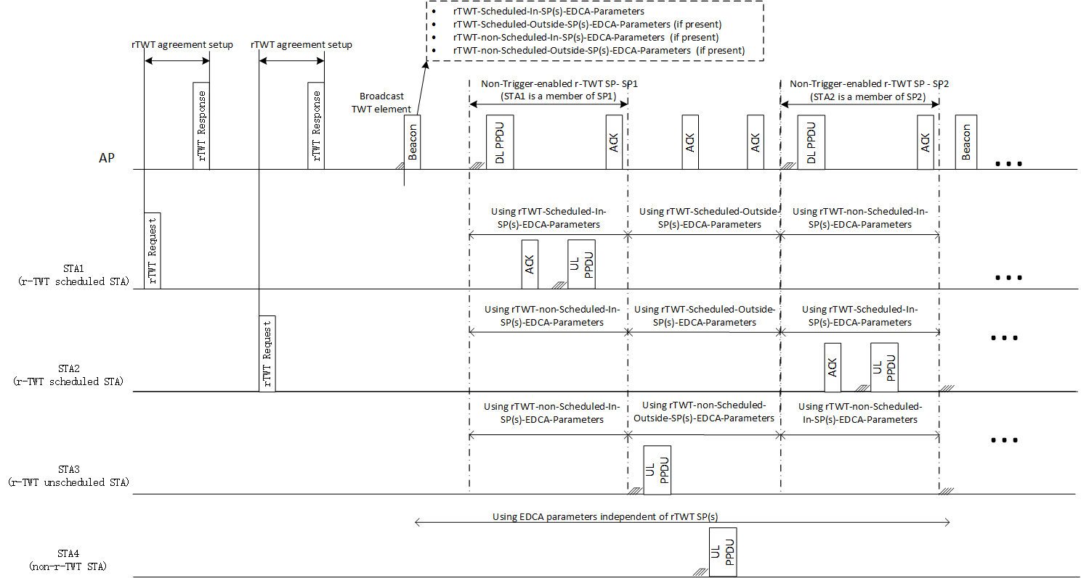
EDCA operation for SPs (cont.)
An example of special EDCA parameters used for member STAs and non-member STAs during SPs

Slide 11
Summary
New applications, such as robotics, industrial automation for industrial IoT, logistics and smart agriculture, have been expected to be supported in UHR, and some of the applications belong to non-schedulable services which require low latency with high reliability
Currently specified R-TWT prefers trigger-based transmission by the scheduling AP through providing prioritized access to medium for AP at the start time of R-TWT SPs, which seems to be unsuitable for low latency traffic delivery for non-schedulable services
Enhanced EDCA operation is suggested to be specified for low latency traffic delivery in UHR
Requirements:
High efficient use of the medium, management of OBSS interference, low overhead for the transmission of low latency traffic need to be considered.
Candidate Features:
The optimization of EDCA operation for spatial reuse during SPs by multi-AP coordination
EDCA operation during or outside of SPs for non-trigger-enabled SPs

Slide 12
Reference
[1] UHR proposed PAR, https://mentor.ieee.org/802.11/dcn/23/11-23-0480-01-0uhr-uhr-proposed-par.pdf
[2] Challenges to achieve low latency, https://mentor.ieee.org/802.11/dcn/22/11-22-1926-00-0uhr-challenges-to-achieve-low-latency.pptx
Liuming Lu (OPPO)

Slide 13
SP
SP : Do you support to specify enhanced EDCA operation for member STAs and non-member STAs during SPs (especially non-trigger-enabled SPs) for low latency traffic delivery in UHR?
Liuming Lu (OPPO)

