Slide 1
Comments on 11bk Supporting Puncturing Patterns
Date: 2023-03-10
Authors:
Name | Affiliations | Address | Phone | Email
Julia Feng | Mediatek USA Inc | 2840 Junction Ave., San Jose, CA 95134, USA |  | Julia.feng@mediatek.com
Jianhan Liu |  | 2840 Junction Ave., San Jose, CA 95134, USA |  | Jianhan.liu@mediatek.com
Notes:
September 2012

Slide 2
Introduction
In 11-22/1981 (Thoughts on 320 MHz Ranging NDP), Steve proposed 11bk to
  Support all EHT Preamble Puncturing modes (as signaled in the U-SIG)
In 11-23/0110r0 (Discussions on Preamble Puncturing in 320MHz Ranging NDP), Tianyu proposed that
  11bk only supports non-punctured 320MHz ranging NDP and continuous 240MHz ranging NDP
  I.e., only supports 3 puncturing patterns specified in Table 36-30: [1111 1111] (field value 0), [xx11 1111] (field value 9), and [1111 11xx] (field value 12)
We’ll provide comments on 11bk supporting puncturing patterns following the rules applied on 11be sounding protocol

Slide 3
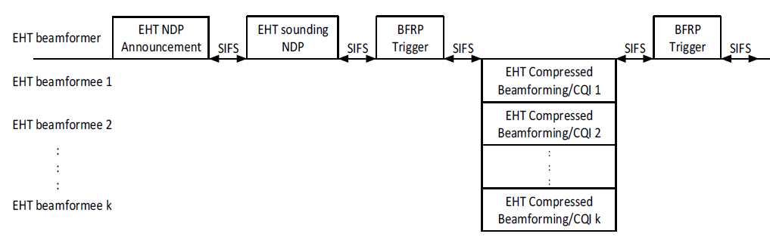
11be TB Sounding and Preamble Puncturing
35.7.2 EHT sounding protocol
  Note 3 -- In the EHT TB sounding sequence, the punctured subchannel(s) indicated by the BW and Puncturing Channel Information fields in the U-SIG field of the EHT sounding NDP might include other punctured subchannel(s) in addition to those indicated in the Disabled Subchannel Bitmap subfield of the most recent EHT Operation element, following the rules defined in 35.15.2 (Preamble puncturing operation).
35.15.2 Preamble puncturing operation
  An EHT SU transmission that contains an MPDU soliciting an immediate response shall not puncture 20 MHz subchannels that are not indicated to be punctured in the Disabled Subchannel Bitmap subfield in the EHT Operation element, unless the EHT SU transmission carries a triggering frame that solicits a TB PPDU from a responding EHT STA.
USIG might include additional punctured subchannels

Slide 4
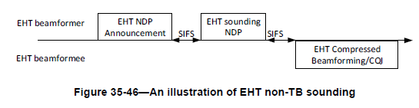
11be non-TB Sounding and Preamble Puncturing
35.7.2 EHT sounding protocol
  In an EHT non-TB sounding sequence case, the punctured subchannel(s) indicated by the BW and Puncturing Channel Information fields in the U-SIG field of the EHT sounding NDP shall not include other punctured subchannel(s) in addition to those indicated in the Disabled Subchannel Bitmap subfield of the most recent EHT Operation element for non-TB sounding.
U-SIGs have the same puncturing pattern as indicated in the Disabled Subchannel Bitmap

Slide 5
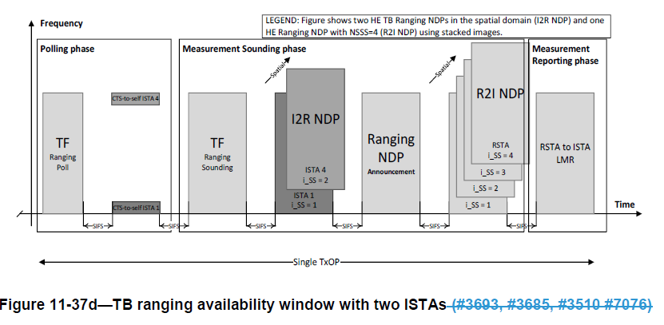
11bk TB Ranging Procedure
Following the rules applied on the EHT TB sounding sequence, the punctured subchannel(s) indicated by the BW and Puncturing Channel Information fields in the U-SIG field of the EHT based ranging NDP might include other punctured subchannel(s) in addition to those indicated in the Disabled Subchannel Bitmap subfield of the most recent EHT Operation element.
But the 11be devices which don’t support additional puncturing in TB sounding NDP transmission still can’t support it in 11bk TB ranging.
Some 11be devices may not support additional punctured subchannels

Slide 6
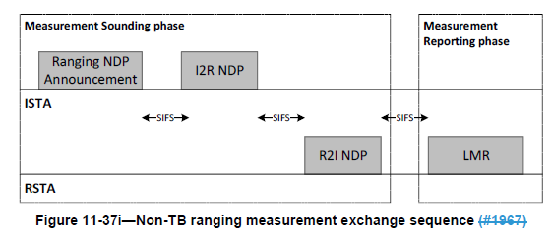
11bk Non-TB Ranging Procedure
Following the rule applied on EHT non-TB sounding sequence, the punctured subchannel(s) indicated by the BW and Puncturing Channel Information fields in the U-SIG field of the EHT based non-TB ranging NDP shall not include other punctured subchannel(s) in addition to those indicated in the Disabled Subchannel Bitmap subfield of the most recent EHT Operation element for non-TB sounding.
11bk non-TB ranging shall not allow ranging frame exchanges with a puncturing pattern including other punctured subchannel(s) in addition to those indicated in Disabled Subchannel Bitmap subfield from data communication to ranging.
  For example, shall not change puncturing pattern 1111 111x for data communication to 1111 11xx for ranging, unless the Disabled Subchannel Bitmap subfield is changed in EHT Operation element.
Shall not change puncturing pattern for ranging

Slide 7
11bk Ranging Supports Puncturing Patterns
During 11bk ranging frame exchanges, the puncturing patterns shall not include other punctured subchannel(s) in addition to those indicated in the Disabled Subchannel Bitmap subfield of the most recent EHT Operation element for non-TB sounding.
  For puncturing pattern [1111 111x] or [x111 1111] indicated by Disabled Subchannel Bitmap, do not allow additional puncturing of 40MHz for ranging with 240MHz (transmit with an equivalent puncturing pattern of [1111 11xx] or [xx11 1111].
  An ISTA will need to fall back to primary 160MHz to send IFTMR if it doesn’t support these puncturing patterns for ranging.

Slide 8
Reduced Ranging Accuracy by Limiting Puncturing Pattern Support in 11bk
Only supporting continuous 320/240MHz (puncturing pattern 0, 9, 12) limits usage of 11bk
  For puncturing pattern [1111 111x] indicated by Disabled Subchannel Bitmap, if an ISTA doesn’t support this puncture pattern, it needs to fall back to primary 160MHz for ranging. The contiguous ranging BW is reduced from 280MHz to 160MHz.
Supporting all puncturing patterns maximizes ranging BW
  11be is mandatory to support all puncturing patterns specified in Table 36-30
  11bk may use the continuous part of the 320MHz band or punctured 320MHz band for ranging to maximize performance.
  For puncturing pattern [1111 1x11] indicated by Disabled Subchannel Bitmap, if an ISTA doesn’t support this puncture pattern, its contiguous ranging BW is reduced from 200MHz to 160MHz.
  The argument that the performance enhancement from 160MHz to 200MHz, or even from 160Mhz to 280MHz is not significant is not convincing since 11bk targets at enhanced ranging performance.
  In fact, less efforts may be needed to obtain this performance enhancement by supporting all puncturing patterns than changing the puncturing patterns in the above scenarios.

Slide 9
Straw Poll
Do you agree with the following statement?
  “IEEE 802.11bk is not allowed to transmit an EHT Ranging NDP or an EHT TB Ranging NDP with a puncturing pattern which is different than the puncturing pattern indicated in the beacon.”
  Yes
  No
  Absent

