Slide 1
MAC header protection
Date: 9-May-2023
Name | Affiliation | Address | Phone | Email
Abhishek Patil | Qualcomm Inc. |  |  | appatil@qti.qualcomm.com
Duncan Ho
Jouni Malinen
George Cherian
Alfred Asterjadhi

Slide 2
Background
There are several fields in the MAC header that are not protected during the encryption of an MPDU
These fields carry critical information that influences the receiving STA’s behavior
Such as indication of more data, power-save, buffer status etc
Over the years, some of these (unprotected) fields have been extended to provide additional functionality
A prime example is the extension of HT Control field by 11ax to enable critical functionalities such as TRS, BSR etc
These unprotected fields are vulnerable to attacks leading to adverse effect at the receiver

Slide 3
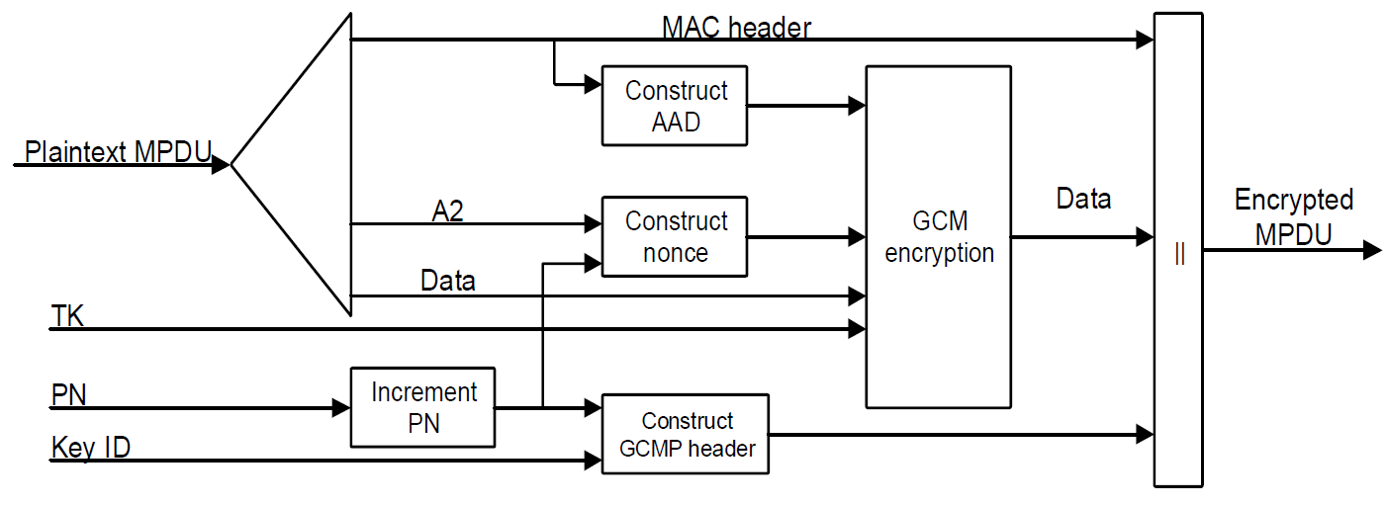
Background: AAD Construction
Fields from the MAC header are used during the construct additional authentication data (AAD).
However, some of the fields are masked out
Because their values can change when the MPDU is retransmitted

Slide 4
Header fields that are not protected
The following (sub)fields are masked during the construction of AAD (and hence not protected):
In Frame Control field:
The 3 LSBs of the Subtype subfield (bits 4 5 6) in a Data frame masked out. Bit 7 is not modified
Retry subfield (bit 11) masked out
Power Management subfield (bit 12) masked out
More Data subfield (bit 13) masked out
+HTC subfield (bit 15) is masked out in all Data frames containing a QoS Control field
Sequence Number subfield in Sequence Control field
All subfield in QoS Control field except TID subfield are masked
A-MSDU Present subfield is conditionally protected (AAD)
Duration/ID and HT Control fields are not part of AAD construction

Slide 5
Header fields that are not protected
Field is not protected
Some subfields within the
field are protected

Slide 6
Example Attack 1: Replay of a Data frame with modified SN
Attacker records a genuine (A)MPDU and replays it with modified Sequence Number(s).
Since it is a replayed frame, it will pass decryption & integrity check. The attack goes unnoticed until the PN-based replay check is performed, which is much later in the processing chain [See Figure 5-1].
But by then:
the scoreboard context (and possibly WinStartR) will get updated.
Scoreboard context will make any entry for the location matching the (fake) SN
WinStartR gets updated if the SN of the injected (fake) frame is > WinEndR
If the fake SN moves the scoreboard window by 2¹¹, the receiver will ignore subsequent genuine MPDUs [see 10.25.6.3]
duplicate detection logic gets corrupted with an entry for the fake SN from replayed MPDU
jeopardizing the processing of a genuine MPDU, received subsequently and matching that SN
Reorder buffer (and possibly WinStartB) will get updated.
The (fake) MPDU is stored in the reorder buffer at the location matching the (fake) SN
WinStartB gets updated if the SN of the injected (fake) frame is > WinEndB
If the fake SN moves the WinStartB by 2¹¹ , then the receiver will ignore subsequent genuine MPDUs [see 10.25.6.6.2.1]

Slide 7
Example Attack 2: Frame w/ modified A-Control
Attacker transmits a fake QoS Null frame or replays a QoS Data frame with an arbitrary value in the A-Control
Such as TRS-Control which will cause the client to react in SIFS
The attack will go unnoticed until PN-based replay check
Will go unnoticed if it was a fake a QoS Null frame.
As a result, the recipient (non-AP STA) burns power and spends it resources in preparing and transmitting a TB-PPDU
Other features such as cross-link signaling via A-Control are vulnerable to such attacks causing the non-AP MLD to wake-up on additional links and burn additional power.

Slide 8
Published attack due to unprotected PM bit
General attack strategy:
Attacker sends a frame indicating that a non-AP STA is entering PS mode
The TA is spoofed to be the MAC address of the (victim) non-AP STA
PM bit is set to 1 (reminder, the PM bit is not protected)
Frame can be a QoS Null frame (i.e., carries no encrypted content)
Attacker tricks the AP into removing the security keys
By sending Auth/Assoc Req
Attacker then indicates that the (victim) non-AP STA is in awake state
AP now DLs unencrypted buffered frames
The attack is possible on popular OS (such as Linux/FreeBSD)
More details on the attack can be found in this paper
to appear at the 32nd USENIX Security Symposium (USENIX Security 2023)
Also see: this article

Slide 9
In summary
Unprotected header fields are vulnerable to various attacks which will lead to DoS, power drain, exposing data, and impact performance.
UHR is focused on improving reliability, reducing latencies and reducing power consumption at devices.
Therefore, MAC header protection must be viewed as one of the necessary steps towards meeting these goals.

Slide 10
Some considerations
A scheme to protect the MAC header needs to account for the header field value(s) getting updated when an MPDU is retried.
Such as Retry bit, PM bit, A-Control field etc
In addition, the scheme needs to preserve the requirement that the contents of the MPDU are not re-encrypted during a retry
Consequently, MAC header protection cannot be combined with MPDU encryption.
i.e., needs to be a separate step such that the protection is re-applied only to the MAC header fields when an MPDU is retried.

