Slide 1
MAC header protection
Date:
Name | Affiliation | Address | Phone | Email
Abhishek Patil | Qualcomm Inc. |  |  | appatil@qti.qualcomm.com
Duncan Ho
Jouni Malinen
George Cherian
Alfred Asterjadhi

Slide 2
Summary of issues
There are several fields in the MAC header that are not protected during the encryption of an MPDU
  These fields carry critical information that influences the receiving STA’s behavior
    Such as indication of more data, power-save, buffer status etc
Over the years, some of these (unprotected) fields have been extended to provide additional functionality
  E.g., extension of HT Control by TGax for functionalities such as TRS, BSR etc
The unprotected fields are vulnerable to attacks leading to adverse effect at the receiver
UHR must consider protecting MAC header to meet its performance goals, reduce power drain and improve reliability.

Slide 3
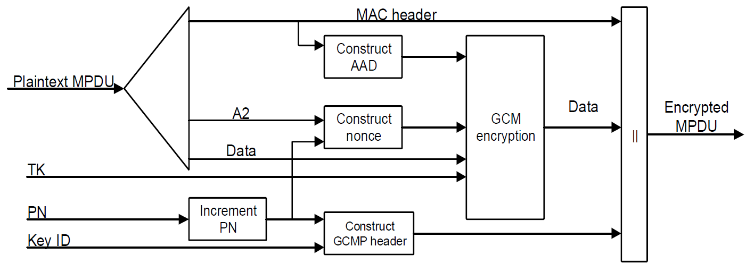
Background: AAD Construction
Fields in the header are used to construct additional authentication data (AAD).
  Some of the header fields, that might change when retransmitted, are masked out during the construction of AAD

Slide 4
Header fields that are not protected
The following (sub)fields are masked during AAD construction (and hence not protected):
  In Frame Control field:
    The 3 LSBs of the Subtype subfield (bits 4 5 6) in a Data frame masked out. Bit 7 is not modified
    Retry subfield (bit 11) masked out
    Power Management subfield (bit 12) masked out
    More Data subfield (bit 13) masked out
    +HTC subfield (bit 15) is masked out in all Data frames containing a QoS Control field
  Sequence Number subfield in Sequence Control field
  All subfield in QoS Control field except TID subfield are masked
    A-MSDU Present subfield is conditionally protected (AAD)
Duration/ID and HT Control fields are not part of AAD construction

Slide 5
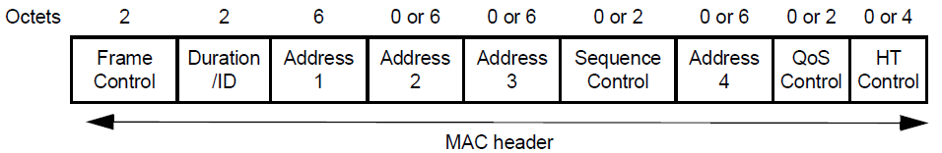
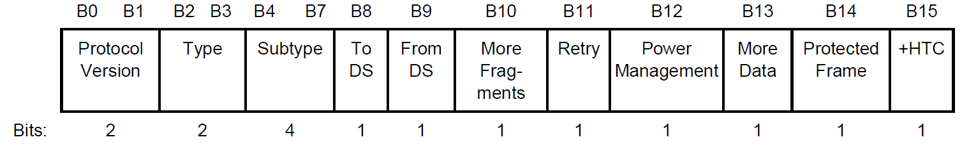
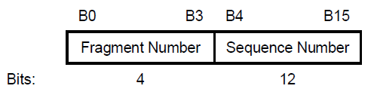
Header fields that are not protected
Field is not protected
Some subfields within the
field are protected

Slide 6
Example Attack 1:
Replay of a Data frame with modified SN
Attacker records a genuine (A)MPDU and replays it with modified Sequence Number(s).
Since it is a replayed frame, it will pass decryption and integrity check and the attack goes unnoticed until (PN-based) replay check is performed, which is much later in the processing chain (i.e., after reorder buffer block).
But by then:
  the scoreboard context (and possibly WinStart_{R}) will get updated.
    WinStart_{R} gets updated if the SN of the injected (fake) frame is > WinEnd_{R}
    receiver ignores genuine MPDUs if the updated WinStart_{R} fall in the 2nd half of the window (i.e., > 2¹¹)
  duplicate detection logic gets corrupted with SN from replayed MPDU
    jeopardizes the processing of a genuine MPDU matching that SN
  Will possibly updates WinStart_{B}
    WinStart_{B} gets updated if the SN of the injected (fake) frame is > WinEnd_{B}
    receiver ignores genuine MPDUs if the updated WinStart_{B} fall in the 2nd half of the window (i.e., > 2¹¹)
      Assumption: An MPDU will be discarded from the re-O buffer when PN check fails but WinStart_{B} will remain updated
      i.e., there is no backtracking to undo the change due to a bad MPDU

Slide 7
Example Attack 2:
Frame w/ modified A-Control
Attacker transmits a fake QoS Null or replays an MPDU with an arbitrary value in the A-Control
  Such as TRS-Control which will cause the client to react in SIFS
The attack will go unnoticed until PN-based replay check
  Will go unnoticed if it was a fake a QoS Null frame.
As a result, the recipient (non-AP STA) burns power and spends it resources in preparing and transmitting a TB-PPDU
Other features such as cross-link signaling via A-Control are vulnerable to such attacks causing the non-AP MLD to wake-up on additional links and consumer additional power.

Slide 8
In summary
Unprotected header fields are vulnerable to various attacks which will lead to DoS, power drain and impact performance.
UHR is focused on improving reliability, reducing latencies and reducing power consumption at devices.
Therefore, MAC header protection must be viewed as one of the necessary steps towards meeting these goals.

Slide 9
Some considerations
A scheme to protect the MAC header needs to account for the header field value(s) getting updated when an MPDU is retried.
  Such as Retry bit, PM bit, A-Control etc
In addition, the scheme needs to preserve the requirement that the contents of the MPDU are not re-encrypted during a retry
Consequently, MAC header protection cannot be combined with MPDU encryption.
  i.e., needs to be a separate step such that the protection is re-applied only to the MAC header fields when an MPDU is retried.

