Slide 1
STA to generate its new AID upon MAC address change
Date: 2023-03-13
Authors:

Slide 2
Revision
Rev 0: initial revision
Rev 1: straw poll text addition.

Slide 3
Abstract
Current contribution describes the mechanism to generated a new AID for an associated STA upon its OTA MAC address modification.
The described mechanism allows the generation of a new AID for an associated STA without any message exchange in most scenario.
The resolution of potential AIDs conflict by the AP is also described.

Slide 4
Overview
11bi requirement document [1] includes requirements (Req 11) mandating to define a mechanism for a station to change its AID address in “associated State 4 without any loss of connection when the OTA MAC address of the CPE Client is changed”.
[2] proposed a mechanism for an AP and its associated STA to generate an new MAC address without exchanging it.
[3] proposed to let the AP assign new AID upon MAC address modification.
This contribution proposes a mechanism that allows a STA to generate its new AID upon MAC address change.
This contribution also propose mechanism for the AP to solve potential collision issues before those collision effectively occur.

Slide 5
11bi requirement
Req 11 : “11bi shall define a mechanism for a CPE Client and CPE AP to change the CPE Client’s AID
to an uncorrelated new value in Associate STA State 4, without any loss of connection
when the OTA MAC address of the CPE Client is changed.”

Slide 6
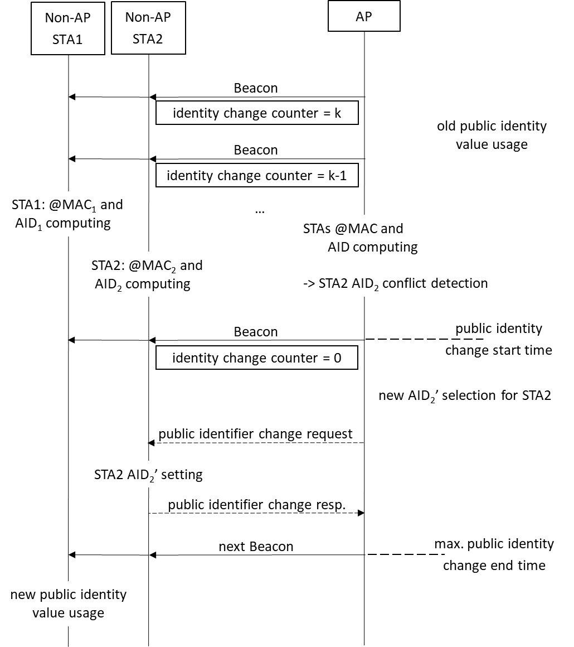
Main principle
Exemple: Public Identity change is initiated by the AP
Each Non-AP STAs compute locally a new Public Identity, AP perform same operations and compute same values.
If the AP detects a conflict, it generates a new identifier and send it to the concerned Non-AP STA(s).
At the end of the transition period, all Non-AP STAs and AP use new Public Identities.

Slide 7
New EDP protected action frames
The change request frame and the response frame are two protected action frames part of the Enhanced Data Privacy (EDP) action frames.
The table below provides an example of encoding of the protected action fields for these new EDP protected action frames in the case of regenerating public identifier values:
indicates a number of beacons or TBTTs to wait before the effective use of the identifier value
min value field and max value field are used to provide an acceptable range of values in which the public identifier value to be used is to be chosen
Example format of change request frames

Slide 8
NEW AID range IE
Element ID
Length
Element ID Extension
Min value
Max value
AID Range IE
This information element can be transmitted during an association / re-association procedure in the association response frame in addition to the initial AID value provided by the AP station during this association procedure.
This reduces the probability for a non-AP station to generate conflicting public identifier values

Slide 9
Benefits
User privacy is enhanced by allowing a station to change its AID upon MAC address change while associated without break of ongoing connection.
In most cases, the change of the AID is not easily detectable since there is no (or few) message exchange.
In any case of potential conflict detection by the AP (prior to the effective use of a new AID), the AP can provide a new AID to the STA.

Slide 10
Straw Poll #1
Do you support AID generation mechanism as described in slide 5
Yes
No
Abstain

Slide 11
Straw Poll #1
Do you support creation of protected action frames for ID change request/response.
Yes
No
Abstain

Slide 12
Straw Poll #1
Do you support creation of a new IE for AID range indication in association response frame ?
Yes
No
Abstain

Slide 13
References
[1] IEEE 802.11-21/1848r16 : Requirements Document
[2] IEEE 802.11-22/0114r3 : Enhanced Randomized and Changing MAC address
[3] IEEE 802.11-23/0166r0 : Mechanism of simultaneous changes to SNscrambler seed PN AID and TID

