Slide 1
Roaming Requirements
April 2023
Authors:
Name | Affiliation | Phone | email
Brian Hart | Cisco Systems |  | brianh@cisco.com
Malcolm Smith | Cisco Systems
Juan Carlos Zuniga | Cisco Systems
Stephen Orr | Cisco Systems
Jerome Henry | Cisco Systems

Slide 2
Wild West Connectivity seems promising …
The simplest approach to more reliable roaming is no roaming at all:
Client has connectivity with multiple AP MLDs and can transmit or receive MSDUs through any of them
Lowest latency, highest reliability
UL MSDUs can be duplicated (e.g., UL MSDU to AP MLD1 received correctly but acknowledgement lost so client retries at AP MLD2)
UL MSDUs can reach the network out-of-order (UL MSDU1 to AP MLD1 then UL MSDU2 to AP MLD2 but AP MLD1 has higher internal latency than AP MLD2)
Network has a duplication function, but this creates similar problems for the DL: the client can receive duplicate MSDUs and out-of-order MSDUs.
As well, each AP MLD is trying to deliver the same DL data to the client, wasting medium time and energy at both AP MLD and client
Network
Multiple Distribution Service Access Points serving the non-AP MLD
AP MLD1
AP MLD2
Non-AP MLD
Hart et al (Cisco Systems)

Slide 3
… but Upper Layers Impose Rigid Requirements on Duplicates and Out-of-Order Delivery within a flow Constrains solutions to roaming & Joint RX
A non-AP MLD is basically not allowed to be served by multiple DSAPs*
Exceptions include splitting by UP or by flow hash
Shortest Path Bridging (SPB) is defined in 802.1Q-2018 and enables multipath routing
Yet, re frame duplication, between SAPs, this is still one-path-at-a-time-per-flow routing since:
“When Bridges in a network connect individual LANs in such a way that physical topology is capable of providing multiple paths between any source and destination, a protocol is required to ensure that the active topology comprises a single path. ”
Re frame misordering, we need to worry about it and be able to disable any feature that causes frame misordering:
“Some known LAN protocols, for example, LLC Type 2 (ISO/IEC 8802-2), are sensitive to frame misordering and duplication; in order to allow Bridges that support RSTP to be used in environments where sensitive protocols are in use, the forceVersion parameter (13.7.2) can be used to force a Bridge that supports RSTP to operate in an STP-compatible manner. ”
Other protocols:
Multipath TCP (RFC 8684) – but TCP only
MP-QUIC (draft-lmbdhk-quic-multipath-00) is for UDP but is not wide-spread
Network
X
Multiple Distribution Service Access Points serving the non-AP MLD
AP MLD1
AP MLD2
Non-AP MLD
Hart et al (Cisco Systems)

Slide 4
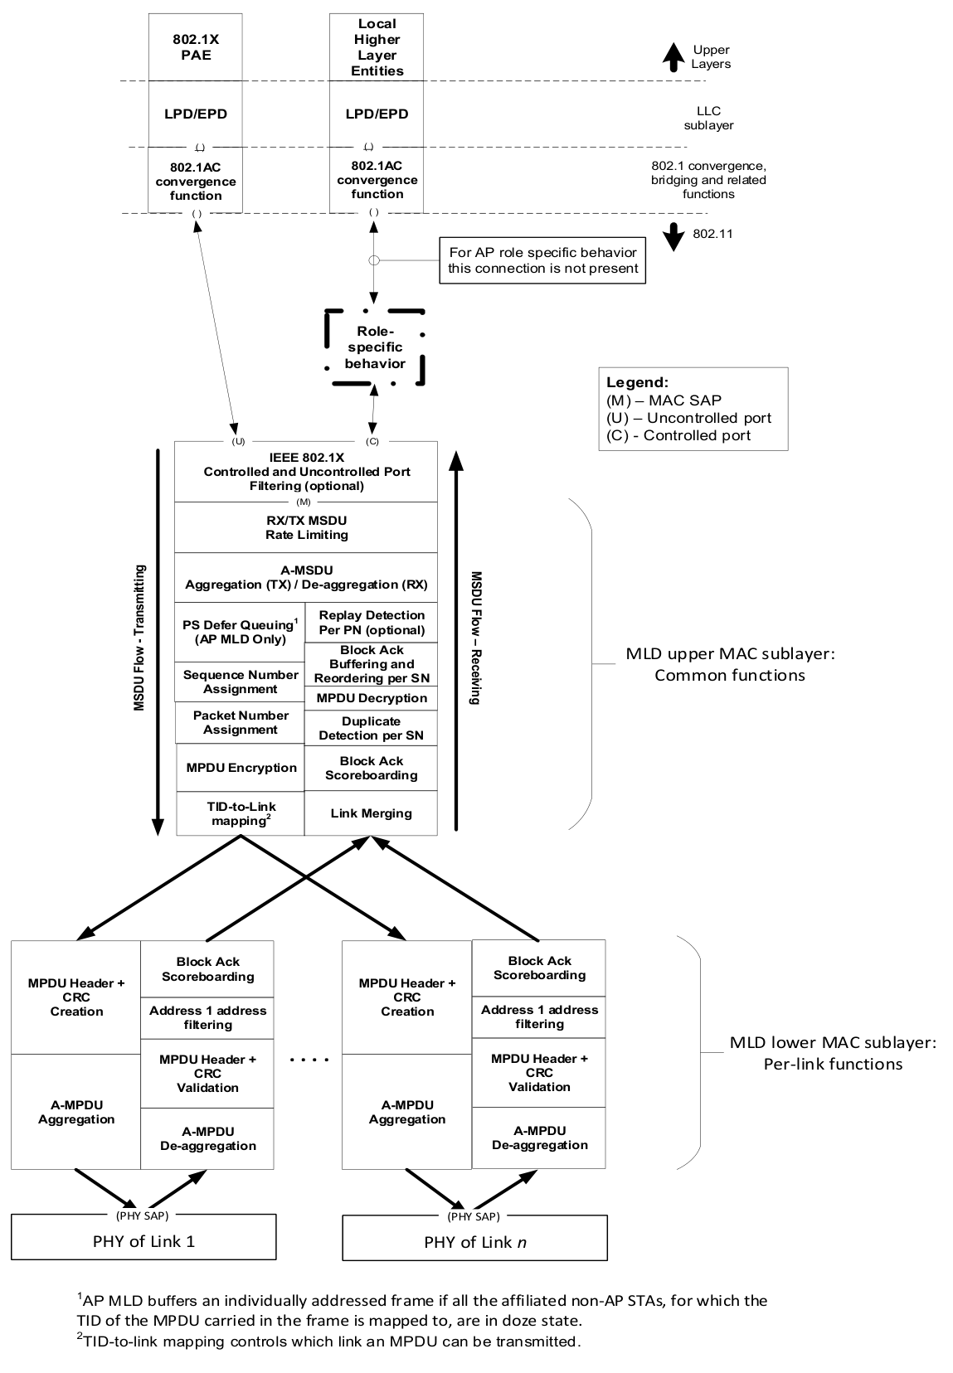
… and these Rigid Requirements Impact How the Datapath can be Distributed
Split-A
Thinking of roaming between two APs with non-negligible communications latency, assuming SN is used as the identifier for de-duplication and reordering, we can partition the state that an AP holds (and processing that each AP performs) for each client into two classes:
Singleton
Distributable
Singleton state/processing naturally belongs at a single entity; distributable state/processing can exist independently at each AP.
However, we see that most distributed processing is just a first draft that needs to be finalized at a singleton entity
UMAC
Upper-UMAC
Singleton | Distributable
Rate limiting state; rate limiting per STA | Rate limiting state; rate limiting per link
MSDU Queue
A-MSDU aggregation/de-aggregation
TX (PS) Queue
TX SN counter & assignment; duplication detection & reorder buffer per STA | TX (BA) Queue; duplication detection per link
TX PN counter & assignment; replay detection per STA | Keys, encryption / decryption; replay detection per link
TX/RX BA scoreboards per STA | TX/RX BA scoreboards per link
Lower-UMAC
Split-D
Split-L
LMAC
Hart et al (Cisco Systems)

Slide 5
Thus we See Four Promising Architectures to manage this state and processing. Option A is …
Mandatory 11k/v/r⁺⁺: Avoid the complexity and mandate support for existing 11k/v/r⁺⁺ features
Details
Constrained scanning is already used in the enterprise to achieve roaming of 5-10 ms …
Mandatory support for:
11k Radio Measurement Request/Report frames of mode Beacon Request/Report with an AP Channel Report
11v BTM Request frame with Neighbor Report elements
1Fast Roaming⁺⁺
Whenever the AP detects that a client has a weak or weakening RSSI …
The AP requests a Neighbor Report from the client
The client responds with a Neighbor Report listing the APs in view
The AP specifies preferred roaming candidates (e.g., adjacent & same floor) by sending a trimmed Neighbor Report to the client
The client initiates Fast Transition⁺⁺[*] to roam to its preferred AP MLD candidate within the trimmed list
[*] Fast Transition++ indicates 11r Fast Transition but upgraded to support association to a “Mobility Domain MLD” (e.g., all AP MLDs on same floor / same building in the same ESS)
Hart et al (Cisco Systems)

Slide 6
Option B is …
Elongated client connectivity: AP MLD1 (current) and AP MLD2 (target) minimize the transferred state, and make the client responsible instead. The knife-switch is at the client
Network
6. Even after the RP, some traffic can arrive from the network
3. After the Roam Point (RP), no further traffic is sent from AP MLD1 to the network
8. After the RP, all new DL traffic is directed over the wire to the AP MLD2 (the target AP MLD)
13. After AP MLD2 has the rate limiting & replay detection state, then a short delay to minimize any mis-ordering within the network, AP MLD2 forwards queued UL traffic to the network
AP MLD1
AP MLD2
TX rate limiting
2. AP MLD1 attempts to flush its reorder to the network before the RP.
TX rate limiting
Rx rate limiting
4. At the RP, AP MLD1 discards all UL state for the client
Rx rate limiting
MSDU Queue
…
MSDU Queue
…
A-MSDU aggregation
A-MSDU de-aggregation
A-MSDU aggregation
A-MSDU de-aggregation
PS Defer Queue
Replay detection
PS Defer Queue
Replay detection
SN+PN counters
De-duplication,
reorder buffer
SN+PN counters
De-duplication, reorder buffer
10. At the RP, a) the SN and PN counters (incremented enough for all the queued MSDUs/A-MSDUs at AP MLD1), b) the rate limiting state and c) the replay detection state, are transferred to AP MLD2.
Encryption
Decryption
Encryption
Decryption
BA TX buffer
BA RX scoreboard
BA TX buffer
BA RX scoreboard
7. After the RP, AP MLD1 continues to attempt to wirelessly deliver queued MSDUs/A-MSDUs/MPDUs to the client
5. After the RP, AP MLD1 discards all UL traffic from the client
11. Once AP MLD2 has the SN and PN counters, it wirelessly delivers DL traffic to the client.
9. After the RP, AP MLD2 accepts UL data traffic from the client
1. Client should try to ensure all UL traffic is delivered well before the RP, or held until after the RP
Non-AP MLD
Hart et al (Cisco Systems)
12. To avoid mis-ordering, at some point the client must decide to abandon residual MSDUs queued at AP MLD1 in order to send traffic from AP MLD2 to upper layers. This knife-switch change could be per flowspec and be based on MSDU expiry times

Slide 7
Option C is …
Hot Standby: AP MLD1 (current) and AP MLD2 (target) transfer all state one time and perform a DSAP roam at the same time. The knife-switch is within the infrastructure
Network
4. Even after the RP, some traffic can arrive from the network
3. After the Roam Point (RP), no further traffic is sent from AP MLD1 to the network
6. After the RP, all new DL traffic is directed over the wire to the AP MLD2 (the target AP MLD)
10. After AP MLD2 has the rate limiting & replay detection state, then a short delay to minimize any mis-ordering within the network, AP MLD2 forwards queued UL traffic to the network
AP MLD1
AP MLD2
TX rate limiting
1. AP MLD1 attempts to flush its reorder to the network before the RP.
TX rate limiting
Rx rate limiting
Rx rate limiting
MSDU Queue
…
MSDU Queue
…
A-MSDU aggregation
A-MSDU de-aggregation
A-MSDU aggregation
A-MSDU de-aggregation
PS Defer Queue
Replay detection
PS Defer Queue
Replay detection
SN+PN counters
De-duplication,
reorder buffer
SN+PN counters
De-duplication, reorder buffer
5. From the RP, AP MLD1 (the current AP MLD) transfers ALL state including all queued MSDUs/A-MSDUs/MPDUs to AP MLD2
9. And initially queues it
Encryption
Decryption
Encryption
Decryption
BA TX buffer
BA RX scoreboard
BA TX buffer
BA RX scoreboard
2. After the RP, AP MLD1 does not attempt to send anything to the client, and drops everything received from the client
7. After the RP, as soon as AP MLD2 has the SN and PN counter state it can begin to first send received queued DL MSDUs/A-MSDUs/MPDUs from AP MLD1 to the client. Although the BA window provides some flexibility, at some point AP MLD2 must decide to abandon waiting for residual MSDUs/A-MSDUs/MPDUs from AP MLD1 in order to send queued network traffic to the client. After this a knife-switch, DL MSDUs from the network are sent to the client.
8. After the RP, AP MLD2 accepts UL data traffic from the client
Non-AP MLD
Hart et al (Cisco Systems)

Slide 8
Option D is …
Distributed MLO: Lower UMACs at AP MLD1 and AP MLD2 and an Upper UMAC synchronize all state on an ongoing basis; with decoupled Upper UMAC roams. There is no knife-switch.
Network
1. Client’s point of attachment to the network; and all the client’s traffic traverses this link
9. a) to avoid overloading AP MLD1, and b) to minimize steady-state latency, then the UUMAC state should be moved to AP MLD3. If ALL state is transferred (like Option C) during this process, there are brief delays but no lost traffic. If the basic state (i.e., excluding queued traffic; like Option A) is transferred, then a window of traffic is lost but the interruption should be shorter.
6. The reorder buffer and final replay protection occur at the UUMAC.
Upper UMAC1
(+SN, PN)
Upper UMAC2 (+SN, PN)
Upper UMAC3 (+SN, PN)
Upper UMAC1
(+SN, PN)
Upper UMAC3 (+SN, PN)
2. On DL, after SN+PN are added and optionally the entire MPDU is formed (encryption, MAC header, CRC), then the MPDU is replicated to the lower UMACs
Lower UMAC1
Lower UMAC3
Lower UMAC1
Lower UMAC2
Lower UMAC3
3. For DL, need ongoing TX BA scoreboard maintenance / synchronization, etc
4. DL MPDUs are sent successfully by at least one Lower LMAC (and sometimes more)
5. The client is responsible for successfully transmitting its UL data on (at least) one link and moving the SSN forwards. RX BA scoreboards from AP MLDs may be incomplete.
7. Client moves closer to Lower UMAC3
Non-AP MLD
8. Client moves away from Lower UMAC1
Hart et al (Cisco Systems)

Slide 9
Comparing these Options
 | A | B | C | D
Name | Mandatory 11k/v/r⁺⁺ | Elongated client connectivity | Hot standby | Distributed MLO
Knife-switch | Within infrastructure | At client | Within infrastructure | None
Frame loss upon roaming | Typical but brief losses | Rare DL & infrequent UL losses | Rare losses | No losses
Infrastructure upper layer complexity | N/A | N/A | N/A | High
AP complexity | Very low | Low | Moderate | High
Client complexity | Very low | Low-Moderate | Low | Moderate
Association / Security | Client associates to the “Mobility Domain MLD”, with a single unicast key
Notes |  |  |  | Superset of C
Option D is markedly more complicated than options A-C; prefer it to not progress.
Hart et al (Cisco Systems)

Slide 10
Part Two …
Hart et al (Cisco Systems)

Slide 11
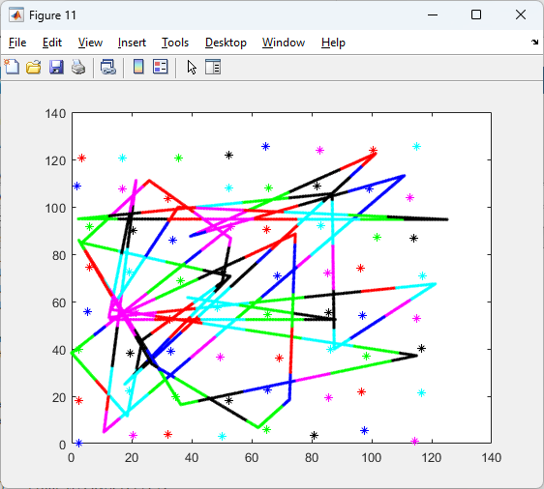
Abstracted Study of Impact of Roaming on Reliability …
A non-AP MLD travels at a constant speed from one randomly selected location to another in a field of AP MLDs (here, 64)
Non-AP MLD associates based on geometry: either without hysteresis (the closest AP always) or after it is sqrt(2) closer to a new AP than the old AP (i.e., the new AP is 3-5 dB stronger than the old AP)
A sample run is shown at right
In the following slide, results are based on 50 sample runs each with randomly selected AP locations and client trajectories
Line color identifies the client’s associated AP
Hart et al (Cisco Systems)

Slide 12
… Shows Reliability is sensitive to Roaming Rate & BSA^{(1/2)} For instance, Augmented Reality while on the move; no roaming hysteresis
BSA Speed | 100 m² | 250 m² | 500 m²
1 m/s | 1.2, 8.8, 14.1 | 1.8, 13.9, 22.3 | 2.6, 19.7, 31.6
1.5 m/s | 0.8, 5.9, 9.4 | 1.2, 9.3, 14.9 | 1.7, 13.1, 21.0
2 m/s | 0.6, 4.4, 7.0 | 0.9, 6.9, 11.2 | 1.3, 9.8, 15.8
Table 1: Roam interval (sec) [P5 P50 P95], P/ercentile
Study roaming model:
AP BSA is 100-250-500m² on a noisy grid
Non-AP MLD travels at 1-1.5-2 meters/sec along lines at a random orientation wrt APs
Perfect proximity-based roaming (no hysteresis)
Non-AP MLD roaming events mostly occur every 0.6-31.6 sec, where a roam every 9.3 sec is reasonably typical (Table 1)
Study impact of roaming model on reliability of QoS flow:
Assume data can be lost during each roam (not delivered or delivered too late).
We analyze the maximum data loss duration in order to achieve a given level of reliability. We see a mean 10 sec roam interval requires 10msec max data loss for 99.9% reliability (Table 2)
Mean Roam interval Required Reliability | 5 s | 7.5 s | 10 s | 15 s | 20 s
99% | 50 | 75 | 100 | 150 | 200
99.9% | 5 | 7.5 | 10 | 15 | 20
99.99% | 0.5 | 0.75 | 1 | 1.5 | 2
Table 2: Maximum data loss duration (msec)
Hart et al (Cisco Systems)

Slide 13
… Shows Reliability is sensitive to Roaming Rate & BSA^{(2/2)} Even with roaming hysteresis
BSA Speed | 100 m² | 250 m² | 500 m²
1 m/s | 3.5, 9.9, 16.6 | 5.6, 15.7, 26.3 | 7.9, 15.7, 37.2
1.5 m/s | 2.3, 6.0, 11.1 | 3.7, 10.5, 17.6 | 5.3, 14.8, 24.8
2 m/s | 1.7, 4.9, 8.3 | 2.8, 7.8, 13.2 | 3.9, 11.1, 18.6
Table 1: Roam interval (sec) [P5, P50, P95], P/ercentile
Study roaming model:
AP BSA is 100-250-500m² on a noisy grid
Non-AP MLD travels at 1-1.5-2 meters/sec along lines at a random orientation wrt APs
Roam whenever sqrt(2) closer to another AP (i.e., whenever another AP is 3-5dB better)
Non-AP MLD roaming events mostly every 1.7-37.2 sec, where once every 10.5 sec is reasonably typical (Table 1)
Study impact of roaming model on reliability of QoS flow:
Same as previous slide
Mean Roam interval Required Reliability | 5 s | 7.5 s | 10 s | 15 s | 20 s
99% | 50 | 75 | 100 | 150 | 200
99.9% | 5 | 7.5 | 10 | 15 | 20
99.99% | 0.5 | 0.75 | 1 | 1.5 | 2
Table 2: Maximum data loss duration (msec)
Hart et al (Cisco Systems)

Slide 14
What Level of Roaming Performance is Really Required?
We see options A/B/C/D, with different levels of performance and complexity
We solicit what is “sufficient roaming” performance for current and anticipated use cases
Hart et al (Cisco Systems)

Slide 15
Straw-poll: Which roaming goal do you prefer?
Option 1: no lost MSDUs and temporary latency increase of W msec during roaming
For example, W = 10 msec
// Much higher infrastructure complexity: please advise why
Option 2: potential for losing X msec of MSDUs during roaming, but minimal increase in latency for MSDUs transferred during roaming
For example, X = 10 msec
Option 3: define an SLA# and a roaming model and lump all impairments, including from roaming, together and compare that against the SLA
#Y% of MSDUs delivered within Z msec
For example, 99.9% of MSDUs delivered within 10 msec.
Abstain
Hart et al (Cisco Systems)

