Slide 1
Study on AI CSI Compression
Date: 2023-09
Authors:

Slide 2
Revision History
DCN0290r1:
Proposed the vector quantized variational autoencoder (VQVAE) method for CSI compression
Showed the performance gain
DCN0290r2 :
Showed further overhead reduction and goodput improvement
Studied neural network (NN) model generalization under different channel models and different numbers of spatial streams
Discussed the workflow of the VQVAE based CSI compression
DCN0290r3 :
Studied NN model generalization under different bandwidths
Proposed the lightweight encoder without codebook to reduce computation complexity and model deployment overhead while maintaining the goodput performance
Discussed the workflow of the autoencoder based CSI compression

Slide 3
Summary of questions
Q1: R2 studied the NN model generalization under different channel models and R3 studied that under different bandwidths. Can one NN model be used for both scenarios?
Yes, one NN model can adapt to different channel conditions and effectively handle the inputs of different bandwidths.
Q2: The NN model architecture proposed in [10] has achieved good performance in channel access and rate adaptation use cases. Can it also be used for AI CSI compression?
Yes, reusing the architecture proposed in [10] can achieve similar performance as before but with larger complexity.
Q3: What is the architecture of the lightweight encoder proposed in R3?
We provided the model architecture in this contribution.

Slide 4
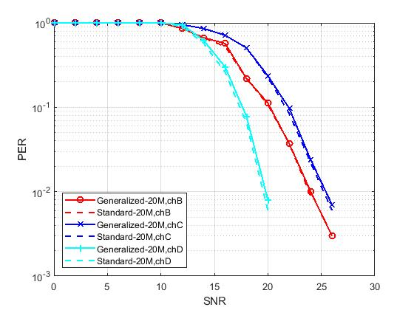
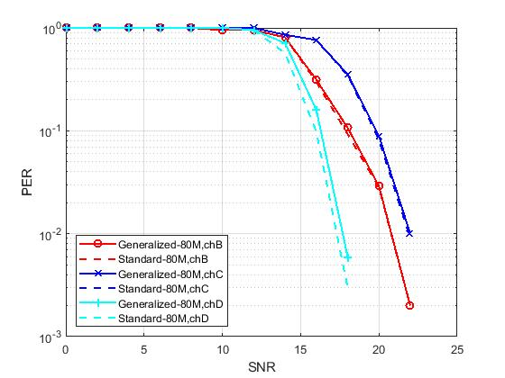
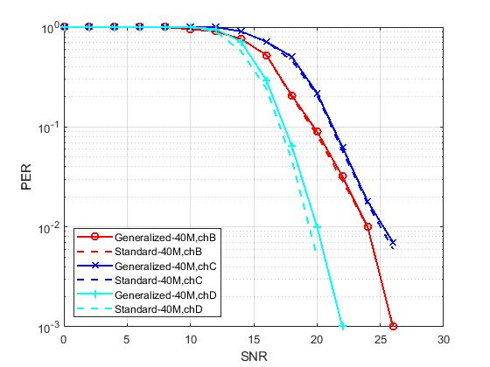
Generalization of channel model and bandwidth
Simulation setup:
Training data are V matrices generated under BW=160MHz, channel model D
After training, the model is tested by data of BW=20MHz, 40MHz, 80MHz and channel models B, C, D, respectively
Comparison baseline：
Method in current standard under the same bandwidth and channel model
The generalized NN model achieved similar PER performance as the standard method with only 1/12 overhead.
One neural network model can adapt to different channel conditions and effectively handle the inputs of different bandwidths.

Slide 5
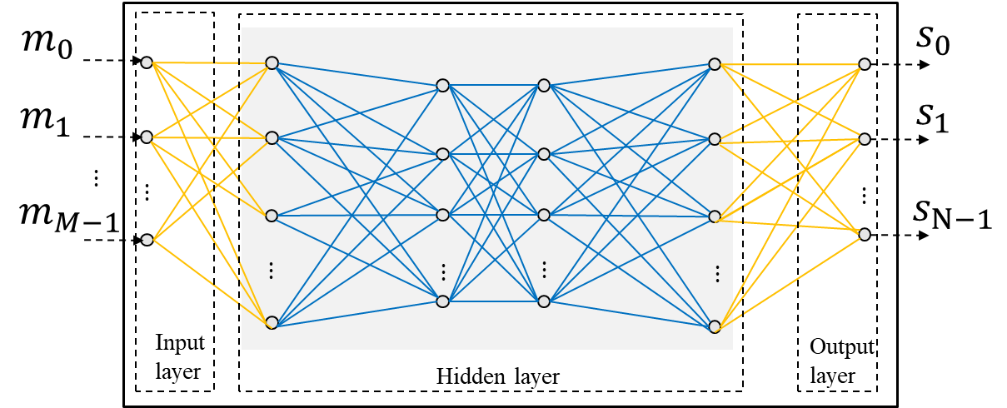
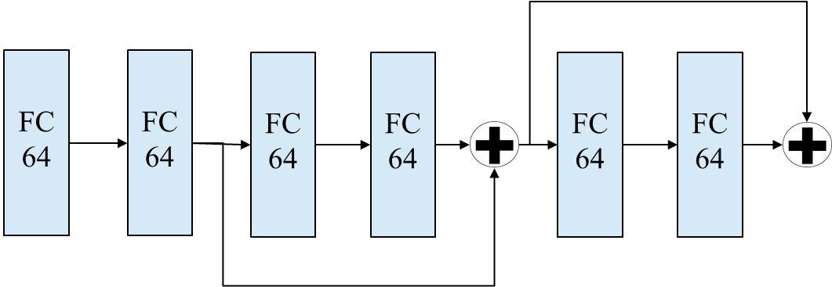
Model reuse for CSI compression
In [10], one NN architecture is shown to be used in different tasks.
A fully connected network with residual connection achieves good performance in both channel access and rate adaptation use cases.
We use the same architecture for CSI compression and compare the performance with the lightweight encoders proposed in R3.
Use the same hidden layer structure for both channel access and rate adaptation use cases

Slide 6
Model reuse for CSI compression
The model architecture proposed in [10] achieves similar overhead reduction and goodput improvement as the lightweight encoders (LW-ENC-1 & 2) proposed in R3.
However, the lightweight encoders proposed in R3 have fewer parameters and lower computation complexity.
Method | Feedback overhead (bits) | Goodput (Mbps) | # params of codebook | # params of encoder | Computation complexity of encoder (MACs)
LW-ENC-1 | 1280 | 16.00 | 0 | 3.9K | 0.7M
LW-ENC-2 |  |  |  | 2.9K | 1.6M
Model in [10] |  |  |  | 25.3K | 5.9M
The overhead and goodput of the standard method (Givens rotation, Ng=4, $b_{φ}=6$, $b_{ψ}=4$) are 32500bits and 5.07Mbps.
MACs: Multiply–accumulate operations

Slide 7
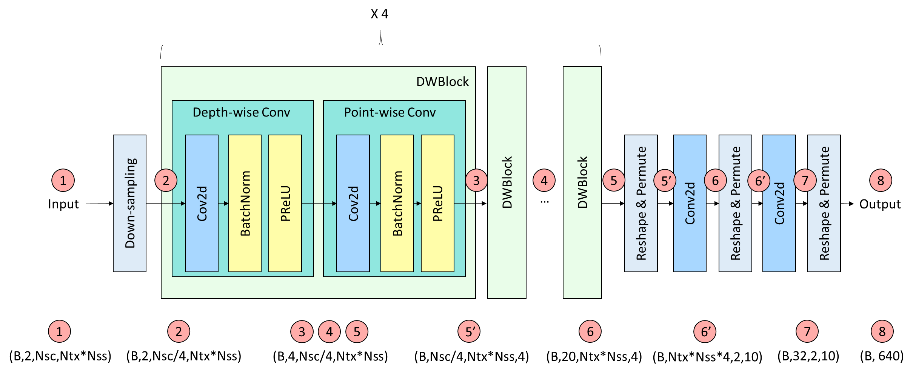
Architecture of lightweight encoder
The lightweight encoders proposed in R3 can reduce the computation complexity and model deployment overhead by more than 1000 times while maintaining the goodput performance. We present the model architectures here. More details can be found in the appendix.
Lightweight encoder #1

Slide 8
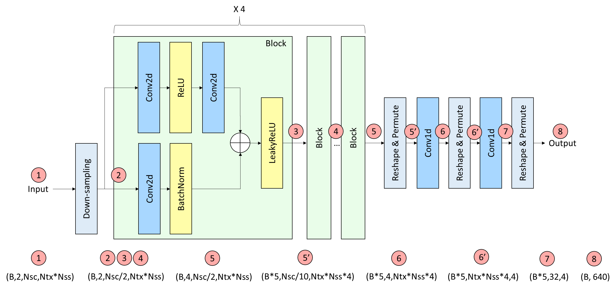
Architecture of lightweight encoder
Lightweight encoder #2

Slide 9
Summary
In this contribution, we continued the study of model generalization. It is shown that one NN model can adapt to different channel conditions and effectively handle the inputs of different bandwidths.
We showed the feasibility of reusing the NN architecture in various use cases, e.g., channel access, rate adaptation and CSI compression.
We provided the structure of the lightweight encoders proposed in R3.

Slide 10
References
[1] M. Deshmukh, Z. Lin, H. Lou, M. Kamel, R. Yang, I. Güvenç, “Intelligent Feedback Overhead Reduction (iFOR) in Wi-Fi 7 and Beyond,” in Proceedings of 2022 VTC-Spring
[2] 11-22-1563-02-aiml-ai-ml-use-case
[3] P. K. Sangdeh, H. Pirayesh, A. Mobiny, H. Zeng, “LB-SciFi: Online Learning-Based Channel Feedback for MU-MIMO in Wireless LANs, ” in Proceedings of 2020 IEEE 28th ICNP
[4] A. Oord, O. Vinyals, “Neural discrete representation learning,” Advances in neural information processing systems, 2017.
[5] 11-23-0290-01-aiml-study-on-ai-csi-compression
[6] The Khronos NNEF Working Group, “Neural Network Exchange Format”, https://www.khronos.org/registry/NNEF/specs/1.0/nnef-1.0.5.html
[7] Open Neural Network Exchange (ONNX), https://onnx.ai
[8] 11-23-0755-00-aiml-aiml-assisted-complexity-reduction-for-beamforming-csi-feedback-using-autoencoder
[9] 11-23-0906-02-aiml-proposed-ieee-802-11-aiml-tig-technical-report-text-for-the-csi-compression-use-case
[10] 11-23-1182-01-aiml-follow-up-discussions-on-neural-network-model-sharing-for-wlan

Slide 11
Appendix

Slide 12
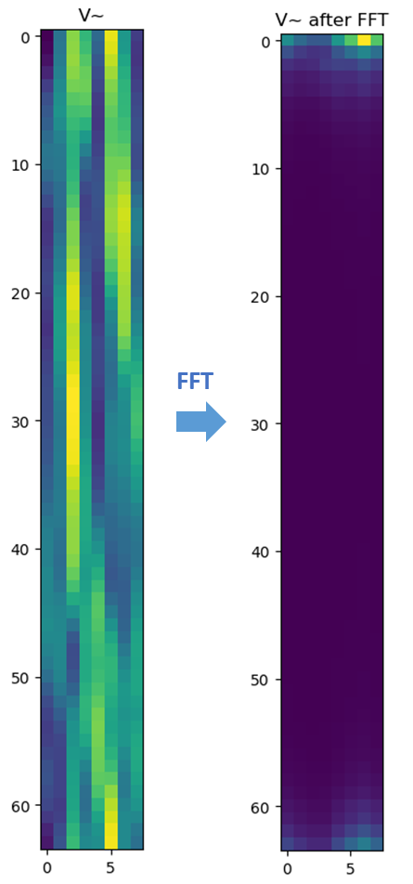
R1 - Background
The AP initiates the sounding sequence by transmitting a NDPA frame followed by a NDP which is used for the generation of a V matrix at the STA.
The STA applies Givens rotation on the V matrix and feeds back the angles in the beamforming report frame.
The total feedback overhead is $N_{a}∗\frac{b_{φ}+b_{ψ}}{2}∗\frac{N_{sc}}{N_{g}}$. The larger bandwidth and number of antennas leads to a significantly increased sounding feedback overhead, which increases the latency and limits the throughput gain.
Visualization of the precoding matrix after an FFT shows its sparsity and therefore its compressibility.
Ntx=Nrx=Nss | BW=20MHz | BW=40MHz | BW=80MHz | BW=160MHz | BW=320MHz
2 | 0.12 (KBytes) | 0.24 | 0.50 | 1.00 | 1.99
4 | 0.73 | 1.45 | 2.99 | 5.98 | 11.95
8 | 3.39 | 6.78 | 13.94 | 27.89 | 55.78
16 | 14.52 | 29.04 | 59.76 | 119.52 | 239.04
20MHz, 8*2

Slide 13
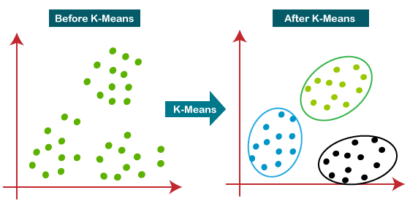
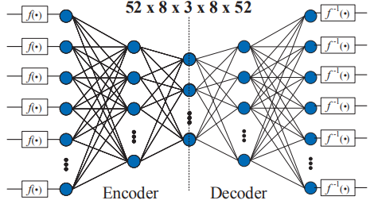
R1 - Existing Work on AI CSI Compression
ML solutions: no neural network
[1][2] adopted a traditional machine learning algorithm, i.e., K-means, to cluster the angle vectors after a Givens rotation
Beamformer and beamformee need to exchange and store the centroids
Only transmit the centroid index during inference
2dB PER loss, up to 50% goodput improvement
AI solutions: use neural network
[3] adopted two autoencoders to compress two types of angles after a Givens rotation separately
Beamformer and beamformee need to exchange the stored neural network models
Only transmit the encoder output during inference
Up to 70% overhead reduction and 60% throughput gain for an 11ac system

Slide 14
R1 - Our Study on AI CSI Compression
Vector quantization variational autoencoder (VQVAE) [4] is proposed for CSI compression
Consists of encoder, codebook, decoder
Learn how to compress and quantize automatically from the data
Convolutional neural network (CNN) or transformer could be used for both the encoder and decoder.
Input of NN could be the V matrix or the angles after a Givens rotation.
Beamformer and beamformee need to exchange and store the codebook and half of the NN model.
Only transmit the codeword index during inference.

Slide 15
R1 - Performance Evaluation
Simulation setup:
Training data are generated under SU MIMO, channel D NLOS, BW=80MHz, Ntx=8, Nrx=2, Nss=2, Ng=4
T_{NDPA}=28us, T_{NDP}=112us, T_{SIFS}=16us, T_{preamble}=64us, MCS=1 for BF report, MCS=7 for data, payload length=1000Bytes
Comparison Baseline:
current methods in the standard, Ng=4 (250 subcarriers) and Ng=16 (64 subcarriers) with $b_{φ}=6$ and $b_{ψ}=4$
Performance Metric:
Goodput: GP = $\frac{\text{successful} \text{data} \text{transmitted}}{\text{total} \text{time} \text{duration}}=\frac{L (1−PER)}{T_{NDPA}+T_{NDP}+T_{BF}+T_{Data}+T_{ACK}+4∗T_{SIFS}}$
Compression ratio: Rc = $\frac{\text{l}\text{egacy} \text{BF} \text{feedback} \text{bits}}{\text{AI} \text{BF} \text{feedback} \text{bits}}$
SNR-PER curve
SIFS
SIFS
SIFS
SIFS
NDPA
NDP
Data
BF
ACK

Slide 16
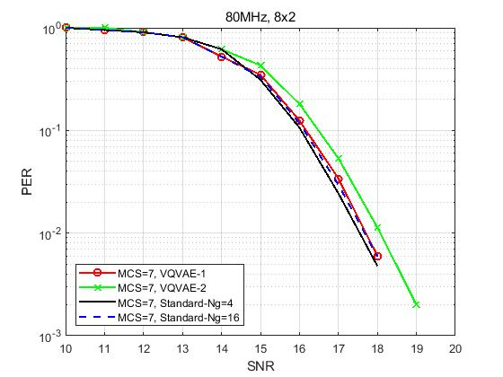
R1 - Performance Evaluation
, MCS=7
Rc=12 (CB size 1024)
Rc=25 (CB size 1024)
Method | overhead Ng=4 (bits) | overhead Ng=16 (bits) | overhead VQVAE (bits) | Rc vs Ng=4 | Rc vs Ng=16 | Loss @ 0.01 PER (dB) vs Ng=4 | loss @ 0.01 PER (dB) vs Ng=16 | GP Ng=4 (Mbps) | GP Ng=16 (Mbps) | GP AI (Mbps) | GP gain (%) vs Ng=4 | GP gain (%) vs Ng=16
VQVAE-1 | 32500 | 8320 | 2560 | 12.70 | 3.25 | 0.16 | 0 | 5.07 | 10.77 | 14.70 | 189.64 | 36.48
VQVAE-2 | 32500 | 8320 | 1280 | 25.39 | 6.50 | 0.5 | 0.4 | 5.07 | 10.77 | 16.00 | 215.20 | 48.53
Notes:
Train the VQVAE model based on generated V matrices
Apply the trained model to do precoding
Run PER curve under

Slide 17
R1 - Summary
In R1, we
reviewed the existing works on AI CSI compression,
introduced a new VQVAE CSI compression scheme,
showed its performance gain,
and discussed possible future work to further improve the goodput and reduce the feedback overhead.

Slide 18
Study in R2
Reduce the feedback overhead and improve the goodput
Different neural network architecture
Reduce codebook size and dimension
More complex scenarios
More simulations under different configurations
MU-MIMO scenarios
Increase model generalization
One neural network can exhibit robustness to different channel models
One neural network can exhibit robustness to a different bandwidth
One neural network can exhibit robustness to a number of antennas

Slide 19
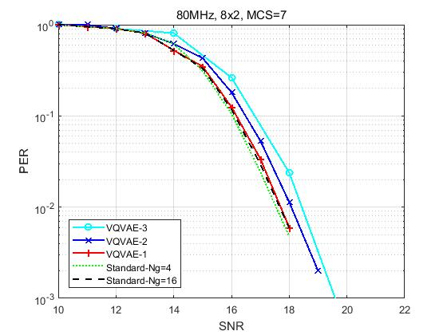
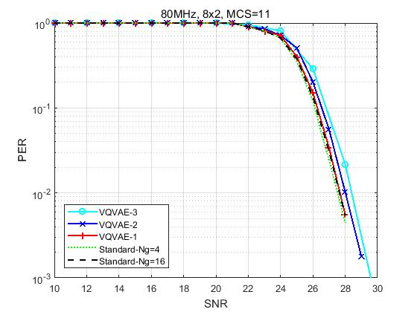
R2 - Feedback overhead reduction and goodput improvement
Simulation setup:
SU MIMO, channel D NLOS, BW=80MHz, Ntx=8, Nrx=Nss=2
Higher compression ratio and more MCS are considered
Comparison baseline：
Standard: Givens, Ng=4/16, $b_{φ}$=6, $b_{ψ}$=4
VQVAEs with different compression ratios achieve less than 1dB PER loss compared with the standard method.
Rc=12 (CB size 1024)
Rc=25 (CB size 1024)
Rc=36 (CB size 128)

Slide 20
R2 - Goodput improvement and feedback overhead reduction
Performance Metric:
Goodput: GP = $\frac{\text{successful} \text{data} \text{transmitted}}{\text{total} \text{time} \text{duration}}$
$=\frac{L (1−PER)}{T_{NDPA}+T_{NDP}+T_{BF}+T_{Data}+T_{ACK}+4∗T_{SIFS}}$
Compression ratio: Rc = $\frac{\text{legacy} \text{BF} \text{feedback} \text{bits}}{\text{AI} \text{BF} \text{feedback} \text{bits}}$
Parameters for goodput calculation: T_{NDPA}=28us, T_{NDP}=112us, T_{SIFS}=16us, T_{preamble}=64us, MCS=1 for BF report, MCS=7 for data, L=1000Bytes, PER=0.01
SIFS
SIFS
SIFS
SIFS
NDPA
NDP
Data
BF
ACK
Method | VQ size | overhead Ng=4 (bits) | overhead Ng=16 (bits) | overhead VQVAE (bits) | Rc vs Ng=4 | Rc vs Ng=16 | Loss @ 0.01 PER (dB) vs Ng=4 | loss @ 0.01 PER (dB) vs Ng=16 | GP Ng=4 (Mbps) | GP Ng=16 (Mbps) | GP AI (Mbps) | GP gain (%) vs Ng=4 | GP gain (%) vs Ng=16
VQVAE-1 | 1024 | 32500 | 8320 | 2560 | 12.70 | 3.25 | 0.16 | 0 | 5.07 | 10.77 | 14.70 | 189.64 | 36.48
VQVAE-2 | 1024 | 32500 | 8320 | 1280 | 25.39 | 6.50 | 0.5 | 0.4 | 5.07 | 10.77 | 16.00 | 215.20 | 48.53
VQVAE-3 | 128 | 32500 | 8320 | 896 | 36.27 | 9.29 | 0.9 | 0.8 | 5.07 | 10.77 | 16.43 | 223.77 | 52.57

Slide 21
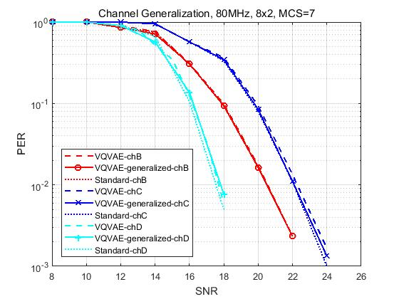
R2 - Generalization of different channel models
Simulation setup:
Training data are a combination of V matrices generated under channel models B, C, and D
The trained model is tested by data of channel B, C, and D, respectively
Comparison baseline：
VQVAE-chX: NN model is trained and tested using data of channel X
Standard-chX: Ng=4, $b_{φ}$=6, $b_{ψ}$=4
Compared with the standard method, the generalized NN model has no PER loss for channel B and C, and 0.5dB PER loss for channel D.
A well-trained neural network model is robust to different channel conditions.
Legend | Train data | Test data
VQVAE-generalized-chB | B, C, D | B
VQVAE-chB | B | B
VQVAE-generalized-chC | B, C, D | C
VQVAE-chC | C | C

Slide 22
R2 - Generalization of different Nrx/Nss
Simulation setup:
Training data are a combination of V matrices of different Nrx (i.e., Nrx=2 and 4)
The trained model is tested by data of Nrx=2 and Nrx=4
Comparison baseline：
VQVAE: NN model is trained and tested using data of certain Nrx
Standard: Ng=4, $b_{φ}=6$, $b_{ψ}=4$
Compared with the standard method, the generalized NN model has 0.2/0.8dB PER loss for Nrx=2/4.
A well-trained neural network model is robust to a different number of receive antennas.
Legend | Train data | Test data
VQVAE-generalized-8x4 | 8x2 + 8x4 | 8x4
VQVAE-8x4 | 8x4 | 8x4
VQVAE-generalized-8x2 | 8x2 + 8x4 | 8x2
VQVAE-8x2 | 8x2 | 8x2

Slide 23
R2 - Workflow of AI CSI compression using autoencoder
AP
STA
AP
STA
Training and model sharing
NDP
Channel estimation, SVD, Givens rotation
V or$φ,ψ$
NDP
Train the encoder, codebook and decoder
Channel estimation, SVD
V
encoder and codebook
$$\tilde{V}$$
Decoder,
codebook
Index
Encoder,
codebook
NN model training and sharing
Infrequently: hours, days or even months
Original V matrix can be fed back to facilitate training if possible
Standardize the encoder architecture; alternatively, negotiate encoder architecture using existing formats such as NNEF[6] and ONNX[7]
beamforming
Data

Slide 24
R2 - Summary
In R2, we showed performance enhancement for VQVAE-based CSI compression scheme proposed in [5], including
Further feedback overhead reduction and goodput improvement,
NN model generalization of different channel models,
NN model generalization of different numbers of receive antennas.
We also presented the workflow of AI CSI compression using autoencoder.

Slide 25
Study in R3
For AIML based CSI compression, if one AIML model, e.g., a set of parameters, is required for one specific scenario, e.g., bandwidth, channel condition or spatial stream, it will bring challenges for the practical implementations.
AIML model generalization is one of the key factors needed to be considered. In R2, we have studied the model generalization of different channel conditions and different number of spatial streams. In this version, we continue to study the model generalization of different bandwidths.
As discussed in [8][9], complexity reduction is discussed as another objective for the CSI compression use case. In this contribution, we also introduce our study on lightweight encoders, which significantly reduces the computation complexity and model deployment overhead, while maintaining the goodput performance.

Slide 26
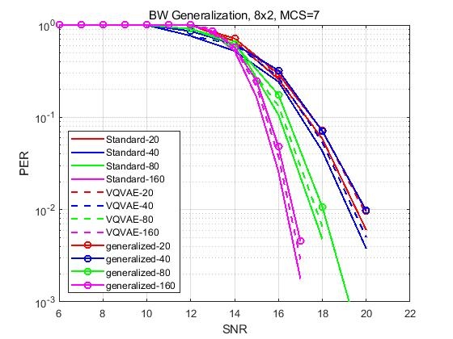
R3 - Generalization of different bandwidth
Simulation setup:
The training data contain only V matrices of BW=160MHz
After training, the model is tested by data of BW=20MHz, 40MHz, 80MHz, 160MHz, respectively
Comparison baseline：
VQVAE: the NN model is trained and tested using data of certain BW
Standard: Ng=4, $b_{φ}=6$, $b_{ψ}=4$
Compared with the standard method, the generalized model achieves similar performance (less than 1dB loss and 12 times overhead reduction).
A single neural network model can effectively handle the inputs of different bandwidths.
Legend | Train data | Test data
generalized-20 | 160 MHz | 20 MHz
VQVAE-20 | 20 MHz | 20 MHz
generalized-40 | 160 MHz | 40 MHz
VQVAE-40 | 40 MHz | 40 MHz

Slide 27
R3 - Computation complexity and model deployment overhead reduction
AP
STA
AP
STA
Training and model sharing
NDP
Channel estimation, SVD, Givens rotation
NDP
V or$φ,ψ$
Channel estimation, SVD
Train the encoder, codebook and decoder
V
encoder and codebook
$$\tilde{V}$$
Decoder,
codebook
Index
Quantized output
Encoder,
codebook
Beamforming
Efficient ways to reduce the overhead and computation complexity:
Lightweight encoder
Direct quantization without codebook
Data

Slide 28
R3 - Computation complexity and model deployment overhead reduction
Previous VQVAEs adopt symmetric encoder and decoder architectures and vector quantization (codebook-based).
A transformer-based decoder is used to enable a lightweight encoder.
Codebook-based quantization is replaced by uniform quantization to reduce transmission overhead.
The number of encoder parameters (weight and bias), as well as the computation complexity are reduced by more than 1000 times.
ENC
codebook
codebook
DEC
LW-ENC
quantize
dequantize
DEC

Slide 29
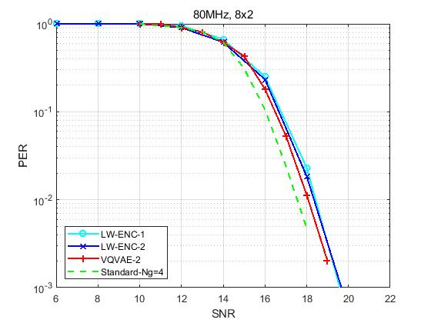
R3 - Computation complexity and model deployment overhead reduction
Two CNN-based lightweight encoders (LW-ENC) are studied
Reduce computation complexity and model and codebook sharing overhead significantly
Achieve the same compression ratio and goodput performance compared to the previous model
Method | Feedback overhead (bits) | Goodput (Mbps) | Codebook size | Codebook dimension | # params of codebook | # params of encoder | Computation complexity of encoder (MACs)
VQVAE-2 | 1280 | 16.00 | 1024 | 32 | 32768 | 5.0M | 2.2G
LW-ENC-1 |  |  | 0 | 0 | 0 | 3.9K | 0.7M
LW-ENC-2 |  |  | 0 | 0 | 0 | 2.9K | 1.6M
The overhead and goodput of the standard method (Givens rotation, Ng=4, $b_{φ}=6$, $b_{ψ}=4$) are 32500bits and 5.07Mbps.
MACs: Multiply–accumulate operations

Slide 30
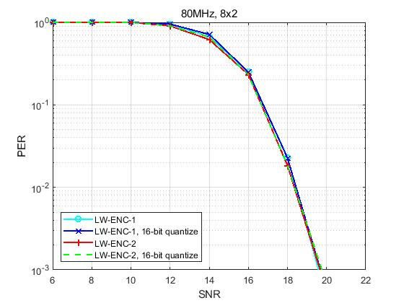
R3 - Computation complexity and model deployment overhead reduction
We discuss possible ways of encoder sharing the corresponding overhead.
If the encoder architecture is standardized, parameters only need to be shared. For LW-ENC-1, the overhead is 7.8KBytes if 16-bit quantization is used. Simulation shows that there is no performance loss using a 16-bit encoder for CSI feedback.
Alternatively, the encoder architecture needs to be negotiated using existing format such as NNEF[6] and ONNX[7]. For LW-ENC-1, the overhead is 22KBytes if ONNX is used.
Other model deployment/quantization methods can be further studied.
AP
STA
NDP
Channel estimation, SVD, Givens rotation
V or$φ,ψ$
Train the encoder and decoder
encoder

Slide 31
R3 - Summary
In R3, we showed performance enhancement for an autoencoder-based CSI compression scheme proposed in [5], including
Model generalization under different bandwidths,
Lightweight encoder that reduces computation complexity and model deployment overhead by more than 1000 times, and maintains the goodput performance.

