Slide 1
ML aided Dual CSI Feedback for Next Generation WLANs
Date: 2023-03-08
Authors:

Slide 2
Introduction
For transmit beamforming, BFer requires the channel state information (CSI) in advance, which is delivered from the BFee.
The CSI feedback techniques can be categorized into two groups: one is based on codebook (CB) and the other is by using Givens rotation (GV).
The CB-based feedback can reduce the feedback overhead significantly by feeding back an index of the codebook, which has been used in 3GPP LTE.
  However, the selected codebook is not necessarily the optimal beamforming matrix due to the limited cardinality of the codebook, showing poor PER performance compared with the GV-based feedback.

Slide 3
Introduction
The GV-based feedback was adopted in IEEE 802.11 n/ac/ax/be WLANs
  The beamforming feedback matrix (i.e., unitary matrix) is decomposed by a series of GV matrices, each of which is expressed with angles.
  However, GV-based feedback incurs a significant feedback overhead, especially for the system using a large bandwidth and/or a large number of antennas
    A new designs for CSI feedback may be needed to support 16 spatial streams MIMO and/or 640MHz bandwidth in the next generation WLANs.
In this contribution, we maximize the advantages of both techniques by combining GV and CB for CSI feedback for the next generation WLANs.
  For further improvement of CB design, the machine learning (ML) technique is incorporated.

Slide 4
System Model
WLAN systems with the proposed dual CSI feedback

Slide 5
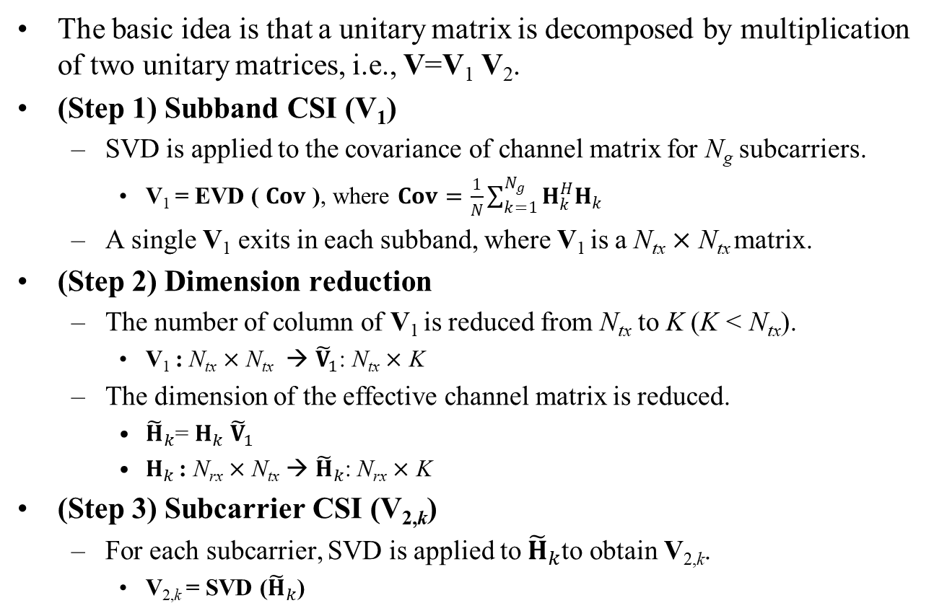
Dual CSI Feedback [1]
The basic idea is that a unitary matrix is decomposed by multiplication of two unitary matrices, i.e., V=V₁ V₂.
(Step 1) Subband CSI (V₁)
  SVD is applied to the covariance of channel matrix for N_{g} subcarriers.
    V₁ = EVD ( $Cov$ ), where $Cov=\frac{1}{N}\sum_{k=1}^{N_{g}}{H_{k}^{H}H_{k}}$
  A single V₁ exits in each subband, where V₁ is a N_{tx} $×$ N_{tx} matrix.
(Step 2) Dimension reduction
  The number of column of V₁ is reduced from N_{tx} to K (K < N_{tx}).
    V₁ : N_{tx} $×$ N_{tx} → ${\tilde{V}}_{1}$: N_{tx} $×$ K
  The dimension of the effective channel matrix is reduced.
    ${\tilde{H}}_{k}$= $H_{k}$ ${\tilde{V}}_{1}$
    $H_{k}$ : N_{rx} $×$ N_{tx} → ${\tilde{H}}_{k}$: N_{rx} $×$ K
(Step 3) Subcarrier CSI (V_{2,k})
  For each subcarrier, SVD is applied to ${\tilde{H}}_{k}$to obtain V_{2,k}.
    V_{2,k} = SVD (${\tilde{H}}_{k}$)

Slide 6
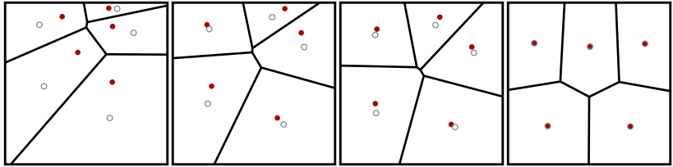
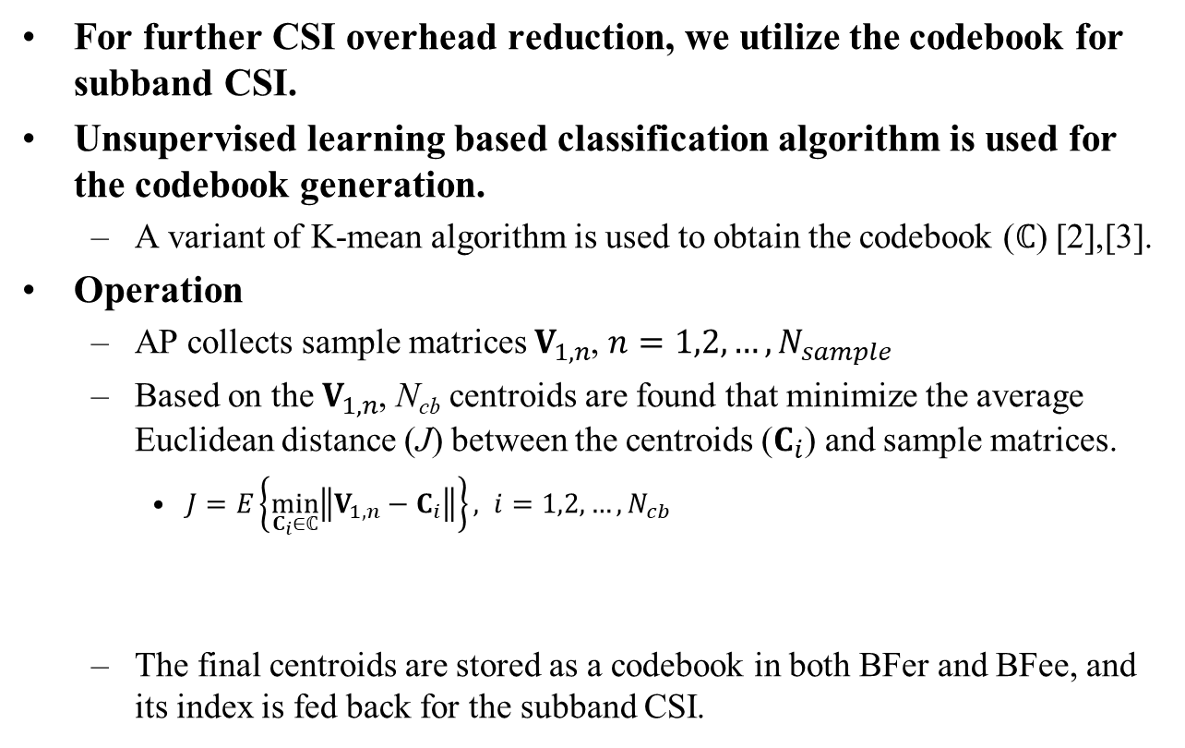
ML aided Dual CSI Feedback
For further CSI overhead reduction, we utilize the codebook for subband CSI.
Unsupervised learning based classification algorithm is used for the codebook generation.
  A variant of K-mean algorithm is used to obtain the codebook ($ℂ$) [2],[3].
Operation
  AP collects sample matrices $V_{1,n}$, $n=1,2,…, N_{sample}$
  Based on the $V_{1,n}$, N_{cb} centroids are found that minimize the average Euclidean distance (J) between the centroids ($C_{i}$) and sample matrices.
    $J=E\left\{\min_{C_{i}∈ℂ}\left\|V_{1,n}−C_{i}\right\|\right\}, i=1,2,…, N_{cb}$
  The final centroids are stored as a codebook in both BFer and BFee, and its index is fed back for the subband CSI.

Slide 7
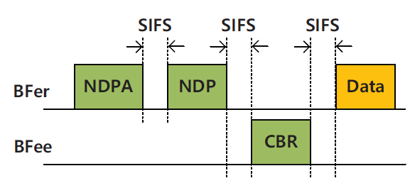
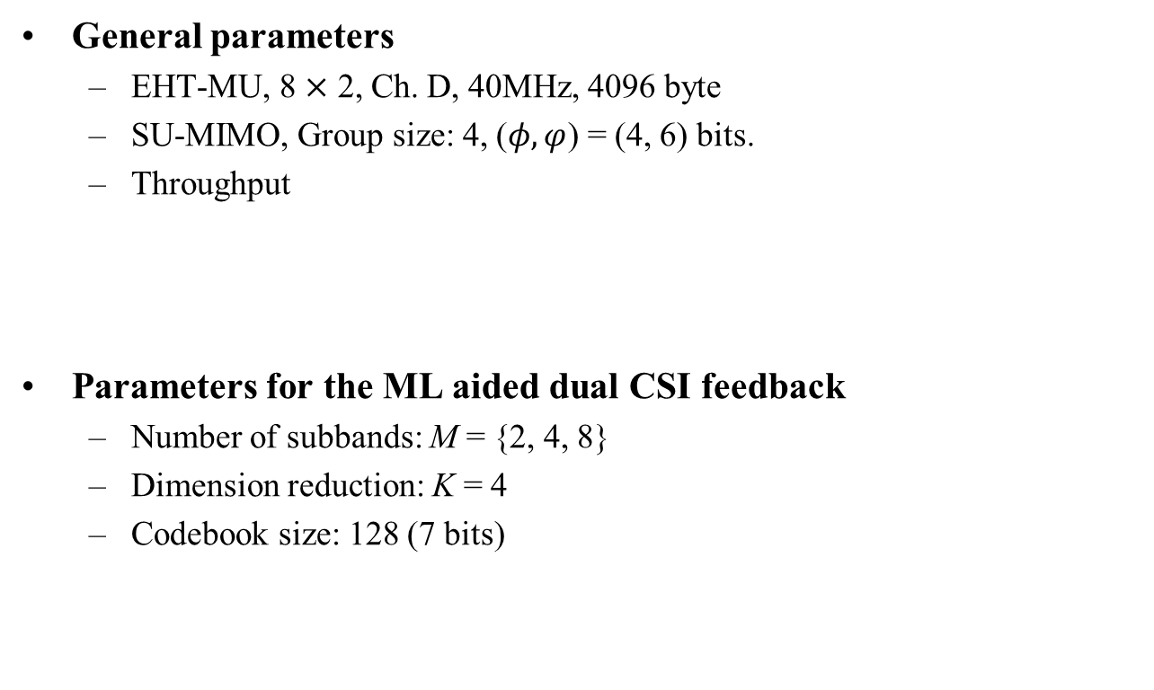
Simulation Parameters
General parameters
  EHT-MU, 8 $×$ 2, Ch. D, 40MHz, 4096 byte
  SU-MIMO, Group size: 4, ($φ,φ$) = (4, 6) bits.
  Throughput
Parameters for the ML aided dual CSI feedback
  Number of subbands: M = {2, 4, 8}
  Dimension reduction: K = 4
  Codebook size: 128 (7 bits)
$${Throughput}_{SU}=\frac{L_{data}}{T_{NDPA}+T_{NDP}+T_{CBR}+2T_{SIFS}+T_{Data}}×\left(1−PER\right)$$

Slide 8
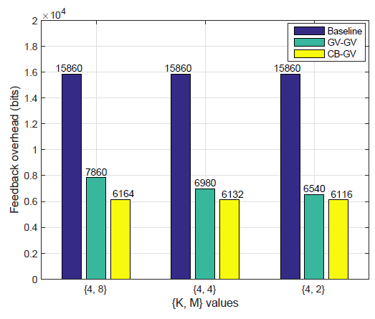
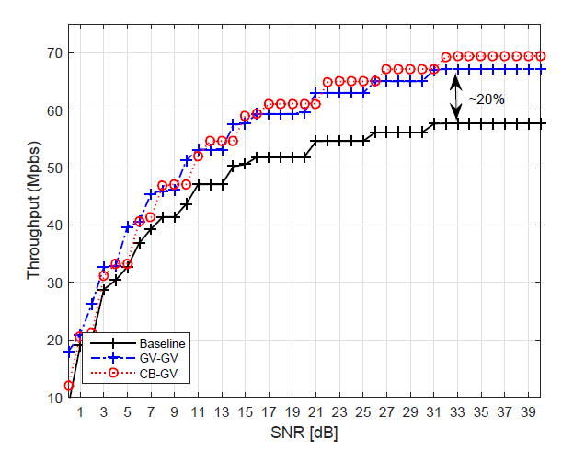
Simulation Results
Feedback Overhead
  The dual CSI feedback scheme has only 49.5% of the baseline and it is further reduced to 38.8% when the codebook is incorporated for subband CSI feedback.
Throughput
  Due to the reduced feedback overhead, throughput increases about 20%.
Base line: Givens rotation (GV)
GV-GV: Subband CSI (GV) + Subcarrier CSI (GV), CB-GV: Subband CSI (Codebook) + Subcarrier CSI (GV)

Slide 9
Summary
We presented an ML aided dual CSI feedback scheme for the next generation WLANs.
  The basic idea is to decompose a large size CSI into a subband CSI and a subcarrier CSI, giving lower feedback rate for the slow-varying subband CSI.
  The existing ML algorithm can be applied to generate the codebook for subband CSI.
  Simulation results show that the proposed scheme can reduce the CSI overhead about 50% in SU-MIMO.
  As a future work, further investigation on the codebook design for the MU-MIMO should be considered.

Slide 10
Reference
[1] 802.11-19/0391r0, Feedback Overhead Reduction in 802.11be, Samsung.
[2] 802.11-22/950r2 Discussion on Interaction between AI/ML & Wireless LAN, InterDigital.
[3] E. Jeon et al., “Machine Learning-Aided Dual CSI Feedback in Next Generation WLANs,” submitted to IEEE VTC2023-Spring, June 2023.

