Slide 1
Considerations on Seamless Roaming
Date: 2023-03-13
Authors:
Name | Affiliation | Address | Phone | Email
Insun Jang | LG Electronics | 19, Yangjae-daero 11gil, Seocho-gu, Seoul 137-130, Korea |  | insun.jang@lge.com
Jinsoo Choi
 |  |  |  | js.choi@lge.com
Sunhee Baek
 |  |  |  | sunhee.baek@lge.com
Yelin Yoon |  |  |  | yl.yoon@lge.com
Geonhwan Kim |  |  |  | geonhwan.kim@lge.com
Eunsung Park |  |  |  | esung.park@lge.com
Dongguk Lim |  |  |  | dongguk.lim@lge.com
Jinyoung Chun |  |  |  | jiny.chun@lge.com
Insik Jung |  |  |  | insik0618.jung@lge.com
HanGyu Cho |  |  |  | hg.cho@lge.com
Sanggook Kim |  | 10225 Willow Creek Rd, San Diego, CA, USA |  | sanggook.kim@lge.com

Slide 2
Introduction
For a quite long time, we’ve tried to solve issues of STAs moving from a BSS to another BSS
E.g., using Fast Transition (FT) Protocol
However, we are still experiencing the break to transmit/receive data during a roaming due to authentication and reassociation procedures (with additional delay)
It is significantly important to avoid such interruption and delay as customers have always expected while the approved UHR PAR [1] has a scope of considering mobility between BSSs
We need some mechanisms to achieve high reliability with reducing the delay
Therefore, in this contribution, we share some considerations to achieve seamless roaming in UHR
Especially, with the perspective of AP MLD domain [2]

Slide 3
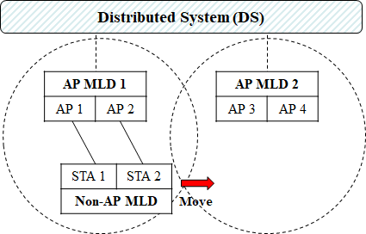
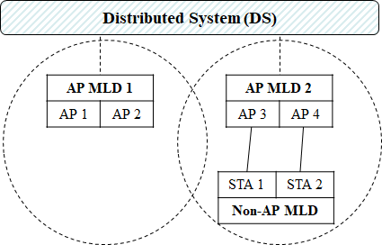
Overview of Current Roaming
Non-AP MLD disassociates with the currently associated AP MLD (AP MLD 1) when intending to roam to another AP MLD (AP MLD 2)
Non-AP MLD authenticates and reassociate with AP MLD 2 (e.g., over-the-air case in fast transition (FT))
After successful setup and authentication, the non-AP MLD negotiates some agreements with AP MLD 2 again (e.g., BA agreement)

Slide 4
Potential Considerations
Maintenance of Contexts/Agreements
When authenticated and reassociated, necessary security keys (e.g., PTK) are established (e.g., /w.o 4-way handshake in FT) and some agreements (e.g., BA) are reset
It leads to additional delay which prevents data frame exchange seamlessly
We need method(s) where most or all of them can be maintained even during/after roaming
Avoidance of data interruption
Before data path to a new AP MLD, i.e., before creating the DS-to-STA mapping for the AP as a result of reassociation, the AP cannot transmit any Data frames (as Class 3 frame) to the roaming STA
The AP wouldn’t guarantee whether it can be transmitted to the STA (without capa. negotiation)
We need method(s) to enable data frame exchanges during roaming by making data paths

Slide 5
Potential Considerations (Cont’d)
Light Frame Exchange
Current Authentication and Reassociation frames overhead are heavy to support seamless roaming
We need light frames compared to existing ones where during their exchange, the new AP MLD and STAs can negotiate security key, capabilities, and operational parameters

Slide 6
Observations on AP MLD from 11be
As a good candidate to resolve those considerations, we can consider an architecture where APs (involved in roaming) are in an AP MLD [2], which can have the followings on some level
MLD-level contexts/agreements (e.g., PTK, BA agreements) can be maintained
MLD-level DS-to-STA mapping (i.e., data path)
Usage of multi-link probe request/response to discover APs in the same AP MLD
Additionally, to enable above-mentioned ones, we need mechanism(s) existing multi-link (ML) setup is reconfigured when roaming by involving the new AP(s) to be roamed without any tear-down (disassociation)
We may reuse Reconfiguration Multi-link Element to change the link(s) for roaming

Slide 7
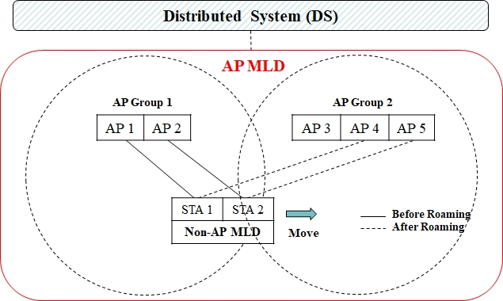
AP MLD for Roaming
APs in AP Group 1 and 2 are affiliated with the same AP MLD
APs in the same group may be in a physical device (collocated)
Roaming would be generally needed between groups
We may allow for a non-AP MLD to be connected with APs in multiple groups (e.g., AP 2 and AP 4)

Slide 8
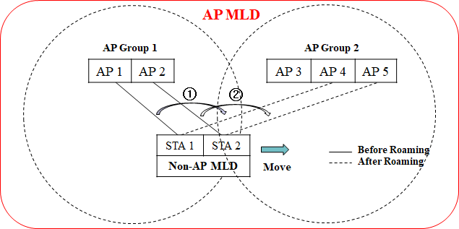
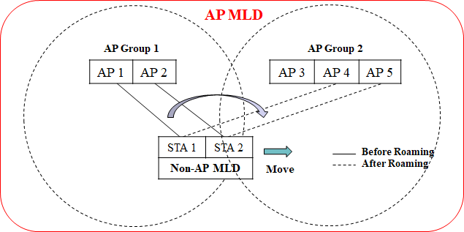
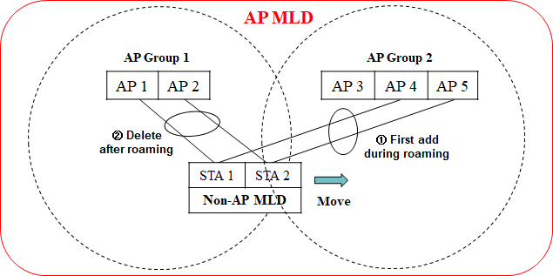
Examples of Roaming Procedure
Assuming ML setup reconfiguration can be performed without tear-down
Non-AP MLD may change one or more link(s) at a time
Non-AP MLD may add additional link(s) temporarily for a STA
After roaming, the previous links will be deleted

Slide 9
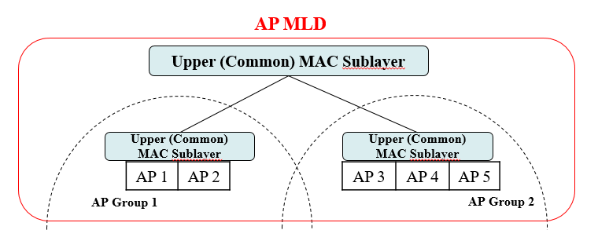
Further Considerations
Identification of Group
Each group may be identified necessarily due to lack of ID space
The identification (if defined) would be utilized in discovery (e.g., multi-link probe request/response) and multi-link setup (e.g., reconfiguration)
Upper (Common) MAC sublayers in AP MLD
We can think about where upper MAC sublayer exists, e.g., per AP Group and/or across all of AP Groups (i.e., centralized)
It can depend on which parameters, which is at MLD-level in 11be, should be at MLD-level across AP groups or AP Group-level (like MLD-level in 11be)
At least, it would be better to have an Upper (Common) MAC sublayer across all of AP groups

Slide 10
Conclusion
In this contribution, we’ve shared considerations to achieve seamless roaming in UHR in terms of
Maintenance of Contexts/Agreements
Avoidance of data interruption
Light Frame Exchange
To resolve those considerations, we provide some examples of roaming based on ML setup reconfiguration based on AP MLD domain as a good candidate feature for seamless roaming with further considerations
Identification of Group
Upper (Common) MAC sublayer in AP MLD

Slide 11
References
[1] 23/0480r0, UHR Proposed PAR
[2] 23/1910r3, Seamless Roaming for UHR

