Slide 1
Agenda TGbc Telco January 28, 2022
Date: 2023-02-28
Authors:

Slide 2
Abstract
Agenda Slides for 802.11 TGbc Enhanced BroadCast for the
January 28, 2023 telephone conference.

Slide 3
Dial-in Information
Meeting link:
https://ieeesa.webex.com/ieeesa/j.php?MTID=me0fdfa9b9db10eaf3cb35bddd4c38d69
Meeting number: 2338 040 1580
Meeting password: wireless

Slide 4
Call Meeting to Order

Slide 5
Approval of Agenda

Slide 6
Agenda
Call Meeting to order
Approval of agenda
Review Patent Policy & Call for Essential Patents
Review of IEEE copyright policy
Attendance – IMAT
Review results 2nd SA recirculation ballot
Discussion of comment resolutions
Motion(s)
Comment resolutions discussed today
If applicable: motion to start a new recirculation ballot
Plans for March meeting
Approve report to EC
Resolve comments received from new recirculation ballot
AOB
Adjourn

Slide 7
Submission List

Slide 8
Review Patent Policy & Call for Essential Patents

Slide 9
Participants have a duty to inform the IEEE
Participants shall inform the IEEE (or cause the IEEE to be informed) of the identity of each holder of any potential Essential Patent Claims of which they are personally aware if the claims are owned or controlled by the participant or the entity the participant is from, employed by, or otherwise represents
Participants should inform the IEEE (or cause the IEEE to be informed) of the identity of any other holders of potential Essential Patent Claims
Early identification of holders of potential Essential Patent Claims is encouraged

Slide 10
Other Guidelines for IEEE WG Meetings
All IEEE-SA standards meetings shall be conducted in compliance with all applicable laws, including antitrust and competition laws.
Don’t discuss the interpretation, validity, or essentiality of patents/patent claims.
Don’t discuss specific license rates, terms, or conditions.
Relative costs of different technical approaches that include relative costs of patent licensing terms may be discussed in standards development meetings.
Technical considerations remain the primary focus
Don’t discuss or engage in the fixing of product prices, allocation of customers, or division of sales markets.
Don’t discuss the status or substance of ongoing or threatened litigation.
Don’t be silent if inappropriate topics are discussed … do formally object.
---------------------------------------------------------------
For more details, see IEEE-SA Standards Board Operations Manual, clause 5.3.10 and Antitrust and Competition Policy: What You Need to Know at http://standards.ieee.org/develop/policies/antitrust.pdf

Slide 11
Patent-related information
The patent policy and the procedures used to execute that policy are documented in the:
IEEE-SA Standards Board Bylaws (http://standards.ieee.org/develop/policies/bylaws/sect6-7.html#6 )
IEEE-SA Standards Board Operations Manual (http://standards.ieee.org/develop/policies/opman/sect6.html#6.3 )
Material about the patent policy is available at
http://standards.ieee.org/about/sasb/patcom/materials.html
If you have questions, contact the IEEE-SA Standards Board Patent Committee Administrator at patcom@ieee.org

Slide 12
Resources – URLs
Link to IEEE Disclosure of Affiliation
http://standards.ieee.org/faqs/affiliationFAQ.html
Links to IEEE Antitrust Guidelines
http://standards.ieee.org/resources/antitrust-guidelines.pdf
Link to IEEE Code of Ethics
http://www.ieee.org/web/membership/ethics/code_ethics.html
Link to IEEE Patent Policy
http://standards.ieee.org/board/pat/pat-slideset.ppt

Slide 13
Ways to inform IEEE
Cause an LOA to be submitted to the IEEE-SA (patcom@ieee.org); or
Provide the chair of this group with the identity of the holder(s) of any and all such claims as soon as possible; or
Speak up now and respond to this Call for Potentially Essential Patents
If anyone in this meeting is personally aware of the holder of any patent claims that are potentially essential to implementation of the proposed standard(s) under consideration by this group and that are not already the subject of an Accepted Letter of Assurance, please respond at this time by providing relevant information to the WG Chair

Slide 14
Participation in IEEE 802 Meetings
Participation in any IEEE 802 meeting (Sponsor, Sponsor subgroup, Working Group, Working Group subgroup, etc.) is on an individual basis
Participants in the IEEE standards development individual process shall act based on their qualifications and experience. (https://standards.ieee.org/develop/policies/bylaws/sb_bylaws.pdf section 5.2.1)
IEEE 802 Working Group membership is by individual; “Working Group members shall participate in the consensus process in a manner consistent with their professional expert opinion as individuals, and not as organizational representatives”. (subclause 4.2.1 “Establishment”, of the IEEE 802 LMSC Working Group Policies and Procedures)
Participants have an obligation to act and vote as an individual and not under the direction of any other individual or group. A Participant’s obligation to act and vote as an individual applies in all cases, regardless of any external commitments, agreements, contracts, or orders.
Participants shall not direct the actions or votes of any other member of an IEEE 802 Working Group or retaliate against any other member for their actions or votes within IEEE 802 Working Group meetings, see https://standards.ieee.org/develop/policies/bylaws/sb_bylaws.pdf section 5.2.1.3 and the IEEE 802 LMSC Working Group Policies and Procedures, subclause 3.4.1 “Chair”, list item x.
By participating in IEEE 802 meetings, you accept these requirements. If you do not agree to these policies then you shall not participate.
(Latest revision of IEEE 802 LMSC Working Group Policies and Procedures: http://www.ieee802.org/devdocs.shtml )

Slide 15
IEEE Copyright Policy
By participating in this activity, you agree to comply with the IEEE Code of Ethics, all applicable laws, and all IEEE policies and procedures including, but not limited to, the IEEE SA Copyright Policy.
Previously Published material (copyright assertion indicated) shall not be presented/submitted to the Working Group nor incorporated into a Working Group draft unless permission is granted.
Prior to presentation or submission, you shall notify the Working Group Chair of previously Published material and should assist the Chair in obtaining copyright permission acceptable to IEEE SA.
For material that is not previously Published, IEEE is automatically granted a license to use any material that is presented or submitted.

Slide 16
IEEE Copyright Policy (additional recourses)
The IEEE SA Copyright Policy is described in the IEEE SA Standards Board Bylaws and IEEE SA Standards Board Operations Manual
IEEE SA Copyright Policy, see Clause 7 of the IEEE SA Standards Board Bylaws https://standards.ieee.org/about/policies/bylaws/sect6-7.html#7 Clause 6.1 of the IEEE SA Standards Board Operations Manual https://standards.ieee.org/about/policies/opman/sect6.html
IEEE SA Copyright Permission
https://standards.ieee.org/content/dam/ieee-standards/standards/web/documents/other/permissionltrs.zip
IEEE SA Copyright FAQs
http://standards.ieee.org/faqs/copyrights.html/
IEEE SA Best Practices for IEEE Standards Development
http://standards.ieee.org/develop/policies/best_practices_for_ieee_standards_development_051215.pdf
Distribution of Draft Standards (see 6.1.3 of the SASB Operations Manual)
https://standards.ieee.org/about/policies/opman/sect6.html

Slide 17
Review results 2nd SA recirculation ballot

Slide 18
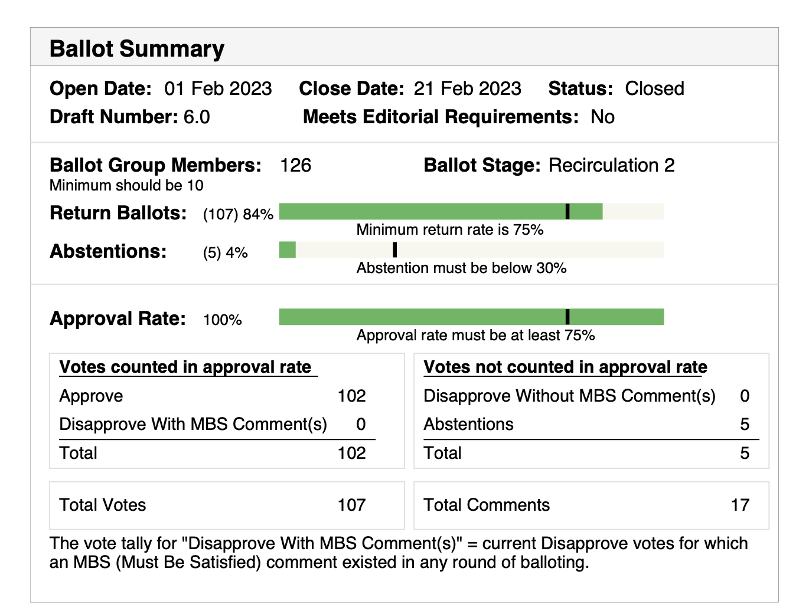
2nd SAB Recirc passed with 100% approval rate

Slide 19
AOB

Slide 20
Adjourn

Slide 21
Timeline
Information item

Slide 22
Current TGbc Schedule (Revision as of 2022-09-12)
January 2019 First meeting as a task group
June 2020 Call for comments on D0.1
November 2020 Initial WGLB (D1.0)
September 2021 D2.0 WG Recirculation LB
March 2022 D3.0 WG Recirculation LB
May intermediate version D3.1
June Form SAB Pool
July Editorial reviews completed: MEC & MDR on D3.1
D4.0 WG Recirculation LB
September 2022 WG request EC for unconditional approval to forward
draft D4.0 to SA ballot
Oct 4th, 2022 (EC telco) EC approval to go to SA Ballot (unconditional)
Oct. 6th Initial SA Ballot (D4.0), Start of
March 2023 Second SA Ballot
July 2023 Third SA Ballot
September 2023 EC approval to RevCom
December 2023 RevCom/SASB approval

Slide 23
Submission to modify SFD
Concepts
Preliminary Draft text
Fully elaborated draft text
TGbc SFD (has 75% approval)
eBallot “Call for Comments’”
TGbc D0.2 unapproved
Straw Poll in Telco
(should indicate strong support)
TGbc D0.1 unapproved
eBallot Motion or TGbc Straw Poll “Approve D0.2” and turn into D1.0
Speculative Edits (unapproved) for SFD (owned by Editor)
Convert SFD into D0.1 unapproved (done by Editor)
Straw Poll to support this step?
eBallot Motion “Request WG letter Ballot D1.0”

Slide 24
Permission for Motions (information item)
Information item – per mail of WG Chair

Slide 25
Rule change (per WG Chair announcement)
==========
Announcement of Rules Change:
To enable the timely and efficient progress of work during the exceptional circumstance of cancelled plenary and interim sessions: Effective immediately,
The following process change is in effect for the duration of time until WG11 is able to hold face-to-face meetings:
(a) “Task Group (TG), Study Group (SG) and Standing Committee (SC) motions may be held during teleconference meetings.
(b) TG/SG/SC teleconference meetings that will consider motions shall be approved by the WG Chair, and if approved, meetings and draft motions announced to the TG and WG11 reflectors 10 days prior to the meeting.
(c) If a motion is not approved by unanimous consent, it shall be taken as a roll call [recorded] vote.
This change is NOT applicable to a TG operating under the accelerated process or as an IEEE-SA Ballot Comment Resolution Committee.
Implementation:
As a default, TG/SG/SC teleconferences during which motions are held will be scheduled at or near 9am Eastern (6AM Pacific, 2PM London, 9PM Beijing, 6:30PM Delhi). The goal being that teleconferences in which motions are held are not 11pm-6am for the majority of members.
==========

