Slide 1
Bluetooth 6 GHz March 2023 Update
Date: 2023-03-15
Authors:
Notes:
September 2012

Slide 2
Abstract
This is an update on Bluetooth SIG actions and plans for sharing the 6 GHz band with incumbents and unlicensed/license-exempt devices.
Notes:
September 2012
doc.: IEEE 802.11-09/0301r1
March 2009
Stephen McCann, RIM
Page 2

Slide 3
Agenda
Bluetooth Sharing Goals
The Overall Bluetooth SIG Plan
Meeting with the FCC OET
Bluetooth ETSI BRAN plans
IEEE 802.11 Coexistence Standing Committee

Slide 4
Bluetooth Sharing Goals
The Bluetooth SIG recognizes the contribution the Wi-Fi industry has made in opening the 6 GHz band for unlicensed/license-exempt sharing
  The 83.5 MHz of the 2.4 GHz band and even 470 MHz (not contiguous) of the 5 GHz band were not a sufficient hedge against congestion or enough room for innovation
Today, Bluetooth is in that same situation
Bluetooth and Wi-Fi successfully shared the 2.4 GHz band for many years
  Unfortunately, most of 5 GHz is not viable for Bluetooth, i.e., indoor restrictions and DFS
The 6 GHz band has room for Bluetooth and Wi-Fi, and there is time to develop optimal sharing mechanisms
We will work closely with the Wi-Fi industry in IEEE 802 and Wi-Fi Alliance to enable Bluetooth sharing this band equitably

Slide 5
The Overall Bluetooth SIG Plan
Create an industry coalition of Bluetooth companies to drive regulatory and standards changes
  Including companies with both Wi-Fi and Bluetooth businesses
Collaborate with Wi-Fi industry to drive needed changes
Work with SDOs to develop optimum spectrum sharing methods and drive regulatory/standards to codify them as required
The detailed plan can be developed working together

Slide 6
Meeting With The FCC OET
On February 16, 2023 the Bluetooth SIG Director of Radio Spectrum Regulatory Affairs and legal representation met with the FCC OET
  Ira Keltz (Deputy Chief) and 16 other OET people
Discussed Bluetooth industry plans to expand operations to the 6 GHz band
It was a preliminary meeting to inform OET that the SIG, supported by its vast membership have requirements that will be restricted by the limits of the 2.4 GHz band, e.g., congestion, the need for room to innovate
Bluetooth SIG indicated it would request a face-to-face meeting in 2Q to discuss technical requirements and detailed spectrum needs

Slide 7
Bluetooth ETSI BRAN Plans
ETSI BRAN EN 303 687 is in the final phases of approval of version 1.1.x
  ENAP restart (90-days) required due to changes beyond EC Assessment comment resolution
  It could be ready to publish around the time of the June meeting (#119)
The first version mentions the use narrow band technologies, but work is needed to complete the specification and the test requirements
Bluetooth SIG members will bring a Work Item request to BRAN #119

Slide 8
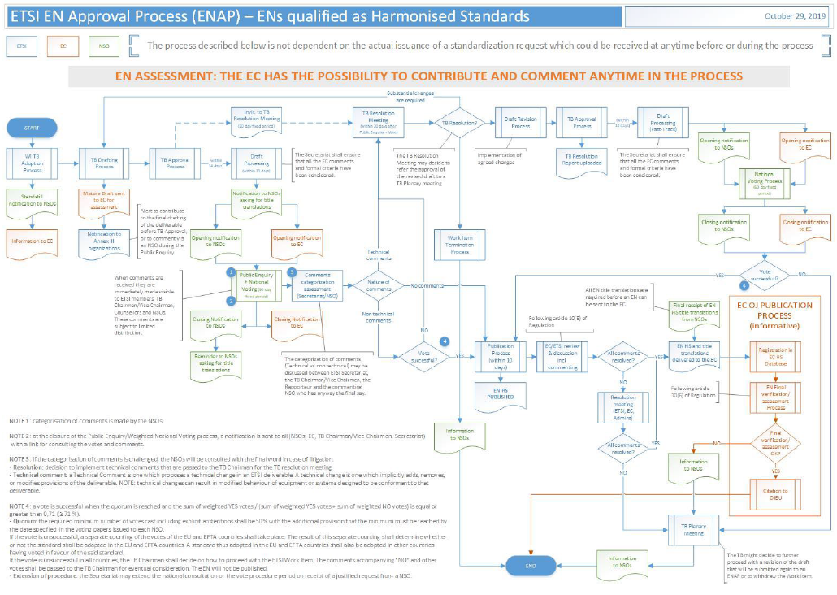
FYI: ETSI Approval Process for European Norms

Slide 9
IEEE 802.11 Coexistence Standing Committee
I chair the Bluetooth SIG Regulatory Expert Group and the Bluetooth Regulatory Action Group
I will be attending all IEEE 802.11 meetings as this project progresses and be very active in this group
I am hoping to have some details of our timelines for the next meeting
We will share our thoughts and plans for coexistence mechanisms as soon as possible and work to make it equitable for all of us

