Slide 1
Considerations for AP coordination in UHR: Coordinated Medium Access
Date: 2023-01-30
Authors:

Slide 2
Problem Statement
Problem: today, in most deployments, APs don’t hear each others preamble which leads to overlapping transmissions within different BSSs resulting in higher latency due to collisions, retransmissions, hidden node issues, etc.
  In addition, single BSS transmissions efficiency may drop significantly with OBSS transmissions occupying the medium
Objective: improve the reliability of the network in terms of latency and throughput by increasing the chances for APs to listen to each others' transmissions and have a better coordination among them

Slide 3
Design Principles
Coordinating APs need to end transmissions at predetermined time to be able to listen to each others' transmissions
Some hooks (e.g., Restricted TWT) have been introduced in EHT where STAs end the TXOP before the start time of a service period
  Restricted TWT is per single BSS
  UHR design can be built on top of the existing hooks
The coordination scheme between APs will facilitate the transmissions between the Coordinating APs at the start of the service periods
  This will help to reduce the unsynchronized transmission that may result from hidden nodes

Slide 4
Coordinated Medium Access
Coordinated Medium Access allows several APs to coordinate their medium access to provide enhanced latency sensitive traffic delivery
Two levels of coordination:
  Level 1: Only APs end the TXOP before the other APs Coordinated SP
    APs can setup Trigger-enabled R-TWT SPs and use MU EDCA to reduce contention from STAs
  Level 2: STAs within each BSS end the TXOP with respect to the start of Coordinated SPs of other coordinating APs
    Associated AP will announce the Coordinated SP of other coordinating APs
    Coordinated SP can be announced through an R-TWT SP
      R-TWT supporting STAs will also end the TXOP before the R-TWT SP announced by the associated AP

Slide 5
R-TWT TXOP rules per BSS, Coordinated Medium Access is for multi-BSS
11be R-TWT
Coordinated Medium Access
TXOP
R-TWT SP
TXOP
Coordinated SP
BSS-1
BSS-1
t
t
TXOP
R-TWT SP
TXOP
BSS-2
BSS-2
t
t
TXOP
BSS-3
TXOP
BSS-3
t
t
Within the BSS, R-TWT supporting STA shall end TXOP before start of R-TWT SP announced by the associated AP
BSS-3 extend over the start of the R-TWT SP of BSS-1 and BSS2. Hence delay the transmissions.
Level 1: APs end TXOP before Coordinated SP of its BSS and coordinating APs SP
Level 2: in addition, STAs that support Coordinated Medium Access end TXOP before the coordinated SP of other BSS

Slide 6
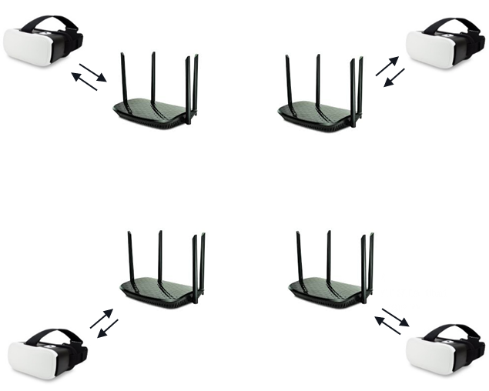
Initial Gain Analysis
Parameters | values
Bandwidth | 80MHz @ 5 GHz, 2 SS
max TXOP | 4 ms
MCS | Fixed MCS 5
AP TXPw | 21 dBm
Low latency traffic | DL VR (Data rate: 60 Mbps, Frame Generation rate: 60 fps)

Slide 7
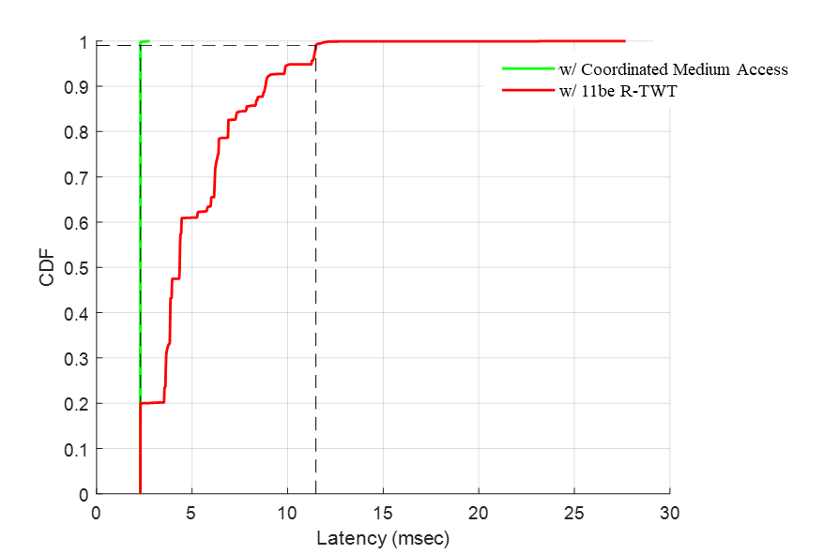
Initial Gain Analysis (Cont’d)

Slide 8
For Level 2: TSF may be different at different APs, two candidate solutions
If AP2 announces Coordinated SP1 without correcting the Target Wake Time, then AP2 will announce a start time that is different from the correct start time of SP1
Beacon of AP1
Coordinated SP information
SP 1
SP 1
SP 1
t
t
t₁
(w.r.t AP1)
AP1
AP2
_{Correct start time}
t₁
(w.r.t AP2)
  Option 1: APs synchronize their clocks
  Option 2: each AP corrects the start time of SPs announced by other APs before announcing other APs Coordinated SP information to its associated STAs (e.g., in its transmitted Beacon frames)
    requires extensions for TWT field to support different offsets between APs when Coordinated SP is communicated through R-TWT

Slide 9
Conclusion
We introduced the Coordinated Medium Access framework that can be considered for UHR
Two levels of coordination has been proposed in the Coordinated Medium Access framework
Coordinated Medium Access will facilitate the transmissions between the Coordinating APs at the start of the service periods and hence increase the reliability of the network

