Slide 1
A simple metric for utility of enhanced privacy design in .11 frames
Date: 2023-02-13
Authors:
Name | Affiliation | Phone | Email
Amelia Andersdotter | Sky Group/Comcast | +46764266862 | Amelia.ieee@andersdotter.cc
Amelia Andersdotter, Sky Group/Comcast

Slide 2
Abstract
The question on and off arises how to assess the utility of a particular proposed privacy enhancement over another[3]
This presentation contains a proposed simple metric for anonymity, namely, to what extent can one device in a network be confused for another device in the same network based on information that can be captured from MAC frame headers by a third-party eavesdropper
This metric does not account for a variety of attacks and threat models that go beyond such eaves-dropping (see slide 9)
The goal is to create some quantified intuition for what is useful and to what extent
Amelia Andersdotter, Sky Group/Comcast

Slide 3
Measuring privacy (1)
Privacy, like security, can in some cases be quantified or qualified. For instance, we can assert that something is or is not confidential (and therefore private).
  Example: encrypting something OTA, not (re)transmitting something twice if not needed to decrease risk of eavesdropping, etc.
A number of attempts have also been done to establish metrics for “degree of anonymity” or relative privacy in a system.
  Differential privacy is a quite well-known recent concept that quantifies the amount of queries that can be done on a database before responses reveal identities of individuals whose data is captured in the database.
Amelia Andersdotter, Sky Group/Comcast

Slide 4
Measuring privacy (2)
In this presentation, I propose a much simpler model than differential privacy for measuring degree of privacy in a network under some of the changes currently discussed in the Tgbi requirements document [2].
The “degree of anonymity” definition was developed by Claudia Díaz, Stefaan Seys, Joris Claessens, and Bart Preneel at KU Leuven in 2002 and is based on an attacker’s ability to establish from whom a particular transmission originated.
The “ability” of the attacker is the probability with which the attacker can be certain that one device was the transmitter.
Amelia Andersdotter, Sky Group/Comcast

Slide 5
Degree of anonymity (1)
The attacker is assumed to be external, passive and local (a passive eavesdropper).
Let N be the number of devices in a network, each carrying a display of information elements in their MAC frame headers.
For all i in {1, …, N} is the probability of an attacker identifying transmitter i.
Is the entropy in the system following an attack (an observation of a display of information elements in MAC frame headers).
Is the degree of anonymity in the system.
$P\left(X=i\right)=p_{i}$
$H\left(X\right)=−\sum_{i=1}^{N}{p_{i}}\log_{2}\left(p_{i}\right)$
$d=\frac{H\left(X\right)}{H_{max}}whereH_{max}=\log_{2}\left(N\right)$
Amelia Andersdotter, Sky Group/Comcast

Slide 6
Degree of anonymity (2)
First (and to my understanding biggest) challenge is to establish a suitable probability distribution
$P\left(X=i\right)=p_{i}$
Conversely, given one observation of a set of displays of information elements, what is the probability that an eavesdropper would find two displays that are the same? (i.e., the inverse probability – what is the probability that an attacked would at all be uncertain as to the identity of a transmitter?)
Proposal: we can model this as the pigeon hole principle. For N devices displaying M = 2^{x} bits, where x is the number of bits in the MAC frame header that are not encrypted or obfuscated, what is the probability that a given device is not uniquely identifiable?
Amelia Andersdotter, Sky Group/Comcast

Slide 7
Degree of anonymity (3)
Pigeon hole principle, continuation.
We have two cases: if N > M, we are guaranteed that at least some devices will share displays. The probability that any particular device will share a display with any other device is
$p_{i}=\frac{1−M/N}{N−M}$
If M <= N, we instead look at the probability of two devices arbitrarily having chosen the same display:
$p_{i}=\frac{1}{M²}$
The anonymity set of a device amounts to any group of devices from which the selected device cannot be distinguished. For many privacy threats (unwanted targetted (political) advertisements), I will make the bold claim that a sufficiently large probability of the existence of an anonymity set is, in fact, sufficiently economically discouraging for the attacker.
Amelia Andersdotter, Sky Group/Comcast

Slide 8
Degree of anonymity (4)
Then
$P\left(X=i\right)=p_{i}$
Should be modelled as
$p_{i}=\begin{aligned}1−\frac{1−M/N}{N−M}forN>M \\ 1−\frac{1}{M²}forM≥N\end{aligned}$
For large M, the probability of a single device being uniquely identified in a single observation is high. If we want a larger anonymity set than 2, we could also use 1/m^a for a being the desired anonymity set size, when M >= N. We could also set target anonymity set sizes with N>aM, where a (integer) is the target size.
Amelia Andersdotter, Sky Group/Comcast

Slide 9
Discussion
There are a number of problems with this model
If someone can already snoop information elements, they can also snoop signal strength and deduce distance between AP and STA. If they have line-of-sight or a decent understanding of, say, a building plan (where are the bathrooms, where is the kitchen, etc.) they could already identify individuals and devices based on this.
Time dependency: usually an eaves-dropper does not observe one set of displays at one time, but continuously observes displays (and the way they change) over time. In a second round of observations the possible display set is reduced.
Other traffic pattern analysis, such as size of frames.
Information leaks from higher layer protocols.
Etc.
Amelia Andersdotter, Sky Group/Comcast

Slide 10
Some results
A MAC frame header contains between 64 and 128 configurable bits, even if we do not count addresses (MAC addresses, DA, SA, etc. are assumed to be en route to confidentiality, see slide 3). This makes M a very large number, if we are not encrypting or obfuscating a large subset of those bits. The birthday problem would tell us that we don’t need that large a number of devices N before the probability of at least one collision is relatively high.*
We can compute the degree of anonymity for various levels of obfuscating in different network sizes (=number of devices)[4]. However, entropy in the system is so low that the metric for degree of anonymity proposed in reference [1] is easier to interpret if scaled up. In the following three slides, entropy is scaled up by a factor 100.
For more information, see [4].
*from the attacker’s perspective, this could be an alternative measure of the risk of failing to single out a device.
Amelia Andersdotter, Sky Group/Comcast

Slide 11
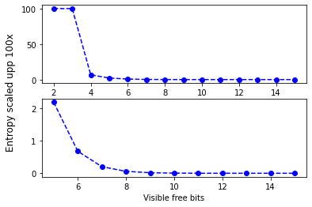
Home network with 5 users having 2 devices each
The attacker cannot be certain of having identified a unique device after observing one frame up to 3 ”free” bits. After 3 bits, uncertainty degrades quickly.
These individuals and their devices are likely to all be present and connected at the same time.
Amelia Andersdotter, Sky Group/Comcast

Slide 12
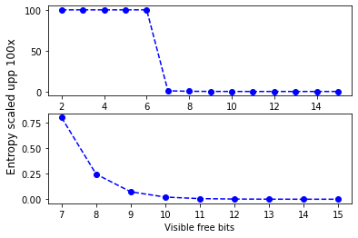
Airport network with 100 people each with one device
Note that in spite of scaling entropy up, the lower graph displays low entropy after 7 visible bits.
The idea here is that at any particular location in the airport, at any particular time, you’re not likely to have that many people, even if the through-put of people over the course of a day is fairly large.
Amelia Andersdotter, Sky Group/Comcast

Slide 13
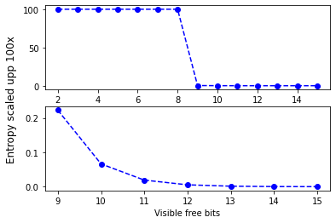
Office network with 500 users each having one device
Even less entropy. The good news is that each additional hidden bit creates exponentially better entropy in all three cases.
These users will be in the same area and possibly using the network at the same time. Obviously number is chosen arbitrarily.
Amelia Andersdotter, Sky Group/Comcast

Slide 14
Every little bit counts
It is worthwhile trying to get a grasp of the level of improvement various proposals could bring to privacy.
Quantifying the extent to which we are able to reduce information leaks and what the implications of these reductions are, can help us assess where our efforts should go.
Confidentiality can contribute to anonymity, but anonomity is generally hard to achieve. This does not mean anonymity (with respect to third-party passive eavesdropper, see slide 5) is not a useful goal. It also means we should continue efforts to increase confidentiality.
Amelia Andersdotter, Sky Group/Comcast

Slide 15
Reference
[1] Towards measuring anonymity, https://www.freehaven.net/anonbib/cache/Diaz02.pdf
[2] 11-21-1848-16-00bi-requirements-document
[3] Various discussions on utility of encrypting single bits, IE containers, etc. see minutes from previous meetings.
[4] https://github.com/teirdes/relative_anonymity_metric
Amelia Andersdotter, Sky Group/Comcast

