Slide 1
Hybrid LC and RF in UHR
Date: 2023-03-14
Authors:

Slide 2
Outline
Introduction
Multilink operation
Light communications
Analysis of 11be and 11bb PARs
Summary
References
Straw poll

Slide 3
Introduction
Multilink operation (MLO) allows parallel operation over 2.4, 5 and 6 GHz bands. This contribution proposes integration of Light Communications (LC) into the MLO framework, as a new offloading opportunity to improve reliability. LC enables high reliability and low latency in critical scenarios where RF may be congested. 802.11be and 802.11bb PARs limited the scope to RF bands at 2.4, 5 and 6 GHz and optical bands in 800 nm to 1000 nm range, respectively.
This presentation proposes developing an open interface for LC in the MLO framework in UHR, which enables the integration of LC with RF.

Slide 4
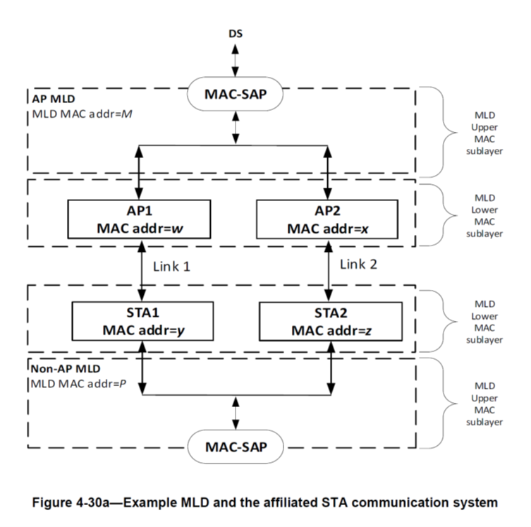
Multilink Operation [1]
Multilink operation (MLO) allows parallel operation over 2.4, 5 and 6 GHz bands.
The MAC is split into MLD upper MACs, MLD lower MACs and Link 1/Link 2.

Slide 5
Offloading: Enhanced reliability and lower latency
Each RF band has independent channel access
  CCA is done on all bands operated in parallel
  If the link is busy in current band, another band can be used
Offloading enhances reliability and reduces latency
  In dense traffic, however, capacity of all bands may be exhausted
  MLO can find no more free bandwidth
More bandwidth is required for reliability and latency guaranties

Slide 6
LC provides a deterministic channel
In contrast to MLO over RF, MLO over LC can be deterministic
UHR demands cable-like QoS over wireless links
  applications want to get rid of cables and use similar properties
  no packet loss, lower latency, zero jitter for TSN support
This is a challenge in randomly shared radio spectrum
  RF going through walls makes interference unpredictable
    Interference from other technologies (Bluetooth, ZigBee, UWB)
    Interference from other APs
MLO forms compound channel based on multiple “loose contacts”
  Parallel circuit improves the situation in low-to-moderate load
  But MLO does not provide guaranteed delivery in dense traffic scenarios

Slide 7
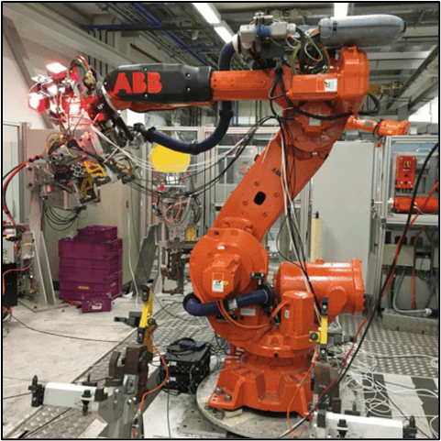
What is Light Communication?
Key facts:
Mobile communication by using light
Mobile, bidirectional, high-speed
Useful complement to RF
Unique Selling Points:
Higher capacity/area in small “hotspots”
  1…10 Mbps/m² (RF) vs. 100+ Mbps/m² (LC)
Cable-like QoS: Guaranteed delivery in dense traffic
Robust against jamming, enhanced privacy
Complement RF by LC
RF is already mature and established in the market
LC adds new value to RF
Important synergies, both indoors and outdoors
RF systems can take new opportunities by adding LC

Slide 8
Opportunities
Light Communication is fundamentally more reliable than RF
  Coexistence with other radio technologies is not an issue
    because LC does not interfere with RF
  Interference from other APs is not an issue
    because LC does not pass through walls
  LC can be used together with deterministic channel access

Slide 9
Hybrid LC and RF
Parallel operation of LC and RF [4]
  spotty optical vs. ubiquitous radio coverage in industrial use cases
  +Synergies: offloading, robustness against rain and fog
MIMO using LC optical and RF antennas [5]
  802.11bb is based on random channel access
  CCA on one link could block the other link, too
Better combine LC and RF using MLO framework developed by 802.11be

Slide 10
Analysis of 11be and 11bb PARs
802.11be PAR limits carrier frequency operation between 1 and 7.250 GHz
802.11bb limits operations to 800 nm to 1000 nm band
Both projects are in final phase, thus PAR ammendments are not feasible
Existing PARs unfortunately exclude hybrid operation of RF and LC
  hybrid LC and RF can only be enabled by a future project
  this will impact the mainstream, and maybe easily done in UHR

Slide 11
LC in MLO via Small Enhancement of agreed Architecture
Separation of MAC in Upper and Lower MLD part already exists
Integration of future technologies kincluding LC would benefit from an open interface between the two
Enables the operation of LC as a new wireless medium next to 2.4, 5 and 6 GHz.
Open
Interface for LC

Slide 12
Summary
Offloading needs to integrate further bands
  integrate LC PHY, possibly together with a deterministic channel access mechanism
  this would substantially improve reliability, reduce latency/jitter and increase throughput
IEEE P802.11bb discussed hybrid operation of LC and RF
  previous proposal in 11bb had a severe technical issue
  it was suggested to integrate LC into 802.11 using the MLO framework in 802.11be
  this was, however, out of scope for both, TGbb and TGbe
Develop an open interface for LC in UHR
  further develop MLD lower MAC and MLD PHY for LC in a separate project

Slide 13
References
[1] IEEE P802.11be™/D3.0: Draft Standard for Information technology — Tele-communications and information exchange betw. systems Local and metropolitan area networks — Specific requirements — Part 11: Wireless LAN Medium Access Control (MAC) and Physical Layer (PHY) Specifications — Amendment 8: Enhancements for extremely high throughput (EHT)
[2] V. Jungnickel et al., “Light Communication for UHR”, https://mentor.ieee.org/802.11/dcn/23/11-23-0091-00-0wng-light-communication-for-uhr.pptx
[3] Tutorial#1 on “IEEE 802 Standards on Light Communication” in March 2023 meeting https://mentor.ieee.org/802.11/dcn/23/11-23-0277-01-0000-ieee-802-standards-on-light-communication.pdf
[4] M. Ayyash et al., "Coexistence of WiFi and LiFi toward 5G: concepts, opportunities, and challenges," in IEEE Communications Magazine, vol. 54, no. 2, pp. 64-71, February 2016
[5] V. Jungnickel et al. „LC/RF multiplexing“, https://mentor.ieee.org/802.11/dcn/23/11-23-0006-00-00bb-lc-rf-multiplexing.docx

Slide 14
Straw Poll
Would you support that
UHR integrates LC into the Multilink Operations framework?
A New Study Group is formed to integrate LC and RF using MLO?
c) Abstain.

Slide 15
Analysis of 11be and 11bb PARs
802.11be
5.2.b Scope of the project: This amendment defines standardized modifications to both the IEEE Std 802.11 physical layers (PHY) and the Medium Access Control Layer (MAC) that enable at least one mode of operation capable of supporting a maximum throughput of at least 30 Gbps, as measured at the MAC data service access point (SAP), with carrier frequency operation between 1 and 7.250 GHz while ensuring backward compatibility and coexistence with legacy IEEE Std 802.11 compliant devices operating in the 2.4 GHz, 5 GHz, and 6 GHz bands. This amendment defines at least one mode of operation capable of improved worst case latency and jitter.
802.11bb
5.2.b Scope of the project: This amendment specifies a new PHY layer and modifications to the IEEE 802.11 MAC that enable operation of wireless light communications (LC). This amendment specifies a PHY that provides: 1) Uplink and downlink operations in 800 nm to 1000 nm band, 2) All modes of operation achieve minimum single-link throughput of 10 Mb/s as measured at the MAC data service access point (SAP), 3) Interoperability among solid state light sources with different modulation bandwidths.
This amendment specifies changes to the IEEE 802.11 MAC that are limited to the following: 1) Hybrid coordination function (HCF) channel access, 2) Overlapping basic service set (OBSS) detection and coexistence,
3) Existing power management modes of operation (excluding new modes), and modifications to other clauses necessary to support these changes.
Existing PARs unfortunately exclude hybrid operation of RF and LC
  hybrid LC and RF can only be enabled by a future project
  this will impact the mainstream, and maybe easily done in UHR

