Slide 1
Hybrid LC and RF in UHR
Date: 2023-03-03
Authors:

Slide 2
Outline
Introduction
Multilink operation
Light communications
Analysis of previous PARs
Summary
References
Straw poll

Slide 3
Introduction
Multilink operation (MLO) allows parallel operation over 2.4, 5 and 6 GHz bands. This contribution proposes integration of light communications (LC) into multilink operation (MLO), as a new offloading opportunity to improve reliability. LC enables high reliability and low latency in critical scenarios where RF may be congested. 802.11be PAR limited the scope to RF bands at 2.4, 5 and 6 GHz while 802.11bb PAR to optical bands in 800 nm to 1000 nm range. It is proposed to develop the 802.11 architecture further and add an Open ML interface which enables the integration of LC.

Slide 4
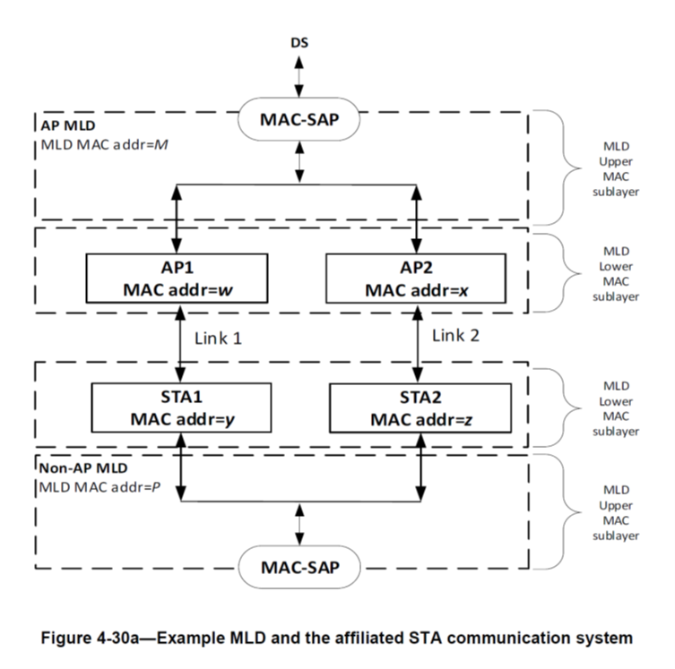
Multilink Operation [1]
Multilink operation (MLO) allows parallel operation over 2.4, 5 and 6 GHz bands.
The MAC is split into MLD upper MACs, MLD lower MACs and Link 1/Link 2.

Slide 5
Offloading: Enhanced reliability and lower latency
Each RF band has independent channel access
  CCA is done on all bands operated in parallel
  If the link is busy in current band, another band can be used
Offloading enhances reliability and reduces latency
  This is true if enough free bandwidth is available
  UHR aims at higher throughput compared to 802.11be
  In dense traffic, capacity of all bands may be exhausted
  MLO cannot find free bandwidth
Offloading requires free bandwidth
  But free bandwidth is not enough

Slide 6
MLO ≠ Deterministic channel access
Cable-like QoS over wireless links
  applications want to get rid of cables and use similar properties
  zero packet loss, lower latency, zero jitter for TSN support
This is a challenge in randomly shared radio spectrum
  RF going through walls makes interference unpredictable
  Interference from other technologies (Bluetooth, ZigBee, UWB)
    coexistence is handled in 802.11 by CSMA/CA
    listen-before-talk creates an unreliable link, inherently
  Interference from other APs
    inter-cell interference is handled in 802.11 by CSMA/CA, too
    new ideas: AFC, C-OFDMA, SINR-aware scheduling, joint transmission
MLO forms compound channel based on multiple loose contacts
  Parallel circuit improves the situation in low-to-moderate load
  But MLO does not provide guaranteed delivery in dense traffic scenarios
  This would require true deterministic channel access

Slide 7
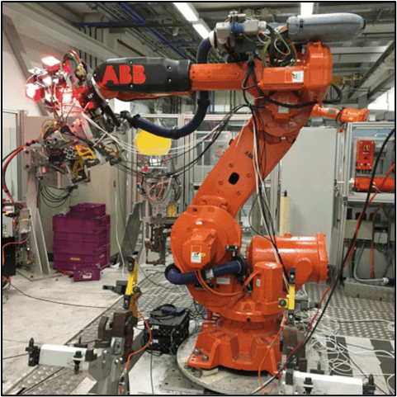
Light Communication for UHR [2]
Key facts:
Mobile communication by using light
Mobile, bidirectional, high-speed
Useful complement to RF
Unique Selling Points:
Higher capacity/area in small “hotspots”
  1…10 Mbps/m² (RF)
  100+ Mbps/m² (LC)
Cable-like QoS: Guaranteed delivery in dense traffic
Robust against jamming, enhanced privacy
Complement RF by LC
RF is already mature and established in the market
LC adds new value to RF
Important synergies, both indoors and outdoors
RF systems take new opportunities by adding LC

Slide 8
Opportunities and Challenges [2]
Light Communication is fundamentally more reliable than RF
  Coexistence with other radio technologies is not an issue
    LC does not interfere with RF
  Interference from other APs is not an issue
    LC does not pass through walls
  LC is best used together with deterministic channel access
LC needs a distributed deployment with central control
  LC propagates similar to lighting
    communication only inside illuminated area
    central control is limited to one room
  use multiple LC optical antennas for reliable transmissions
    if line-of-sight is blocked, use other LC optical antenna(s) in the same room
    cover one room with multiple LC optical antennas
    connect them by wired technologies
This can be handled by using specific protocols for LC
  e.g., IEEE Std 802.15.13 defines distributed MIMO for LC [5]
  enables deterministic channel access likewise

Slide 9
Hybrid LC and RF
Key idea: parallel operation of LC and RF [3][4]
  spotty optical vs. ubiquitous radio coverage in industrial use cases
Previous proposal in TGbb [5]
  MIMO using LC optical and RF antennas [4]
  802.11bb is based on random channel access
  clear channel assessment (CCA) on one link could block the other link, too
  hybrid link should better be implemented using MLO, similar as defined in 802.11be
Combine LC and RF using MLO

Slide 10
Open ML interface
MLO allows parallel operation over 2.4, 5 and 6 GHz bands.
MAC is split into ML upper MACs, MLD lower MACs and Link 1/Link 2.
The proposal is to define an Open ML interface between upper and lower MAC.
Via the Open ML interface, LC could be easily integrated.
Enables operation of LC in parallel to RF.
Open
ML interface

Slide 11
Analysis of previous PARs
802.11be
5.2.b Scope of the project: This amendment defines standardized modifications to both the IEEE Std 802.11 physical layers (PHY) and the Medium Access Control Layer (MAC) that enable at least one mode of operation capable of supporting a maximum throughput of at least 30 Gbps, as measured at the MAC data service access point (SAP), with carrier frequency operation between 1 and 7.250 GHz while ensuring backward compatibility and coexistence with legacy IEEE Std 802.11 compliant devices operating in the 2.4 GHz, 5 GHz, and 6 GHz bands. This amendment defines at least one mode of operation capable of improved worst case latency and jitter.
802.11bb
5.2.b Scope of the project: This amendment specifies a new PHY layer and modifications to the IEEE 802.11 MAC that enable operation of wireless light communications (LC). This amendment specifies a PHY that provides: 1) Uplink and downlink operations in 800 nm to 1,000 nm band, 2) All modes of operation achieve minimum single-link throughput of 10 Mb/s as measured at the MAC data service access point (SAP), 3) Interoperability among solid state light sources with different modulation bandwidths.
This amendment specifies changes to the IEEE 802.11 MAC that are limited to the following: 1) Hybrid coordination function (HCF) channel access, 2) Overlapping basic service set (OBSS) detection and coexistence,
3) Existing power management modes of operation (excluding new modes), and modifications to other clauses necessary to support these changes.
Existing PARs mutually exclude hybrid operation of RF and LC
  hybrid approach can only be enabled by future UHR project

Slide 12
Summary
IEEE P802.11bb discussed hybrid operation of LC and RF
  primitive approach in 11bb had several technical issues
  hybrid RF/LC operation was out of scope for both, 11bb and 11be
Offloading needs to integrate further bands
  define Open ML interface between MLD upper and MLD lower MAC
  integrate LC using a deterministic channel access mechanism
Develop Open ML interface in UHR
  further develop LC in a separate project

Slide 13
References
[1] IEEE P802.11be™/D3.0: Draft Standard for Information technology — Tele-communications and information exchange betw. systems Local and metropolitan area networks — Specific requirements — Part 11: Wireless LAN Medium Access Control (MAC) and Physical Layer (PHY) Specifications — Amendment 8: Enhancements for extremely high throughput (EHT)
[2] V. Jungnickel et al. “Light Communication for UHR”, https://mentor.ieee.org/802.11/dcn/23/11-23-0091-00-0wng-light-communication-for-uhr.pptx
[2] M. Ayyash et al., "Coexistence of WiFi and LiFi toward 5G: concepts, opportunities, and challenges," in IEEE Communications Magazine, vol. 54, no. 2, pp. 64-71, February 2016
[3] S. Shao, "Design and Analysis of a Visible-Light-Communication Enhanced WiFi System," J. Opt. Commun. Netw. 7, 960-973 (2015)
[4] V. Jungnickel et al. „LC/RF multiplexing“, https://mentor.ieee.org/802.11/dcn/23/11-23-0006-00-00bb-lc-rf-multiplexing.docx
[5] IEEE P802.15.13_D10: IEEE Draft Standard for Multi-Gigabit per Second Optical Wireless Communications (OWC), with Ranges up to 200 meters, for both stationary and mobile devices
[6] IEEE P802.11bb/D6: IEEE Draft Standard for Information Technology — Telecommunications and Information Exchange Between Systems Local and Metropolitan Area Networks — Specific Requirements — Part 11: Wireless LAN Medium Access Control (MAC) and Physical Layer (PHY) Specifications — Amendment 7: Light Communication (LC).

Slide 14
Straw Poll
Would you support that UHR develops Open ML interface to integrate LC?
Y / N / A =

