Slide 1
TGbc Closing Report
Date: 2023-03-17
Authors:

Slide 2
Abstract
Closing report for IEEE 802.11 TGbc (Broadcast Services) for March 2023.

Slide 3
Meeting Goals & Accomplishments of the week
Goals for the week:
Resolve comments received from SAB recirculation on D7.0
Approve Report to EC to request P802.11 D7.0 be forwarded to RevCom
Discuss dissemination activities
Accomplishments
100% approval, no comments on D7.0
Report and motion to forward D7.0 to RevCom passed
Discussed Computer Society seminar
So long, and
thanks for the fish
TGbc is done:
This will be the last TGbc closing report
Special thanks to all TGbc members – your contribution and support were the basis for having solid technical standard with an outstanding 100% approval rate
We’ll shake hands again during the reward ceremony

Slide 4
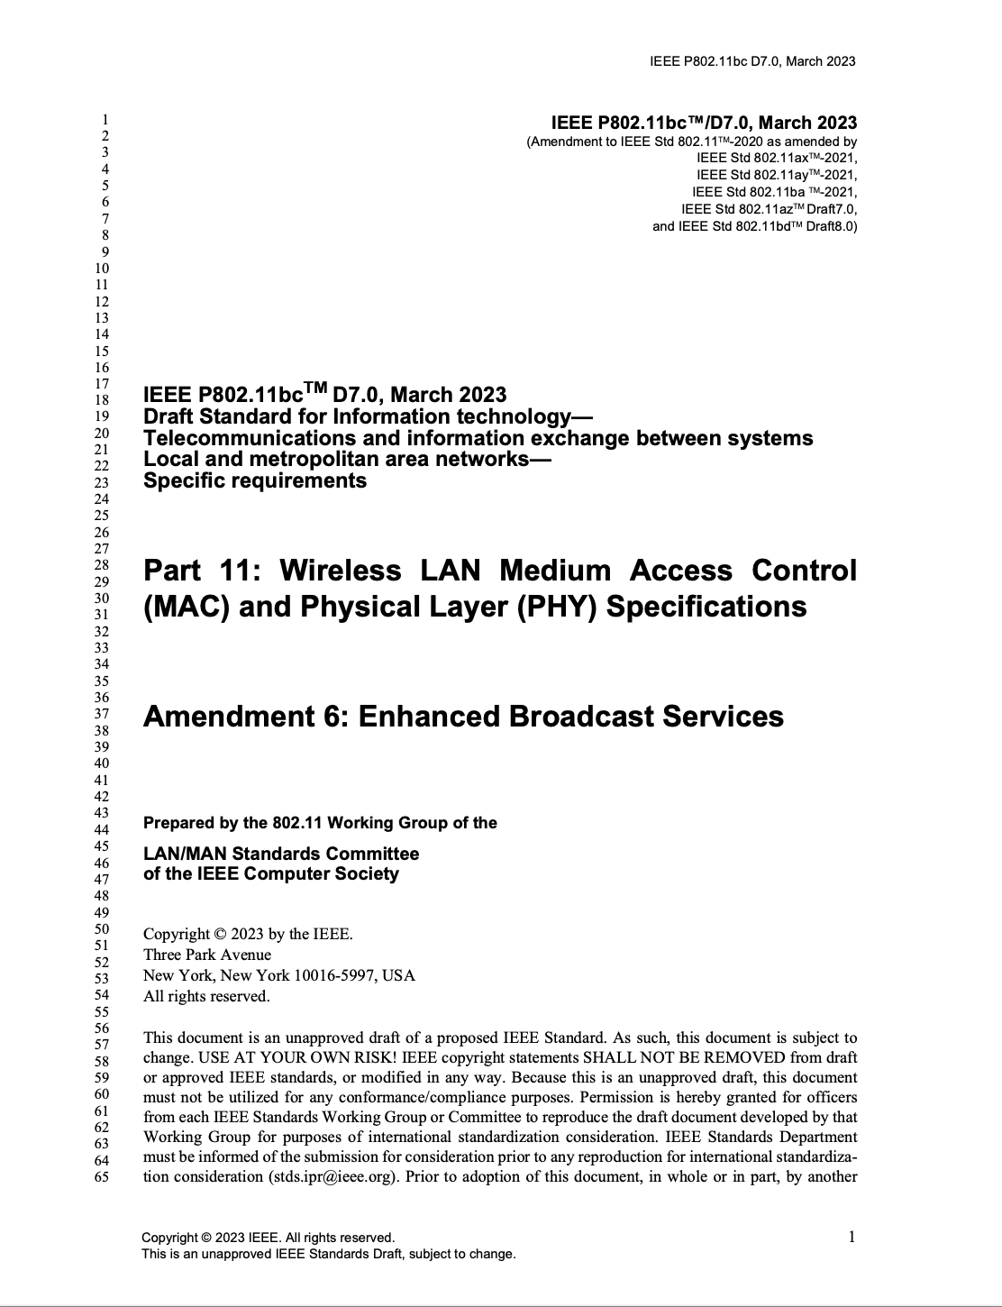
P802.11bc D7.0 is available in the IEEE SA Standards Store
IEEE P802.11bc: IEEE Draft Standard for Information technology--Telecommunications and information exchange between systems Local and metropolitan area networks--Specific requirements - Part 11: Wireless LAN Medium Access Control (MAC) and Physical Layer (PHY) Specifications - Amendment 6: Enhanced Broadcast Service. ISBN(s):9781504495301
Number of Pages:102
See: https://www.techstreet.com/ieee/standards/ieee-p802-11bc?product_id=2241694

Slide 5
IEEE Computer Society Webinar
IEEE 802.11: Future of Wi-Fi Standards
The webinar provides an overview of ongoing work on the IEEE 802.11 standard. … It will take an in-depth look at … P802.11bc Enhanced Broadcast Services amendment.
Tuesday, April 4, 2023
11:00 AM Eastern Daylight Time
Registration open at: https://event.on24.com/wcc/r/4153277/A4D7185230A328AF38376C8193EE9714?partnerref=speaker

Slide 6
References for this week
Agenda for this week: 11-23/0148
Meeting / Chair’s Slide Deck: 11-23/0149
Meeting minutes: 11-23/0408
Snapshot Slide: 11-23/0150
Closing report: 11-23/0151

Slide 7
Historical References
P802.11bc PAR https://www.ieee802.org/11/PARs/P802_11bc_PAR_Detail.pdf
P802.11bc CSD https://mentor.ieee.org/802-ec/dcn/18/ec-18-0250-00-ACSD-p802-11bc.pdf
TGbc Motion Booklet https://mentor.ieee.org/802.11/documents?is_dcn=2123&is_group=00bc
TGbc Use Case Document https://mentor.ieee.org/802.11/documents?is_dcn=268&is_group=00bc
TGbc Functional Requirements https://mentor.ieee.org/802.11/documents?is_dcn=151&is_group=00bc
P802.11bc All comments from all CCs, WGLBs, and SABs https://mentor.ieee.org/802.11/documents?is_dcn=486&is_group=00bc

