Slide 1
PSD-based EDT in ETSI 5 GHz
Author:
Name | Affiliation | Address | Phone | Email
Menzo Wentink | Qualcomm | Utrecht, The Netherlands |  | mwentink qti.qualcomm.com

Slide 2
ETSI 5 GHz PSD-based EDT definition
In December 2022, ETSI BRAN adopted a PSD-based energy detect threshold (EDT) into the 5 GHz standard (EN 301 893 draft v2.1.50):
This is a compromise between -62 dBm/20 MHz and -72 dBm/20 MHz
  the new definition replaces the -72 dBm/20 MHz EDT that was in the standard before
  a PSD-based EDT reconciles the fact that the EDT in EN 301 893 applies per 20 MHz and that the power per 20 MHz depends on the configured BW
The EDT shall be −85 dBm/MHz + (PSD_{limit} – PSD_{max}) with a minimum of −85 dBm/MHz and a maximum of −75 dBm/MHz, where PSD_{max} is the maximum PSD when using all channels in the configured combination/grouping of channels and PSD_{limit} is the PSD limit in the sub-band of operation. [For simultaneous operation in more than 4 channels, 3 dB shall be added to PSD_{max}.]

Slide 3
Examples of the PSD-based EDT
For a device configured for 80 MHz operation at 23 dBm Tx power (PSD_{max} = 4 dBm/MHz) in subband 1 (where 23 dBm is the maximum power and 10 dBm/MHz is the regulatory PSD limit (PSD_{limit} = 10 dBm/MHz)):
  PSD_{max} = 4 dBm/MHz
  PSD_{limit} = 10 dBm/MHz
  EDT = −85 + (PSD_{limit} – PSD_{max}) = −85 + (10 – 4) = −79 dBm/MHz
  = −66 dBm/20 MHz
For a device configured for 20 MHz operation at 23 dBm Tx power (PSD_{max} = 10 dBm/MHz) in subband 1 (where 23 dBm is the maximum power and 10 dBm/MHz is the regulatory PSD limit (PSD_{limit} = 10 dBm/MHz)):
  PSD_{limit} = 10 dBm/MHz
  PSD_{max} = 10 dBm/MHz
  EDT = −85 + (PSD_{limit} – PSD_{max}) = −85 + (10 – 10) = −85 dBm/MHz
  = −72 dBm/20 MHz

Slide 4
Overview of EDT levels
The PSD-based rule results in the following EDT levels for operation at the regulatory power limit:
For operation below the regulatory max power, the EDT levels scale up accordingly, with a maximum of -62 dBm/20 MHz
For a given configured BW, transmissions in lower BW can use the same EDT
  i.e. the EDT is not dynamic based on a per-TXOP PSD

Slide 5
Transition period
802.11ax and prior can keep using -62 dBm/20 MHz until ~2027
  based on a minuted agreement in BRAN, which can be communicated with Notified Bodies
  the date is the date of withdrawal for EN 301 893 V2.1.1
    which will be ~36 months after the next revision of EN 301 893 becomes listed in the OJEU
802.11be might be able to use -62 dBm/20 MHz until ~2027
  this depends on whether Notified Bodies will agree to it, because the minuted agreement does not mention 11be
Agreement on the transition period in BRAN(22)116e003r3:
  Guidance on EDT levels -- text for inclusion in the minutes of ETSI TC BRAN #117
  With respect to IEEE 802.11ax equipment only, ETSI TC BRAN agrees that such equipment could be treated under the existing rules for option 1 EDT defined in EN 301 893 v2.1.1 clause 4.2.7.3.2.5 until the date of withdrawal of that standard.
  ETSI TC BRAN will contact the EC before ENAP to discuss the acceptance of an extension to the default date of withdrawal to at least 36 months after listing of the new version of the standard in the Official Journal.

Slide 6
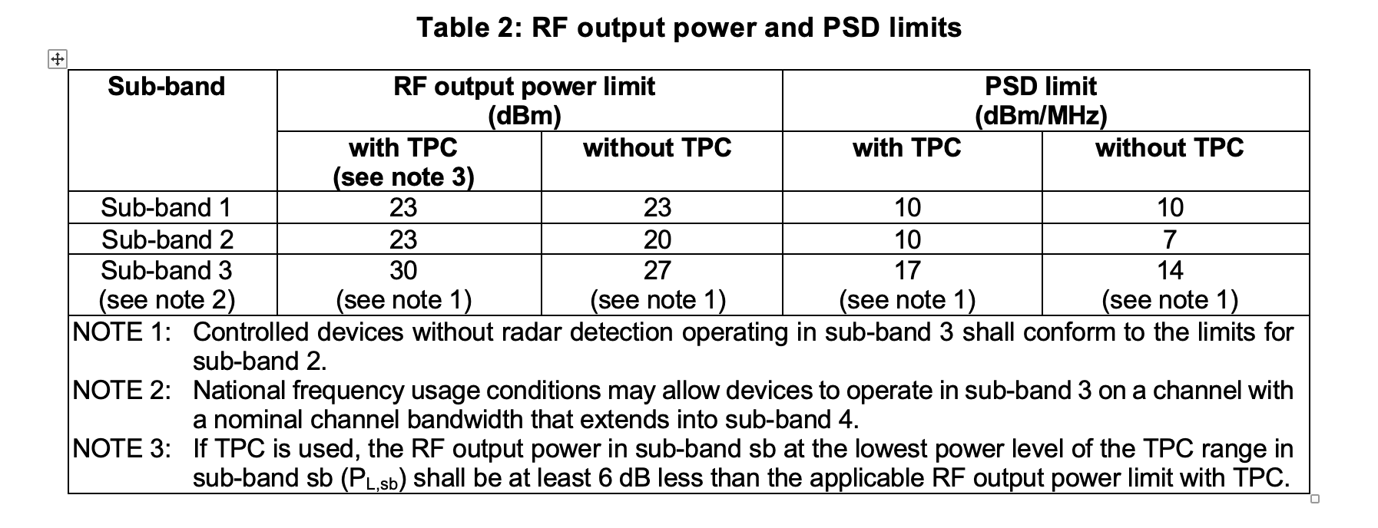
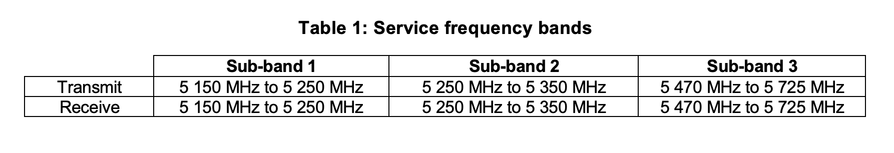
Annex: ETSI 5 GHz regulatory PSD limits

