Slide 1
Some Thoughts on Backscatter Modulation
Date: 2023-01-16
Authors:

Slide 2
Abstract
This document briefly introduces the principle of backscatter modulation. Additionally, it shows potential issues wrt. frequency regulation.

Slide 3
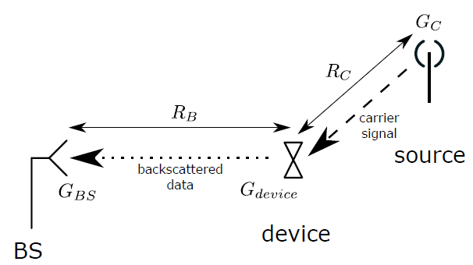
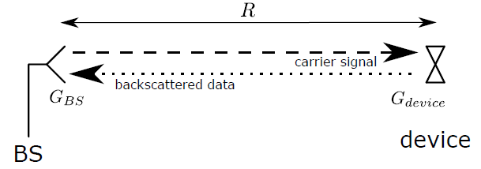
Possible Backscatter System Configuration
Bi-Static Configuration:
→ Full duplex with other device
RX signal of device is ~60dB below RX signal of carrier
Mono-Static Configuration:
Identical antenna for TX and RX
→ Full duplex with same device
→ RX signal is 100dB below TX signal

Slide 4
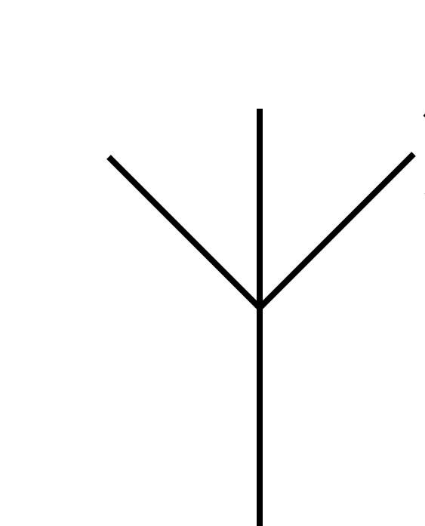
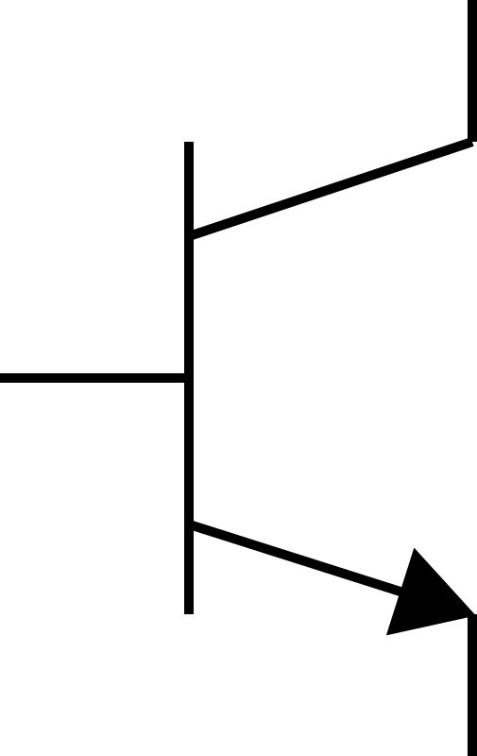
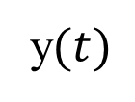
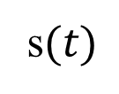

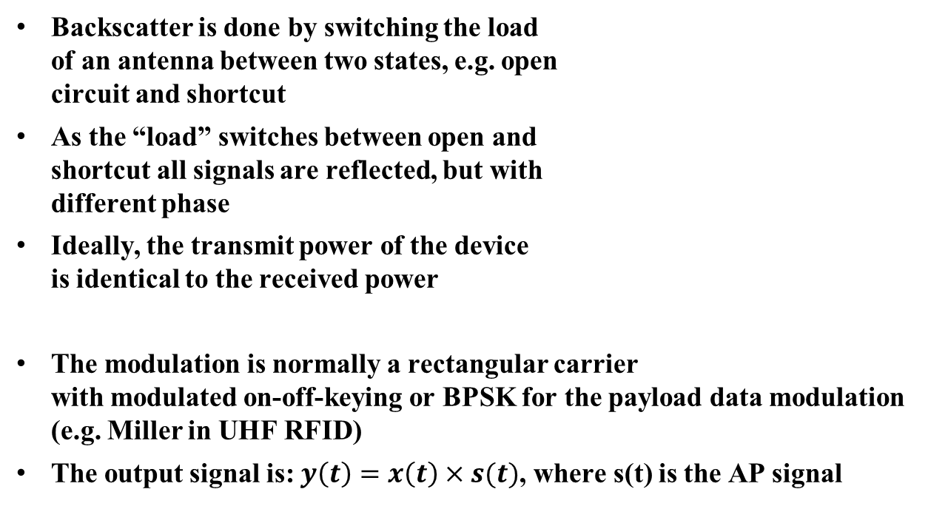
Modulation of the Backscatter Device
y$(t)$
s$(t)$
Backscatter is done by switching the load
of an antenna between two states, e.g. open
circuit and shortcut
As the “load” switches between open and
shortcut all signals are reflected, but with
different phase
Ideally, the transmit power of the device
is identical to the received power
The modulation is normally a rectangular carrier
with modulated on-off-keying or BPSK for the payload data modulation (e.g. Miller in UHF RFID)
The output signal is: $y\left(t\right)=x\left(t\right)×s(t)$, where s(t) is the AP signal
$$x(t)$$

Slide 5
Some Backscatter Theory ( I / II )
We can describe the square wave by means of a Taylor series (we exclude the DC component) [1]:
The corresponding frequency spectrum results in:
|X(f)|
…
…
f
-5f₀
-3f₀
-f₀
f₀
3f₀
5f₀

Slide 6
Some Backscatter Theory ( II / II )
The multiplication in the time domain leads to a convolution in the frequency domain [2].
|S(f)| AP TX Signal
f_{s}
f
|Y(f)| Backscattered Signal
…
…
-5f₀+f_{s}
-3f₀+f_{s}
f₀+f_{s}
3f₀+f_{s}
5f₀+f_{s}
f
-f₀+f_{s}

Slide 7
What does the AP Receive?
AP TX Signal
e.g. 100dB for monostatic,
60dB for bistatic
…
…
-5f₀+f_{s}
-3f₀+f_{s}
f_{s}
f₀+f_{s}
3f₀+f_{s}
5f₀+f_{s}
f
-f₀+f_{s}
A higher f₀ simplifies the decoding, but increases the out of band emissions → problems with frequency regulation
The bandwidth of classical UHF-RFID readers is typically very low (CW)

Slide 8
Summary
Backscatter modulation typically uses a rectangular modulation
The rectangular modulation with frequency f₀ shifts the backscatter-signal out of the original AP TX signal → simplifies decoding
Backscatter modulation typically at least doubles the spectrum, additional harmonics are typically present
➔ Issues with the frequency regulation (e.g. in Europe)

Slide 9
References
[1] https://en.wikipedia.org/wiki/Fourier_series
[2] John G. Proakis, and Masoud Salehi. Digital communications. McGraw-Hill., 2008.

