Slide 1
802.11 WNG
IEEE 802 & 802.11 opportunities in
AFV* (EV and HV) Fueling Infrastructure
Craig Rodine
Renewable and Distributed Systems Integration
Sandia National Laboratories
Albuquerque, NM, USA
Jan 2023 IEEE 802 Wireless Interim Meeting
Baltimore, Maryland, USA (and remote)
Sandia National Laboratories is a multimission laboratory managed and operated by National Technology & Engineering Solutions of Sandia, LLC, a wholly owned subsidiary of Honeywell International Inc., for the U.S. Department of Energy’s National Nuclear Security Administration under contract DE-NA0003525.
* Alternative Fuel Vehicle

Slide 2
Agenda
Summary of 802.24 discussion (began Sept 2022)
  EV charging, Hydrogen Surface Vehicle fueling
  Opportunity for IEEE 802-wide vertical applications
  Example use cases (depots, parking, heavy EV charging)
AFV fueling edge architecture and environment
Discussion, call for collaboration

Slide 3
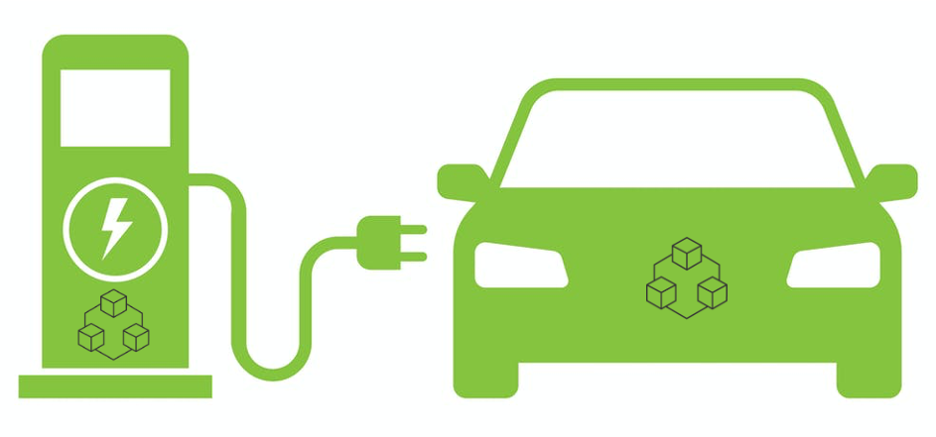



EV Charging (systems, services)
CNO₂ cloud
MSP₂ cloud
OEM₂ cloud
Reseller/Self
Partner/Self
Roaming
Reseller
CNO₁ cloud
Reseller
MSP₁ cloud
OEM₁ cloud
Reseller
Partner
Reseller/Self
Partner/Self
Foundation: safe energy exchange via coupler (connector+inlet), controlled by communication between state machines in EV and EVSE.

Slide 4
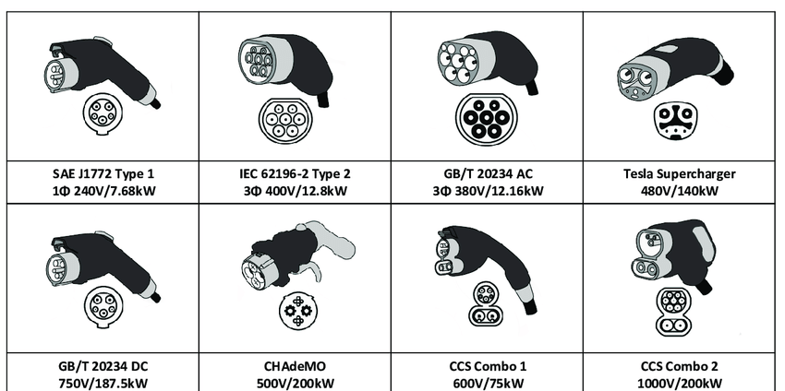
EV Charging (couplers, comms)
AC charging: analog control (so far*)
DC charging: digital signaling between EV-EVSE
EV-EVSE Communications
CHAdeMO, GB/T:
CAN bus / packets
CCS:
BPLC / IP / TCP / [TLS**] / XML (EXI)
Tesla:
SW-CAN / packets
* AC charging using messages over TCP/IP is defined in ISO 15118-2 but not yet implemented, since analog control plus CSP service logic works just fine.
** ISO 15118-2 and -20 define Certificate Profiles for TLS endpoints (EV and EVSE) but no PKI requirements. An industry group is developing those in SAE Intn’l.

Slide 5
EV Charging (cybersecurity)
CAN bus stack (CHAdeMO, GB/T)
  Differential signaling in cable is hard to sniff, disturb
  Functionality limited to energy transfer, no “higher level services” (AAA, payment)
BPLC/IP/TCP stack
  >1000 channels, 2-28 MHz energy (IEEE 1901/HomePlug Green PHY)
    Cable radiates, easily ‘heard’ at 40+ m, > 99% packet capture
    DoS attack disclosed (Brokenwire, Univ. Oxford cybersecurity research team)
  Almost all DC charging in NA (CCS) uses unprotected TCP/IP
    Using the DIN 70121 protocol, which has no cybersecurity provisions
    A very small % of charging session use TLS (v1.2, one-way per ISO 15118-2)
  Remedies being explored, but wide-scale mitigation would be very challenging
IEEE 802 standards can provide a superior, secure LAN/MAN connection

Slide 6
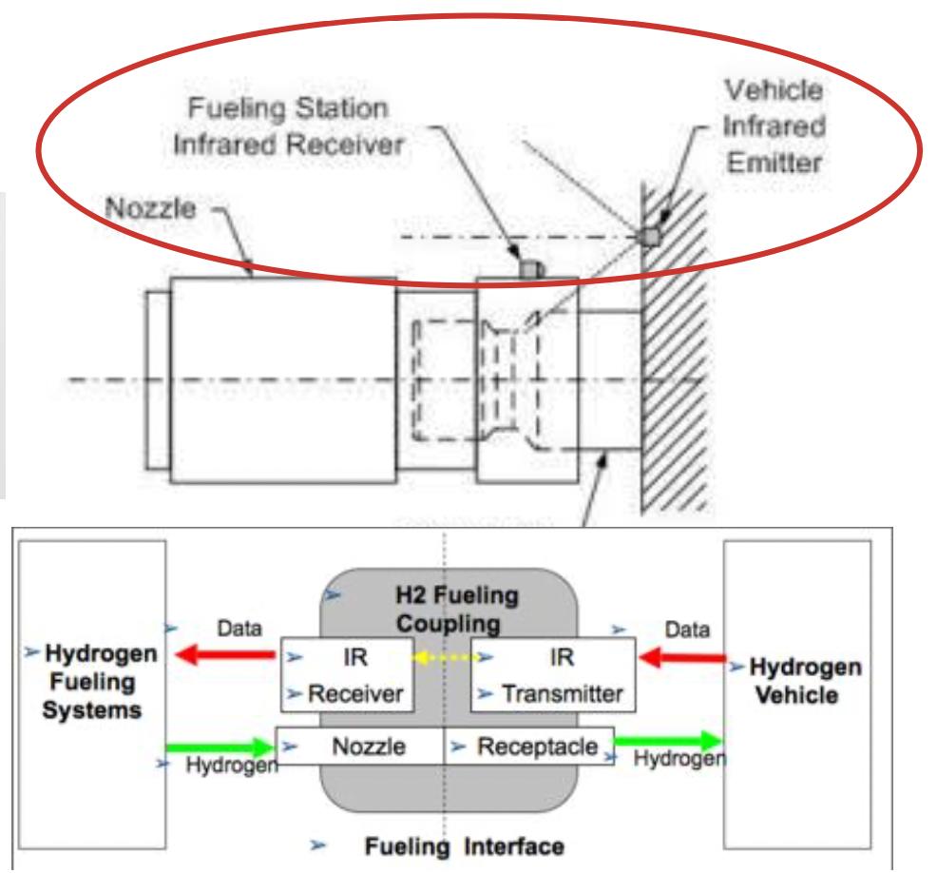
HSV (gaseous hydrogen) fueling
Current system uses IrDA standards for one-way communication
  SAE J2799 (supports SAE J2600/J2601)
  Vehicle sends fixed fueling parameters (V, T, p)
  Dispenser can only react (i.e. for safety shutdown)
  Overly large margins for physical and functional safety
  Doesn’t support higher fill rates, tank temp ranges
  IrDA not very reliable (sunlight, fogging); easily damaged
  IrDA is not secure, easily compromised (MITM)
Opening for IEEE 802 standards-based comms
  2-way: tank characteristics; pre-cooling; dynamic control
  Needed for higher-speed fueling (larger tank HSVs)
  EU Project PRHYDE -> ISO 19885-2/-3 (ISO TC 297/WG 24)
  Contemplating transactional services (e.g. payment, loyalty
  points) and fleet management (fueling logs, maintenance)
  Developing requirements for trust and security (e.g. PKI)
  Interested in using Secure Layer 2 (802.1/802.3/802.11)

Slide 7
802.24: exploring IEEE 802 vertical application
Establish a secure, cohesive, extensible AFV fueling edge
  LAN/MAN support for critical (depot, transportation) sites and operations
  Comms, computing, control, data, energy for next-gen fueling applications
Enhance AFV fueling site system integration using 802 standards for e.g. location, management, mobility, privacy, reliability, security, TSN …
Example next-generation (especially, fleet) AFV fueling uses cases
  Site-level comms fabric under 802.1 security and management framework
  VLANs for security, QOS of high-data-volume applications, e.g. GIS data, route and schedule optimization, media services, trusted SW updates for vehicle ECU/DCU
  Wi-Fi for charging, transactions, robotics, Autonomous Vehicle (AV) control
  SPE for control and management of high-power EV charging, integrating building/site DERs and the electrical utility edge
  TSN-based time synchronization for power system controls

Slide 8
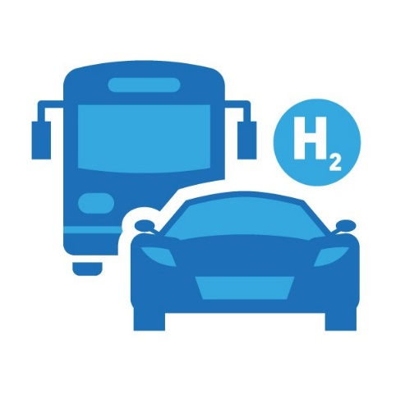
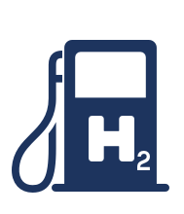
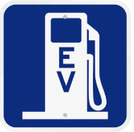
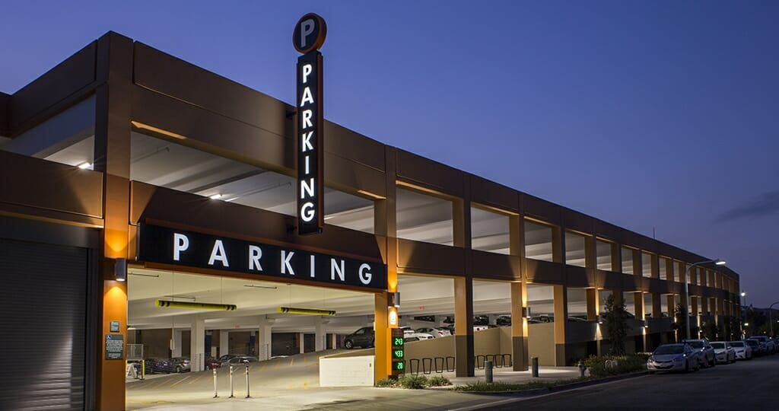


Near-term 802.11 use case #1
Use Wi-Fi for “over-the-top” transaction services
EV/HSV joins site Wi-Fi® network, negotiates fueling service parameters
On-site edge services platform directs AFV to fueling bay
Cloud-based services platform coordinates with energy market
Coupling to fueling device might be robotic, controlled via Wi-Fi
Fueling control could be via Wi-Fi as well

Slide 9
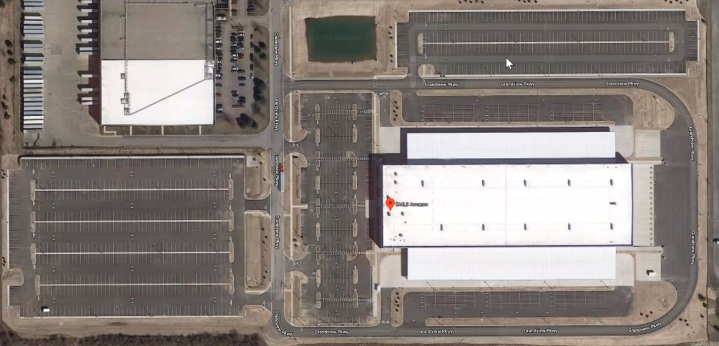
Near-term 802.11 use case #2
Use Wi-Fi® for large-scale EV (AC) charging
800 parking spots, 400 AC charging stations (6.6 kW)
Medium/long dwell (4-10 hour) charging
Wi-Fi applications
  Replace PLC (L1/L2)
  Managed charging
  Data (logistics & tracking)
  EV (ECU) maintenance

Slide 10
802.1 & 802.3 opportunities
How could 802.1 and 802.3 standards support AFV fueling?
  Convergence/concentration of energy & data for transportation
  Support for fueling, power/energy distribution, logistics, operations
  Sites/locale: depots, ‘truck stops’, public transport hubs (LAN/MAN)
Architecture
  Distributed energy, computing, control
  Coordinated security contexts
    Fueling: vehicle, dispenser, energy sources and sinks; safety-critical?
    Data: public/private, site/region, cooperating entities; trust domains
  Orchestration of workloads between edge/cloud
Applications:
  SPE in EV charging cables/couplers, for sensors (situational awareness)
  Power system controls (e.g. protection, UPS, load management)
  Data services (Internet/media, goods tracking, mobility services)

Slide 11
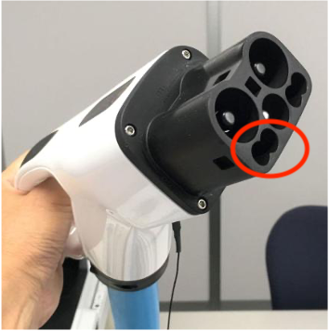
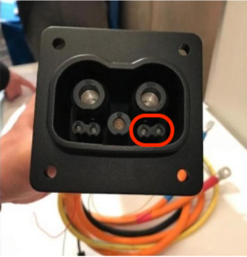
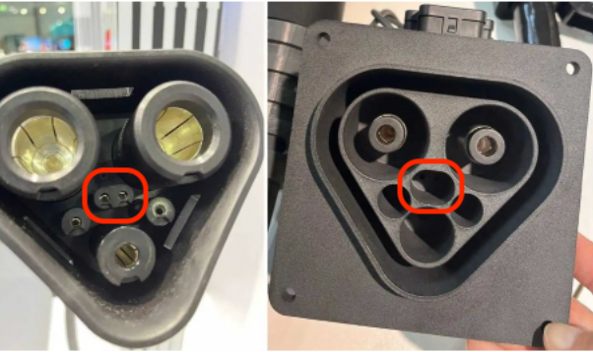
Near-term SPE use case (x2)
Use 802.3 (SPE) for control and management of high-power EV charging systems
Both couplers have 2x pins with ~8mm spacing for comms
CHAdeMO/ChaoJi have validated “Two-wire Ethernet” over these pins
MCS group is exploring alternatives to BPLC (CAN bus, 10Base-T1S, ??)
ISO 15118-10 launched (req’ts for Ethernet PHY/MAC for EV charging)
CHAdeMO 3.0 aka ChaoJi
Megawatt Charging System (MCS)

Slide 12

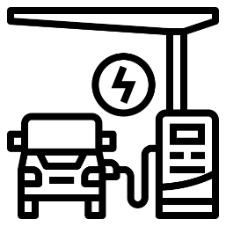



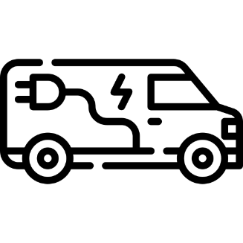




AFV ‘fueling edge network’
HPC (high-power charging) bays
Energy/Fueling Mgmt Server
AC charging Wi-Fi network
Security Manager (KMS, PKI ICA)
Workforce Comms AP
Edge/Cloud GW
Logistics App Server
Asset Mgmt Server
Charging Depot/Hub Local Area

Slide 13
Potential relevance of TSN for AFV Fueling
Critical transportation hubs must be robust and reliable
  In normal and emergency operational conditions
  Applies to charging, cybersecurity, data services
Time Synchronization for power system control
  Protection (sub-AC-freq reaction times, faster)
  Hi-fidelity data for anomaly detection, analysis, mitigation
  Coordination of distributed (local) sources and sinks
  Next-gen switchgear; integration of site w/utility grid

Slide 14




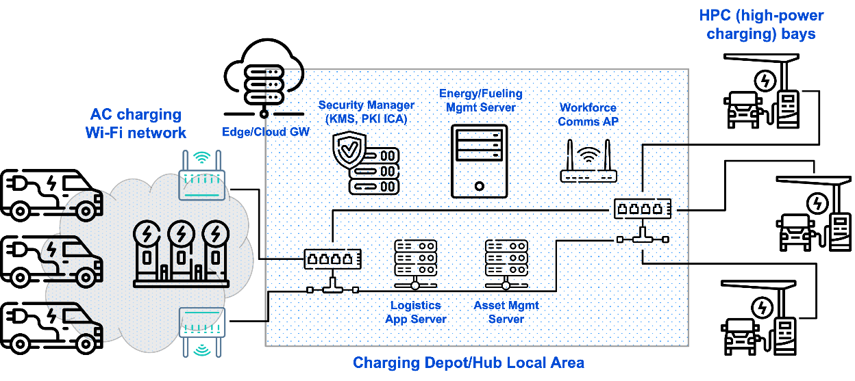


EV charging edge node in (energy systems) context
Enterprise operations
Utility operations
Customer wind
Utility solar
Customer solar
Feeder
Customer storage
Substation
Local resources
(e.g. building/site EMS)
Utility-based resources
(distribution SCADA)

Slide 15
In summary
Invitation: come join us in 802.24, explore the
AFV Fueling Vertical Opportunity for IEEE 802
Questions, Discussion

Slide 16
Thank you very much!
c.rodine@ieee.org
crrodin@sandia.gov

