Slide 1
SBP Indication in Measurement Setup
Date: 2023-01-14
Authors:
Name | Affiliations | email
Debashis Dash | Apple | debashis_dash@apple.com

Slide 2
Introduction
In a SBP procedure, the AP performs WLAN sensing when requested by a SBP initiator
The responder(s) cannot identify if the request for the measurement setup is for a WLAN sensing or SBP sensing session
Since any sensing capable associated node can send the SBP request, this is a potential security and privacy issue
We propose to include a SBP indication in the sensing setup request frame

Slide 3
Background: Problem
SBP Initiator sends a SBP request frame to the AP to setup a SBP sensing
This contains SBP Parameters element which contains Sensing responder addresses
This information helps the AP in Responder selection
When responders get a sensing request from the AP
The responder(s) cannot identify if the request for the meas. setup is for a WLAN sensing or SBP sensing session
The responder(s) have no idea who is the SBP initiator

Slide 4
Background: Use Case
An un-associated STA can send a SBP request to the AP
A STA that had previously joined the network can send a SBP request to the AP
Use case: Security hub + 11bf capable sensor setup (all are non-AP STAs from 11bf perspective)
Security hub sends SBP request to the AP
11bf capable sensors accept the request only when it comes from the Hub
Assuming no coordination of the AP and the security system

Slide 5
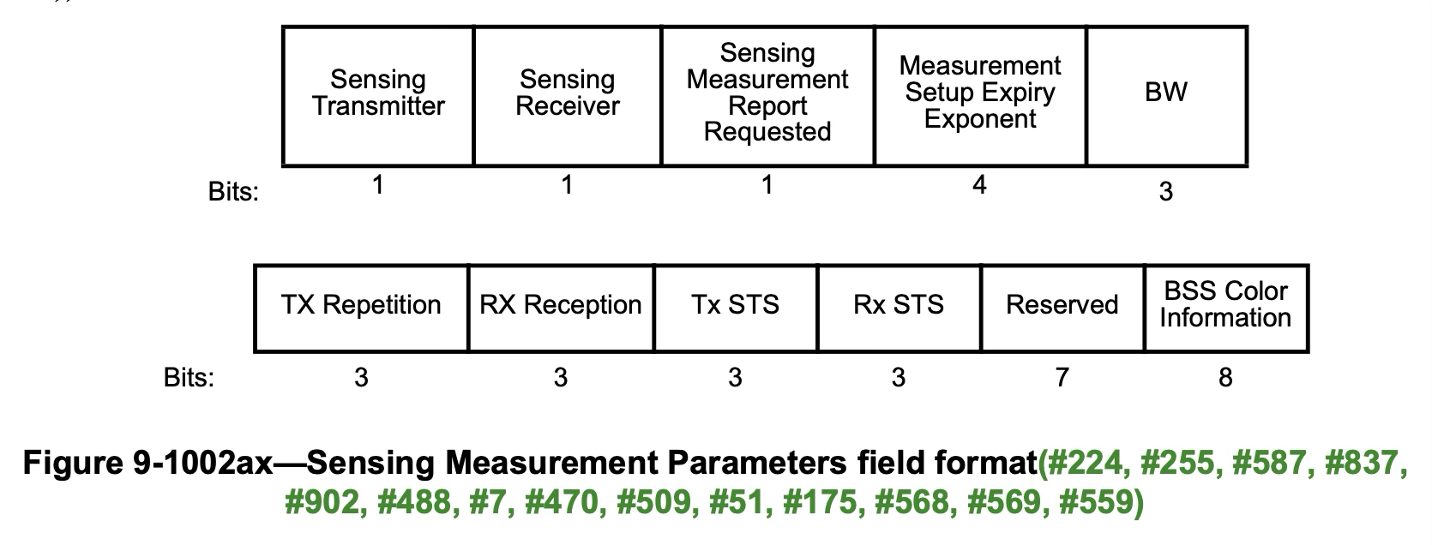
Proposal
SBP Procedure
Indicator
Reserved
1
9
SBP Procedure Indicator = 1 when the setup is a part of a SBP procedure
SBP Procedure Indicator = 0 otherwise
7/10

Slide 6
Straw Poll #1
Do you agree to include a SBP procedure indicator sub-field (1 bit) to the sensing measurement parameters field?

Slide 7
Straw Poll #2
Do you agree to add a SBP Initiator identifier (e.g. AID/USID) to the sensing measurement setup?

