Slide 1
Thoughts on Utilizing mmWave
Date: 2022-01-11
Authors:
Name | Affiliations | Address | Phone | email
Mengshi Hu | Huawei |  |  | humengshi@huawei.com
Zhi Mao |  |  |  | maozhi3@huawei.com
Ming Gan |  |  |  | ming.gan@huawei.com
Bo Gong |  |  |  | gongbo8@huawei.com
Xiaoqian Liu
Xiaofei Bai
Ross Jian Yu
Yan Xin
Genadiy Tsodik

Slide 2
Introduction
As an efficient way to improve throughput and latency performance, utilizing the high frequency bands (i.e. mmWave) of 45 GHz and above has been recently discussed in Ultra High Reliability (UHR) SG:
DCN | Discussions Related to mmWave [1]-[10]
22/1395 | Discusses challenges and provides possible numerologies based on sub-7 GHz for mmWave
22/1466 | Use an upclocked version of sub-7 GHz for mmWave
22/1566 | Need more discussions on choosing a unified PHY or having an independent mmWave design
22/1580 | mmWave is very interesting from an enterprise perspective
22/1595 | Reuse as much as possible the low band baseband and design
22/1804 | mmWave may risk evolution path of mainstream WLAN
22/1865 | Discusses the phase noise impact in details
22/1872 | Show views on GI, SU/MU MIMO, MCS, bandwidth, etc.
22/1884 | Should focus on the least complexity solution to enable mmWave in UHR
22/1924 | Suggest weighing the pros and cons before deciding on mmWave feature
We believe mmWave is a promising feature helping reach some of the UHR objectives. In this presentation, we further present some views on utilizing mmWave.

Slide 3
Thoughts on mmWave Implementation
Utilizing mmWave has the following advantages:
  Resolve the spectrum problem of using 6 GHz band in some countries
  Achieve the UHR goal on high throughput and low latency
  Product advertising
  High frequency reuse in enterprise networks
Reusing the baseband and designs of low band as much as possible is a good direction to go.
  Benefits: Cost efficiency & Fast implementation
  Can reuse the frequency domain processing part such as the channel equalizer, phase tracking, etc. Many modules such as the encoding, decoding, parser, interleaving parts can be reused.
  To minimize the influence of carrier frequency offset (CFO) and phase noise (PN) in mmWave, an upclocked version can be used.
  The time domain part such as the frame detection, CFO correction, timing synchronization might need some updates to adjust the changed sampling rate.
  In the subsequent slides, we further discuss the upclocked PPDU based on 802.11ac considering the impacts of CFO, PN and PA.

Slide 4
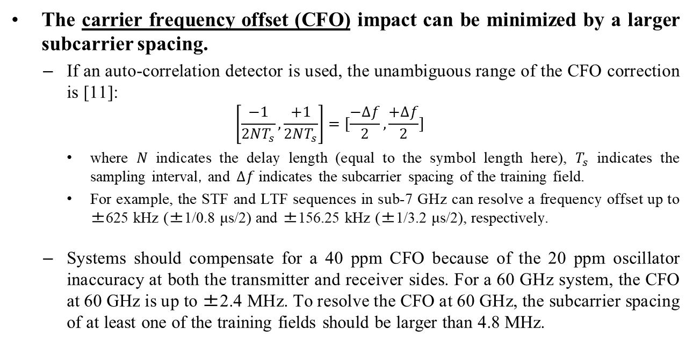
CFO
The carrier frequency offset (CFO) impact can be minimized by a larger subcarrier spacing.
  If an auto-correlation detector is used, the unambiguous range of the CFO correction is [11]:
  $$\left[\frac{−1}{2NT_{s}}, \frac{+1}{2NT_{s}}\right]=[\frac{−∆f}{2},\frac{+∆f}{2}]$$
  where $N$ indicates the delay length (equal to the symbol length here), $T_{s}$ indicates the sampling interval，and $∆f$ indicates the subcarrier spacing of the training field.
  For example, the STF and LTF sequences in sub-7 GHz can resolve a frequency offset up to ±625 kHz (±1/0.8 μs/2) and ±156.25 kHz (±1/3.2 μs/2), respectively.
  Systems should compensate for a 40 ppm CFO because of the 20 ppm oscillator inaccuracy at both the transmitter and receiver sides. For a 60 GHz system, the CFO at 60 GHz is up to ±2.4 MHz. To resolve the CFO at 60 GHz, the subcarrier spacing of at least one of the training fields should be larger than 4.8 MHz.

Slide 5
PN and PA
The phase noise (PN) impact can be minimized by a larger subcarrier spacing and pilot designs.
  The inter-carrier interference (ICI) and common phase error (CPE) caused by PN can be minimized by a larger subcarrier spacing and pilot designs [12], [7].
Nonlinearities in power amplifiers (PA)
  The amplitude and phase of a signal are affected in the saturation region of a PA. Output backoff (OBO) and digital pre-distortion (DPD) can be used to mitigate the influence [13], [14].

Slide 6
Simulation Configuration
To verify whether an upclocked sub-7 GHz PPDU version (such as 11ac) works well in a mmWave scenario, we further have some simulations with consideration of the above hardware impairments.
Simulation Parameters
Parameter | Description
MCS | MCS 0 (BPSK), MCS 1 (QPSK), and MCS 4 (16 QAM)
PPDU type | VHT format (11ac)
Channel model | 802.11ad channel model (conference room, CR)
TX/RX | 1T1R
Fc | 73.44 GHz (Channel #8 of 802.11ay)
Packet size | 4096 Bytes
Other considerations | CFO, PN, and PA

Slide 7
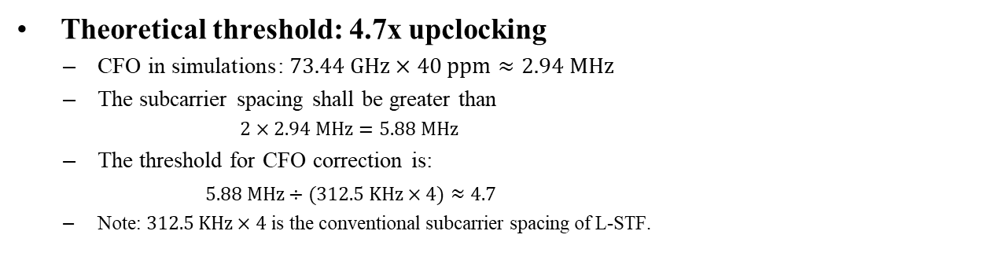
CFO Impact Simulation
Theoretical threshold: 4.7x upclocking
  $\text{CFO} \text{in} \text{simulations}$: $73.44 GHz×40 ppm$ $≈2.94 MHz$
  The subcarrier spacing shall be greater than
  $2×2.94 MHz=5.88 MHz$
  The threshold for CFO correction is:
  $5.88 MHz÷(312.5 KHz×4)≈4.7$
  Note: $312.5 KHz×4$ is the conventional subcarrier spacing of L-STF.
SNR = 15 dB (4x upclocking)
SNR = 15 dB (16x upclocking)

Slide 8
PN Impact Simulation
  8x upclocking of 11ac
  MCS = 4 (16 QAM)
PN related parameters
  PSD0 = -93 dBc/Hz, fp = 1 MHz, fz = 100 MHz [15]
SNR=30 dB, without PN
Adding PN
Applying phase tracking

Slide 9
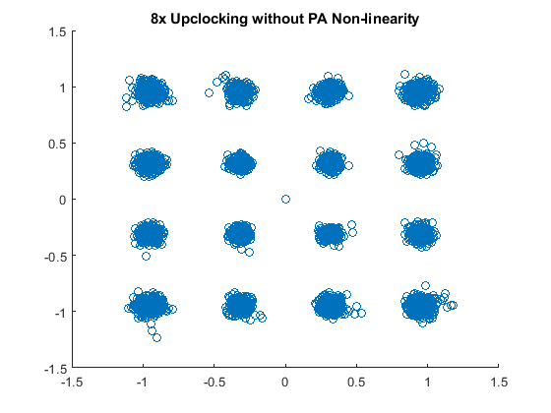
PA Impact Simulation
  8x upclocking of 11ac
  MCS = 4 (16 QAM)
PA related parameters
  PA backoff: 8 dB [16]
  PA non-linearity model: Modified Rapp model [16]
SNR = 20 dB
Adding PA

Slide 10
Hardware Impairment Simulation
The figure below shows the PER performance with consideration of CFO, PN and PA.
Suggestions
  An upclocking version (8x, 16x, or a larger one) of 802.11ac PPDUs can be considered in UHR, and the 4x upclocking version should not be used.
  The PER performance improves with the increase of subcarrier spacing for high MCSs. Note that the selection of the upclocking value should also take the increased sampling rate into consideration.
  Supporting low MCS is necessary to overcome the impairment impacts.
PN: PSD0 = -93 dBc/Hz
PN: PSD0 = -93 dBc/Hz & -90 dBc/Hz

Slide 11
Summary
We believe mmWave is a promising feature helping reach the UHR objectives.
  An upclocked version of 802.11ac PPDU can be used to achieve mmWave communication.

Slide 12
References
[1] Myeongjin KIM, et al. Thoughts on high frequency band, 802.11 DCN 2022/1395r0
[2] Eunsung Park, et al. Potential PHY Features for UHR, 802.11 DCN 2022/1466r0
[3] Sigurd Schelstraete, et al. Views on UHR, 802.11 DCN 2022/1566r0
[4] Brian Hart, et al. A Perspective On Proposed Uhr Features For Enterprise Use Cases, 802.11 DCN 2022/1580r1
[5] Laurent Cariou, et al. Some questions to answer in the SG, 802.11 DCN 2022/1595r1
[6] Vinko Erceg, et al. Band Complexity Discussion, 802.11 DCN 2022/1804r0
[7] Miguel Lopez, et al. Considerations on the PHY for 60 GHz, 802.11 DCN 2022/1865r1
[8] Eunsung Park, et al. Considerations on PHY designs for mmWave band, 802.11 DCN 2022/1872r0
[9] Eunsung Park, et al. mmWave operation for UHR, 802.11 DCN 2022/1884r0
[10] Xiaofei Wang, et al. Thoughts on UHR Features, 802.11 DCN 2-22/1924r0
[11] Yong S K, Xia P, Valdes-Garcia A. 60GHz Technology for Gbps WLAN and WPAN: from Theory to Practice[M]. John Wiley & Sons, 2011.
[12] Armada A G. Understanding the effects of phase noise in orthogonal frequency division multiplexing (OFDM)[J]. IEEE transactions on broadcasting, 2001, 47(2): 153-159.
[13] Rappaport T S, Heath Jr R W, Daniels R C, et al. Millimeter wave wireless communications[M]. Pearson Education, 2015.
[14] Yang X, Matthaiou M, Yang J, et al. Hardware-constrained millimeter-wave systems for 5G: challenges, opportunities, and solutions[J]. IEEE communications magazine, 2019, 57(1): 44-50.
[15] Chang-Soon Choi, et al. RF impairment models for 60GHz-band SYS/PHY simulation, 802.15 DCN 2006/477r1
[16] Laurent Cariou, et al. TGay Evaluation Methodology, 802.11 DCN 2016/0866r2

