Slide 1
Discussion on S1G regulation requirements
January 2023
Doc.: IEEE 802.11-23/0064r0
Date: 2023-01-11
Authors:
Name | Affiliation | Address | Phone | Email
Weijie Xu | OPPO |  |  | xuweijie@oppo.com
Yinan Qi |  |  |  | v-qiyinan@oppo.com

Slide 2
Outline
January 2023
Doc.: IEEE 802.11-23/0064r0
Background
Proposal on S1G regulations for AMP

Slide 3
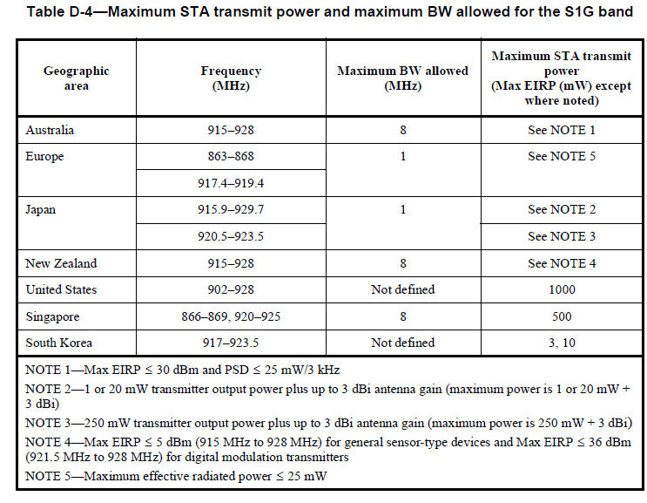
Background
January 2023
Doc.: IEEE 802.11-23/0064r0
For S1G, there has already frequency band regulation requirement as specified in 802.11 amendment.
There are also regional regulations for the relevant frequency bands. e.g., the regulation for China[1], EU[2] and US[3].

Slide 4
Proposal on S1G regulations for AMP
January 2023
Doc.: IEEE 802.11-23/0064r0
Proposal 1: For most of the regions, follow the S1G regulations.
Proposal 2: For China, follow the regulation for 920MHz~925MHz(i.e., that for RFID).
Proposal 3: For EU, South Korea etc., seek the possibilities to follow the regional regulation on the relevant frequency bands.
Different channelization may be required., e.g., the channel bandwidth may be different for different regions.
Fortunately, simple waveform such as OOK ( also what WUR uses) is not sensitive to the channel bandwidth.

Slide 5
Reference
January 2023
Doc.: IEEE 802.11-23/0064r0
http://www.srrc.org.cn/article29539.aspx
https://www.etsi.org/deliver/etsi_en/302200_302299/302208/03.03.01_60/en_302208v030301p.pdf
https://www.ecfr.gov/current/title-47/chapter-I/subchapter-A/part-15/subpart-C/subject-group-ECFR2f2e5828339709e/section-15.247

