Slide 1
The discussion on pre-association schemes
Date: 2023-01-13
Authors:

Slide 2
Background-1
Device ID approach was proposed by 11bh group to address the trouble shooting use case
→ Does AP & STA vendor have the strong motivation to implement it if only one use case is addressed?
The intention of pre-association identification is to meet Wi-Fi interstudy requirement.
→ use case in WBA&WFA: client steering, VBSS implementation, etc.
The group shows strong support to have an extra scheme to cover the pre-association use case based on the SP results in previous meetings (e.g. the last plenary meeting in Bangkok in Nov 2022)
→ Do you support TGbh working on adding an additional mechanism to support identification prior to association (or at Association Request)?
Y: 17 N: 4 Abs: 7
11bi group is less interested in returned STA identification & protection, therefore pre-association identification for returned STA should be addressed in 11bh group.

Slide 3
Background-2
RCM implementation that enables STA to use any random MAC address in the MAC header probably is open to some DoS attacks.
→The 3rd party can flood the authentication/association request frames to the AP, and AP has to respond with authentication/association response frames, which will cause the serious performance issue on AP side.
→The pre-association scheme possibly can address such issue. e.g. set a allow list on AP side, AP won’t send Auth/association response if it’s not a pre-configurated STA or a returned STA.

Slide 4
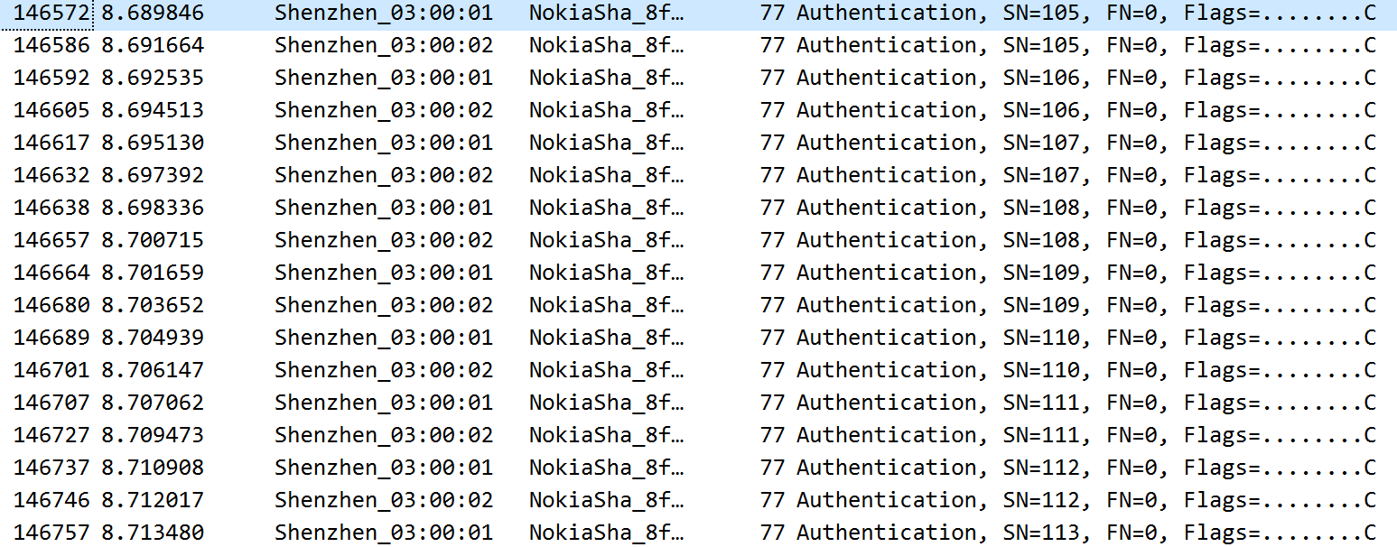
DoS attack shown in Sniffer log

Slide 5
Several pre-association solutions on the table
Solution list:
→Old IRMA: 11-22/1626-- IRMA with IRMK
→MAAD: 11-22/0928r1 – MAAD Text for TGbh
→New IRMA: 11-22/895r1 -Draft text IRMA 3
→ID encoding: 11-22/2013r1 – ID encoding in pre-schemes
→RRCM: 11-22/1079r8 – CR for STA generated ID :Opt1
→e-RRCM: 11-22/1079r8 – CR for STA generated ID :Opt 2

Slide 6
Security concern on pre-association scheme
11bh group already defined the device ID approach
→the identifier exchanged under the security context(KDE is encrypted by PTK)
→benefit: no replay attack, no identifier copy issue, no spoof AP issue
The pre-association scheme should provide the similar security context as the device ID has.
→the identifier should be exchanged in encrypted IE or the identifier should be the unique key.
→the identifier should not be exposed in the air, even if it’s one time identifier.
→no extra security issue

Slide 7
Summary
11bh group should define a pre-association identification solution to meet it’s target.
Several candidate solution is already on the table
→We should vote for the direction first among these candidate solutions.

Slide 8
SP
Do you prefer “pre-association identification” (non-4-way handshake scenarios) to be communicated via an IE (or similar frame body protocol), or MAC Address?
→Opt1:IE/frame body
→Opt2: MAC Address
→Opt3: Abstain
Note: candidate solutions for Opt1: Old IRMA, e-RRCM, ID encoding
candidate solutions for Opt2: new IRMA,MAAD, RRCM

