Slide 1
Layered QoS and multi-layer transmission follow-up
Date: 2023-03-12
Authors:
Name | Affiliation | Address | Phone | Email
Ross Jian Yu | Huawei |  |  | ross.yujian@huawei.com
Anqi Wei
Wei Ruan
Mengyao Ma
Ying Li
Dan Wang
Ming Gan

Slide 2
Recap
In [3], a detailed description on cloud VR use case have been presented, which needs high requirement on Tput and latency. Moreover, two aspects regarding latency reduction have been presented:
  QoS enhancement
  Unequal error protection (multi-layer/coding transmission)
In [1], we show multi-layer transmission has the following benefits:
  Provide different protections for frames of different importance.
  Take advantage of the channel selective gains
  Good for interference environment, errors happened in one RU layer doesn’t affect the other RU.
There were some comments received regarding the simulation results we show for MC (Multiple Coding)-MIMO vs SU-MIMO. In this contribution, further simulation results are provided in response to those comments. Simulation results for an interference environment are also provided.

Slide 3
Simulation setup – MC-MIMO vs SU-MIMO – 4T4R
In previous simulations, we show the comparison of 4Tx, 4Rx, 4SS transmission between MC (Multiple Coding)-MIMO vs SU-MIMO where MC code can apply different MCS on different streams. Different PSDU are transmitted in different streams. The MC-MIMO shows at least 10%~15% gain over SU-MIMO.
We receive the following comments regarding the simulations:
  For baseline SU-MIMO, 3SS sometimes can achieve higher Tput than 4SS for a 4Tx, 4Rx transmission.
  With unequal power allocation (waterfilling), the baseline SU MIMO can achieve better performance.
Hence in this simulation, we compare the following four cases:
  MC-MIMO
  SU-MIMO 4SS (with equal power)
  SU-MIMO 3SS (with equal power)
  SU MIMO 4SS with unequal power*
  SU MIMO 3SS with unequal power*
  Other parameters are the same as before: 4 Tx and 4 Rx, 20MHz channel
  The simulations are based on real measured channels.
*With unequal power allocation, the transmit power imbalance of each antenna increases. The power of some RF channels may exceeds a preset value, and the power of some channels is not fully used.

Slide 4
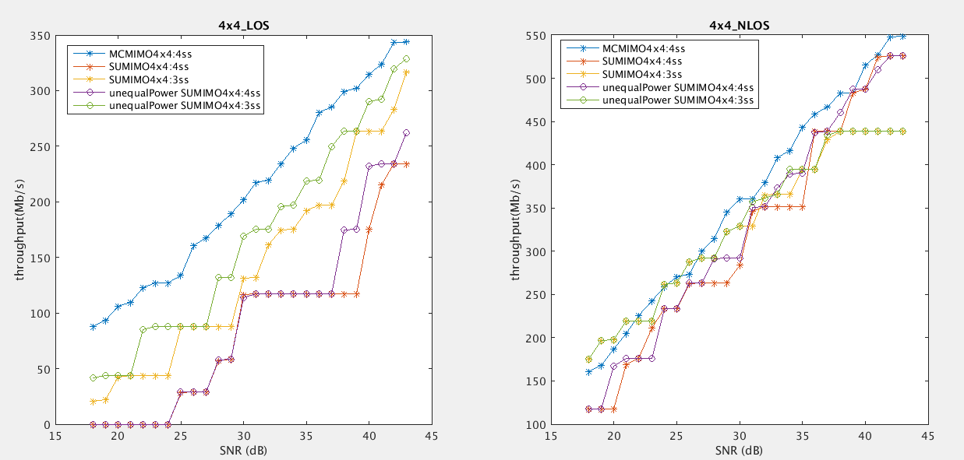
Simulation results – MC-MIMO vs SU-MIMO – 4T4R
  X-axis: channel SNR, Y-axis: Tput
MC-MIMO still shows obvious gain over baseline SU-MIMO through the SNR range of interest for the LOS case and most of the SNR range for the NLOS case.

Slide 5
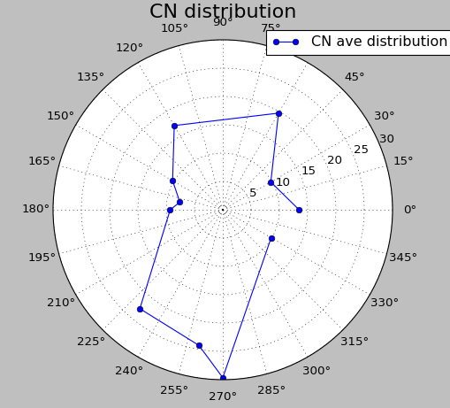
Simulation setup – MC-MIMO vs SU-MIMO – 2T2R
We received further comments to show the performance for 2SS case.
We further compare the following three cases:
  MC-MIMO 2SS
  SU-MIMO 2SS (with equal power)
  SU-MIMO 1SS (with equal power)
  Other parameters are the same as before: 2 Tx and 2 Rx, 20MHz channel
The simulations are based on a real channel. Three directions with different condition number (CN) number are chosen:

Slide 6
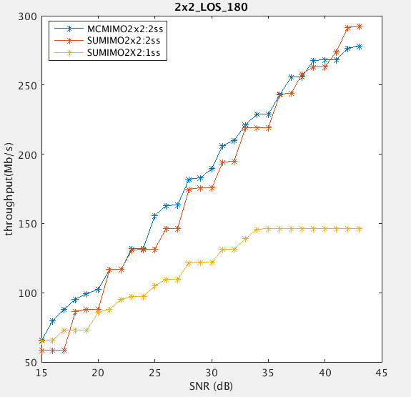
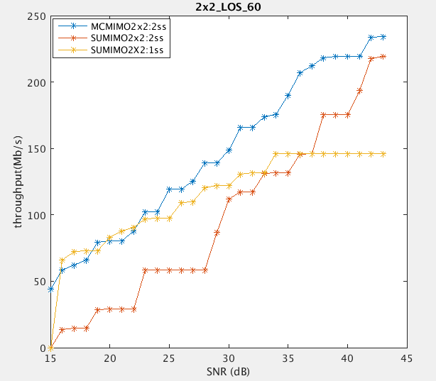
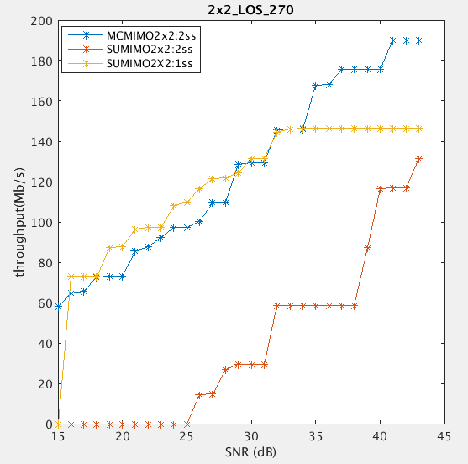
Simulation results – MC-MIMO vs SU-MIMO – 2T2R
CN: 4.8
CN: 20
CN: 30
  X-axis: channel SNR, Y-axis: Tput
MC-MIMO still shows obvious gain over baseline SU-MIMO.

Slide 7
Simulation setup – MC-MIMO vs SU-MIMO – 4T2R
We received further comments to show the performance for 2SS case.
We further compare the following three cases:
  MC-MIMO 2SS
  SU-MIMO 2SS (with equal power)
  SU-MIMO 1SS (with equal power)
  Other parameters are the same as before: 4 Tx and 2 Rx, 20MHz channel
The simulations are based on a real channel. Three directions with different CN number are chosen: 5, 10, 15.

Slide 8
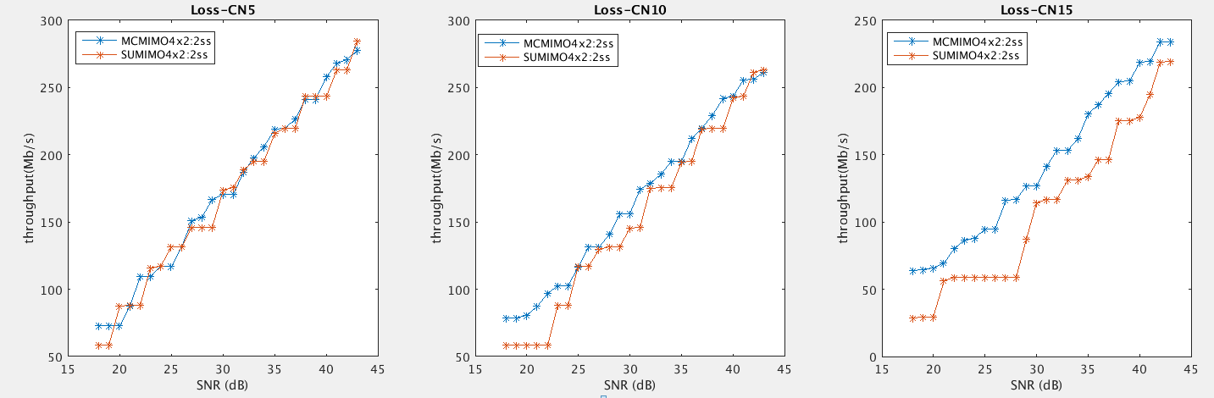
Simulation results – MC-MIMO vs SU-MIMO – 4T2R
CN=5
CN=10
CN=15
  X-axis: channel SNR, Y-axis: Tput
MC-MIMO shows gain over baseline SU-MIMO when CN is 10 or 15, whilst usually CN<10. In general, no obvious gain.

Slide 9
Simulation setup – Independent coding MRU vs joint coding RU/MRU
Simulation results for interference environment are also provided.
The total bandwidth is 80 MHz, AWGN channel. The Power RSSI is -50dBm. The interference is added to the upper 40 MHz (defined as RU 1). The interference occupies 50% and 90% of the total time respectively.
Three cases are compared:
  SU case: joint coding over the whole bandwidth, following the current procedure
  SU Punc case: joint coding over the non-interfered potion of the total bandwidth (lower 40 MHz, defined as RU 0). More accurately, this is a smaller bandwidth transmission.
  MRU case: independent coding MRU case, the data is encoded separately in RU 0 and RU1.
1T1R. Throughput is optimized regarding all supported MCSs.
Interference
Upper 40 MHz, RU 1
Lower 40 MHz, RU 0

Slide 10
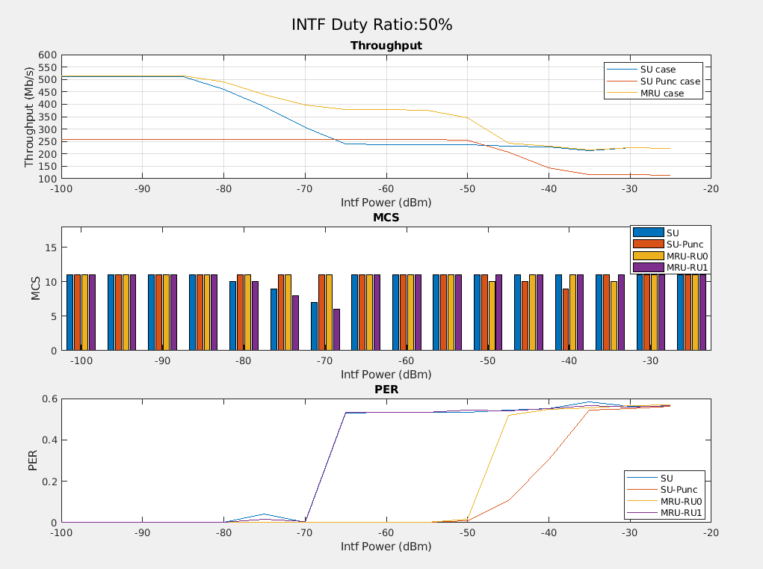
Simulation results – Independent coding MRU vs joint coding RU/MRU
Independent coding MRU case shows obvious throughput gain compared with SU case and SU punc case.

Slide 11
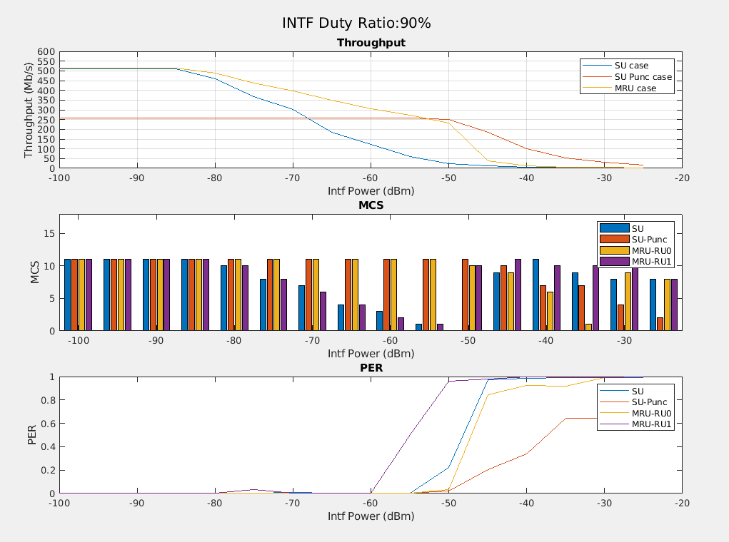
Simulation results – Independent coding MRU vs joint coding RU/MRU
Independent coding MRU case shows obvious throughput gain compared with SU case and SU punc case.

Slide 12
Summary
In this contribution, we show more simulation results to show the benefits of multi-layer transmission regarding two aspects:
  Multi-layer over spatial domain: taking advantage of the channel selective gain
  Multi-layer over frequency domain: Tput gain in interference scenario.

Slide 13
Reference
[1] 11-22/1930r0, Layered QoS and multi-layer transmission
[2] 11-22/1518r0, 802.11 UHR SG Proposed PAR, Ming Gan et.al., Huawei
[3] 11-22/0952r0, Cloud VR use case and requirements, Ross Jian Yu et.al., Huawei

Slide 14
Appendix

Slide 15
Multi-layer transmission
In [2], it mentions multi-layer transmission is one kind of unequal error protection at PHY layer that can provide different robustness to different services.
  The base layer (I frame) is protected better with lower rate whilst the enhancement layer (P/B frame) is protected with higher rate.
  Multi-layer transmission can achieve a good tradeoff between data rate and robustness. It can further reduce transmission latency.
One way of enabling unequal error protection (UEP) is to use different MCS for different frames in different PPDUs (time domain). An alternative way is to enable multiple PSDUs with different MCS within one PPDU.
Control Info
I frame
P/B frame
Other frame
In different SSs/RUs/
Constellation points
PHY
Resources
PHY
Resources
PHY
Resources
PHY
Resources
Multi-layer transmission (QAM, coding rate, NSS, ReTx times)
PPDU

Slide 16
Multi-layer transmission
Besides UEP for frames of different importance, multi-layer transmission can also take good advantage of the channel selective gain (e.g., divergence of eigenvalues between different spatial streams).
In 11n, UEQM (unequal modulation) MIMO enables different QAMs for different streams with the same coding rate. Here, we further assume coding rate can also be different. Below is an example.
Tput/MCS
Figure: MC (Multiple Coding)-MIMO vs SU-MIMO
MCS11
vs
MCS6
Legend
Post SNR
Tput of SSx for MC-MIMO
Tput of SSx for SU-MIMO
MCS10
vs
MCS6
Post SNR
SS0
MCS9
vs
MCS6
Post SNR
SS1
MCS6
vs
MCS6
Post SNR
SS2
SS0
SS1
SS2
Post SNR
SS3
SS3
PostSNR

Slide 17
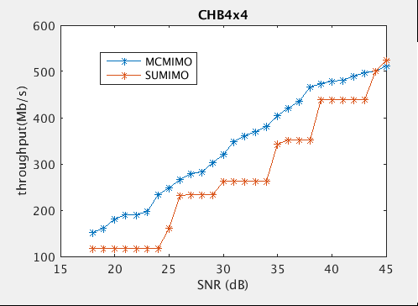
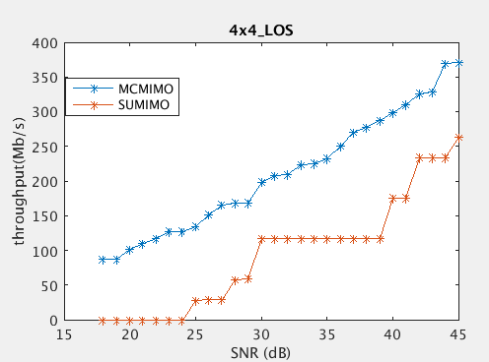
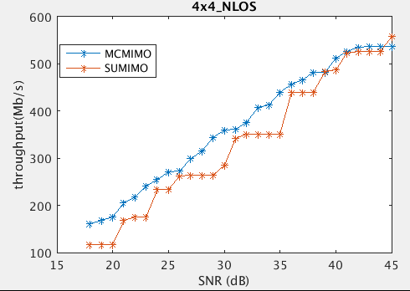
Multi-layer transmission
Below we show some simulation results comparing MC-MIMO and SU-MIMO.
  4 Tx and 4 Rx and a 4SS MIMO, 20MHz channel.
  X-axis: channel SNR, Y-axis: Tput
  MC-MIMO has 10%~15% gain over baseline SU-MIMO.
(a) Channel B
(b) Shielding room
(c) Home environment

Slide 18
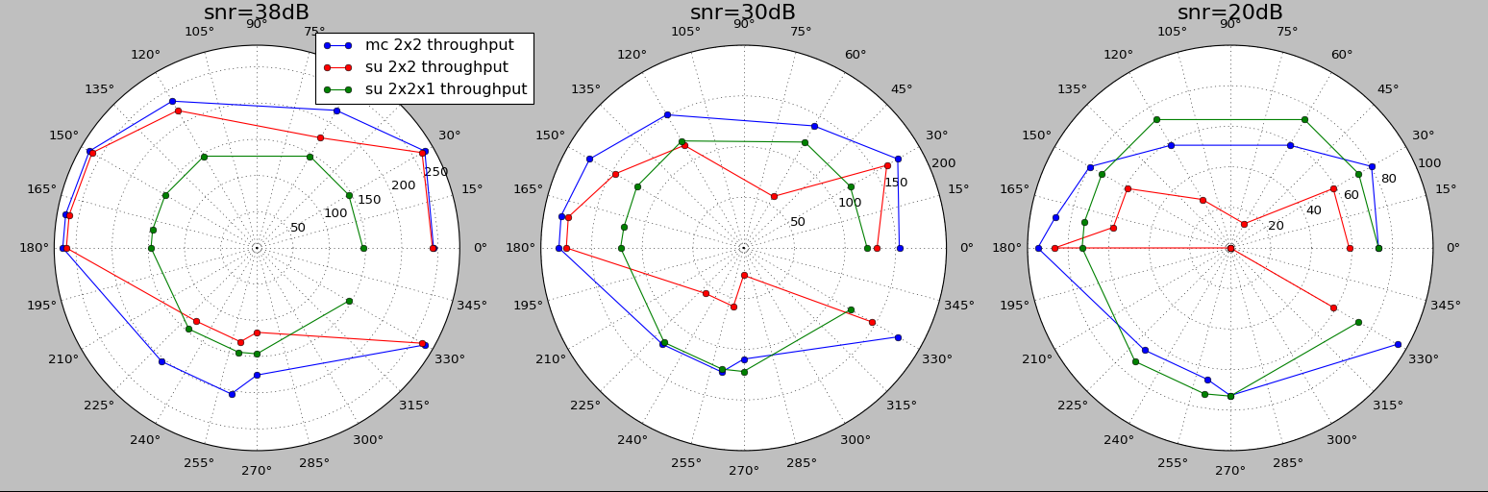
Multi-layer transmission
Below we also show some simulation results comparing MC-MIMO and SU-MIMO regarding different directions.
  2 Tx and 2 Rx and a 2/1 SS MIMO, 20MHz channel.
  Tput regarding different directions are compared (omni-direction antennas)

