Slide 1
Spatial Reuse in Coordinated M-AP for UHR
Date: 2023-01-15
Authors:

Slide 2
Introduction
Spatial reuse (SR) was introduced in 802.11ax and included in 802.11be
  Improving spectral efficiency and spectral usage in scenarios with high-density networks
If UHR supports coordinated Multi-AP, SR can be further improved and combined with other coordinated schemes
In this contribution we
  Recall basic SR schemes in 11ax/be and proposed coordinated M-AP concepts
  Propose some functions that could enhance SR in coordinated M-AP
  Discuss other features that may benefit from coordinated SR

Slide 3
Recap: Spatial Reuse in 11ax/be
Spatial Reuse: Reuse frequency resources among OBSSs
  Increase the opportunity of reusing the medium between OBSSs
Two basic SR modes
  OBSS PD-based Spatial Reuse: Achieving SR by changing the channel access threshold
    Two possible operations
      Non-SRG OBSS PD: Ignore an inter-BSS PPDU using a non-SRG OBSS PD level
      SRG OBSS PD: Ignore inter-BSS PPDUs that are identified as being SRG PPDUs using a SRG OBSS PD level
    Trade-off between sensitivity and Tx power
  PSR-based Spatial Reuse: Achieving SR during the TB transmissions in OBSS with limited the Tx power
    Need to decode trigger frame or TB PPDU in OBSS

Slide 4
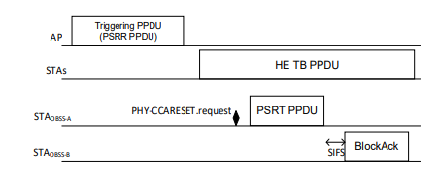
Issues with Existing SR modes
SR transmissions in both modes are “passive”
  STAs in different BSSs have no knowledge about their frequency resources being used
    STAs may suffer from packet losses – reduce reliability
Both modes do not concern how the signals in different BSSs are constructed and transmitted
  E.g., beamforming, preamble puncturing, etc.
  Over conservative can reduce SR opportunities
For PSR, a SR transmission (PSRT) may not cause interference to its neighbor BSS, but the response (e.g., BA) to the transmission may

Slide 5
Recap: Coordinated Multi AP [1]
Sharing AP: An AP which obtains a TXOP and initiates the multi-AP coordination
Shared AP: An EHT AP which is coordinated for the multi-AP transmission by the sharing AP
M-AP coordination: Share frequency resources with one or more APs within the AP candidate set over certain channel bandwidth allocated by a sharing AP in the BSS operating channel of the shared Aps, subject to
  Exchange measurements among APs
  Synchronized/organized operation within a TXOP
Different coordination schemes
  C-SR
  C-OFDMA
  C-BF
  JT
Construct and transmit the signals via reusing frequency resources among OBSSs

Slide 6
Possible enhancement to existing SR schemes in 11ax/be
OBSS PD
  OBSS PD-based spatial reuse with SRG can be constructed within coordinated M-APs
    E.g., the SR group is a subset of the M-AP coordinate set
  Simplifying SRG identification, for example,
    The information about OBSSs, e.g., BSS color and BSSID, within SRG can be obtained from the associated AP in advance
  More control on OBSS PD level and Tx power at all coordinated APs/STAs
    Trade-off of Tx powers and sensitivities among all SR BSSs

Slide 7
Enhancing Existing SR Schemes in 11ax/be (cont.)
Parameterized SR
  Obtaining SR information in OBSS transmission directly from associated AP, rather from decoded trigger frame or TB PPDUs
  Setting the Tx power upper bound more accurately based on reported Inter-OBSS SINR measurements and required/target SNR for certain QoS among multiple BSSs
  Achieving PSR during both non-TB and TB transmissions in OBSSs
  Allow more accurate PSR between transmissions in different OBSS with different channel bandwidth and puncturing patterns
  Allow synchronized transmissions among BSSs, including transmission responses
    E.g., Synchronized ACKs among BSSs

Slide 8
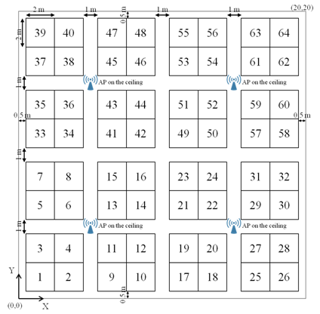
Expanding C-SR in other coordinated operations
Coordinated Beamforming [2]
  C-BF/Null steering with PSR
    Latency reduction
Coordinated OFDMA [3]
  Extend the SR at per-RU basis
  Based on intra- and inter-OBSS SINR measurements or threshold detections select resources and Tx power according to targeted SNRs
  Allow more flexible bandwidth selection, preamble puncturing in different OBSSs
Combining C-BF and C-OFDMA can achieve even better system performance
  Higher throughput and lower latency
80MHz
RU
RU
RU
RU
20MHz

Slide 9
Conclusion
M-AP sets the stage for advanced spatial reuse
UHR can take two directions for C-SR
  Enhance SR schemes in 11ax/11be
    Allow asynchronized coordination
    Avoid unexpected interference
  Expand SR for other coordinated M-AP operations, e.g., C-OFDMA and C-BF
    Allow synchronized coordination
    Reduce latency and increase system throughput

Slide 10
References
[1] 11-19/1262r23 Specification Framework for TGbe
[2] 11-20/0091r7 Performance of parameterized spatial reuse (PSR) with coordinated beamforming/null steering for 802.11be
[3] 11-20/1399r2 On Joint C-SR and C-OFDMA M-AP Transmission

