Slide 1
Coverage with realistic propagation for AMP IoT
Date: 2023-01-11
Authors:

Slide 2
Abstract
Evaluating link budget under realistic propagation conditions can reveal significant reduction in coverage for backscatter.
Coverage in a 3000 ft² residential is evaluated using a RF raytracing tool
Improvements in coverage through additional infrastructure, TX beamforming, backscatter device beamforming and joint transmission by infrastructure is evaluated and shows considerable coverage improvement

Slide 3
Background
Analysis of coverage under realistic propagation can reveal shortcomings of passive backscatter
RF raytracing can provide a realistic propagation model [1]
Multipath
Shadowing
Diffraction
Building geometry and materials accounted for

Slide 4
Propagation Scenario
Residential use case
recent North American construction “3000 sq ft”
dry wall/wood interior, brick exterior
3 levels, 456m² total interior area
Propagation evaluated at red dot locations
Infrastructure co-located TX and RX at blue dot(s)

Slide 5
Scenario Parameters
Assumptions:
tag is detector sensitivity limited
no power harvesting
RX is AWGN sensitivity limited
Sufficient ACR / self jamming suppression
Monostatic – TX/RX collocated
Backscatter only (no active TX) i.e. AMP IOT only device
Downlink TX and uplink TX using 802.11 AP- or non AP-STAs
Parameter | Value
Band | 2.4 GHz
TX total power (conducted), Single antenna | +30 dBm
Tag sensitivity | -35 dBm
Net backscatter efficiency (2-way) Incl switch loss, pol. mismatch, detuning | -7 dB
RX sensitivity | -95 dBm
# RX antennas | 2 with MRC
Bandwidth | 20MHz
Polarization | V V

Slide 6
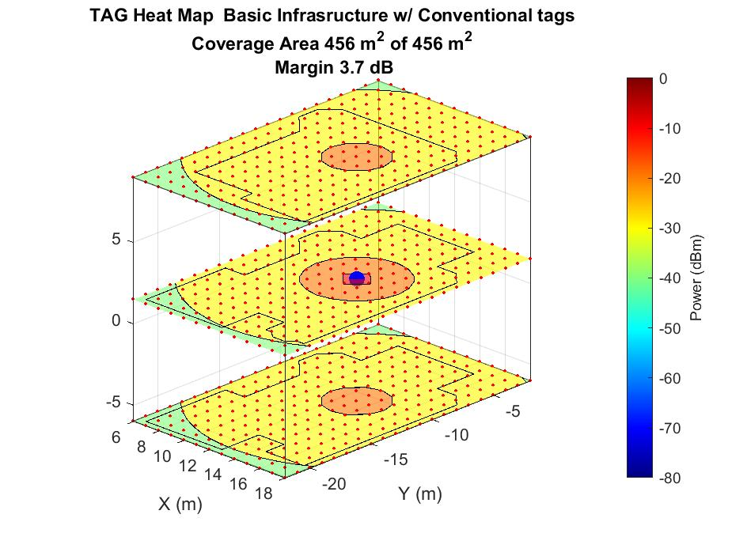
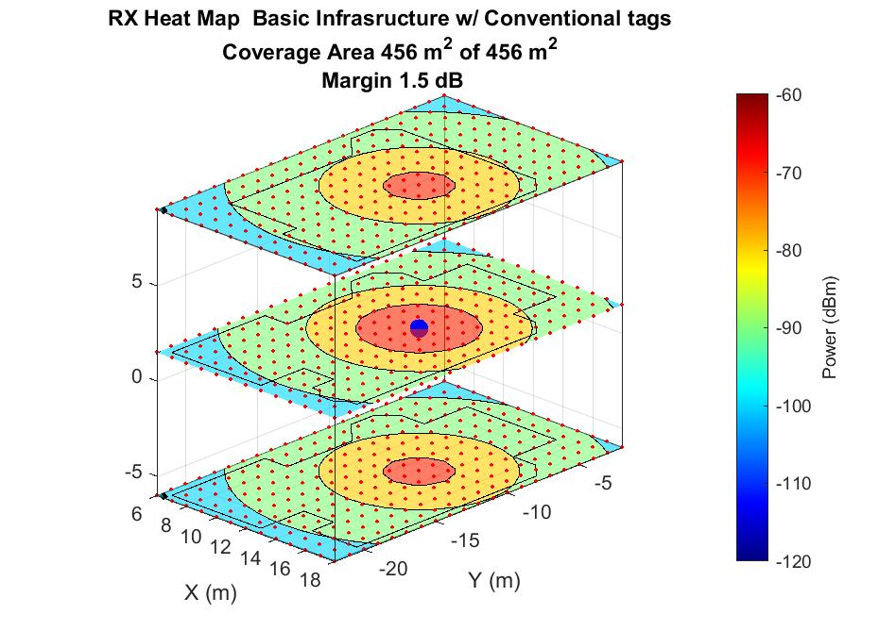
Downlink and Uplink coverage – Free space (FS)
Downlink power at tag
Uplink power at RX
Entire house is covered from a single TX/RX location

Slide 7
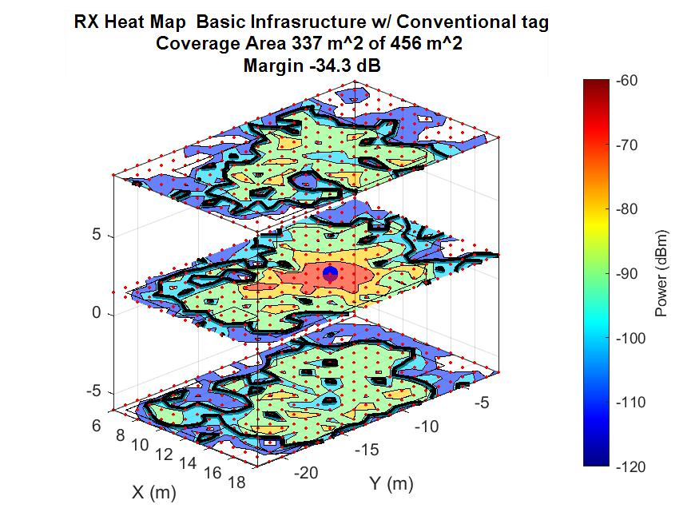
Downlink and Uplink coverage – Ray tracing
Downlink power at tag
Uplink power at RX
Only 74% covered from single TX/RX location with -34dB link margin

Slide 8
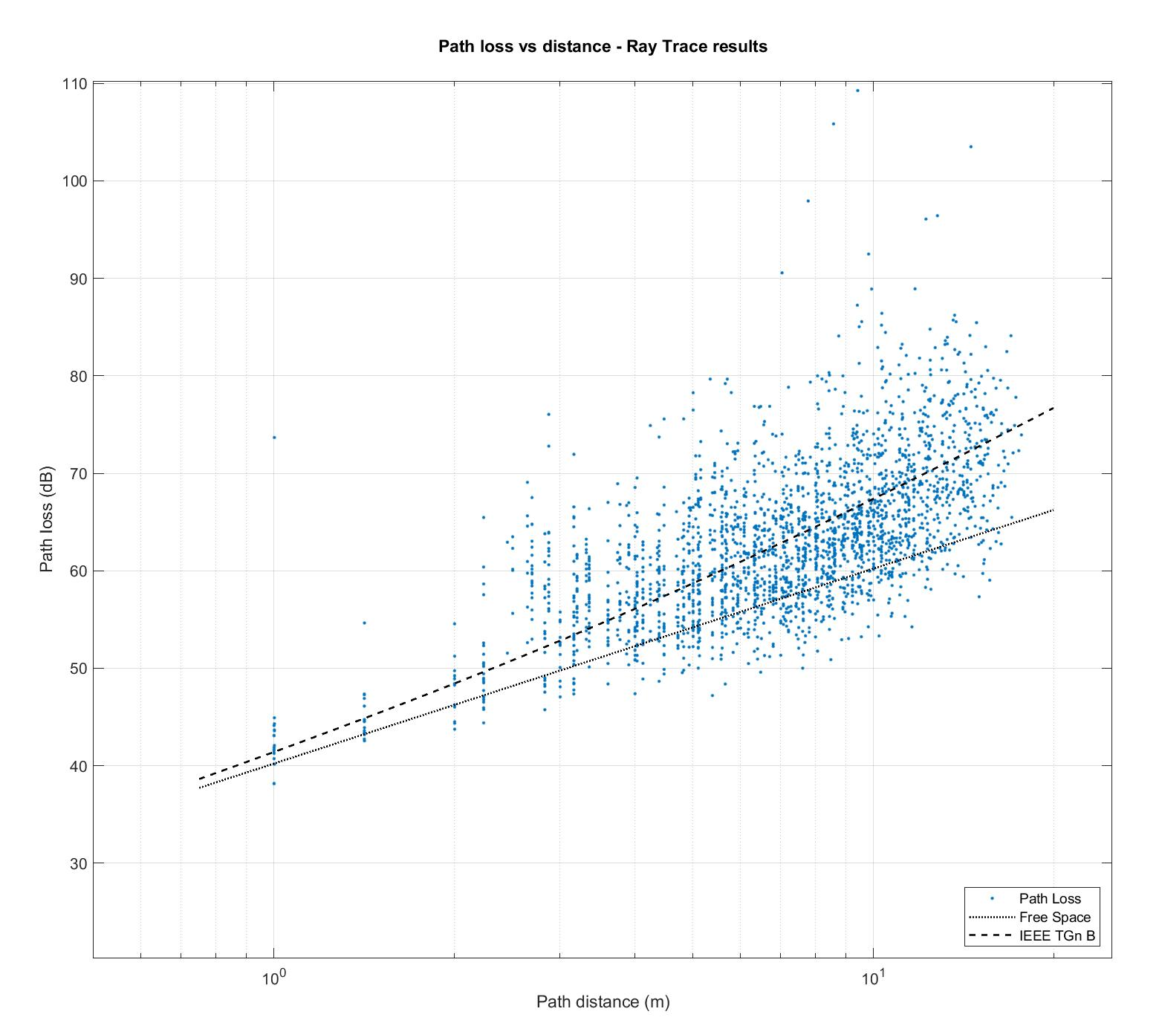
Realistic propagation with Ray tracing
One-way path loss vs distance
FS propagation is overly optimistic
does not include shadowing, multipath, diffraction etc.
IEEE.11 TGn propagation model provides mean path loss but sample loss is distributed with more than a 20 dB spread above and below
With ray tracing model we can see that we have insufficient coverage without taking further steps

Slide 9
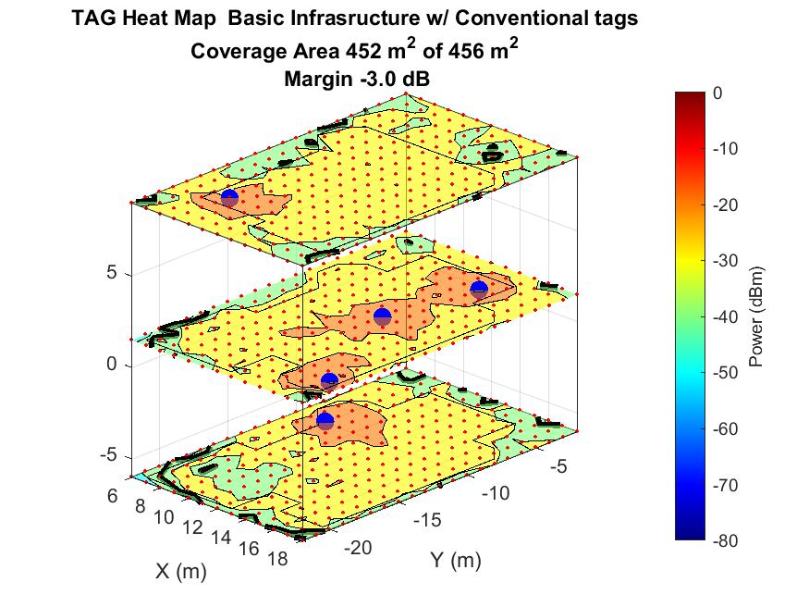
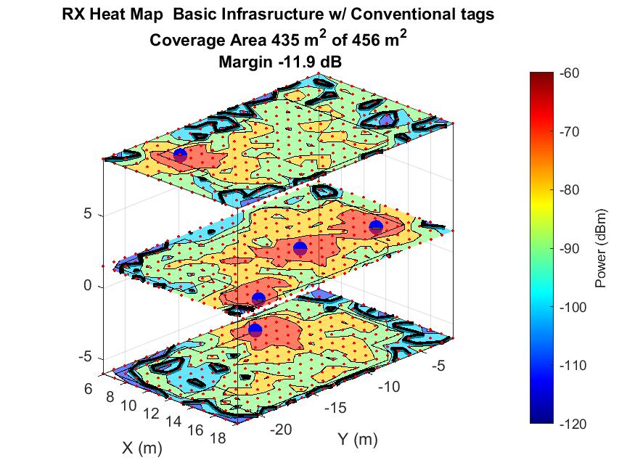
Five TX/RX - selection diversity across TXs
95% covered from five TX/RX locations with -12dB link margin

Slide 10
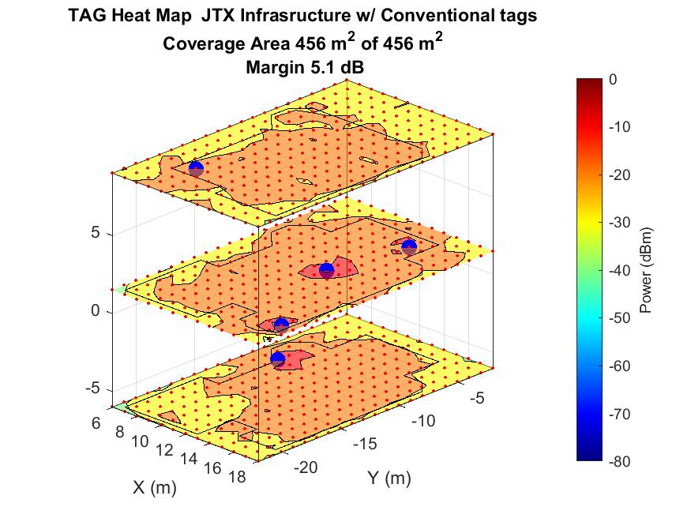
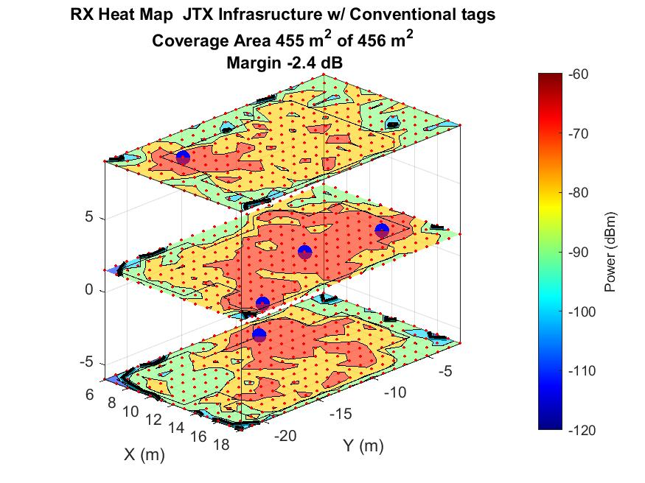
Five TX/RX - Joint Transmission (JTX)
minimum -30dBm at tag
99.8% covered from five TX/RX locations with -2.4dB link margin

Slide 11
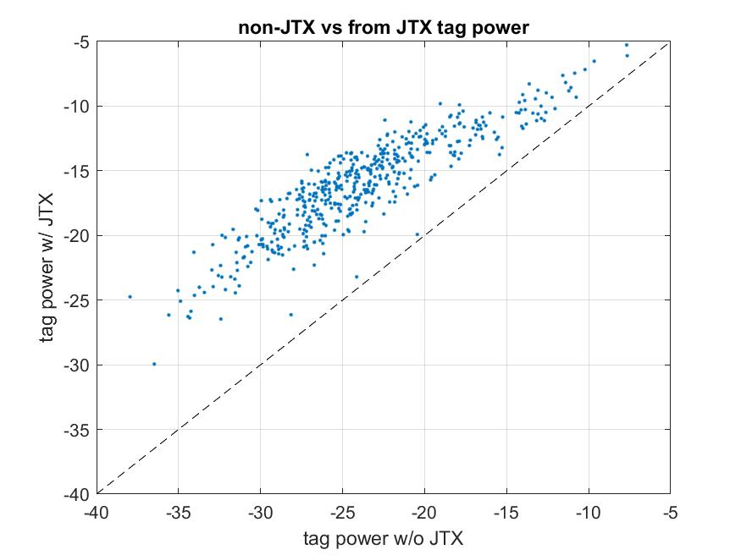
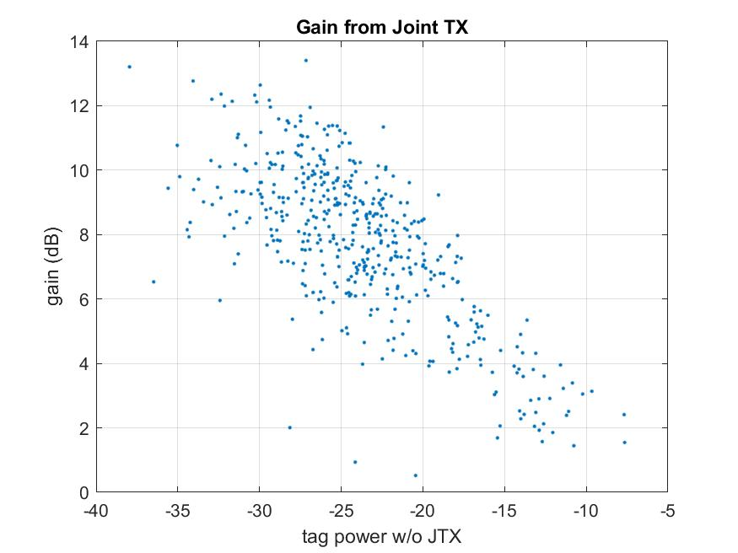
Five TX/RX JTX gain
non-JTX vs JTX tag power
Joint transmission combines power from TXs coherently [2]. Tag power will scale as high as square of number of TX
In our case with 5 TX, we see up to 14dB of gain compared to selection diversity between TXs
Key: gain tends to be highest where tag power is lowest – i.e. where it is needed!

Slide 12
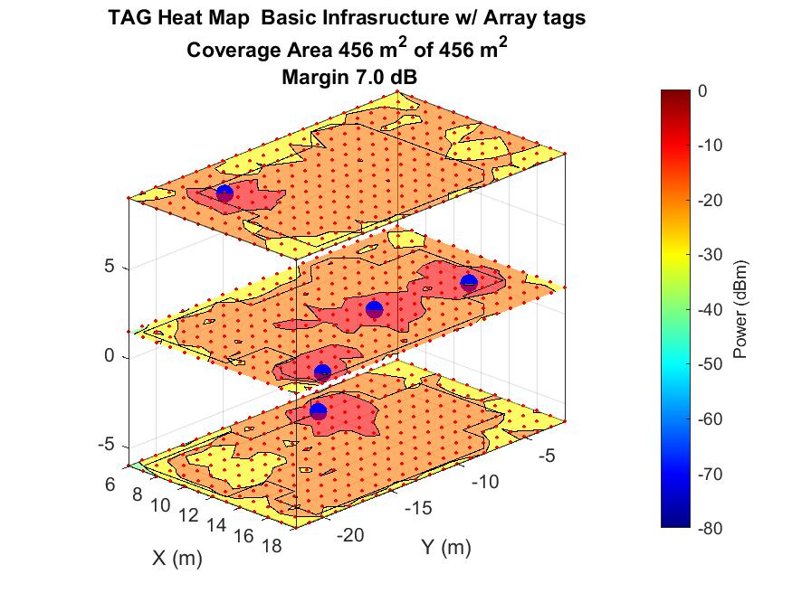
4 antenna passive beamforming at tag
every dB of tag antenna gain results in 2 dB of RX link budget improvement

Slide 13
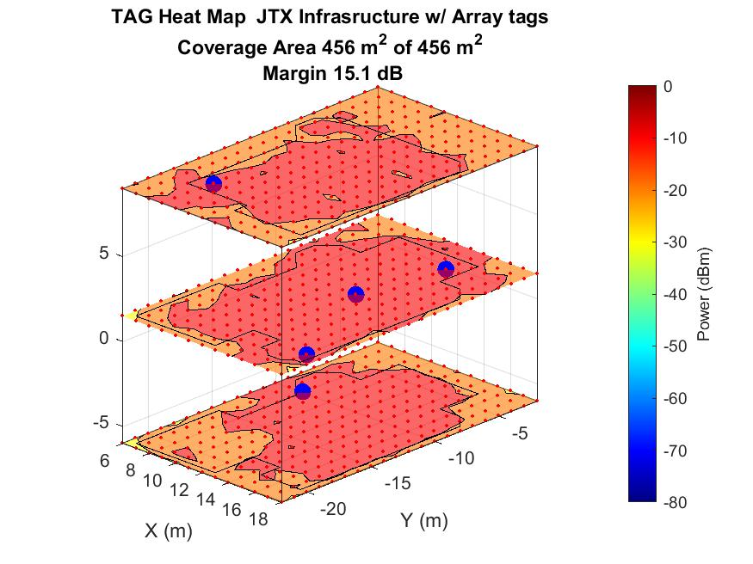
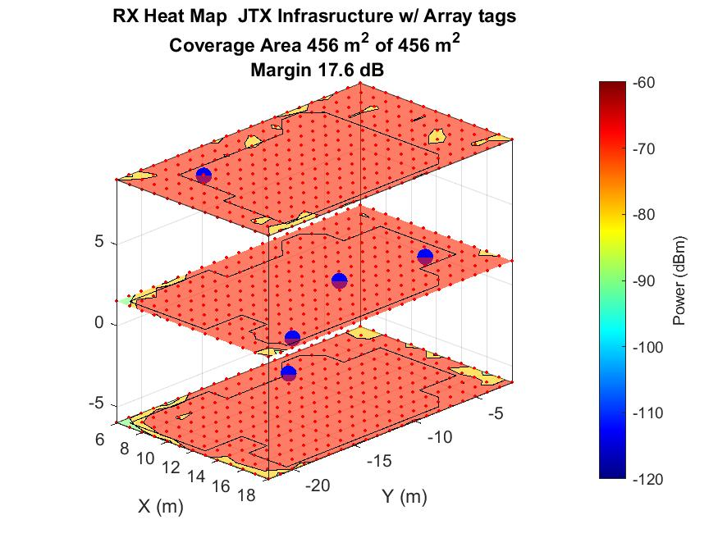
All In
at least -22dBm at tag - sufficient for RF energy harvesting / battery free tag

Slide 14
Summary Ray tracing results
#TX/RX | TX combining | # tag antennas | Missed Coverage | Downlink margin | Uplink margin
1 | none | 1 | 26% | -14 dB | -34 dB
5 | Selection diversity | 1 | 5% | -3 dB | -12 dB
5 | Joint transmission | 1 | 0.2% | +5 dB | -2.4 dB
5 | Selection diversity | 4 w/ BF | 0% | +7 dB | +8 dB
5 | Joint transmission | 4 w/ BF | 0 % | +15 dB | +18 dB
3 | Selection diversity | 4 w/ BF | 0% | +5 dB | +5 dB

Slide 15
Conclusions
Whole home coverage with passive backscatter possible
Protocol amendments need to support specialized implementations for beamforming at TX including joint transmission, and passive tag beamforming
With a combination of techniques, sufficient power could be delivered to tag for RF energy harvesting

Slide 16
References
[1] https://www.remcom.com/wireless-insite-em-propagation-software
[2] “Joint Transmission for UHR –A Refresher and New Results” IEEE 802.11-22/2188

