Slide 1
Notes from 3GPP Rel-18: Key Coexistence Issues
Date: 2023-01-18
Authors:

Slide 2
Abstract
3GPP RAN1 is currently extending NR sidelink operation to 5-7 GHz unlicensed spectrum (SL-U). Several issues remain under discussion regarding SL-U channel access and physical channel design in these bands, notably:
Listen Before Talk (LBT) type for synch, feedback, and data channels, including one-shot LBT.
UE-to-UE COT sharing in pairs and groups.
Key points to track for IEEE 802.11
Coexistence simulations between SL-U and WiFi have been largely based on 3GPP TR38.889 from Rel-16, and there have been no updates to account for Wi-Fi 6E/7 operation
The use of one-shot (Type 2) LBT for multiple types of transmissions – e.g ACK/NACK, sidelink broadcast & synch etc.
Conditions where UEs are allowed to share a COT without gNB intervention.
The presentation will discuss the pertinent 3GPP developments on the above topics.

Slide 3
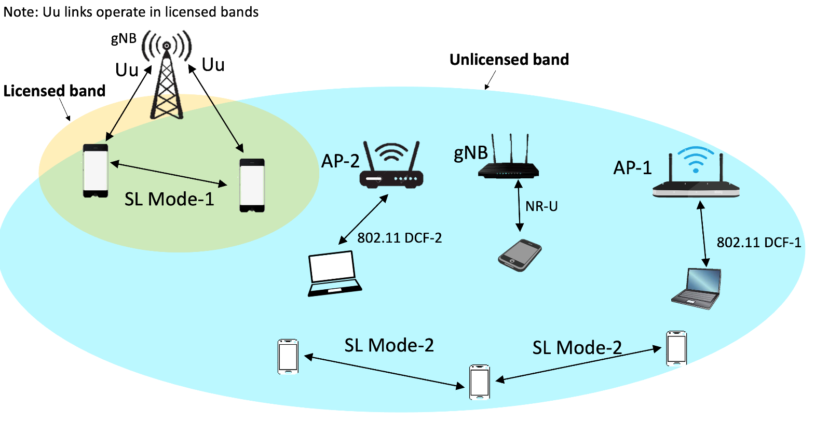
3GPP Work Item on NR Sidelink Evolution¹
Objective 2: Study and specify support of sidelink on unlicensed spectrum for both mode 1 and mode 2 where Uu operation for mode 1 is limited to licensed spectrum only [RAN1, RAN2, RAN4]
Channel access mechanisms from NR-U² shall be reused for sidelink unlicensed operation
Focus on FR1 unlicensed bands (n46 and n96/n102)
Legend
AP-1, AP-2: IEEE 802.11 Access Points
gNB: 3GPP New Radio (NR) base station
NR-U: NR operations in unlicensed band
SL Mode-1: Sidelink mode 1
SL Mode-2: Sidelink mode 2
Sidelink supports direct UE-to-UE links
Sidelink mode 1: gNB allocates resources for UEs
Sidelink mode 2: autonomous resource allocation (without gNB)
¹ OPPO, "WID revision: NR sidelink evolution," RP-222806. 3GPP TSG RAN Meeting #98-e, December 12 – 16, 2022.
² 3GPP TS 37.213: "Physical layer procedures for shared spectrum channel access."

Slide 4
Regulatory Requirements at 5 and 6 GHz Unlicensed Bands
5 GHz band: USA¹, European Union² and many countries/region allow unlicensed operations
Access Point (AP)-to-client and client-to-client operations authorized
Table summarizes the regulations in the USA/European Union
DFS (Dynamic Frequency Selection): protects radar operations. A different frequency channel must be selected for at least 30 minutes if a radar is detected
Legend
TPC: Transmit Power Control
EIRP: Effective Isotropic Radiated Power
6 GHz band: Only AP-to-client operations, not client-to-client, authorized in the USA (47 CFR § 15.407 (d)(5))
European Union: indoor and outdoor operations authorized in 5.925 – 6.425 GHz frequency band
¹ United States Code of Federal Regulations, 47 CFR 15.407, https://www.ecfr.gov/current/title-47/chapter-I/subchapter-A/part-15/subpart-E/section-15.407
² ECC Decision (04)08, “On the harmonised use of the 5 GHz frequency bands for Wireless Access Systems including Radio Local Area Networks (WAS/RLAN),” approved 09 July 2004, latest amended 2 July 2021.

Slide 5
3GPP Emission/Bandwidth Requirements^{1,2}
5925 MHz
7125 MHz
n96
n102
n104
6425 MHz
Band | gNB max carrier BW | gNB ACLR limit | UE max carrier BW | Max aggregated CA
n96 | 80 MHz | 35 dB / 40 dB | 100 MHz | 320 MHz (80+80+80+80)
n102 | 80 MHz | 35 dB / 40 dB | 100 MHz | TBD
n104 | 100 MHz | 35 dB / 40 dB | 100 MHz | TBD
Legend
ACLR: Adjacent Channel Leakage ratio
CA: Carrier Aggregation
Channelization generally follows 20/40/60/80/100 MHz operation
EIRP limits are country-, region-specific
¹ 3GPP TS 38.101, ²3GPP TS 38.104.

Slide 6
Channel access mechanisms^{1,2}
 | R16 NR-U | R17 FeURLLC | R18 SL-U
Access modes | Dynamic Semi-static | Semi-static + UE-initiated COT | Dynamic Semi-static (TBC)
Energy Detect | -72 dBm/20 MHz | -72 dBm/20 MHz | -72 dBm/20 MHz
Max COT | 8 ms or 10 ms | 8 ms or 10 ms | 8 ms or 10 ms
No-LBT transmissions | Responding transmissions within 25 us of end of initiating transmission | Responding transmissions within 25 us of end of initiating transmission | TBC
Short sensing transmissions | SS-PBCH, PRACH | UL to initiate COT | TBC
Semi-static access applicable when absence of other technologies is guaranteed
FeURRLC adds UE-initiated COT to the semi-static access mode
¹ 3GPP TS 37.213, ²3GPP TS 38.212.

Slide 7
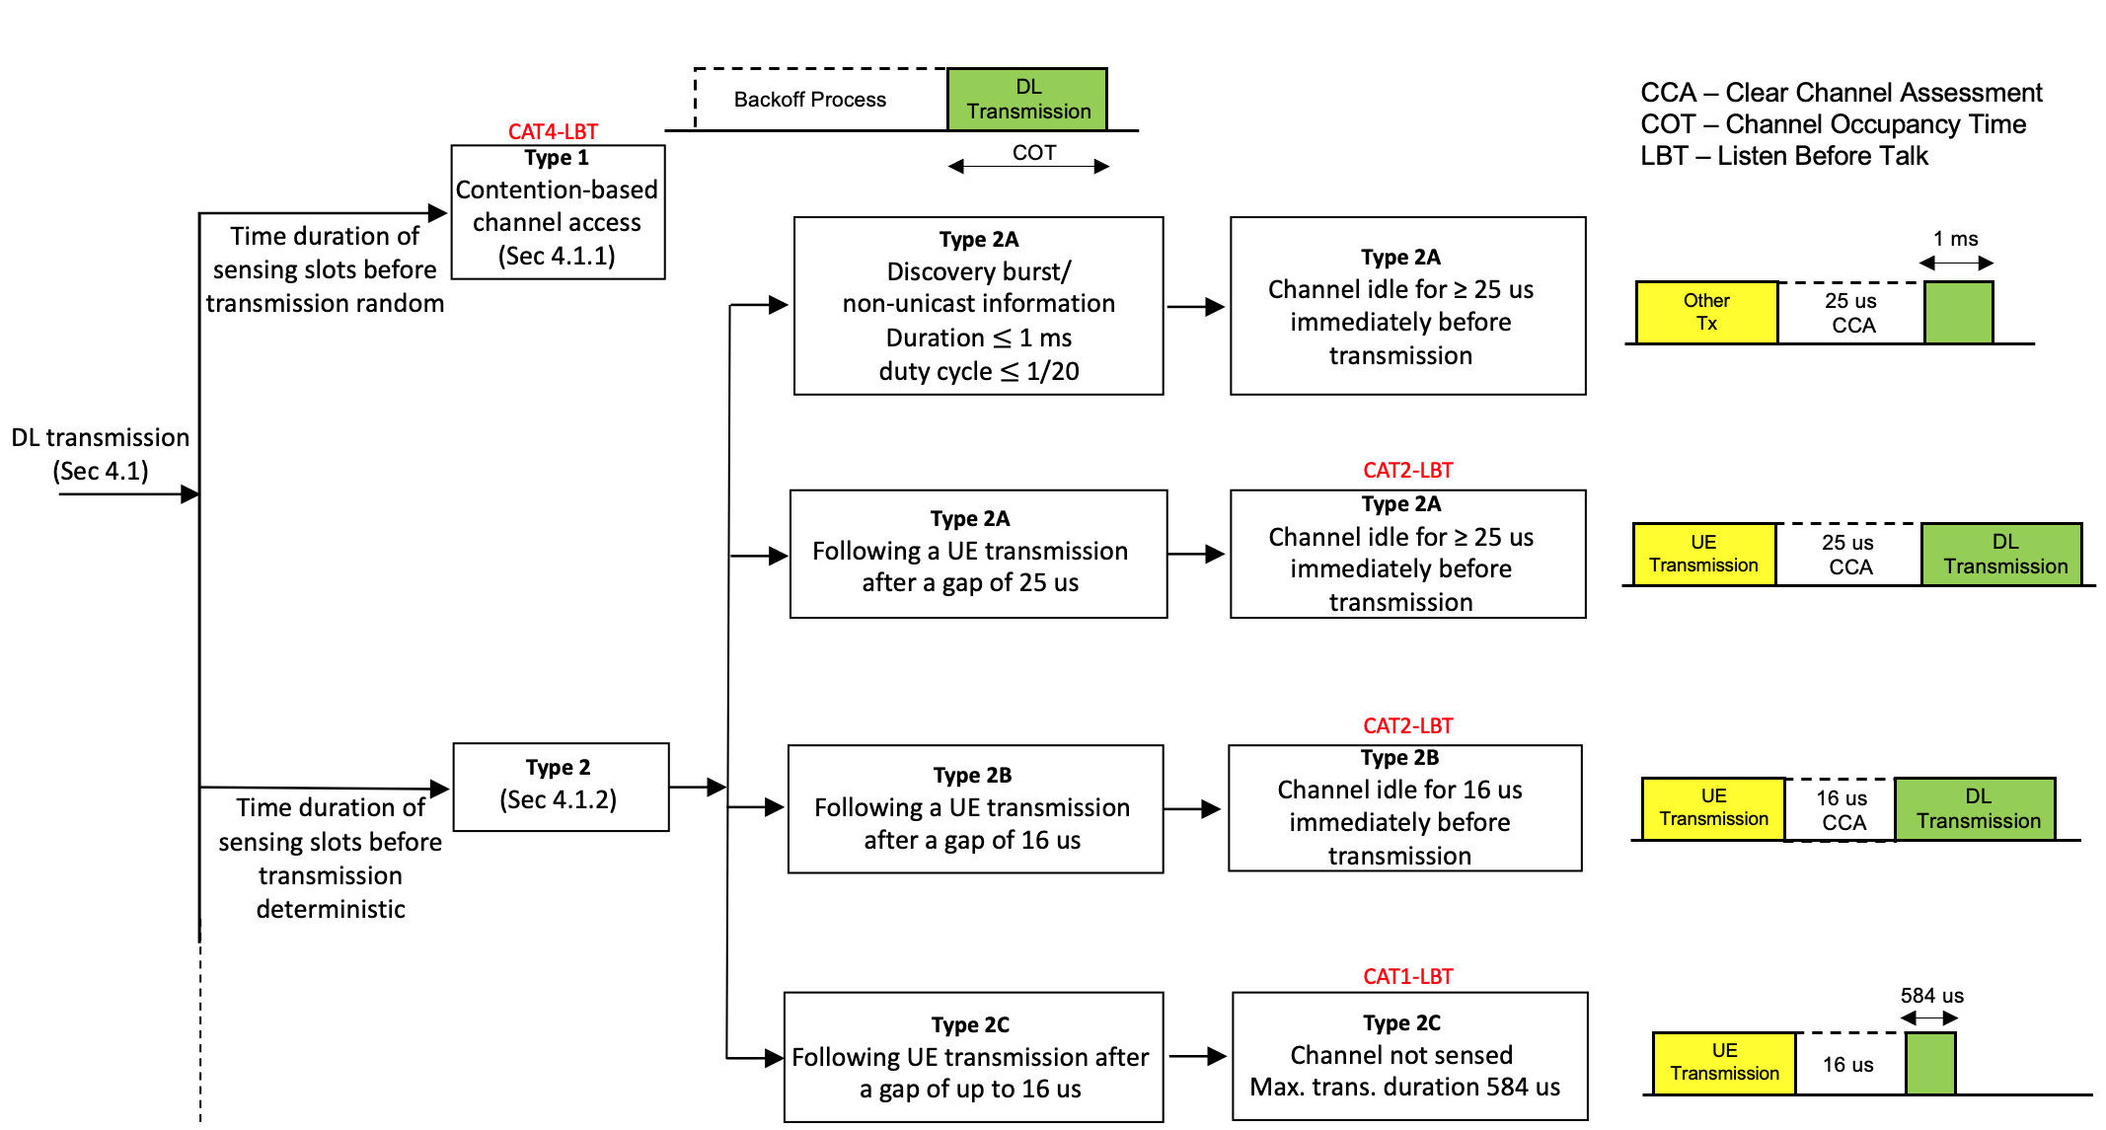
NR-U Downlink Channel Access Procedure
NR-U channel access procedures are specified in 3GPP TS 37.213
Sidelink should use this channel access procedure

Slide 8
SL-U¹ Challenge: Large Slot Size and Synchronized Transmissions
NR-U channel access mechanism uses a backoff procedure with a sensing slot size of 9 us (similar to IEEE 802.11)
Sidelink UEs are synchronized so transmissions occur at sidelink slot boundaries
Sidelink slot sizes ($T_{SL}$): 250 us, 500 us or 1 ms depending on numerology used
Sidelink cannot transmit until the slot boundary
A gap results as shown
Note: TS 37.213 allows freezing the backoff counter so that end of backoff counter coincides with slot boundary
Backoff counter ends before the slot boundary
Another radio network may gain access to the channel during the gap duration
¹SL-U: Sidelink in unlicensed bands

Slide 9
SL-U Challenge: Limited Transmission in Contiguous Slots
In general sidelink does not support transmissions in contiguous (sidelink) time slots
Suppose each sidelink UE accesses the channel using NR-U channel access mechanism (Type 1)
UE A has to contend for channel access again after T_{SL} transmission time
Overall data rate is very low because T_{SL} very small
UE B has to contend for channel access with other radio networks
Transmissions in adjacent slots as shown here not possible for the UE network
Sidelink resource reservations for a 3-UE network
Periodic resource reservations for A, B and C
Minimum periodic time in sidelink is 1 ms
Slot sizes $T_{SL}=250 μs, 500 μs, 1 ms$
Overall data rate for the sidelink network is very low because each UE has to contend for channel access after each time slot

Slide 10
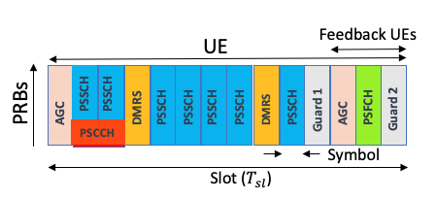
SL-U Challenge: Presence of Guard Symbols in Sidelink Slots
Example PSSCH/PSCCH slot with PSFCH
Guard symbols included in sidelink slot to accommodate switching time from transmit mode to monitor/receive mode
Guard symbol time duration: 17.8 $μs$, 36.7 $μs$ or 71.3 $μs$ (when T_{SL} = 250 $μs$, 500 $μs$ or 1 ms)
Another radio network could access the channel during the guard symbol time
Feedback (ACK/NACK) information lost if another radio network gains access during Guard1 time
PSSCH: carries data
PSCCH: control information
PSFCH: carries feedback information
DMRS: demodulation reference signal
Last 3 symbols for feedback UE transmissions
Guard 1 symbol gives time to switch from transmit to receive mode
Guard 2 symbol gives UE time to switch from transmit to receive/monitor mode for transmissions in next slot
ACK/NACK may not be available because of loss of access to feedback channel

Slide 11
SL-U Challenge: Absence of UE-to-UE COT¹ Sharing in NR-U
NR-U channel access procedure supports COT sharing only between gNB and UEs
For efficient operation of the sidelink it is desired to support UE-to-UE COT sharing
One of the UEs accesses the channel using NR-U access procedure
Other UEs share this UE's COT up to a Maximum Channel Occupancy Time (MCOT)
Use a modified mode 2 scheme to allocate resources within the COT
This approach not adopted at 3GPP because NR-U channel access procedure does not specify COT sharing between UEs
A framework for a possible solution currently being established at 3GPP RAN1 meetings
Only the COT initiating UE (UE0) can share the COT
COT sharing in NR-U: UEs sharing gNB COT
COT sharing in NR-U: gNB sharing uplink UE COT
Desired SL-U COT share
UE-to-UE COT sharing is crucial to mitigate disadvantageous channel access for SL-U
¹Channel Occupancy Time

Slide 12
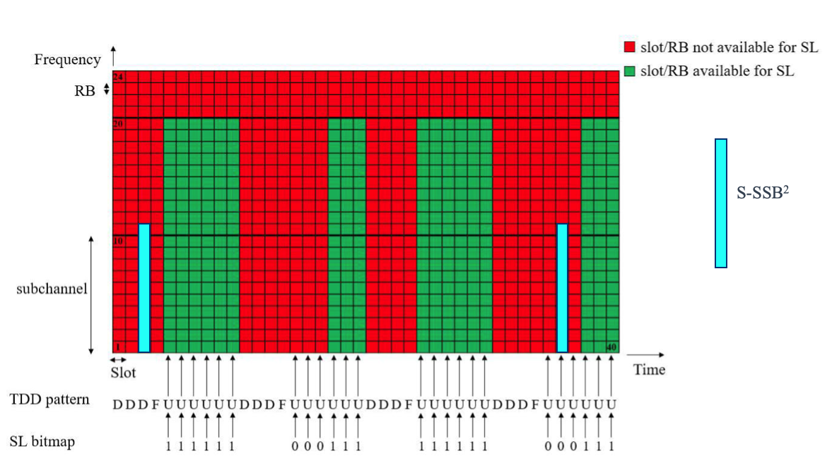
SL-U Challenge: Channel Access for Synchronization Signals
Synchronization signals in SL-U have to contend for channel access
In licensed bands synchronization signals are at known locations outside the sidelink resource pool
S-SSB² access under consideration at RAN1
TS 37.213 Type 2A:
Channel idle for 25 us
Transmission duration of a single burst at most 1 ms
Burst duty cycle at most 1/20
S-SSB transmissions interfere with WiFi/NR-U
Frequency of S-SSBs required for SL-U?
Effects (collisions/delay/throughput) of S-SSBs on WiFi/NR-U systems?
Resource pool¹ and S-SSB in sidelink (licensed bands)
¹Z. Ali, S. Lagén, L. Giupponi and R. Rouil, "3GPP NR V2X Mode 2: Overview, Models and System-Level Evaluation," in IEEE Access, vol. 9, pp. 89554-89579, 2021.
²S-SSB – Sidelink Synchronization Signal Block

Slide 13
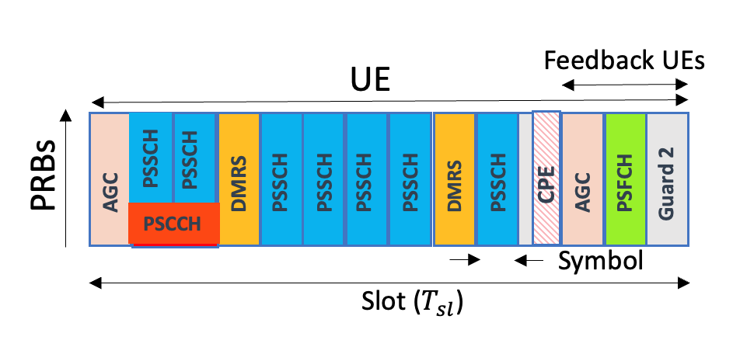
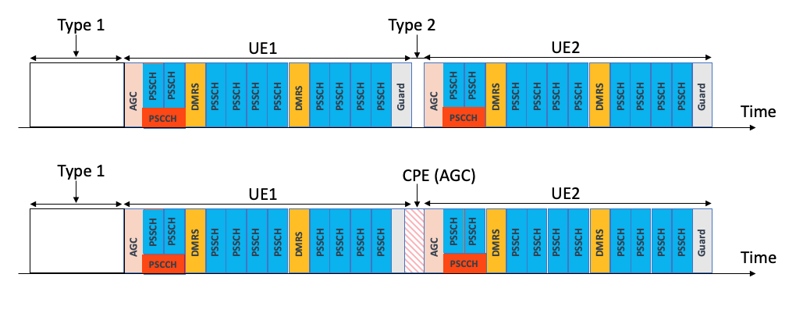
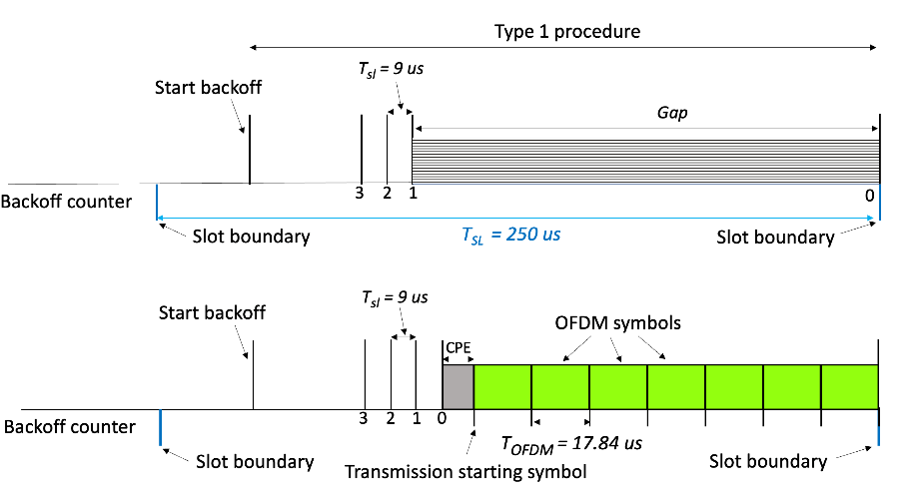
Enhancements to Sidelink to Address the Challenges
CPE before the AGC of PSFCH transmission
Cyclic Prefix (CP) extension (CPE) (NR-U feature)
Decreases guard periods for improved access to channel
Applicable to PSFCH symbol (feedback UE) and UE-to-UE COT share
Multiple starting positions (NR-U feature)
Transmissions at multiple symbol positions within a sidelink slot
Provides enhanced access to the channel
Transmissions in contiguous sidelink slots
Higher data rates once the channel is accessed
May decrease the channel usage time for other UEs
CPE before the AGC of UE2 transmission
Half-slot starting position combined with CPE
Transmissions at slot boundaries
All these enhancements are currently under consideration at RAN1 as part of the sidelink Work Item
Transmissions at half-slot boundaries

Slide 14
Coexistence Analyses
Rel-16 study on NR-U coexistence with 802.11ac or another NR-U network in TR 38.889 was focused on 5 GHz
Rel-17 FeURLLC did not have an extensive coexistence study
Rel-18 SL-U has 6 GHz SL-U + WiFi coexistence as optional scenario
Coexistence simulations between SL-U and WiFi largely based on 3GPP TR38.889 from Rel-16, no updates made to Wi-Fi assumptions
Recommendations to 802.11 Coex SC:
Track coex simulation assumptions
Monitor the use of one-shot LBT (Type 2) for multiple categories of transmissions
Monitor conditions where UEs are allowed to share a COT without gNB intervention

