Slide 1
Follow-up on 320MHz NTB/TB ranging
Jan 2023
Date: 2023-01-15
Authors:
Name | Affiliations | Address | Phone | email
Yanjun Sun | Qualcomm
Ali Raissinia
Steve Shellhammer
George Cherian
Christine Zhang
Youhan Kim

Slide 2
Introduction
Jan 2023
Background:
  802.11az has been developed over 802.11ax and supports up to 160 MHz bandwidth
Motivation:
  320 MHz operation has been defined in 802.11be
  320 MHz BW can offer better resolution than 160 MHz BW in ranging
Objective:
  Expand appropriate 11az frames and procedures with 320 MHz support

Slide 3
Scope of This Contribution
Jan 2023
Focus on MAC related changes
Explore options to indicate 320 MHz BW in the following frames:
  Ranging NDPA
  Ranging Trigger variants
  IFTMR/IFTM for session negotiation
Assumptions:
  May support some non-OFDMA puncturing patterns (see [1])
    Some regions may only have 240 MHz bandwidth
    Still offers better accuracy than 160 MHz BW
  Frame exchange sequence are expected to remain the same as in 11az to maximize the reuse of existing logics

Slide 4
NDPA Enhancement

Slide 5
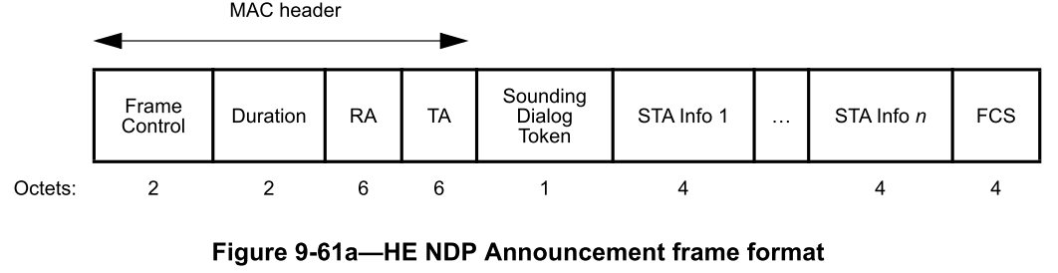
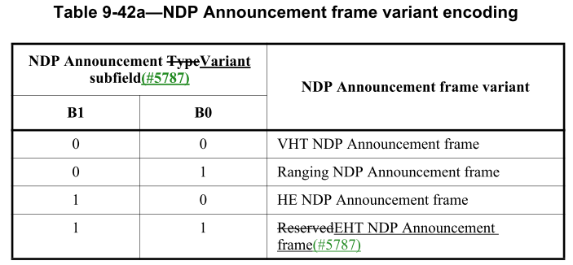
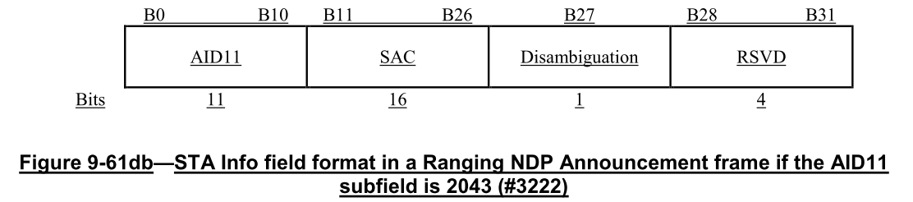
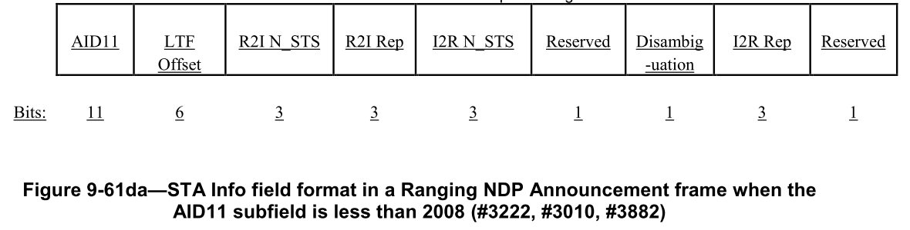
Recap: 11az Ranging NDPA
Jan 2023
NOTE: AIDs of 2044 and 2045 also have unique formats
With secure LTF

Slide 6
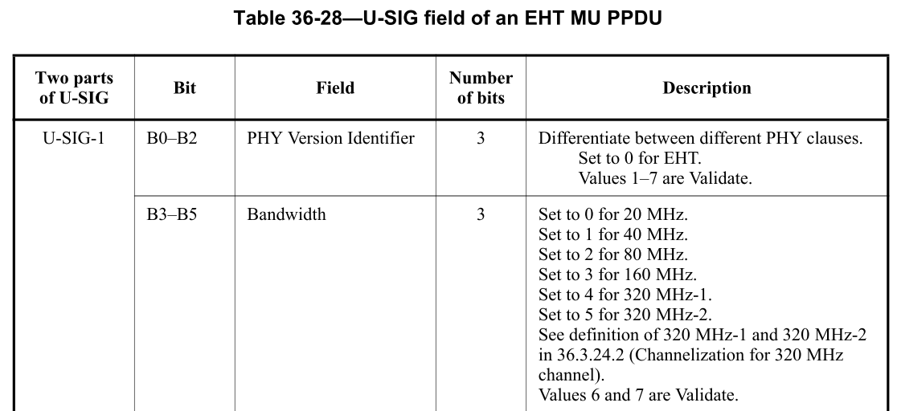
Recap: 320 MHz indication in EHT NDPA
Jan 2023
For NDPA in non-HT Duplicate PPDU:
  B7 in the SERVICE field is set to 1 to indicate 320 MHz based on the following 11be spec text:
    “If the CH_BANDWIDTH_IN_NON_HT parameter in the TXVECTOR primitive is present and is equal to CBW320, then bit 7 of the SERVICE field is set to 1. The remaining 8 bits (8–15) of the SERVICE field shall be reserved for future use.”
For NDPA in EHT MU PPDU:
  The U-SIG field can indicate 320 MHz

Slide 7
Proposal #1: 320 MHz for Ranging NDPA
Jan 2023
Use existing Ranging NDPA variant encoding in 11az and existing 320MHz indication in 11be
  No change to the Ranging NDPA MAC content
  non-HT dup PPDU: set B7 in SERVICE field to 1 to indicate 320 MHz
  EHT MU PPDU: set PHY header to indicate 320 MHz
Non-HT Duplicate PPDU
PHY preamble
Service
PSDU
Set B7 to 1 as defined in 11be
Use the existing Ranging NDPA format defined in 11az
EHT MU PPDU or
Future PPDU
PHY preamble
Service
PSDU
Use the Bandwidth field in the U-SIG field to indicate 320 MHz as defined in 11be
Use the existing Ranging NDPA format defined in 11az

Slide 8
Trigger Enhancement

Slide 9
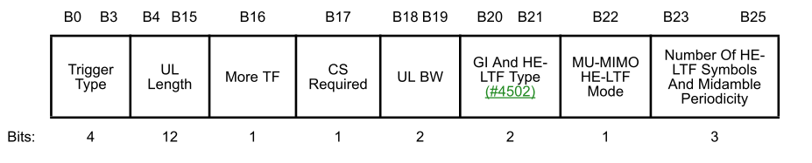
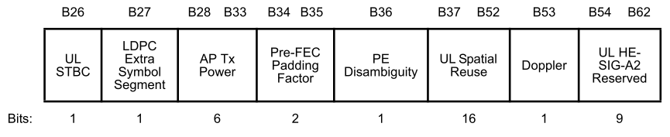
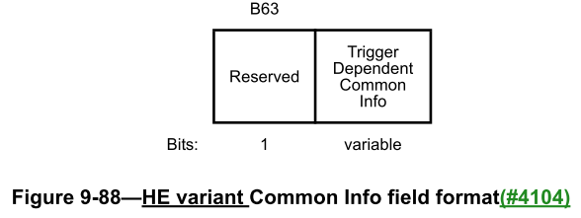
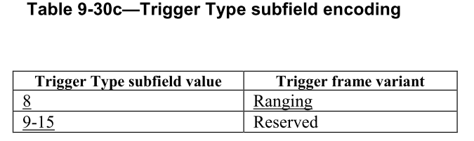
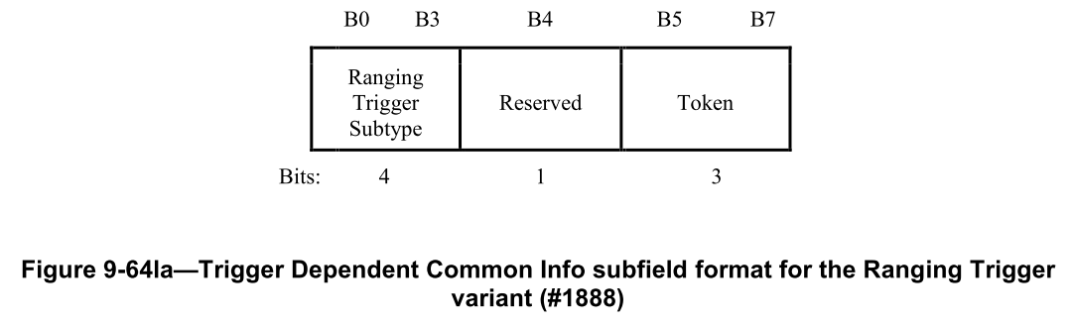
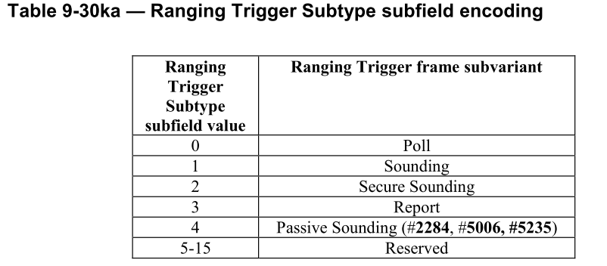
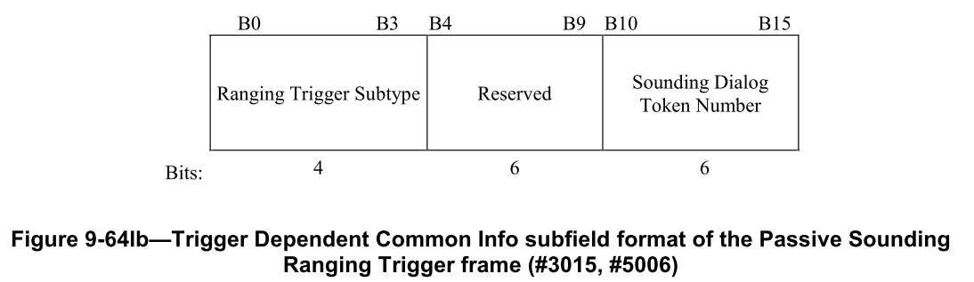
Recap: 11az Trigger frame variants
Jan 2023

Slide 10
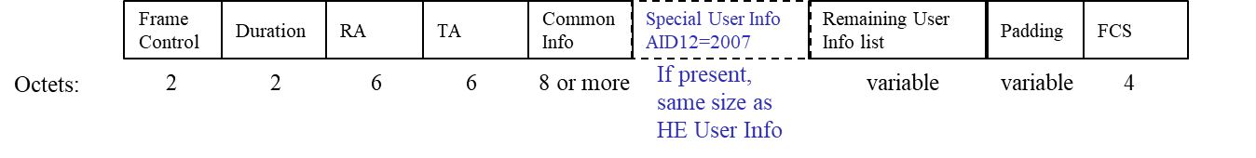
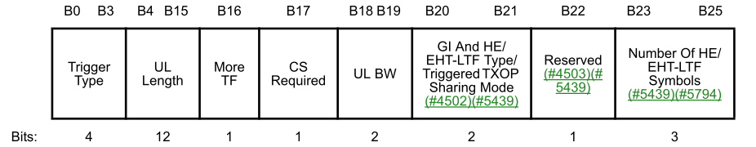
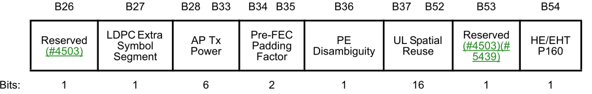
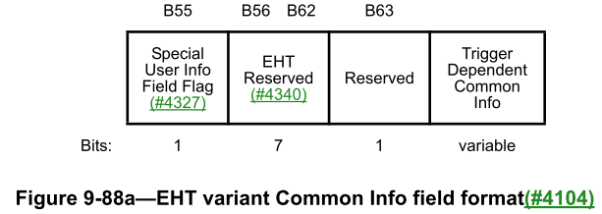
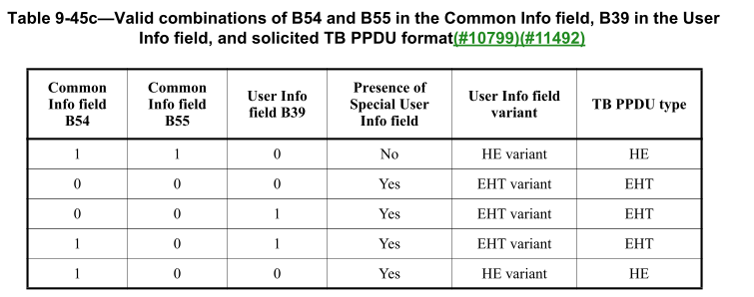
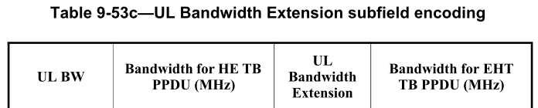

Recap: 320 MHz indication in EHT Trigger
Jan 2023

Slide 11
Proposal #2: 320 MHz for Ranging Trigger
Jan 2023
Add the Special User Info field defined in 11be to the Ranging Trigger frame variants defined in 11az, with B54 and B55 set to 0 to solicit 320 MHz EHT TB PPDU
  Benefit: simple
Set B55 to 0 to indicate the presence of the following Special User Info field, which uses the format defined in 11be to indicate 320 MHz
Set trigger type subfield to 8 to indicate the Ranging variant

Slide 12
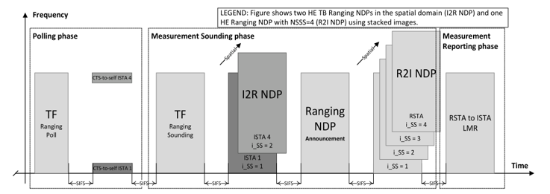
Proposal #3 Clarification on PPDU Types for Ranging Trigger frame
Use-case: a BSS often has a mix of HE STA and EHT STAs
Issue: if the TF Ranging Poll frame is sent in EHT PPDU, the TXOP will be wasted if no EHT STA responds, even if some HE STAs want to participate in the ranging sequence.
Candidate solution:
  RSTA should transmit TF Ranging Poll in non-HT duplicate PPDU instead of EHT PPDU to serve both EHT/HE STAs
  Based on received CTS response, subsequent PPDUs (Ranging sounding, NDPA) may use EHT/HE/non-HT dup PPDUs

Slide 13
Session Negotiation Enhancements

Slide 14
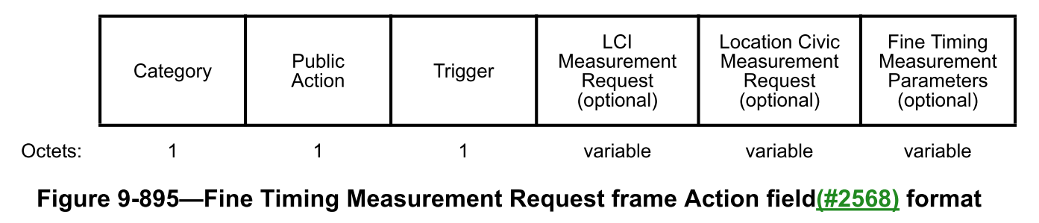
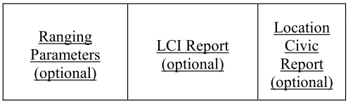
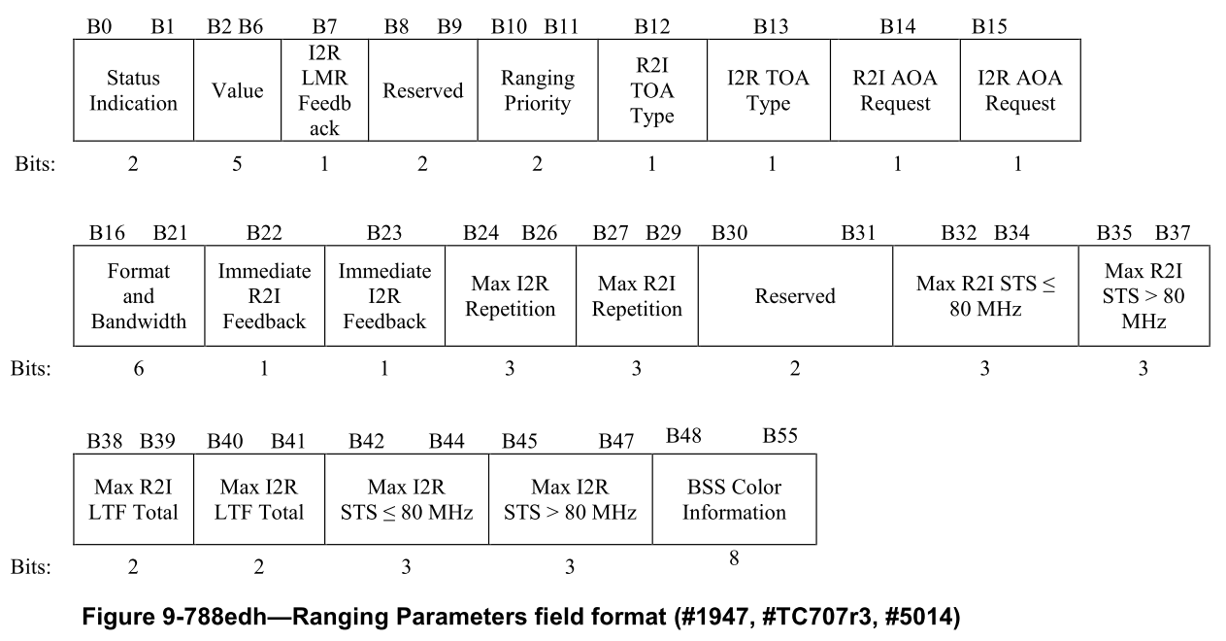
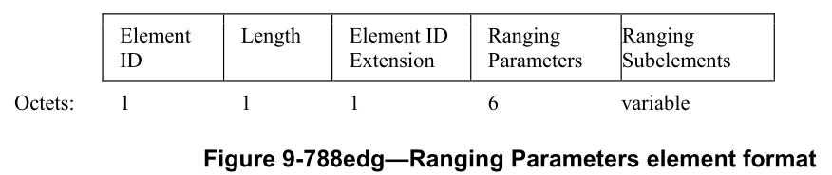
Recap: Negotiation with IFTMR
Jan 2023
From 11md and 11az:
Expansion is needed
New subelement(s) for 11be related info

Slide 15
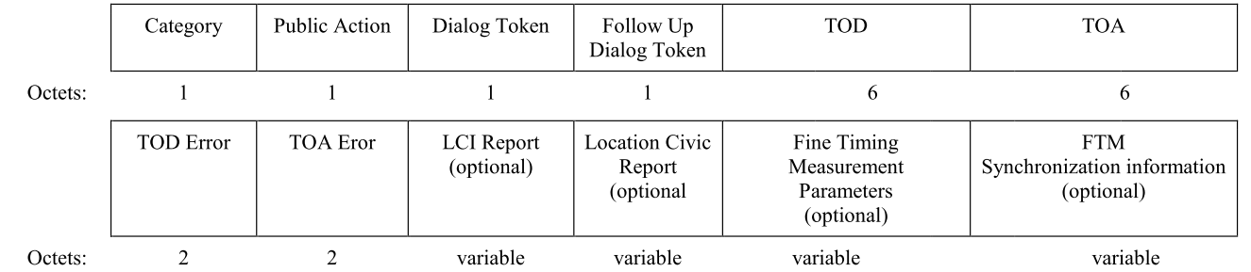
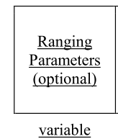
Recap: Negotiation with IFTM
Jan 2023
Expansion is needed
New subelement(s) for 11be related info

Slide 16
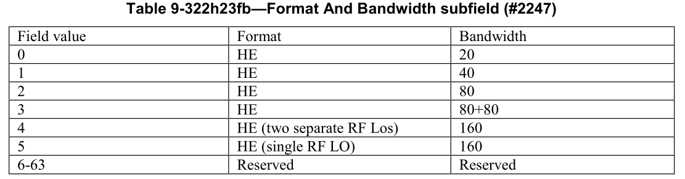
Proposal #4: Additional Info for IFTMR/IFTM
Jan 2023
Use the reserved entries in the Format And Bandwidth subfield to indicate 320 MHz
Candidate entries for 320 MHz
  Value 6 to indicate EHT (single RF LO) for 320 MHz
    This value indicates that the STA also supports values of 5, 2, 1 and 0
    NOTE: an EHT BSS does not support 80+80 or 160+160
Add entries for 320 MHz

Slide 17
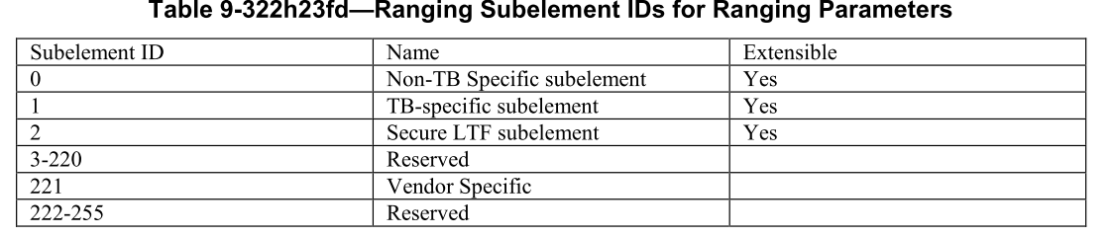
Puncturing Pattern Update
Issue: if an AP updates its puncturing pattern, how to handle a session that has already been established?
    For associated STAs: can learn the updated pattern through Beacon
    For unassociated STAs: cannot learn the change if they don’t monitor the Beacons continuously
Discussion from Nov meeting:
  Need a way to adopt the latest puncturing pattern
Proposal:
  FTM parameter modification or session termination is used to avoid using the old puncturing pattern
  Similar solution can be used for Transmit Power Envelop (TPE)
Define a new subelement for puncturing and another for TPE

Slide 18
Summary
Jan 2023
This contribution explored options to indicate 320 MHz BW in the following frames by an 11be STA
  Ranging NDPA
  Ranging Trigger variants
  IFTMR/IFTM for session negotiation and re-establishment
  On EHT/HE BSS Configuration with Puncturing
The analysis showed that the indications of 320 MHz defined in 11be can be applied to the above frames from 11az
  As the 11be indications are outside the fields that carries the 11az-specific info

Slide 19
Straw Poll #1
Do you agree that the 320 MHz NDP Announcement frame of 802.11bk will use existing Ranging NDP Announcement variant encoding in 802.11az and existing 320MHz indication in 802.11be?
  No change to the 802.11az Ranging NDP Announcement MAC content
  For a non-HT dup PPDU: set B7 in SERVICE field to 1 to indicate 320 MHz
  For an EHT MU PPDU: use the Bandwidth field in the U-SIG field to indicate 320 MHz
Yes
No
Abstain

Slide 20
Motion #1
Move to accept that the 320 MHz NDP Announcement frame of 802.11bk will use existing Ranging NDP Announcement variant encoding in 802.11az and existing 320MHz indication in 802.11be?
  No change to the 802.11az Ranging NDP Announcement MAC content
  For a non-HT dup PPDU: set B7 in SERVICE field to 1 to indicate 320 MHz
  For an EHT MU PPDU: use the Bandwidth field in the U-SIG field to indicate 320 MHz
Moved by:
Seconded by:
Results (Y/N/A):

Slide 21
Straw Poll #2
Do you agree that a 320 MHz Ranging Trigger frame in 802.11bk sets the Trigger Type subfield in the Common Info field to 8 as in 802.11az and includes the Special User Info field immediately after the Common Info field as defined in 802.11be?
Yes
No
Abstain

Slide 22
Motion #2
Move to accept that a 320 MHz Ranging Trigger frame in 802.11bk sets the Trigger Type subfield in the Common Info field to 8 as in 802.11az and includes the Special User Info field immediately after the Common Info field as defined in 802.11be?
Moved by:
Seconded by:
Results (Y/N/A):

Slide 23
Straw Poll #3
Do you agree that IFTMR/IFTM frames of 802.11bk will use reserved entries in the Format And Bandwidth subfield to indicate 320 MHz?
Yes
No
Abstain

Slide 24
Motion #3
Move to accept that IFTMR/IFTM frames of 802.11bk will use reserved entries in the Format And Bandwidth subfield to indicate 320 MHz?
Moved by:
Seconded by:
Results (Y/N/A):

Slide 25
Straw Poll #4
Do you agree that IFTMR/IFTM frames of 802.11bk will use reserved subelements to indicate information on transmit power envelop and puncturing pattern of the BSS for 320 MHz?
Yes
No
Abstain

Slide 26
Motion #4
Move to accept that IFTMR/IFTM frames of 802.11bk will use reserved subelements to indicate information on transmit power envelop and puncturing pattern of the BSS for 320 MHz?
Moved by:
Seconded by:
Results (Y/N/A):

Slide 27
References
Jan 2023
[1] Thoughts on 320 MHz Ranging NDP, 22/1981r0, https://mentor.ieee.org/802.11/dcn/22/11-22-1981-00-00az-thoughts-on-320-mhz-ranging-ndp.pptx, Steve Shellhammer et al.

Slide 28
Backup

Slide 29
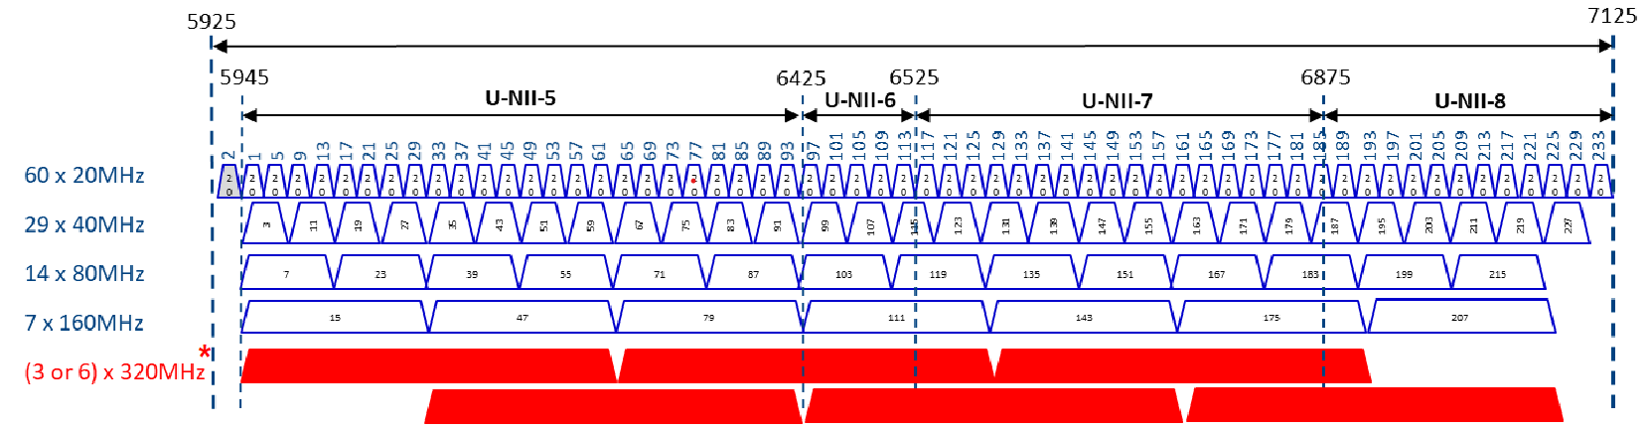
On 320 MHz-1 and 320 MHz-2
36.3.24.2 Channelization for 320 MHz channel
  The 320 MHz channel consists of any two adjacent 160 MHz channels in the 6 GHz band. Two type of channelizations for 320 MHz channel are defined: 320 MHz-1 and 320 MHz-2.
  320 MHz-1 is defined as 320 MHz channel with channel center frequency numbered 31, 95, and 159. 320 MHz-2 is defined as 320 MHz channel with channel center frequency numbered 63, 127, and 191.
Credit: source of the image

