Slide 1
Multi-AP Coordination for Low Latency Traffic Delivery: Usage Scenarios and potential features
Date: 2023-03-13
Authors:
Name | Affiliation | Address | Phone | Email
Liuming Lu | OPPO |  |  | luliuming@oppo.com
Chaoming Luo
Pei Zhou
Liuming Lu (OPPO)

Slide 2
Introduction
The proposal of specifying at least one mode of operation capable of improving tail latency and jitter for OBSS scenarios in UHR has gained a majority of support according to the PAR discussion.
The contribution tries to demonstrate the usage scenarios and potential features of multi-AP coordination for low latency traffic delivery

Slide 3
Recap
Multi-AP Coordination for Low Latency Traffic Delivery
Multi-AP Type 1 Coordination (loose/light coordination)
The related information is shared among APs (i.e. co-channel APs not affiliated with the same MLD)
the resource (such as r-TWT SPs) to be protected
The coordinating AP and its associated STAs and/or their allowed transmit power/ RSSI
Multiple co-channel APs interoperate with each other to enhance medium access protection for SPs
ensure low-latency QoS Data frames to be first delivered during protected SPs
reduce impact on transmission efficiency in BSSs
spatial reuse can be considered to allow the medium to be reused during SPs
transmission schemes may include OBSS PD-based/PSR-based spatial reuse etc.
Multi-AP Type 2 Coordination (tight coordination)
transmission schemes includes coordinated OFDMA/MU-MIMO/Beamforming, Joint Transmission etc.
Real-time signaling among APs: strict time synchronization
Interoperation level:
co-channel signaling with better KPIs
Backhaul - with different requirements for special transmission schemes

Slide 4
Differentiation of Scenarios
The factors to differentiate the scenarios (limited to co-channel APs not affiliated with the same MLD)
APs pending for multi-AP coordination: the KPIs for the communication among APs
Option 1: AP1 and AP2 communicate with each other by co-channel signaling with better KPIs
Option 1a: multiple-AP Type2 coordination(such as coordinated OFDMA/MU-MIMO/Beamforming, Joint Transmission) and Type 1 coordination(enhance medium access protection during R-TWT SPs) are supported
Multi-AP Type 1 & 2 coordination are considered for R-TWT operation (which one is suitable needs for further analysis – see next slide)
Option 1b: multiple-AP Type 2 coordination is not supported but multiple-AP Type 1 coordination is supported
Multi-AP Type 1 coordination is considered for R-TWT operation
Option 2: APs cannot communicate with each other by co-channel signaling
Option 2a: APs can share the information through an intermediary STA by beacon request/response
Multi-AP Type 1 coordination is considered for R-TWT operation
Option 2b: APs can share the information by backhaul with limited KPIs
Multi-AP Type 1 coordination is considered for R-TWT operation
Option 2c: APs cannot share the information
No multi-AP coordination is suitable

Slide 5
Differentiation of Scenarios(Cont.)
The factors to differentiate the scenarios (limited to co-channel APs not affiliated with the same MLD)
STA pending for R-TWT operation with potential multiple-AP operation :
Option 3: STA and AP from OBSS can communicate with each other with better KPIs
Option 3a: STA supports multiple-AP Type2 coordination(such as coordinated OFDMA/MU-MIMO/Beamforming, Joint Transmission)
Option 3a-1: Option 1a is satisfied by APs
Multi-AP Type 1 & 2 coordination are considered for R-TWT operation (which one is suitable needs for further analysis – see next slide)
Option 3a-2: Option 1a is not satisfied by APs
Multi-AP Type 1 coordination is considered for R-TWT operation
Option 1b: STA doesn’t support multiple-AP Type2 coordination
Multi-AP Type 1 coordination is considered for R-TWT operation
Option 4: STA and AP from OBSS cannot communicate with each other
Option 4a: at least one of Option 1, Option 2a and Option 2b is satisfied
Multi-AP Type 1 coordination is considered for R-TWT operation
Option 4b: none of Option 1, Option 2a and Option 2b is satisfied
No multi-AP coordination is suitable

Slide 6
Differentiation of Scenarios(Cont.)
The factors to differentiate the scenarios (limited to co-channel APs not affiliated with the same MLD)
Channel conditions for STA and APs pending for multi-AP coordination :
Option 5: Channel conditions are suitable for multi-AP Type2 coordination(such as coordinated OFDMA/MU-MIMO/Beamforming, Joint Transmission)
Option 5a: Option 3a-1 is satisfied
Multi-AP Type 1 & 2 coordination are suitable for R-TWT operation
Option 5b: Option 4a is satisfied
Multi-AP Type 1 coordination is suitable for R-TWT operation
Multi-AP Type 2 coordination is NOT suitable for R-TWT operation
Option 5c: None of Option 3a-1 and Option 4a is satisfied
Option 6: Channel conditions are not suitable for multi-AP coordination
Multi-AP Type 1 coordination is suitable for R-TWT operation
Multi-AP Type 2 coordination is NOT suitable for R-TWT operation

Slide 7
Differentiation of Scenarios(Cont.)
The factors to differentiate the scenarios (limited to co-channel APs not affiliated with the same MLD)
Other factors for the selection of Multi-AP Type 1 & 2 coordination :
The number of STAs pending for R-TWT operation that are associated with only one AP or different APs for multi-AP coordination
The throughput or latency requirements of latency sensitive traffic needed by STAs pending for R-TWT operation
The BSS load requirements of non-latency-sensitive traffic from other STAs that are associated with different APs for multi-AP coordination

Slide 8
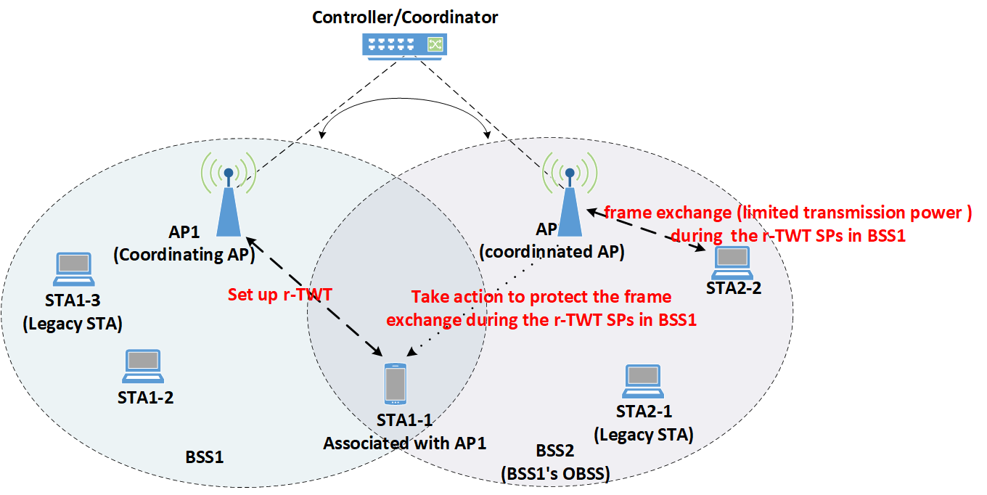
Multi-AP Type1 coordination
Roles of APs for Multi-AP Type1 coordination
Coordinating AP (AP1 in the Figure): initiating the R-TWT operation, for example a STA associated with the AP(i.e. AP1) requests for the setup of R-TWT
Coordinated AP (AP2 in the Figure): restrict the frame exchanges between the AP(i.e. AP2) and its associated STAs for enhance medium access protection for the BSS of the coordinating AP(i.e. AP1) during R-TWT SPs in BSS1
AP1 and AP2 can share the information by co-channel communication or a backhaul
Multi-AP Type1 coordination for SP scheduling
AP2 take actions to protect the frame exchanges during the r-TWT SPs in BSS1
Frame exchanges during the r-TWT SPs are limited in BSS2
Only STAs that satisfy the constraints (their frame exchanges with AP2 cannot disturb the frame exchanges during R-TWT SPs in BSS1, such as STA2-2 in the Figure) are allowed or given priority to exchange frames
Transmission power is limited for the STAs(i.e. STA2-2) that exchange frames in BSS2
Another R-TWT can be set up in BSS2 to implement this function
The schedule in this R-TWT in BSS2 is aligned with the schedule in the R-TWT in BSS1
STAs that satisfy the constraints(i.e. STA2-2) can be the member STAs of this R-TWT in BSS2
Limit the frame exchange of the STAs that cannot satisfy the constraints (the STAs are NOT the member STAs of this R-TWT in BSS2)
Quieting the legacy STAs in BSS2
Figure. Scenario for Multi-AP operation Type1
(loose coordination)

Slide 9
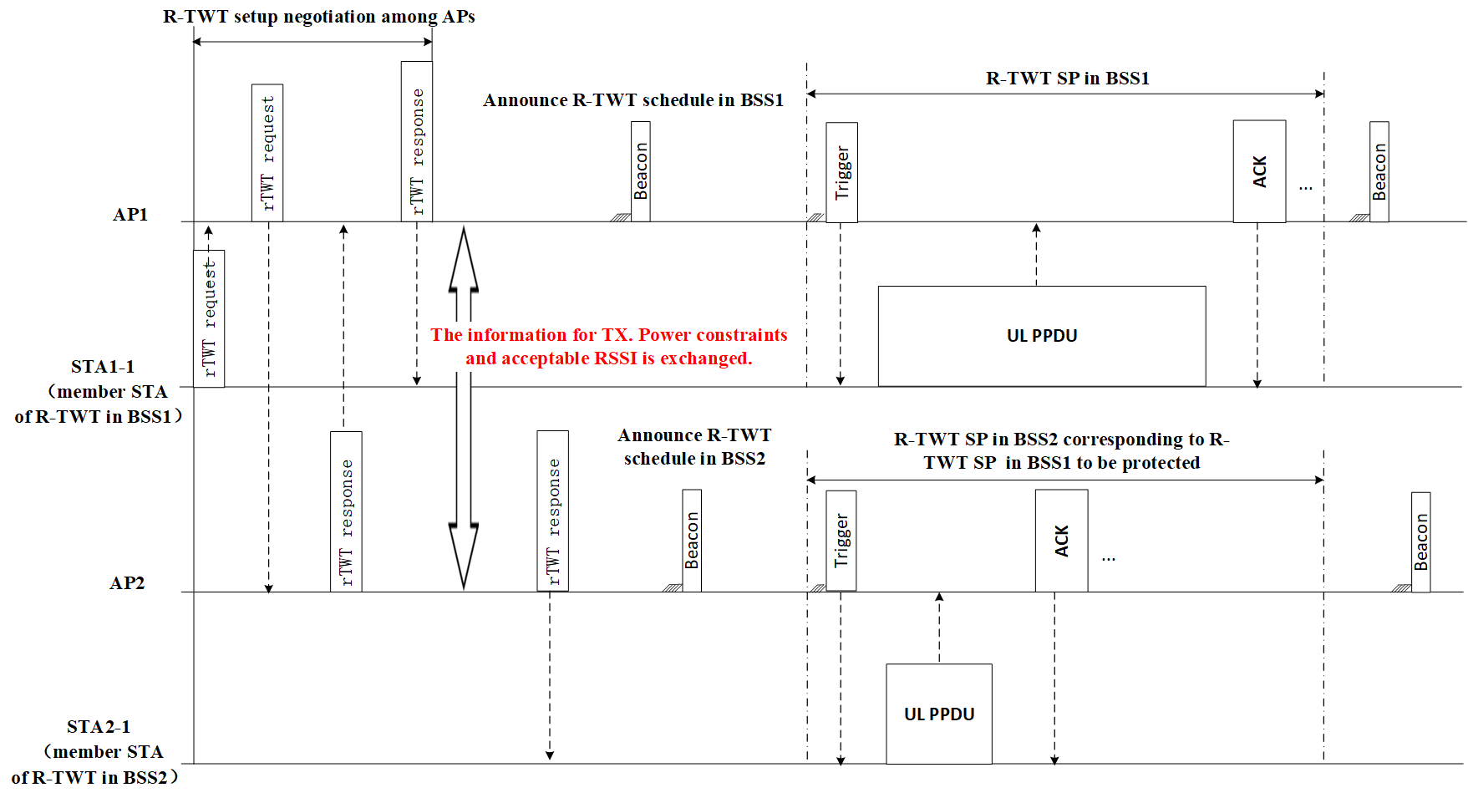
Multi-AP Type1 coordination (Cont.)
R-TWT setup is negotiated among APs
AP2 can accept or reject the R-TWT request from BSS1
The information for TX. Power constraints and acceptable RSSI of AP1 and STA1-1 is exchanged.
After successful R-TWT setup
STA1-1 exchanges frames initiated by AP1 during R-TWT SP in BSS1 with allowed TX. power.
AP2 initiates frame exchange with the STAs that satisfy the TX. constraints with allowed TX. power during R-TWT SP in BSS2 corresponding to R-TWT SP in BSS1 to be protected
Figure. Signaling for Multi-AP operation Type1 (loose coordination)

Slide 10
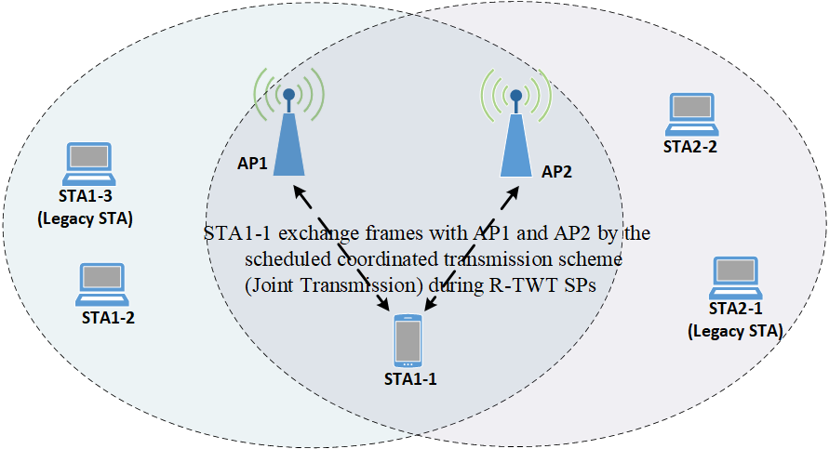
Multi-AP Type2 Coordination
Roles of APs for Multi-AP Type2 coordination
APs for Multi-AP Type2 coordination set up jointly R-TWT schedule
AP1 and AP2 communicate with each other by co-channel signaling better KPIs
AP1 and AP2 support one or more of coordinated transmission schemes, such as OFDMA/MU-MIMO/Beamforming, Joint Transmission etc.
Multi-AP Type2 coordination for SP scheduling
AP1 and AP2 and their associated STAs follow the channel access rules for R-TWT SPs
AP1 or AP2 initiates multiple-AP Type2 coordination once obtaining the TXOP near the start time of SPs
The R-TWT member STAs exchange frames with AP1 and AP2 by the scheduled coordinated transmission scheme during R-TWT SPs
Figure. Scenario for Multi-AP operation Type2 (tight coordination)

Slide 11
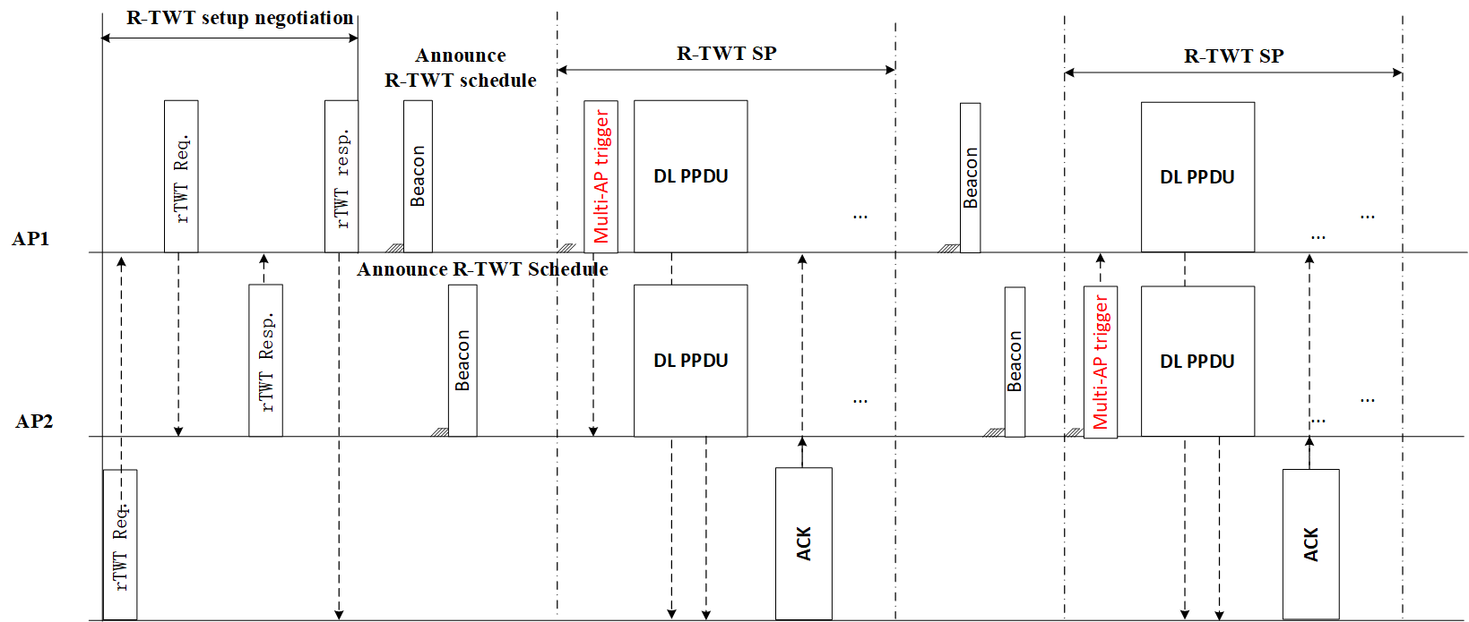
Multi-AP Type2 Coordination (Cont.)
R-TWT setup is negotiated among APs
AP2 can accept or reject the R-TWT request from BSS1
the scheduled coordinated transmission scheme and related transmission parameters are exchanged.
After successful R-TWT setup
If obtaining the TXOP any AP (AP1 or AP2) initiate the frame exchanges with the R-TWT member STA by the scheduled coordinated transmission scheme during R-TWT SPs
Figure. Signaling for Multi-AP operation Type2 (tight coordination)

Slide 12
Candidate Features for Multi-AP Coordination
The setup procedure of R-TWT for multi-AP Coordination
The setup of R-TWT needs to be negotiated among APs that will participate in multi-AP coordination
The extended parameters are suggested to be negotiated
The type of multi-AP coordination for R-TWT SPs, such as multi-AP Type1 Coordination, or multi-AP Type2 Coordination or hybrid multi-AP Coordination
The TX. Power constraints and acceptable RSSI of coordinating AP and its associated STA that requests for R-TWT setup for multi-AP Type1 Coordination
The parameters related to one or more of transmission schemes (such as coordinated OFDMA/MU-MIMO/Beamforming, Joint Transmission) for multi-AP Type2 coordination
Another type of R-TWT is suggested to be specified for multi-AP Type1 coordination
The schedule in this R-TWT for coordinated AP is aligned with the schedule in the R-TWT for coordinating AP.
STAs that are associated with coordinated AP and satisfy the constraints are the member STAs of this R-TWT for coordinated AP
Limit the frame exchange of the STAs that are associated with coordinated AP and cannot satisfy the constraints (the STAs are NOT the member STAs of this R-TWT for coordinated AP )

Slide 13
Summary
Two types of multi-AP coordination for LL traffic delivery can be considered based on different Scenarios
(1) Multi-AP Type1 coordination
TX. Power constraints and acceptable RSSI for related STAs are negotiated among APs for SP scheduling.
The coordinated AP takes actions to protect the frame exchange during the scheduled SPs in BSS of the coordinating AP (such as transmission with limited TX. power)
(2) Multi-AP Type2 coordination
the scheduled coordinated transmission scheme and related transmission parameters are exchanged for SP scheduling
The member STAs exchange frames with APs by the scheduled coordinated transmission scheme during scheduled SPs
Candidate Features for multi-AP coordination for LL traffic delivery
(1) The setup of R-TWT needs to be negotiated among APs that will participate in multi-AP Coordination
(2) Some extended parameters are suggested to be negotiated for multi-AP Type1 & Type2 coordination
(3) Another type of R-TWT(i.e. R-TWT for coordinated AP) is suggested to be specified for multi-AP Type1 coordination

Slide 14
Straw Poll
Do you agree that UHR should specify a mode of multi-AP coordination/operation to provide higher reliability for delivering low latency traffic including enhanced medium access protection for reserved resource during scheduled time among co-channel BSSs?

Slide 15
Reference
[1] IEEE 802.11be Draft 3.0
[2] IEEE 802.11-23/0028r6，PAR discussion
Liuming Lu (OPPO)

