Slide 1
Urgency-based Delivery of
Latency Sensitive Traffic
Date: 2023-02-10
Authors:
Name | Affiliation | Address | Phone | Email
Liuming Lu | OPPO |  |  | luliuming@oppo.com
Chaoming Luo
Pei Zhou
Yapu Li
Ning Gao
Liuming Lu (OPPO)

Slide 2
Introduction
11be has taken great effort to define features for improved worst case latency and jitter, such restricted TWT
Use cases: virtual reality or augmented reality, gaming, remote office and cloud computing
Traffic characteristics: typically shows periodic pattern with burst arrival of packets in each interval (the traffic is referred to as latency sensitive traffic in 11be).[1]
The features are beneficial especially for the delivery of the schedulable traffic at lightly loaded BSS with less OBSS interference
UHR takes enhanced latency improvement with high reliability as one of main Objectives/KPIs
Use cases to be extended: robotics and industrial automation for industrial IoT, logistics, and smart agriculture.[2]
Traffic characteristics to be considered: not limited to periodic pattern, may include event-based low-latency traffic which is hard to schedule
Scenarios to be extended: improving tail latency and jitter compared to 802.11be including scenarios of overlapping Basic Service Sets (BSSs) and mobility between BSSs.[3]

Slide 3
Limitations of existing features for reducing latency
According to currently specified R-TWT operation, the QoS Data frames belonging to specific R-TWT DL/UL TIDs for member R-TWT scheduled STAs during r-TWT SPs are first scheduled for delivery.
R-TWT SPs need to be negotiated in advanced between non-AP STA and AP
AP schedule the QoS Data frames for low latency traffic based on
whether the STA is a member R-TWT scheduled STA,
whether the QoS Data frames is belonging to R-TWT DL/UL TIDs
expected QoS requirement (such as delay bound) of the traffic provided at the negotiation stage with QoS characteristics element if SCS streams is established
Buffer status information by BSRP/BSR (AC/TID-based)
Current mechanism cannot dynamically and precisely obtain the urgencies of low latency traffic for the delivery, which would result that the MSDUs pending for urgent transmission can not be delivered timely.
the urgency for the delivery of MSDUs refers to whether the delay bound for the MSDU(s) has expired or is about to expire.
MSDUs corresponding to different low latency traffic may have different requirements for delay bound.
the urgency for the delivery of MSDUs would change as time going on according to the network conditions and whether the BSS is heavily loaded
The negotiation of R-TWT SPs would take some time which is not negligible, and for event-based low-latency traffic it is hard to schedule

Slide 4
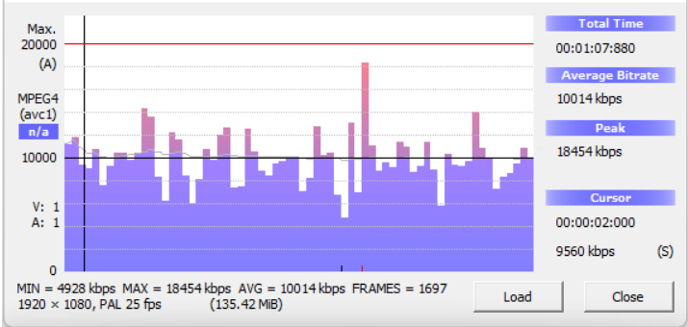
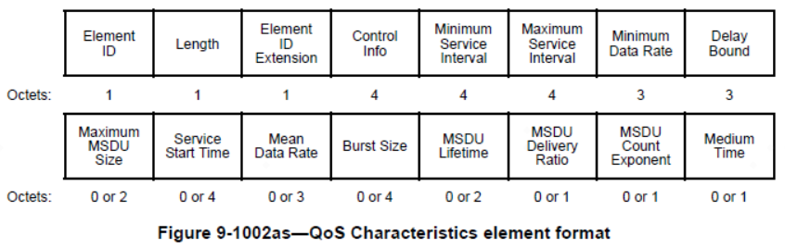
Scenario example
Use cases: HD video, virtual reality or augmented reality
Traffic characteristics: periodic pattern, relatively easy to predetermine the QoS characteristics (such as service start time, delay bound, mean date rate, etc.) at the negotiation stage, but the actual values of the QoS parameters may fluctuate in a limited range during the delivery of the traffic
Current mechanism: an EHT STA establishes SCS stream with an EHT AP by transmitting an SCS Request frame containing a QoS Characteristics element, which includes a set of parameters defines the characteristics and QoS expectations of a requested traffic flow, such as Delay Bound, Minimum Data Rate, Mean Data Rate, etc.
As a reference for the AP’s scheduling the QoS Characteristics element just gives the rough data rate of the traffic. For a typical video traffic the real-time bitrate fluctuates between the minimum bitrate and the maximum bitrate, and the difference is non-negligible.
Figure. The minimum, average, and maximum bitrates of a typical video stream

Slide 5
Scenario example
Issue: for the delivery of latency sensitive traffic during a particular r-TWT SP the QoS Data frames corresponding to the latency sensitive traffic may have different QoS requirements due to OBSS interference and/or increased burst traffic out of schedule especially in heavily loaded BSS, which means that the urgencies for the delivery of the different data frames may change dynamically.
BSRP/BSR frames don’t consider the urgency-based BSR information, which would lead to the imprecise scheduling of the delivery of the QoS data frames of latency sensitive traffic.

Slide 6
Candidate Urgency-based BSRP/BSR
Urgency-based BSR contains buffer status information of latency sensitive traffic including whether or the amount of the corresponding MSDU(s) or A-MSDU(s) pending for transmission of which the delay bound has expired or is about to expire for the traffic. BSRP is used by AP to trigger urgency-based BSR from non-AP STAs matching given conditions for QoS requirements.
Urgency-based BSRP/BSR can help to ensure more urgent QoS data frames for latency sensitive traffic are firstly scheduled for delivery.
For scenario of latency sensitive traffic with periodic pattern: more urgent QoS data frames of the traffic are firstly delivered during a restricted TWT SP even in the heavily loaded BSS with OBSS interference.
For scenario of event-based latency sensitive traffic with non-periodic pattern: AP can immediately know the urgency-based BSR information for the latency sensitive traffic from non-AP STAs before the schedule of its delivery.

Slide 7
Evaluation of urgency for delivery
Evaluation of urgency for the delivery of an MSDU or A-MSDU based on delay bound
TimetoDelayExpire(Time to delay expire): specifies the time duration from current time (T1) to the transmission delay expiration time (T2) for an MSDU or A-MSDU with the transmission requirement of delay bound belonging to a traffic flow
the transmission delay expiration time (T2) is the time marking the arrival of the MSDU, or the first MSDU of the MSDUs constituting an A-MSDU, at the local MAC sublayer from the local MAC SAP (T0) plus delay bound.
T
a)A MSDU or A-MSDU with its transmission delay time having not expired
b)A MSDU or A-MSDU with its transmission delay time having expired
for an MSDU or A-MSDU in the buffer if its transmission delay expiration time (T2) is later than the current time (T1), its transmission delay time has not expired (denoted as TimetoDelayExpire > 0)
for an MSDU or A-MSDU in the buffer if its transmission delay expiration time (T2) is equal to or earlier than the current time (T1), its transmission delay time has not expired (denoted as TimetoDelayExpire ≤ 0)

Slide 8
Evaluation of urgency for delivery
The urgency for the delivery of MSDUs or A-MSDUs belonging to latency sensitive traffic for different STAs associated with an AP can be measured based on the parameter of TimetoDelayExpire
0<Min(TimetoDelayExpire<Max(TimetoDelayExpire)
The delay bound for all of the corresponding MSDU(s) or A-MSDU(s) pending for transmission has not expired.
Min(TimetoDelayExpire)<0<Max(TimetoDelayExpire)
The delay bound for part of the corresponding MSDU(s) or A-MSDU(s) pending for transmission has expired.
Current Time
The delay bound for all of the corresponding MSDU(s) or A-MSDU(s) pending for transmission has expired.
Min(TimetoDelayExpire)<Max(TimetoDelayExpire)<0
An example for measuring the urgency for the delivery of MSDUs or A-MSDUs at a specific time (current time)

Slide 9
Candidate Solution
Evaluation of urgency for the delivery of an MSDU or A-MSDU
(1) Based on TimetoDelayExpire Bound
TimetoDelayExpire Bound indicates the range of the urgency for the delivery of MSDUs or A-MSDUs
if the current TimetoDelayExpire of an MSDU or A-MSDU is equal to or less than TimetoDelayExpire Bound, it satisfies the condition within the range of the urgency for MSDUs or A-MSDUs in the buffer
(2) Based on whether the transmission delay time expires in a given upcoming time
if the transmission delay time of an MSDU or A-MSDU will expire in a given time (i.e. the TimetoDelayExpire of the MSDU or A-MSDU in the given time is equal to or less than 0) it satisfies the condition within the range of the urgency for MSDUs or A-MSDUs in the buffer

Slide 10
Candidate Solution
AP schedules the delivery of the QoS data frames of the latency sensitive traffic to ensure that more urgent QoS Data frames are firstly delivered during a R-TWT SP.
U-BSRP contains the information of the given urgency range, such as TimetoDelayExpire Bound, to trigger the BSR which satisfies the urgency condition.
U-BSR contains the BSR information within the given urgency range, such as the buffer status of QoS data frames with the given TID(s) of the latency sensitive traffic, which would expire within TimetoDelayExpire Bound.

Slide 11
Summary
QoS Data frames corresponding to the latency sensitive traffic may have different urgencies for the delivery due to OBSS interference and/or increased burst traffic out of schedule especially in heavily loaded BSS
Urgency-based BSRP/BSR can help to ensure more urgent QoS data frames for latency sensitive traffic are firstly scheduled for delivery.
For scenario of latency sensitive traffic with periodic pattern: more urgent QoS data frames of the traffic are firstly delivered during a R-TWT SP even in the heavily loaded BSS with OBSS interference.
For scenario of event-based latency sensitive traffic with non-periodic pattern: AP can immediately know the urgency-based BSR information for the latency sensitive traffic from non-AP STAs before the schedule of its delivery.

Slide 12
Reference
[1] IEEE 802.11be Draft 3.0
[2] IEEE 802.11-22/1919r4, Considerations on UHR PAR and KPIs
[3] IEEE 802.11-23/0028r6，PAR discussion
Liuming Lu (OPPO)

Slide 13
SP
SP : Do you support to specify urgency-based BSRP (U-BSRP) and Urgency-based BSR (U-BSR) for UHR?
Liuming Lu (OPPO)

