Slide 1
Thought for Range Extension in UHR
Jan. 2023
Date: 2023-01-13
Authors:
Name | Affiliation | Address | Phone | Email
Dongguk Lim | LG Electronics | 19, Yangjae-daero 11gil, Seocho-gu, Seoul 137-130, Korea |  | dongguk.lim@lge.com
Eunsung Park |  |  |  | Ensung.park@lge.com
Jinyoung Chun |  |  |  | jiny.chun@lge.com
Insik Jung |  |  |  | insik0618.jung@lge.com
Jinsoo Choi |  |  |  | js.choi@lge.com
Insun Jang |  |  |  | insun.jang@lge.com
Sunhee Baek |  |  |  | sunhee.baek@lge.com
HanGyu Cho |  |  |  | hg.cho@lge.com
Sanggook Kim |  | 10680 Treena St San Diego, CA 92131 |  | sanggook.kim@lge.com

Slide 2
Introduction
To improve the reliability and enhance the throughput in the UHR(i.e. Ultra High Reliability) coverage, we can consider the range extension for the UHR.
The potential technologies have been proposed in [1-2] to achieve the range extension in UHR.
In this presentation, we investigate the candidate technologies for range extension and consider the technical direction for the object of that.

Slide 3
Candidate technologies for range extension
For the range extension, the following technologies can be considered candidate techniques.
  Repeated transmission
  Multi-AP operation
  Relay transmission
In the next slides, we will provide more details for each of the candidates above.

Slide 4
Repeated transmission
It is very simple and conservative way used to extend the range and enhance the SNR.
  The repeated transmission in the time/frequency domain can improve the received SNR.
    One RU or one symbol can be considered a unit of repetition.
Using the smaller size of OFDMA RU with repetition is one way to extend the range.
  For example, ideally, 9.5dB gain is expected when the 26-tone RU with 9 times repetition is applied in 20MHz.
    In [2], to achieve enhanced longer coverage based on market needs, about 9dB improvement was required.
Alternatively, iterating over one symbol multiple times to obtain this gain may be considered.
Frequency rep.
26-tone RU1
26-tone RU2
20MHz
∙∙∙
26-tone RU8
26-tone RU9
∙∙∙

Slide 5
Considerations
Performance limitation
  Due to the limitation of the preamble performance, repetition with a smaller RU size tone may not bring significant range benefit[3].
    We may consider around 3dB gain by applying preamble boosting or symbol repetition SIGs, but, that might not be still enough for UHR range.
  It may not be easy to expect enough gain practically due to the various impairments (e.g., fading/ shadowing, interference, etc.) in real world
Data rates
  The data rate may be limited as a low rate due to the repetition of RU/Symbols for performance enhancement.
    Considering reliable transmission, using low MCS may also affect on data rate
  Due to restricted space of the supported data rates, limited services may be provided to STAs located at the boundary.
Power imbalance
  Generally, AP can transmit at higher power and antenna than Non-AP STA. Thus, we may consider the range difference between AP and non-AP STA.
    UL generally needs more repetition whilst DL can achieve higher BF/MIMO gain

Slide 6
Multi-AP operation
Since a single AP has limited coverage, by using the Multi-AP operation we can expand the coverage of Wi-Fi.
  It can be extended from the aspect of network coverage.
The Multi-AP operation can provide the extension of coverage through the following operations.
  Reduction of interference from other OBSS in the coverage area.
    It can improve the weak RSSI or SINR of receiving non-AP STA
  Joint transmission of data that will be transmitted from other BSS to non-AP STA.
    Non-AP STA may receive same data jointly in coverage area from two APs that compensates channel impairments and improves received SINR.
Nulling or interference cancelation
AP1
STA
AP2
Joint transmission

Slide 7
Considerations
AP coordination
  Since it performs through mutual coordination with other AP, cooperation protocols between APs are required. And, regarding this, signaling for synchronization, and sounding/feedback procedure to get CSI among APs and STAs may be considered.
Joint Transmission
  In addition to coordination, for joint transmission of the same data, it requires data transfer/sharing between APs.
    Thus, consideration on backhaul link(wired/wireless) and its capacity should be taken into account for efficiently sharing data between Aps.
    For example, MLO may be useful for handling this by enabling normal transmission to serving STAs and data sharing in different links.
  To get intact gain of joint transmission, there are other technical points that should be considered as following.
    For example, CSI among all APs/STAs, synchronization, residual CFO, Tx gain fluctuation, Phase drift, allocation of wireless co-channel, etc.

Slide 8
Relay transmission
Relay technology has been widely considered for extending the coverage area.
  To provide an enhanced user experience, it has been applied to the cellular network and the discussion for enhancement of Relay support was processed[4].
Relay can be used as a bridge between the link between AP and Relay and the link between Relay and non-AP STA.
  It is expected that both links experience better channel conditions compared to the direct link between AP and non-AP STA(s) on condition that the Relay is appropriately deployed.
    It may possible to use the higher MCS order in each link when Relay operation is assumed.
STA1
AP1
Relay
STAn

Slide 9
Considerations (1/5)
Definition of Relay STA
  There are two types of Relay STAs that can be considered, and each type is distinguished by whether a Relay STA has an AP function or not.
    For example, if Relay STA has an AP function, it can act as AP, and it can schedule itself.
      Flexibility in relay operation, but more complexity.
        The same or different operating channel widths can be used.
        Since independent scheduling is possible, high complexity as a role of AP for relay STA is required to apply the appropriate transmission parameters ( OFDMA scheduling, beamforming, etc.).
    On the contrary, if the relay STA doesn't have an AP function, it can act as a non-AP STA, and it is controlled by the AP.
      The support of relay operation is announced with management frame such as beacon frame by AP.
      Relay STA can be defined by the capability when it associates with AP.
      It may require the new signaling design to compose both TX parameters and RX parameters for relay operation.

Slide 10
Considerations (2/5)
Processing of Relay
  In the processing of the relay, two methods are considered. One is Amplify and forward(i.e. AF) and, the another is decode and forward( i.e., DF).
  AF is a very simple way but, since it can also transfer the amplified noise, it can incur performance degradation.
  DF decodes the received signal and re-encodes the decoded signal for transmission.
    Thus, it may have higher complexity than AF and additional latency due to Demodulation/modulation and Decoding/encoding operations. So, preferred for less delay-sensitive transmission.
    However, it can prevent performance degradation due to the amplification of inter-cell interference and noise and enhance the signal quality by error correction.
    Also, it is possible to adapt suitable MCS per channel between relay STA and non-AP STA(s), which can enhance the RvR.

Slide 11
Considerations (3/5)
Radio resource Duplexing
  For relay operation, transmission between AP and Relay STA and transmission between Relay STA and non-AP STA are considered.
    To perform those two transmissions, there are two duplexing methods that can be done either in the frequency or time domain.
      It is preferred to allocate separate time resources to the AP to Relay link and Relay to STA link in one TXOP.
        It may minimize the signaling complexity, overhead, and impact on conventional operations.
TXOP
  To accommodate two different transmissions. i.e., AP to Relay STA and Relay STA to non-AP STA, it may be considered how to set up TXOP and share it.
    TXOP for relay transmission may be set in consideration of all transmissions or may be set in consideration of some transmissions such as a relay STA to non-AP STA(s).

Slide 12
Considerations (4/5)
    TXOP sharing is performed by the AP, and for this, we can consider the reusing Triggered TXOP sharing(TXS) has been defined in 11be.
      For simplicity, TXOP for a relay operation is shared by one TXS.
      In addition, new designs or modifications for TXS should be considered for sharing the TXOP with more than one STA.
    Example of procedure for relay operation.

Slide 13
Considerations (5/5)
End to End QoS enhancement
  The channel status of two transmissions, i.e., AP to Relay STA and Relay STA to non-AP STA is different. So, for efficient transmission, the situation of each channel should be well measured.
    To measure the channel status between Relay STA and non-AP STA, the channel sounding between non-AP STAs should be considered.
      For example, the measurement is initiated by the Relay STA which may be defined as non-AP STA. Also, this procedure can be triggered by the AP.
    By using the appropriate MCS per link according to channel status, RvR enhancement can be achieved.
Multi-hop operation
  Using multi-hop operation can expand the coverage largely, but it may also incur performance degradation and complexity increases.
    For the above reasons, only one-hop operation may be considered.

Slide 14
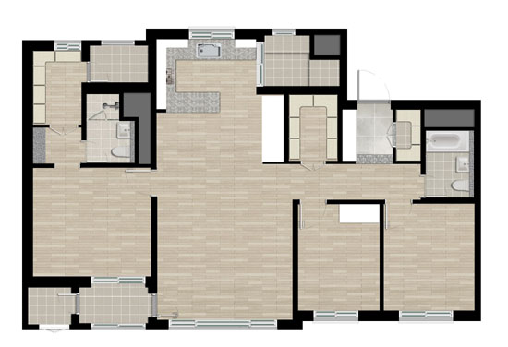
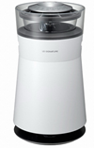
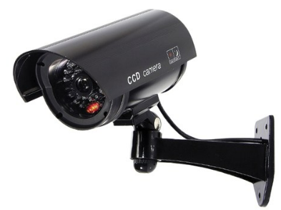
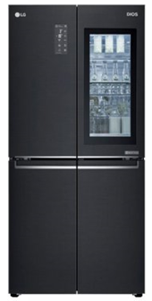
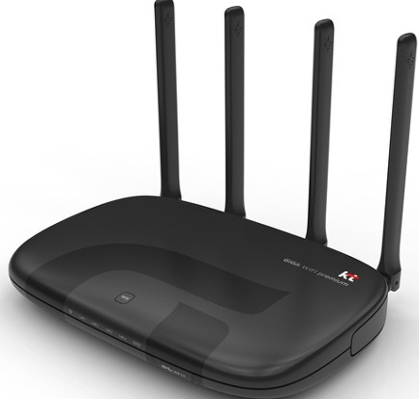


Use case for Relay transmission
Exemplary illustration for Relay on residential smart home devices.
  The majority of smart home devices like TV, Laptop/Pad supports Wi-Fi these days, and this trend is growing.
  In this situation, TV or some high-end home appliances can acts as Relay, covering the coverage hole in the home and supporting the devices that locate at the edge.
    For example, TV can act as Relay, and support for Wi-Fi connectivity of devices located at the edge of the home, such as surveillance camera or air-conditioner.
      The home appliances located at the edge can transmit or receive the signal to AP or from AP through the TV, respectively.
No relay link(enough coverage)
AP to Relay STA link
Relay STA to non-AP STA link
Relay

Slide 15
Summary
In order to provide the reliability of UHR coverage, the expansion of UHR coverage should be considered.
As an effort to extend of range, in this contribution, we took a look at the candidate technologies for the range extension in UHR.
  Repeated transmission
  Multi-AP operation
  Relay transmission
The technological considerations for each of the candidate technology described in this contribution should be taken into account to determine the appropriate way to improve throughput, range, and reliability in the coverage area.

Slide 16
Reference
[1] 11-22-1908-01-0uhr-uhr-rate-vs-range-enhancement-with-Relay
[2] 11-22-1928-01-0uhr-enhanced-long-range-usage-scenarios-design-target-and-feasibility
[3] 11-15-1309-01-00 Extended Range Support for 11ax
[4] 3GPP TR 38.874, “Study on Integrated Access and Backhaul,” V16.0.0, Dec. 2018.

