Slide 1
Proposal on 320 MHz Ranging NDP
Date: 2023-03-31
Authors:
Name | Affiliations | email
Steve Shellhammer | Qualcomm | shellhammer@ieee.org
Ali Raissinia |  | alirezar@qti.qualcomm.com
Yanjun Sun |  | yanjuns@qti.qualcomm.com
Bin Tian |  | btian@qti.qualcomm.com

Slide 2
Introduction
There are several areas where enhancements are needed to support 320 MHz Ranging in 802.11bk
Here we focus on the 320 MHz Ranging NDP and the 320 MHz TB Ranging NDP
We begin by providing some background related to 802.11az and 802.11be
Then we make several proposals on the 320 MHz Ranging NDP and the 320 MHz TB Ranging NDP

Slide 3
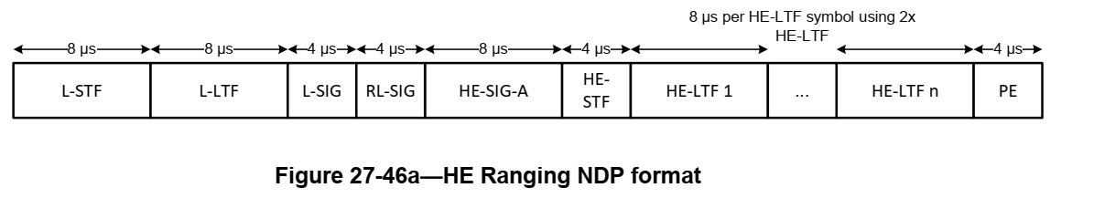
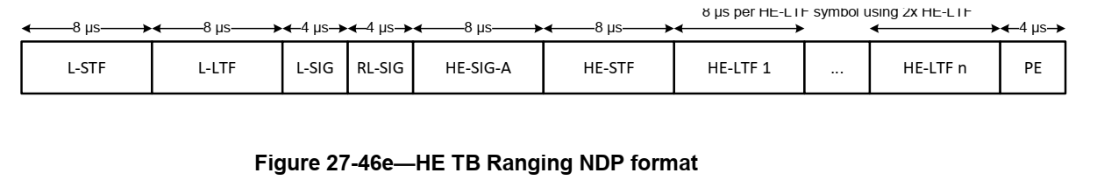
Background – HE (TB) Ranging NDP
The Ranging NDP is an extension of the 11ax NDP
There is a Ranging NPD as well as a TB Ranging NDP
  They are similar in structure with a different duration HE-STF

Slide 4
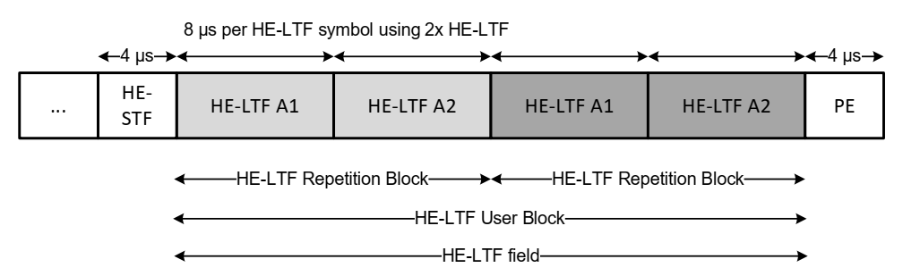
Background – HE (TB) Ranging NDP (cont.)
Ranging NDP supports HE-LTF Repetition Blocks
  The number of Repetitions is specified in the NDPA
  Secure ranging uses the repetitions in detection of attacks
Support only 2x LTFs with 1.6 µs GI
Ranging NDP uses HE-LTF for non-secure ranging and uses Secure HE-LTFs for secure ranging
Secure HE-LTFs have a zero GI

Slide 5
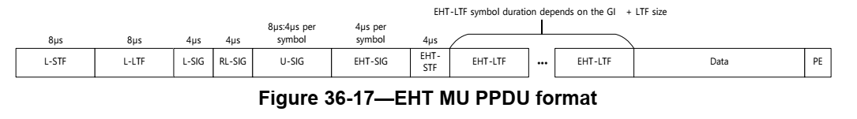
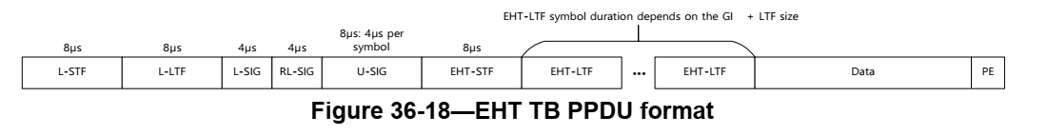
Background – 320 MHz EHT NDP
EHT supports two PPDU formats
The NDP is simplified version of the MU PPDU without the Data field
In the TB PPDU:
  There is no EHT-SIG (Information sent in the Trigger Frame)
  The EHT-STF is 8 µs versus 4 µs per symbol

Slide 6
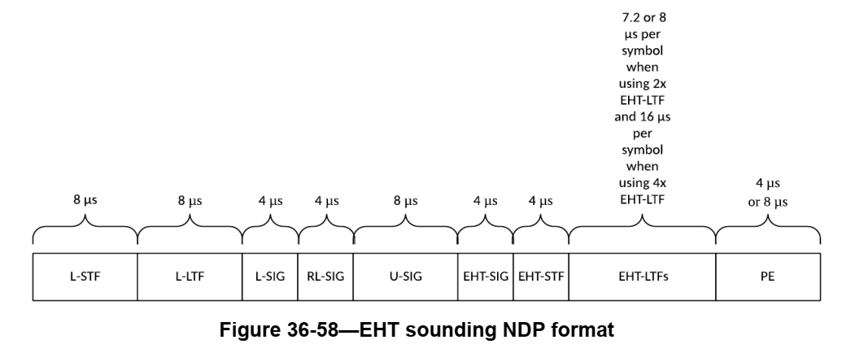
Background – 320 MHz EHT NDP (cont.)
Currently 11be only supports NDP based upon the MU PPDU
In addition to modifying the 320 MHz EHT NDP to support LTF Repetition Blocks, we will need a Ranging NDP based upon the EHT TB PPDU

Slide 7
EHT LTF Versions
IEEE 802.11az Ranging NDP uses 2x LTFs with 1.6 µs GI
  Other LTFs are disallowed
Support for 2x LTF with 1.6 µs GI is mandatory in EHT for both MU PPDU and TB PPDU
Proposal #1
  Just like in 802.11az we propose to support only the 2x LTF with 1.6 µs GI for both the 320 MHz Ranging NDP and the 320 MHz TB Ranging NDP

Slide 8
LTF Repetition Blocks (Non-Secure LTFs)
We can use the 320 MHz EHT LTFs for the Repetition Blocks
No change in the LTF sequence from EHT LTFs is required
Support up to 8 EHT-LTF Repetition Blocks, just like in 802.11az
Proposal #2
  We propose no changes to the EHT 320 MHz LTF sequences
Proposal #3
  We propose support of up to eight EHT-LTF Repetition Blocks

Slide 9
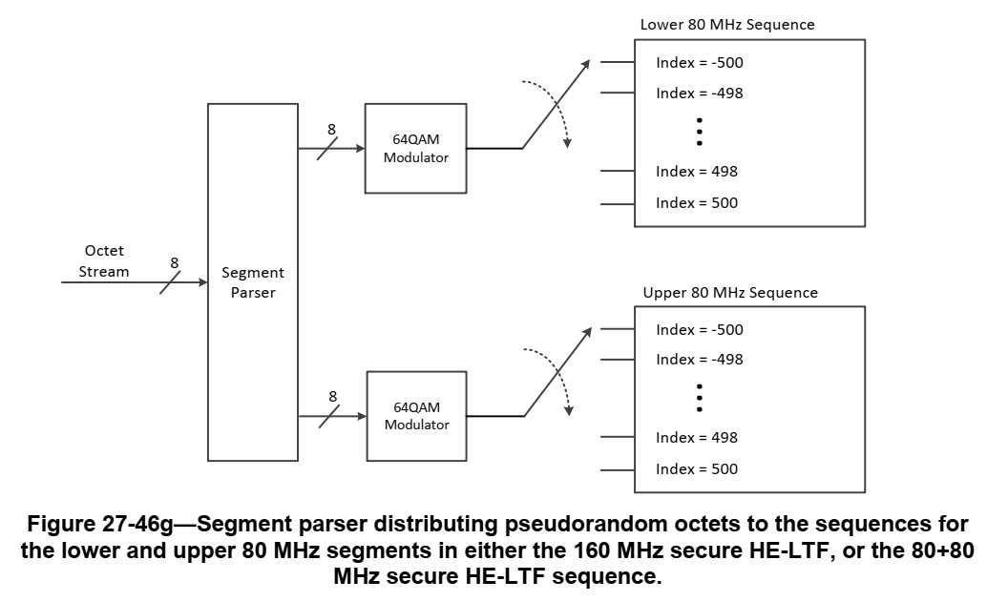
Secure LTFs
In 802.11az we used a segment parser for 160 MHz NDP
For 802.11bk we need to extend this for:
  320 MHz
  Support Preamble Puncturing

Slide 10
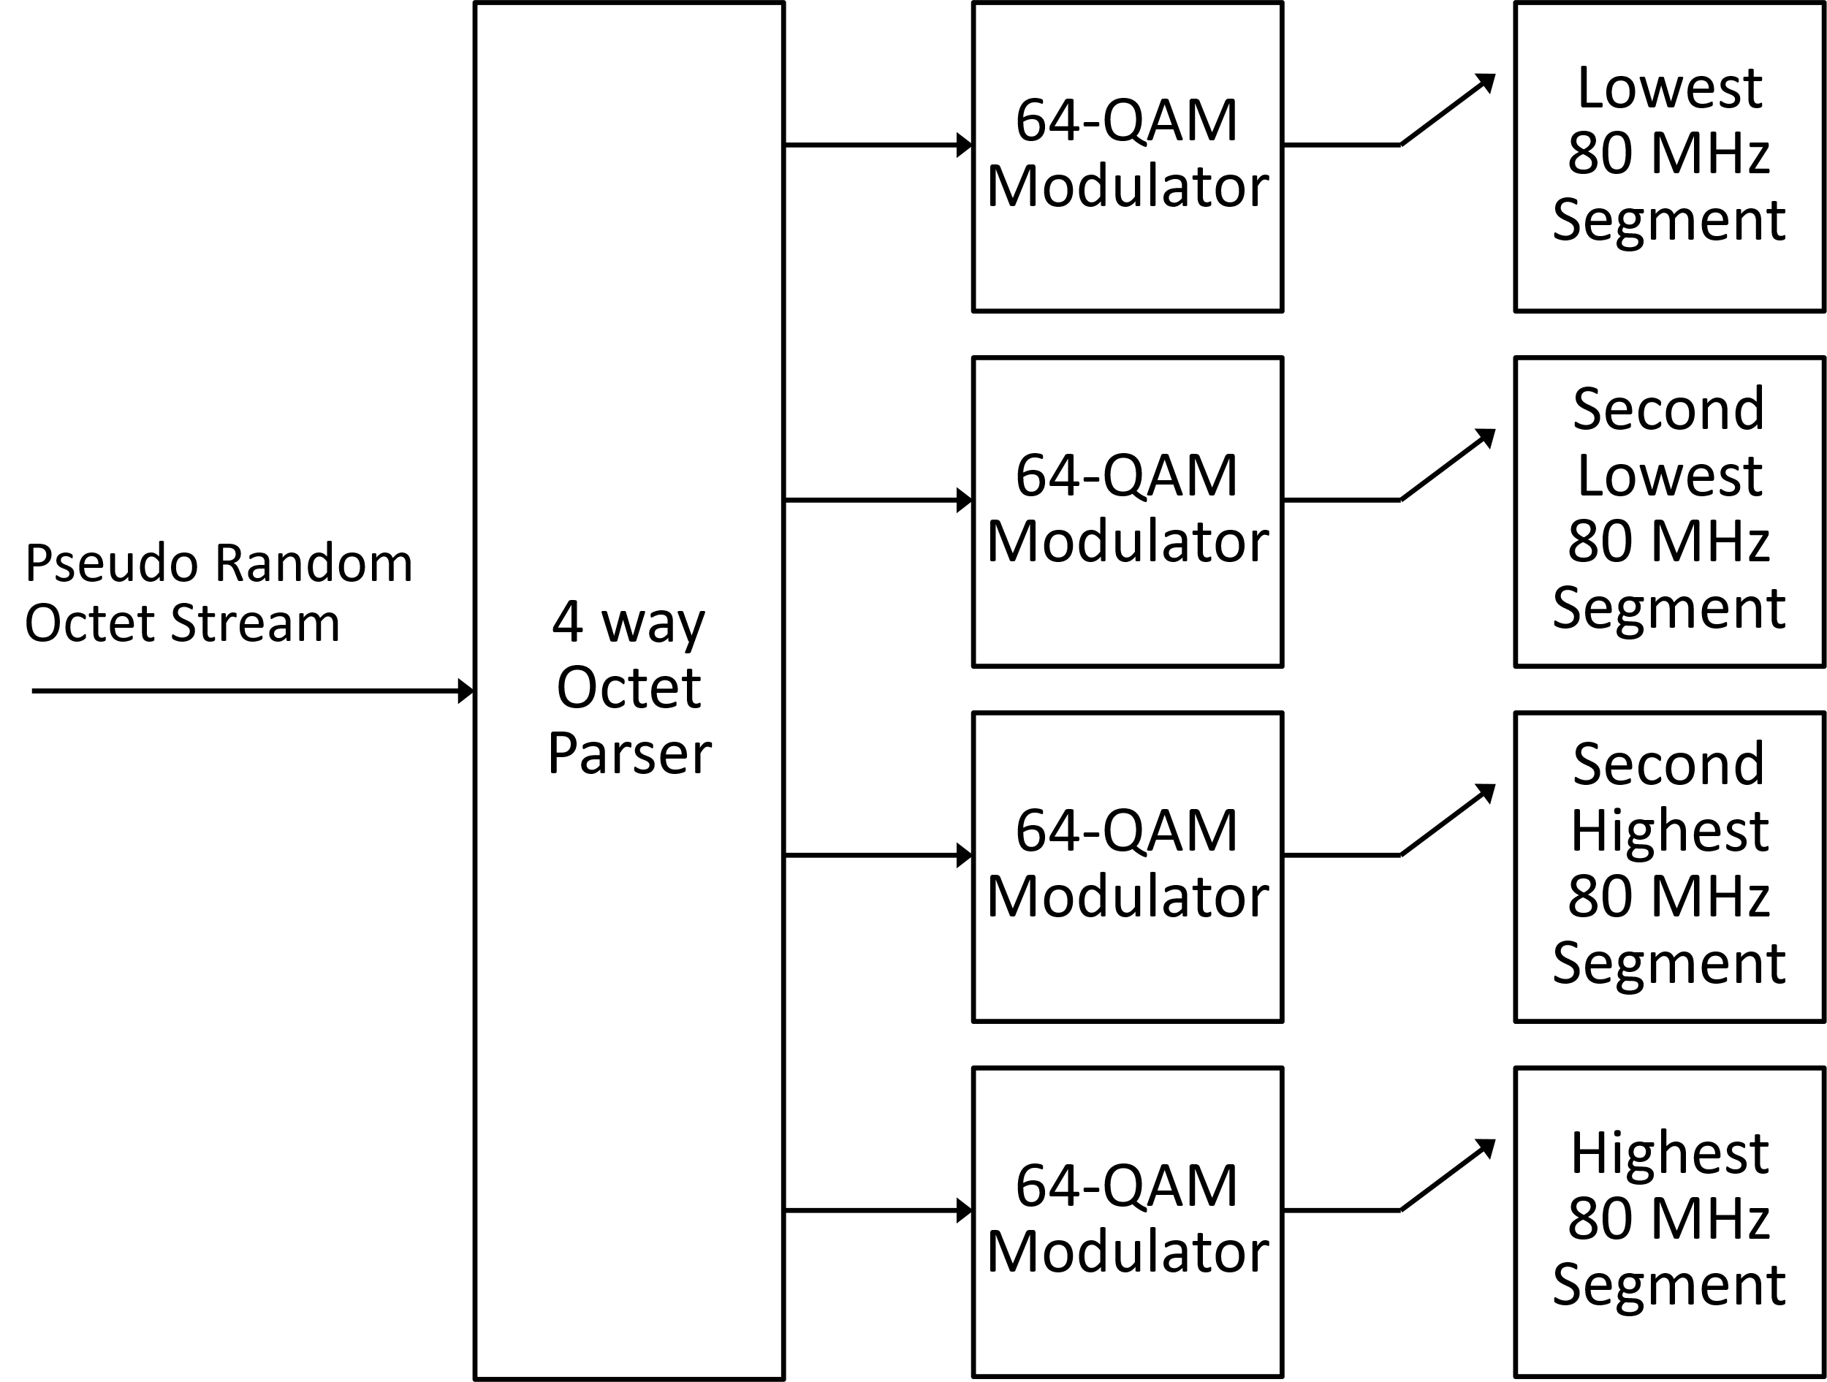
320 MHz Secure LTF (No Puncturing)
Natural Extension from 11az
Change from a 2-way Octet Parser to a 4-way Octet Parser

Slide 11
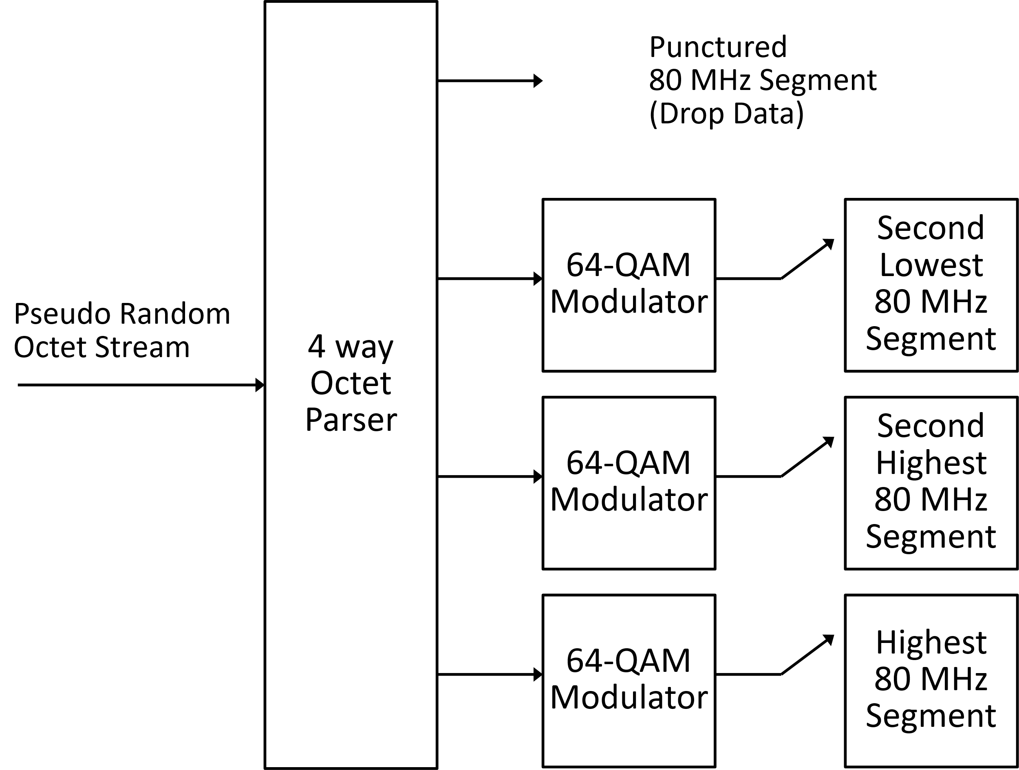
320 MHz Secure LTF (80 MHz Puncturing)
Here we stick with the 4-way parser
A 3-way parser would work in this case but not in the 40 MHz puncturing case
We just drop pseudo random octets we do not need
  A few comments about enough pseudo random octets provided in the backup
It is the same process at transmitter and receiver, so tones are populated the same in both transmitter and receiver
Any of the four 80 MHz segments can be punctured

Slide 12
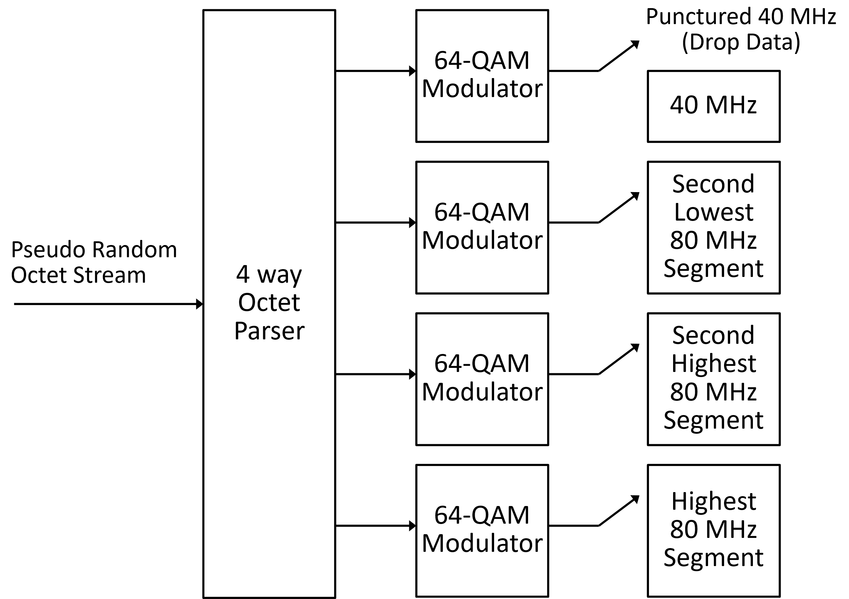
320 MHz Secure LTF (40 MHz Puncturing)
Here we see the advantage of sticking with the 4-way parser
We drop the octets that would have populated the tones of the first 40 MHz
No need to change the architecture
It is the same process at transmitter and receiver, so tones are populated the same in both transmitter and receiver
Any of the four 40 MHz segments can be punctured

Slide 13
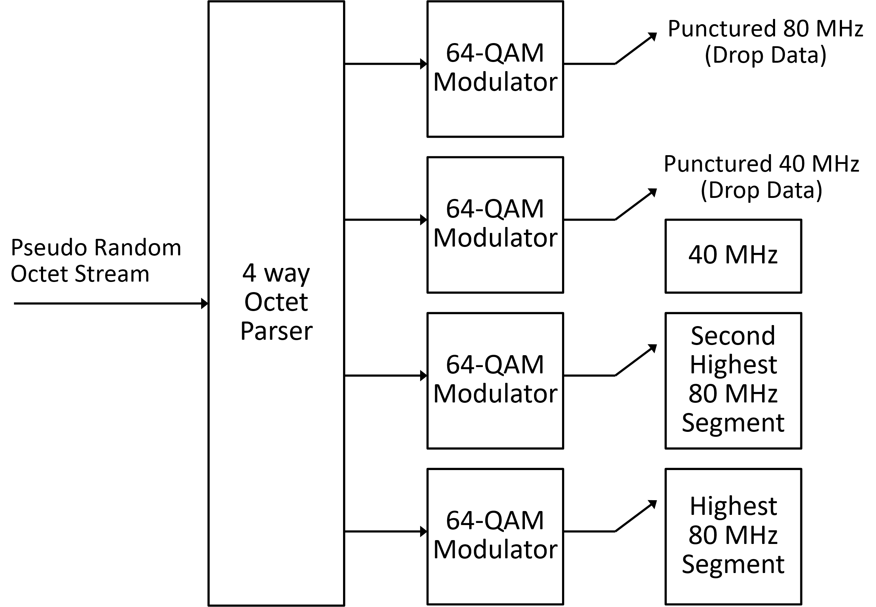
320 MHz Secure LTF (40 & 80 MHz Puncturing)
This architecture also works for the case of 40 & 80 MHz puncturing
Being able to drop pseudo random octets makes using the same architecture possible and simplifies the implementation

Slide 14
Proposal for 320 MHz Secure LTFs
Proposal #4
  We propose that a 4-way octet parser be used to parse the pseudo random octets between the four 80-MHz segments
  We propose that when either 40 MHz and/or 80 MHz is punctured then the pseudo random octets which would have been sent to that punctured bandwidth be dropped at both the transmitter and the receiver
Note: This is illustrated on Slides 10-13

Slide 15
Signaling 320 MHz Ranging NDP in Preamble
In the 320 MHz Ranging NDP the intended receiver of the NDP knows from the NDP U-SIG bandwidth field and the preceding NDPA that this is a 320 MHz Ranging NDP
In the 320 MHz TB Ranging NDP the AP is the intended receiver
  Since the AP solicited the NDP with the Trigger frame, it knows it will be receiving the 320 MHz TB Ranging NDP
It is useful to signal in the preamble of the NDP that this is a Ranging NDP and not a traditional EHT NDP (as currently signaled in U-SIG)
  Informs Third-Party STAs this is a Ranging NDP
  Useful for Sniffers to ease parsing of PPDUs
Do this for both the 320 MHz Ranging NDP and 320 MHz TB Ranging NDP

Slide 16
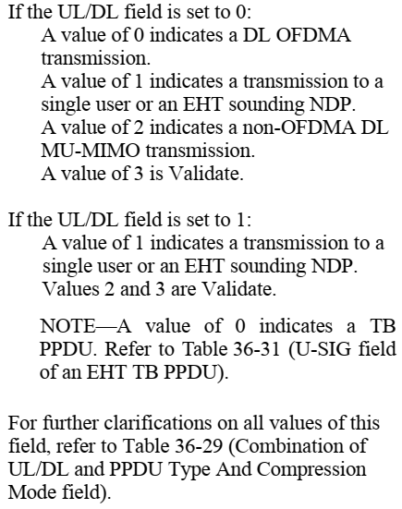
Indicating Ranging NDP in 320 MHz Preamble
The MU PPDU preamble will be used for the 320 MHz Ranging NDP
Currently there is a field which indicates if this is an NDP
This is the U-SIG PPDU Type And Compression Mode field (U-SIG-2 B0-B1)
We could set the “PPDU Type And Compression Mode” field to a value of 3
There are also some reserved bits (Validate or Disregard) in the U-SIG
  We can also consider using one of the reserved bits

Slide 17
Indicating TB Ranging NDP in 320 MHz Preamble
Currently there is not a TB EHT NDP
As mentioned earlier we would need to build this upon the EHT TB PPDU
The U-SIG is a little different in the TB PPDU
The PPDU Type And Compression Mode field is also present in the U-SIG of the TB PPDU
There are also some reserved bits (Validate or Disreguard) in the U-SIG of the TB PPDU
So, we should be able to signal in the U-SIG of the TB PPDU that this is a 320 MHz TB Ranging NDP

Slide 18
Recommended Signaling Approach
Type of Ranging NDP | EHT PPDU Type | U-SIG UL/DL Field value | U-SIG PPDU Type And Compression Mode value
320 MHz Ranging NDP | MU PPDU | 0 | 3
320 MHz TB Ranging NDP | TB PPDU | 1 | 3
The UL/DL indicates if this is transmitted by an AP (Downlink) or if it is sent to an AP (Uplink)
  The downlink case uses at EHT MU PPDU preamble
  The uplink case uses an EHT TB PPDU preamble
The PPDU Type and Compression Mode is set to 3 for both the 320 MHz Ranging NDP and the 320 MHz TB Ranging NDP
  This value of 3 is Validate in both the EHT MU PPDU and the EHT TB PPDU

Slide 19
Proposal on Signaling the PPDU is a Ranging NPD
Proposal #5
  We propose in both the 320 MHz Ranging NDP and the 320 MHz TB Ranging NDP signaling be included in the U-SIG indicating the NDP is a 320 MHz Ranging NDP
Note: Since there are several options for this signaling, we will include straw polls on these options for both the 320 MHz Ranging NDP and the 320 MHz TB Ranging NDP

Slide 20
Longer Packet Extension
The current packet extension (PE) in the Ranging NDP is 4 µs
Given that we are extending the bandwidth to 320 MHz we think it is good to increase the PE to 8 µs in the 320 MHz Ranging NDP and the 320 MHz TB Ranging NDP
  This provides the receiver some additional time for computations
Proposal #6
  We propose an 8 µs PE duration for both the 320 MHz Ranging NDP and the 320 MHz TB Ranging NDP

Slide 21
Summary
We provided relevant background on 802.11ax and 802.11be
We provided several proposals on the 320 MHz Ranging NDP and the 320 MHz TB Ranging NDP
We provide several Straw Polls

Slide 22
Straw Poll #1
Do you agree that 802.11bk will only support the 2x LTF with 1.6 µs GI for both the 320 MHz Ranging NDP and the 320 MHz TB Ranging NDP?
Yes 22
No 0
Abstain 7

Slide 23
Straw Poll #2
Do you agree that 802.11bk 320 MHz Ranging NDP will use the EHT MU PPDU preamble? (New wording from Jonathan)
Yes 23
No 1
Abstain 6

Slide 24
Straw Poll #3
Do you agree that 802.11bk 320 MHz TB Ranging NDP will use the EHT TB PPDU preamble?
Yes 22
No 0
Abstain 8

Slide 25
Straw Poll #4
Do you agree that for 802.11bk non-secure LTF will use the 320 EHT LTFs for both the EHT Ranging NDP and the EHT TB Ranging NDP?
Unanimous consent

Slide 26
Straw Poll #5
Do you agree that 802.11bk will support up to eight EHT-LTF Repetition Blocks for both the EHT Ranging NDP and the EHT TB Ranging NDP, and will not support extra EHT LTFs?
Yes
No
Abstain

Slide 27
Straw Poll #6
Do you agree that 802.11bk will support secure ranging, using AES-128 for pseudo random octet generation and use 64-QAM modulation?
Note: 802.11az uses AES-128 for pseudo random octet generation and 64-QAM modulation for secure LTFs
Yes
No
Abstain

Slide 28
Straw Poll #7
Do you agree that 802.11bk secure LTF ranging will use a 4-way octet parser to parse the pseudo random octets between the four 80-MHz segments, and that when a subchannel is punctured then the pseudo random octets which would have been sent to that punctured subchannel be dropped at both the transmitter and the receiver
Note: This is illustrated on Slides 10-13 (doc 11-23/40r1)
Yes
No
Abstain

Slide 29
Straw Poll #8
Do you agree that in 802.11bk an 8 µs PE duration will be used in both the EHT Ranging NDP and the EHT TB Ranging NDP?
Yes
No
Abstain

Slide 30
Straw Poll #9
Do you agree that in both the EHT Ranging NDP and the EHT TB Ranging NDP signaling be included in the U-SIG indicating the NDP is a Ranging NDP?
Yes
No
Abstain

Slide 31
Straw Poll #10
For indicating the PPDU is a 320 MHz Ranging NDP in the U-SIG of the MU PPDU which is your preferred method?
  Option #1
    Set the PPDU Type And Compression Mode subfield to 3 (The value of 3 is currently Validate)
  Option #2
    Set U-SIG-1 B25 to 0 (It is currently set to 1 and Validate)
  Option #3
    Set U-SIG-2 B2 to 0 (It is currently set to 1 and Validate)
  Option #4
    Set U-SIG-2 B8 to 0 (It is currently set to 1 and Validate)

Slide 32
Straw Poll #11
For indicating the PPDU is a 320 MHz TB Ranging NDP in the U-SIG of the TB PPDU which is your preferred method?
  Option #1
    Set the PPDU Type And Compression Mode subfield to 3 (The value of 3 is currently Validate)
  Option #3
    Set U-SIG-2 B2 to 0
    (It is currently set to 1 and Validate. This is performed by copying the value from the Special User Info field in the Trigger frame into U-SIG-2 B2, so changing this is accomplished by changing the subfield in the prior Trigger frame)

Slide 33
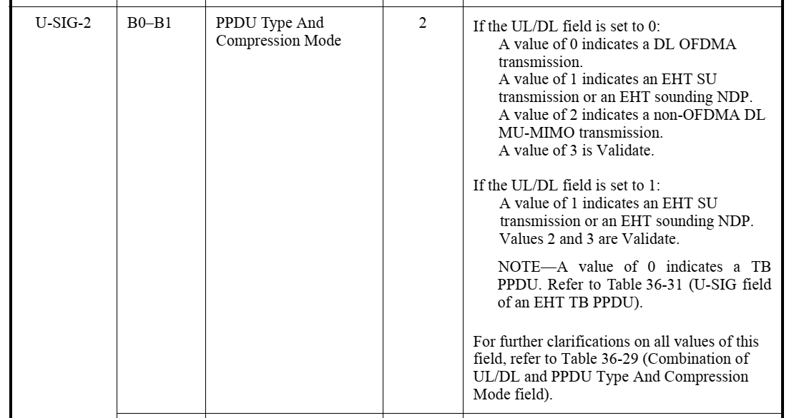
Backup – Tables on EHT U-SIG PPDU Type and Compression Mode

Slide 34
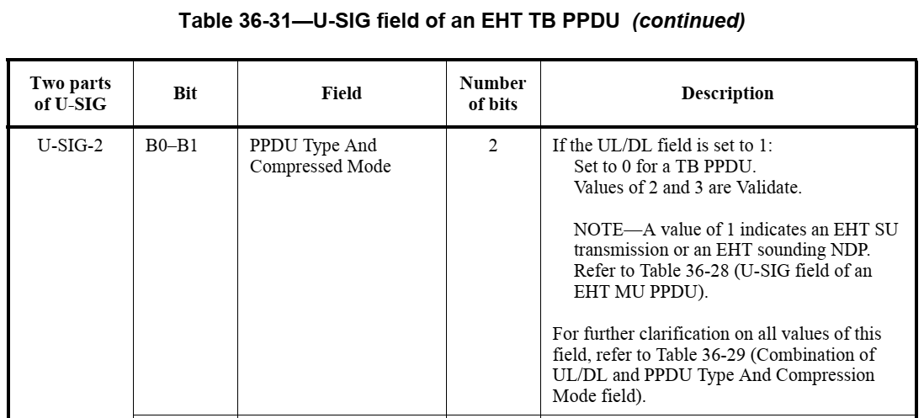
Tables on EHT U-SIG PPDU Type and Compression Mode (cont.)

Slide 35
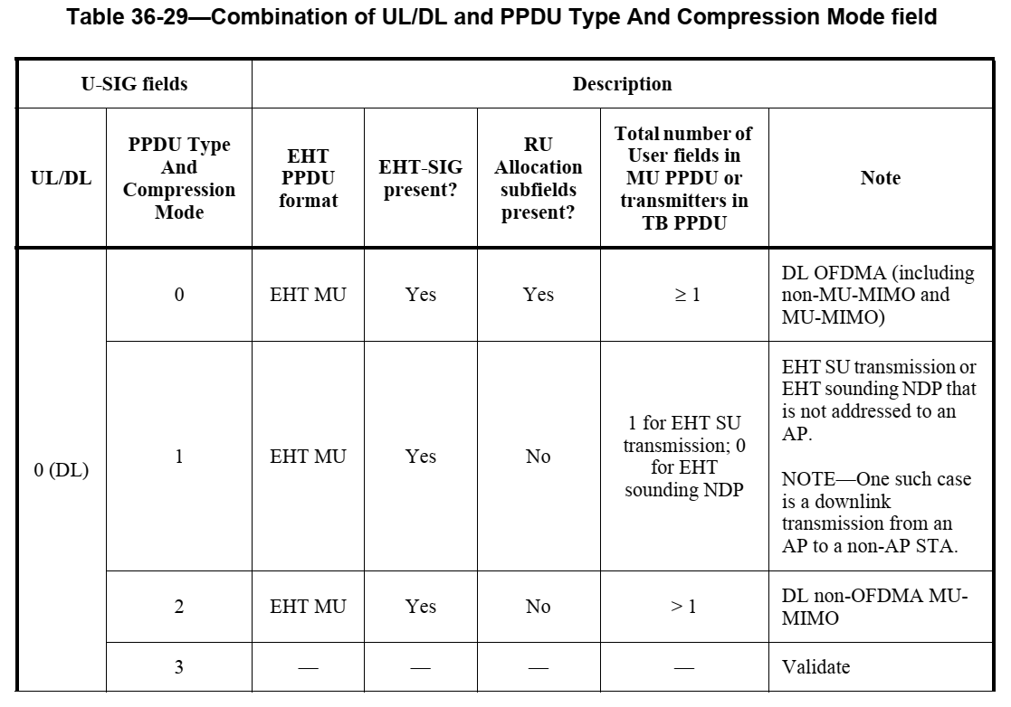
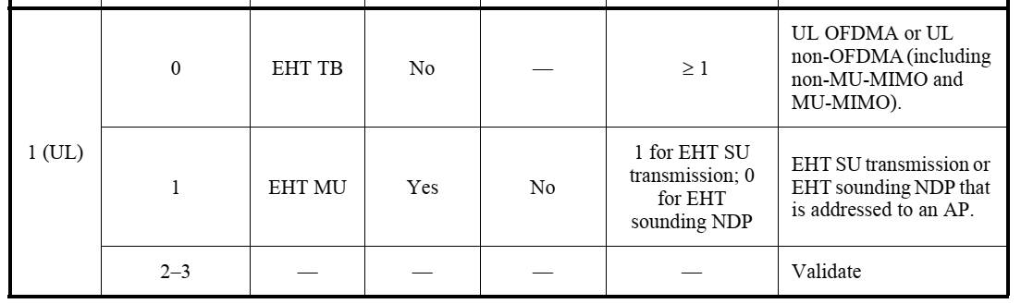
Tables on EHT U-SIG PPDU Type and Compression Mode (cont.)

Slide 36
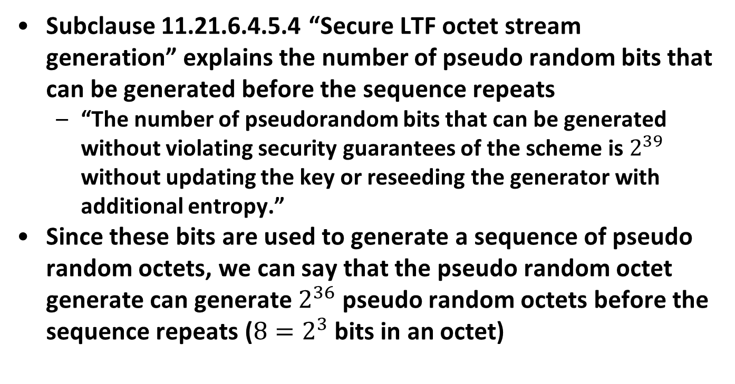
Backup – Pseudo Random Octets
Subclause 11.21.6.4.5.4 “Secure LTF octet stream generation” explains the number of pseudo random bits that can be generated before the sequence repeats
  “The number of pseudorandom bits that can be generated without violating security guarantees of the scheme is $2^{39}$ without updating the key or reseeding the generator with additional entropy.”
Since these bits are used to generate a sequence of pseudo random octets, we can say that the pseudo random octet generate can generate $2^{36}$ pseudo random octets before the sequence repeats ($8=2^{3}$ bits in an octet)

