Slide 1
ML-based Adaptive Subcarrier Grouping for Beamforming Feedback
Date: 2023-01-10
Authors:

Slide 2
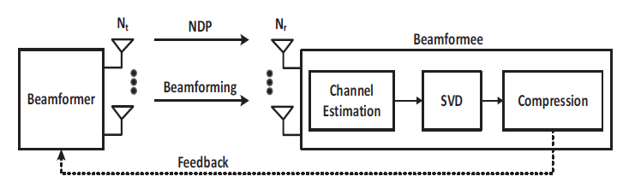
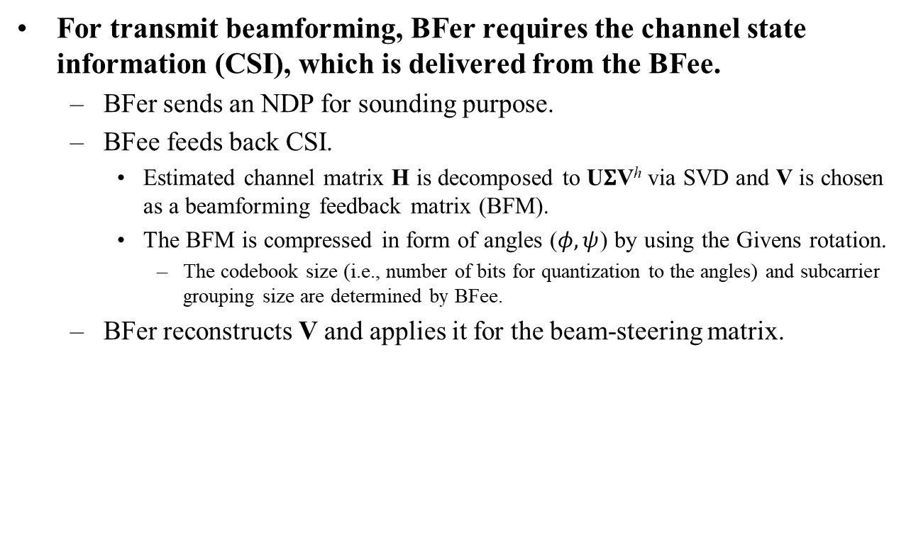
Recap: Beamforming procedure
For transmit beamforming, BFer requires the channel state information (CSI), which is delivered from the BFee.
  BFer sends an NDP for sounding purpose.
  BFee feeds back CSI.
    Estimated channel matrix H is decomposed to U$Σ$V^{h} via SVD and V is chosen as a beamforming feedback matrix (BFM).
    The BFM is compressed in form of angles ($φ, ψ$) by using the Givens rotation.
      The codebook size (i.e., number of bits for quantization to the angles) and subcarrier grouping size are determined by BFee.
  BFer reconstructs V and applies it for the beam-steering matrix.

Slide 3
Recap: Subcarrier grouping
Subcarrier grouping
  Assuming that the channel frequency response is correlated across the subcarriers, only a single BFM is fed back for each group of N_{g} adjacent subcarriers.
    Some sort of interpolation needs to be performed by BFer to obtain the beam-steering matrix for rest of the subcarriers.
  By using the grouping, the overhead for CSI feedback can be reduced.
    If N_{g} value is large, CSI becomes inaccurate.
    If N_{g} value is small, CSI overhead becomes large.
N_{g} value of subcarrier grouping
11ac | 1, 2, 4
11ax, 11be | 4, 16

Slide 4
Motivation
To the best of our knowledge, there is no study on how to determine the subcarrier grouping value adaptively according to real-time channel conditions.
Basic idea
  Highly frequency selective channel
    BFee selects a small N_{g} value (e.g. N_{g} = 4 )
  Small frequency selective channel
    BFee selects a large N_{g} value (e.g. N_{g} = 16 )

Slide 5
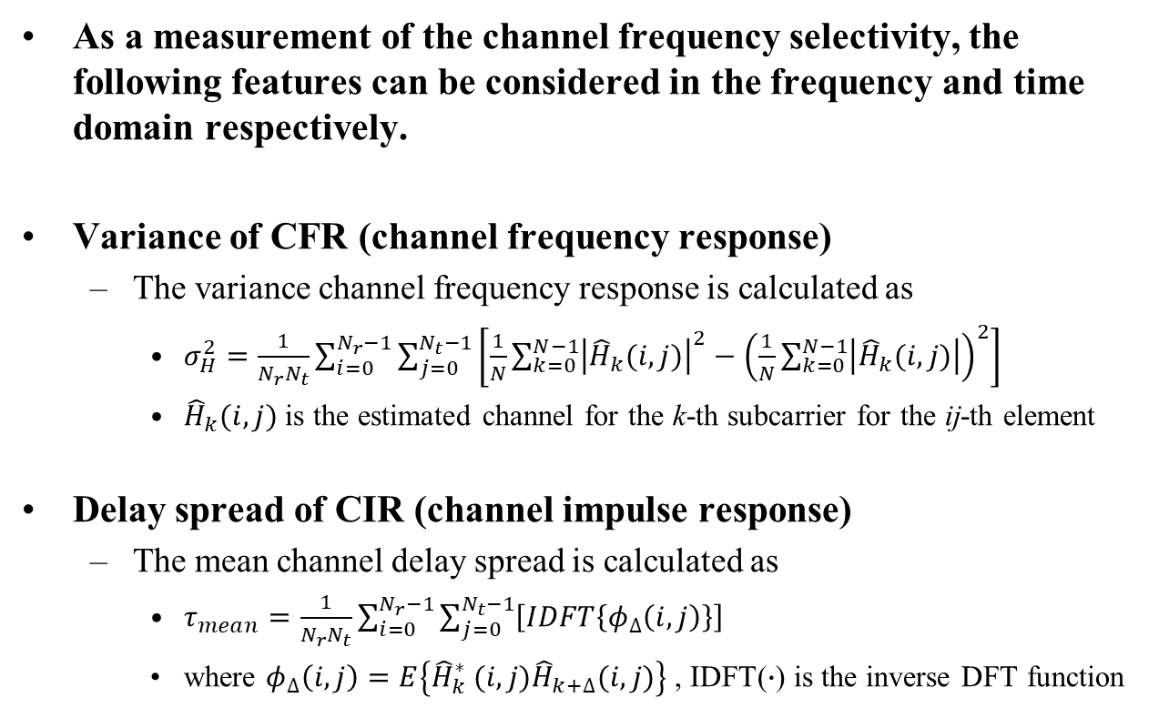
Measurement of channel frequency selectivity
As a measurement of the channel frequency selectivity, the following features can be considered in the frequency and time domain respectively.
Variance of CFR (channel frequency response)
  The variance channel frequency response is calculated as
    $σ_{H}^{2}=\frac{1}{N_{r}N_{t}}\sum_{i=0}^{N_{r}−1}{\sum_{j=0}^{N_{t}−1}{\left[\frac{1}{N}\sum_{k=0}^{N−1}{{\left|{\hat{H}}_{k}(i,j)\right|}^{2}}−{\left(\frac{1}{N}\sum_{k=0}^{N−1}{\left|{\hat{H}}_{k}(i,j)\right|}\right)}^{2}\right]}}$
    ${\hat{H}}_{k}(i,j)$ is the estimated channel for the k-th subcarrier for the ij-th element
Delay spread of CIR (channel impulse response)
  The mean channel delay spread is calculated as
    $τ_{mean}=\frac{1}{N_{r}N_{t}}\sum_{i=0}^{N_{r}−1}{\sum_{j=0}^{N_{t}−1}{\left[IDFT\left\{φ_{∆}\left(i,j\right)\right\}\right]}}$
    where $φ_{∆}\left(i,j\right)=E\left\{{\hat{H}}_{k}^{∗} (i,j){\hat{H}}_{k+∆}(i,j)\right\}$ , IDFT($∙$) is the inverse DFT function

Slide 6
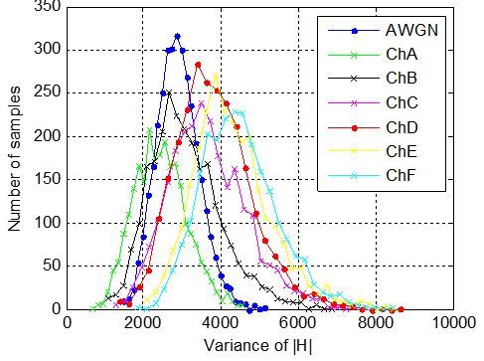
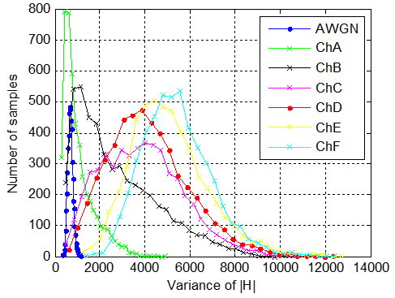
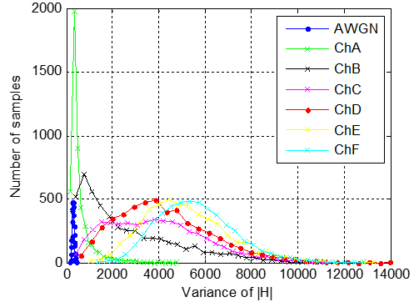
Distribution of CFR variance
The IEEE channel model is classified into A, B, C, D, and E in the order of high frequency selectivity.
Distribution of CFR variance
  We observe that the distribution can be distinguished according to the channel models in the middle (or high) SNR.
SNR = 0dB
SNR = 10dB
SNR = 15dB

Slide 7
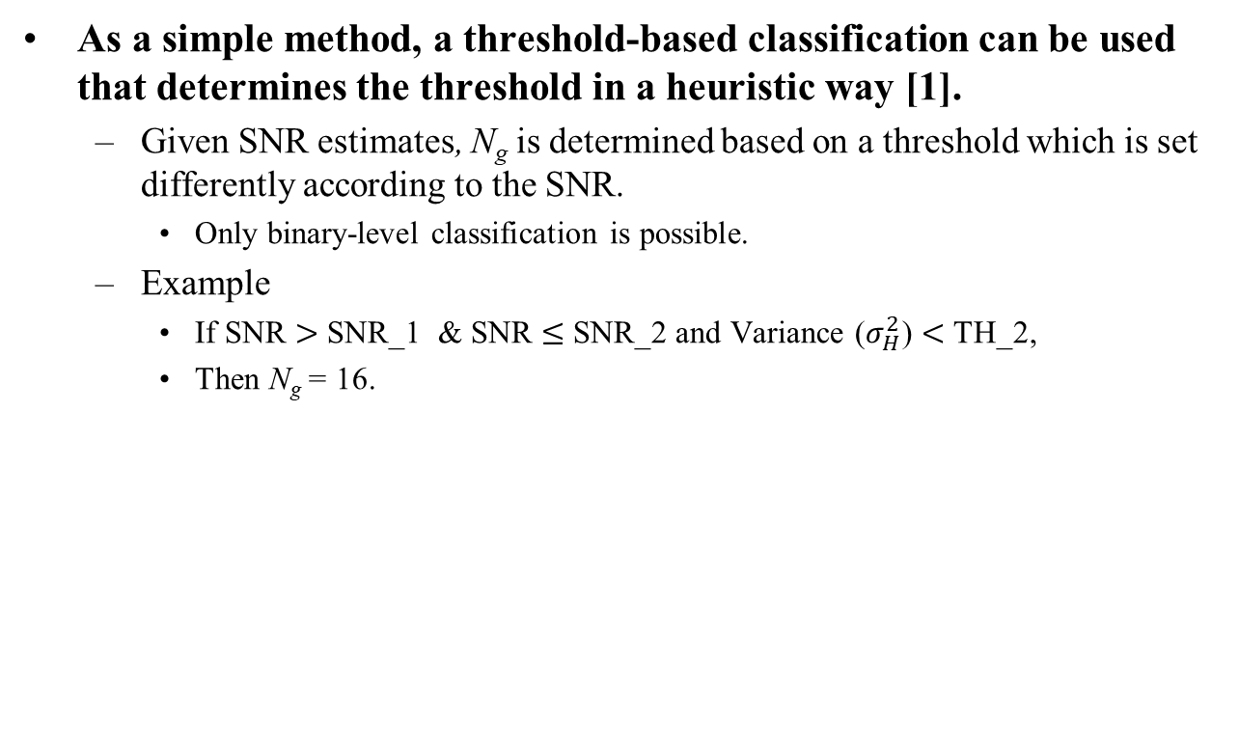
Threshold-based channel classification
As a simple method, a threshold-based classification can be used that determines the threshold in a heuristic way [1].
  Given SNR estimates, N_{g} is determined based on a threshold which is set differently according to the SNR.
    Only binary-level classification is possible.
  Example
    If SNR $>$ SNR_1 & SNR $≤$ SNR_2 and Variance ($σ_{H}^{2}$) $<$ TH_2,
    Then N_{g} = 16.
SNR | SNR_1 | SNR_2 | … | SNR_K
Threshold | Th_1 | Th_2 | … | Th_K

Slide 8
ML-based channel classification
To order to improve performance, ML can be used to classify the channels.
  Multi-level classification is possible.
Supervised learning
  Generate random channels for each class.
  Configure a set of data samples to be used to train the machine.
    Data sample = (SNR, Variance, Delay spread)
  For a new incoming sample, its class is assigned by the trained machine, and N_{g} is determined based on the assigned class.

Slide 9
Example of channel classification
Binary-level classification
Multi-level classification
Class | Feature | IEEE channel Model | N_{g}
Class I | Frequency flat channel | A | N_{g} = 16
Class II | Frequency selective channel | B, C, D, E, F | N_{g} = 4
Class | Feature | IEEE channel Model | N_{g}
Class I | Frequency flat channel | A | N_{g} = N_{ST}
Class II | Low frequency selective channel | B, C | N_{g} = 16
Class III | High frequency selective channel | D, E, F | N_{g} = 4

Slide 10
N_{g} = N_{ST} for frequency flat channel
N_{g} = N_{ST}
  N_{ST} : Total number of subcarriers in a non-punctured non-OFDMA PPDU
  Only a single BFM is fed back for N_{ST} subcarriers.
    The BFM for the remaining subcarriers can be obtained by copying and pasting the single BFM.
    The overhead for CSI feedback can be significantly reduced.
 | BW20 | BW40 | BW80 | BW160 | BW320
N_{ST} | 242 | 484 | 996 | 1992 | 3984

Slide 11
Remarks: Unsupervised learning
The subcarrier grouping value (and/or the codebook size) can be determined adaptively by using an unsupervised learning algorithm.
The K-means algorithm divides the given data samples into two clusters defined by centroids [4].
  For the new input data sample, the algorithm determines the subcarrier grouping value based on the assigned cluster.

Slide 12
Simulation parameters
Parameter | Value
PPDU type | EHT
Channel model | A, B, C, D, E, F
Learning algorithm | Neural network
Optimization solver | Adaptive moment estimation (Adam)
Number of data | ~27K
Number of training data | 70% of data
Number of testing data | 30% of data
Number of hidden nodes | 2
Number of nodes per hidden layer | [100, 100]
Activation function | Tanh

Slide 13
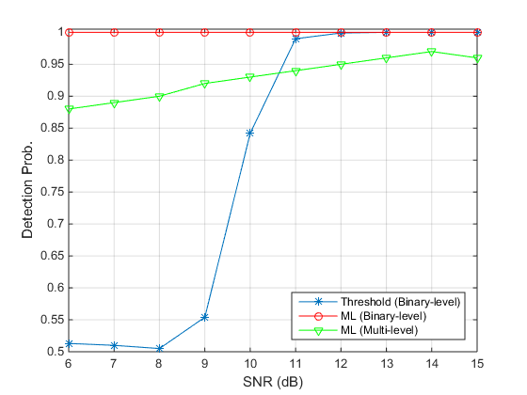
Simulation results (1)
Classification performance
  Threshold-based classification
    The noise causes significant degradation to the performance.
  ML-based classification
    In case of binary-level classification, almost 100% success is achieved.
    In the case of multi-level classification, around 90% success can be achieved even in the low SNR region.

Slide 14
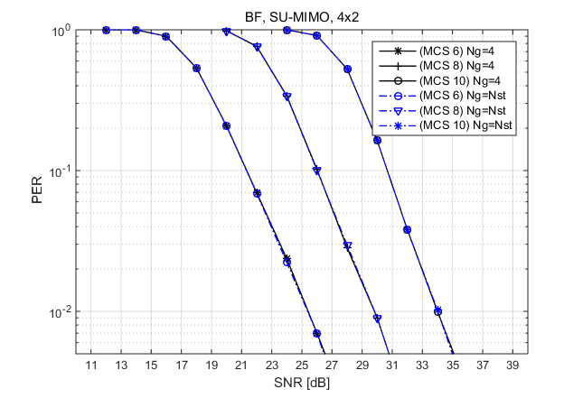
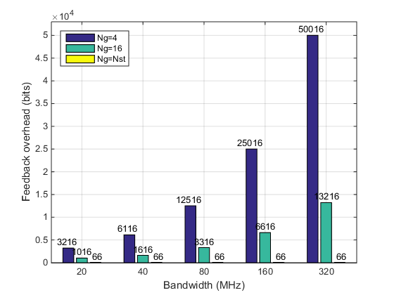
Simulation results (2)
PER performance
  If a frequency flat channel is identified by ML, the CSI is fed back with N_{g} = N_{ST} .
  For frequency flat channel, the PER performance with N_{g} = N_{ST} is almost same as N_{g} = 4, while the CSI overhead is significantly reduced.

Slide 15
Conclusion
In this contribution, we presented an ML-based adaptive beamforming feedback method.
  A supervised learning-based ML technique is used for channel classification.
  Based on the channel classification, the subcarrier grouping value is determined in an on-line manner.
In addition, the N_{g} = N_{ST} option was also presented for frequency flat channel identified by ML.
  Significant CSI overhead reduction can be achieved without loss of PER performance.
The ML-based channel classification can also be applied to adaptive codebook selection.
Class | Feature | Codebook | bits for (ϕ, ψ)
Class I | Frequency flat channel | Coarse codebook | (2, 4)
Class II | Frequency selective channel | Fine codebook | (4, 6)

Slide 16
Reference
[1] E. Jeon, Device And Method Of Performing Subcarrier Grouping And/Or Codebook Size Selection In Real-Time For Beamforming Feedback And Wireless Communication System Including The Same, US17/550172, 2021.
[2] E. Kurniawan, L. Zhiwei, and S. Sun, “Machine Learning-based Channel Classification and Its Application to IEEE 802.11ad Communications,” in Proc. IEEE GLOBECOM, Dec. 2017.
[3] H. Arslan and T. Yücek, “Delay Spread Estimation for Wireless Communication Systems”, in Proc. IEEE ISCC, Jul. 2003.
[4] M. Deshmukh, Z. Lin, H. Lou, M. Kamel, R. Yang, and I. Guvenc, “Intelligent Feedback Overhead Reduction (iFOR) in Wi-Fi 7 and Beyond,” in Proc. IEEE VTC-Spring, Jun. 2022.

