Slide 1
RSSI in the Sensing Measurement Report
Date: 2023-01-12
Authors:
Name | Affiliations | email
Steve Shellhammer | Qualcomm | shellhammer@ieee.org

Slide 2
Introduction
The Sensing Measurement report will include CSI
Recently there has been a PDT document under development for adding signaling on receiver operating gain in the Sensing Measurement report [1]
Some RF Sensing applications can utilize the receive signal strength indicator (RSSI) on each RX Antenna
We propose to also include the per-RX-Antenna RSSI in the Sensing Measurement Report

Slide 3
Update R1
Feedback was provided when presenting the R0 version of this presentation
One of the key issues that was raised was should we specify the RSSI accuracy
Here we consider the RSSI accuracy issue and reconsider the range of RSSI in light of the having an accuracy requirement

Slide 4
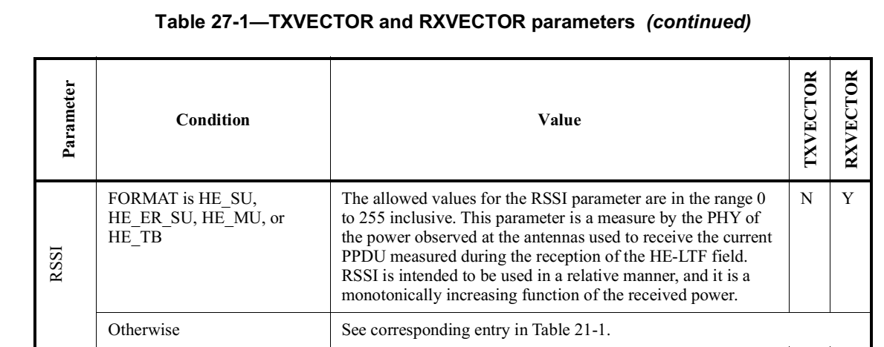
Background
For reference it is useful to look at the RSSI format in the 802.11 standard
The RSSI is described in the RX Vector as such:
RSSI at each RX antenna is represented as a value between 0 and 255, so it can be represented using a single octet
This description does not provide a mapping between bit values and dBm

Slide 5
Background
There are requirements for RSSI accuracy in the standard
Subclause 11.43 provides requirements for the RSSI accuracy of the Beacon
The RSSI accuracy requirement is $±5$dB

Slide 6
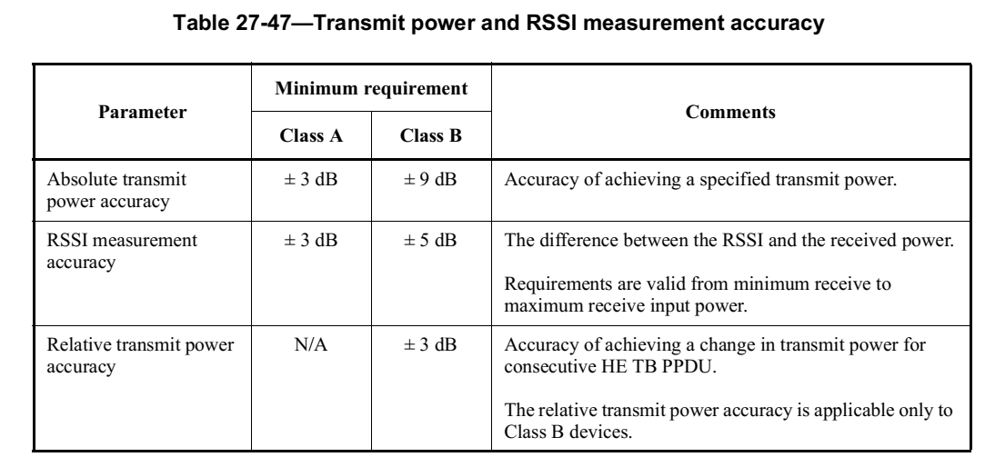
Background
There are also requirements for RSSI measurement accuracy for a STA responding to a Trigger Frame
Subclause 27.3.15 provides the following table for RSSI accuracy
Here the accuracy is either $±3$ dB or $±5$ dB, depending on STA Class

Slide 7
Range of RSSI Values
The minimum RSSI value should be the specified receiver sensitivity for a 20 MHz PPDU, which is $−82$dBm
Lower values than this do not make sense for RF Sensing since it is necessary to decode a PPDU and it is also necessary to have sufficiently high SNR to perform effective RF Sensing

Slide 8
Proposal
We propose to include per-RX-Antenna RSSI in the Sensing Measurement report
We propose that each RSSI is represented using a single octet and is encoded as follows
RSSI Subfield value | RSSI Measured at the Receive Antenna (dBm)
0 | $$−82$$
1 | $$−81$$
2 | $$−80$$
$$⋮$$ | $$⋮$$
61 | $$−21$$
62 | $$−20$$
63-255 | Reserved

Slide 9
Proposal
We think the RSSI measurement accuracy specified for the Beacon, of $±5$ dB, is appropriate for the per-RX-Antenna RSSI accuracy requirement
Both AP and non-AP STAs should be able to support this accuracy
We propose a per-RX-Antenna RSSI accuracy requirement of $±5$ dB

Slide 10
Straw Poll #1
Do you agree to include the per-RX-Antenna RSSI in the Sensing Measurement report?

Slide 11
Straw Poll #2
Do you agree that the encoding of the per-RX-Antenna RSSI in the Sensing Measurement report uses the following table?
RSSI Subfield value | RSSI Measured at the Receive Antenna (dBm)
0 | $$−82$$
1 | $$−81$$
2 | $$−80$$
$$⋮$$ | $$⋮$$
61 | $$−21$$
62 | $$−20$$
63-255 | Reserved

Slide 12
Straw Poll #3
Do you agree to specify a $±5$ dB RSSI accuracy requirement for the per-RX-Antenna RSSI in the Sensing Measurement report?

Slide 13
References
Shuling (Julia) Feng, Rui Du, Jianhan Liu, and Kevin Tsai, “PDT for Rx_OP_Gain_Type and Rx_OP_Gain_Index in CSI Report,” IEEE 802.11-22/2116r2, December 2022

