Slide 1
RSSI in the Sensing Measurement Report
Date: 2023-01-11
Authors:
Name | Affiliations | email
Steve Shellhammer | Qualcomm | shellhammer@ieee.org

Slide 2
Introduction
The Sensing Measurement report will include CSI
Recently there has been a PDT document under development for adding signaling on receiver operating gain in the Sensing Measurement report [1]
Some RF Sensing applications can utilize the receive signal strength indicator (RSSI) on each RX Antenna
We propose to also include the per-RX-Antenna RSSI in the Sensing Measurement Report

Slide 3
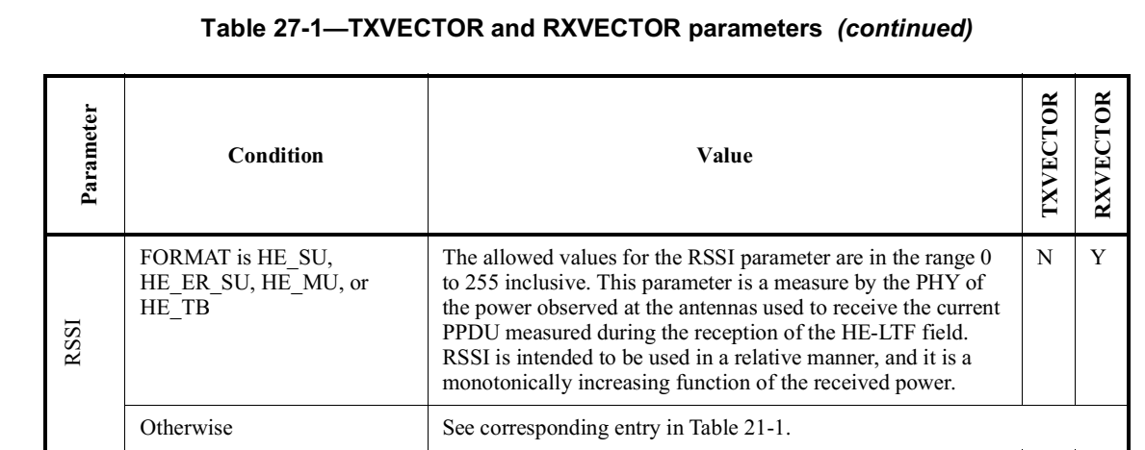
Background
For reference it is useful to look at the RSSI format in the 802.11 standard
The RSSI is described in the RX Vector as such:
RSSI at each RX antenna is represented as a value between 0 and 255, so it can be represented using a single octet
This description does not provide a mapping between bit values and dBm

Slide 4
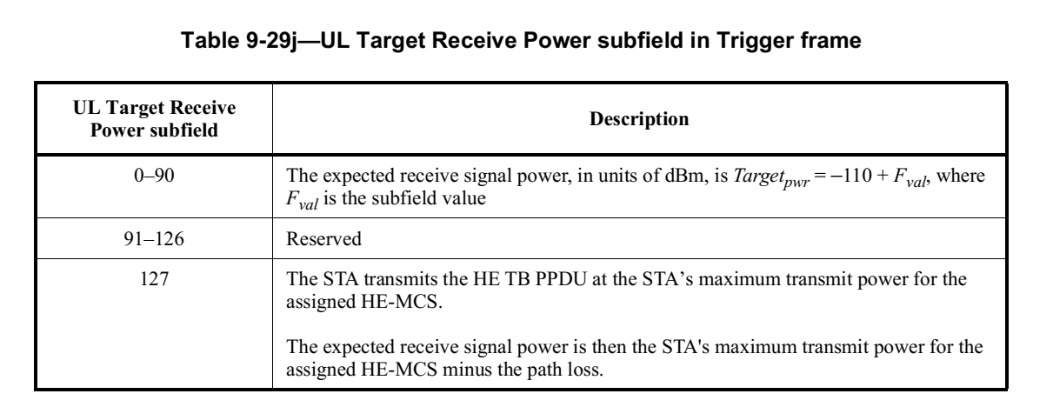
Background (cont.)
In the Trigger Frame we do have the Encoding of the Target Receive Power level
Supports Receive power levels of $\{−110, −109, −108,…−20\}$dBm, in 1 dB steps

Slide 5
Proposal
We propose to include per-RX-Antenna RSSI in the Sensing Measurement report
We propose that each RSSI is represented using a single octet and is encoded as follows
RSSI Subfield value | RSSI Measured at the Receive Antenna (dBm)
0 | -110
1 | -109
2 | -108
$$⋮$$ | $$⋮$$
89 | -21
90 | -20
91-255 | Reserved

Slide 6
Straw Poll #1
Do you agree to include the per-RX-Antenna RSSI in the Sensing Measurement report?

Slide 7
Straw Poll #2
Do you agree that the encoding of the per-RX-Antenna RSSI in the Sensing Measurement report uses the following table?
RSSI Subfield value | RSSI Measured at the Receive Antenna (dBm)
0 | -110
1 | -109
2 | -108
$$⋮$$ | $$⋮$$
89 | -21
90 | -20
91-255 | Reserved

Slide 8
References
Shuling (Julia) Feng, Rui Du, Jianhan Liu, and Kevin Tsai, “PDT for Rx_OP_Gain_Type and Rx_OP_Gain_Index in CSI Report,” IEEE 802.11-22/2116r2, December 2022

