Slide 1
Uplink MU MIMO Improvements
Date: 17-Jan-23

Slide 2
Introduction
The focus topics of UHR include improved reliability and increased throughput at different SNR levels
Uplink Multiuser MIMO can help to increase reliability and throughput
Uplink Multiuser MIMO throughput can be increased
  By transmitter precoding at the STA
  Coordination of the uplink precoding by the AP

Slide 3
Precoding in Uplink MU MIMO
Many stations have more than one Antenna, which could be used to improve Uplink MU MIMO
The (non-AP) station can apply precoding to benefit from multiple antennas
Precoder P₁
Equalizer
G
STA 1
AP
…
Precoder P_{N}
STA N

Slide 4
Precoding in Uplink MU MIMO
In [1], uplink beamforming is proposed for UHR, based on implicit beamforming and a downstream NDP
The proposal in [1] has various drawbacks
  In the proposal of [1], the STAs need extra time to prepare beamforming
  Implicit beamforming is not accurate, as UL and DL channels are different
  The STAs don’t have knowledge of other STA’s channels and can’t optimize the overall throughput
Precoder P₁
No coordination
Equalizer
G
STA 1
AP
…
Precoder P_{N}
STA N
Slide 4
Sigurd Schelstraete, MaxLinear

Slide 5
Coordinated Uplink MIMO Precoding
To improve the proposal from [1], uplink precoding can be coordinated at the AP
The AP has full knowledge of the channel from all stations
Interference between the stations can be minimized and overall throughput is maximized
Precoder P₁
Coordination
Equalizer
G
STA 1
AP
…
Precoder P_{N}
STA N

Slide 6
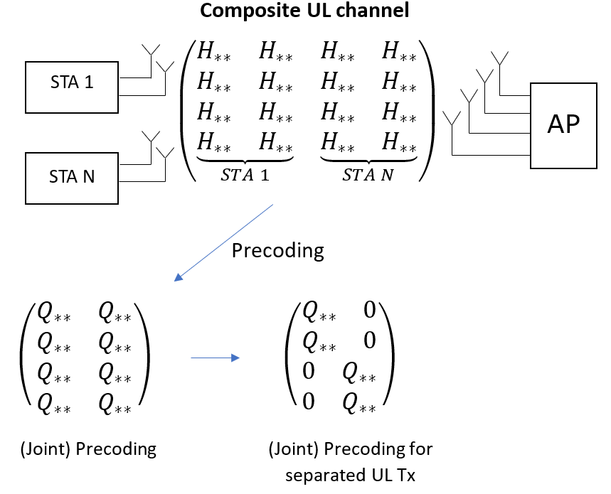
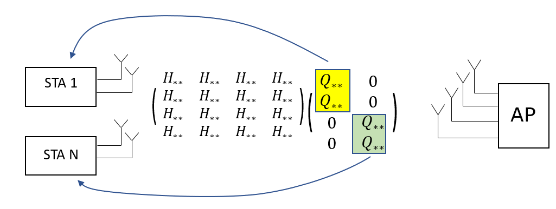
Coordinated Uplink MIMO Precoding
Coordinated Uplink MIMO Precoding
  The MIMO precoder is jointly optimized for all stations
  Coefficients that couple antennas of different stations are forced to zero
  Each station applies the relevant part of the precoder

Slide 7
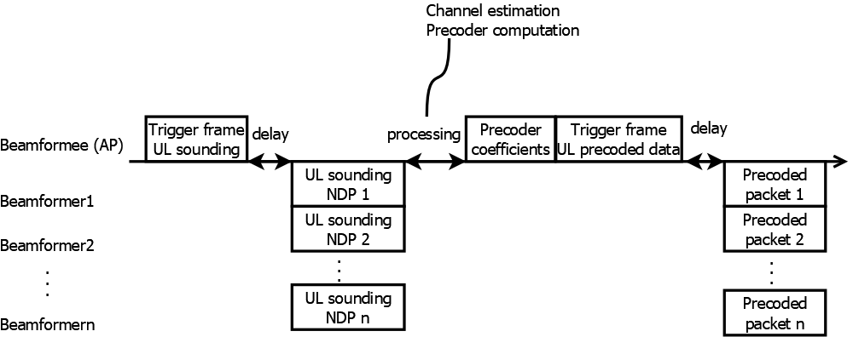
New Procedure for Coordinated Uplink MIMO Precoding
Suggested Procedure
  Non-AP STAs (beamformers) send sounding NDPs to the AP, which is triggered by the AP
  AP calculates a block-diagonal precoding matrix that deals with all STAs collectively, but that can be implemented by STAs in distinct locations
  AP provides the relevant part of the precoding matrix to the STAs, together with the trigger frame
  STAs uses their part of the precoding matrix to perform the transmit precoding

Slide 8
Simulation results
Simulation Conditions
D NLOS channel, 320MHz
2x LTF; 1.6µs GI
Grouping 4
4STAs, 1 AP
STAs: 2 TX antennas, 1SS
AP: 4 RX antennas
8dB gain

Slide 9
Conclusion
Coordinated precoding for Uplink MU MIMO increases the uplink throughput and reliability
  Up to 8dB SNR improvement
Required changes
  Sounding NDP transmitted from STAs to AP
  Precoder message from the AP to the STAs

Slide 10
References
[1] IEEE 802.11-22/1392r0, “Beamforming Improvement for UHR”, 2022-09-02

Slide 11
Backup
More detailed simulation conditions
Simulation Conditions
D NLOS channel, 320MHz
2x LTF; 1.6µs GI, grouping 4
4STAs, 1 AP
STAs: 2 TX antennas, 1SS
AP: 4 RX antennas
Uplink impairments
Receive time offset between STAs max. 0.8µs
Frequency offset max. 0.14ppm
10ms sounding-to-rx delay
8dB gain

