Slide 1
Considerations on the enhanced link adaptation
Date: 01/10/23
Authors | Affiliations | Address | Email
Xiaogang Chen | ZEKU | 2479 E Bayshore Road, Suite 260. Palo Alto, CA | Xiaogang.chen@zeku.com
Bolton Shen
Chunlin Zhang
Wen Song
Ivan Yu

Slide 2
Outline
Recap on the discussions of the link adaptation (LA) improvement in 11be and 11ax.
Issues identified in the field.
Way forward and summary.

Slide 3
Recap of the discussions on the link adaptation
Several contributions focused specifically on the link adaptation (LA) improvements in 11be and 11ax:
Different categories of feedback to simplify the implementation [1];
Denser MCS levels [2] [3];
LA in the interference dominated scenario [4].
HARQ, an alternative of fast link adaptation, has been extensively debated in 11be.
The feature was dropped in the end, but significant gain was shown to be feasible to combat poor rate adaptations.
Although efforts have been made to improve LA, the adoption is relatively low both in the standard and in the field.
Insufficient incentive to motivate vendors adopting new scheme??
No precedent on the certification. Transmitter may not trust the feedback from the receiver?

Slide 4
Enhanced LA (ELA) in the next generation
Motivations:
Issues in the field (will illustrate in this presentation);
Obvious Tpt waste and compromised latency are observed.
Diversified interferences are bloating the unlicensed band. Interference should be handled differently than chose a lower MCS.
In-device interference from different technologies integrated into the smart devices. E.g. BT (in 5/6GHz), NB UWB
Incumbents or OBSS.
Complexity:
Implementation needs to change its proprietary rate adaptation algorithm to accommodate the evolved interference model anyway…
The group was very closed to adopted HARQ, why not be open to ELA which is a much simpler alternative?
ELA could be broader than rate adaptation.

Slide 5
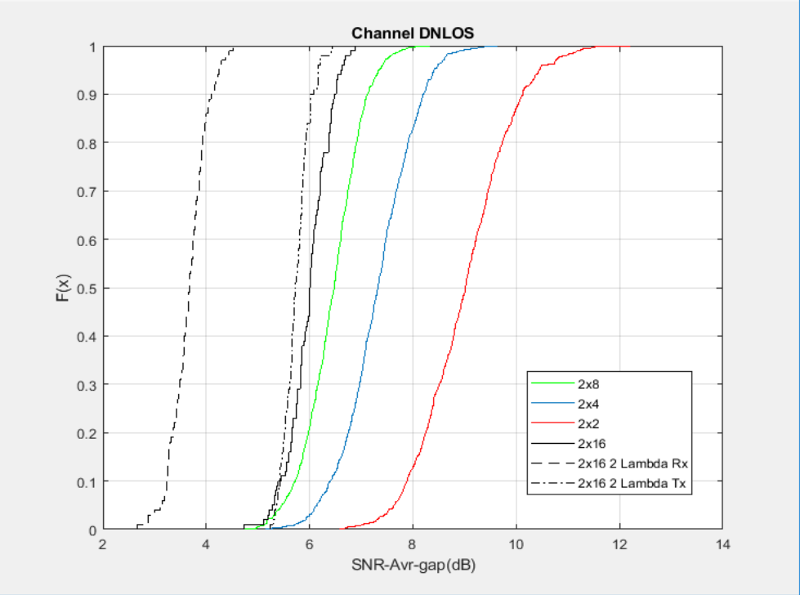
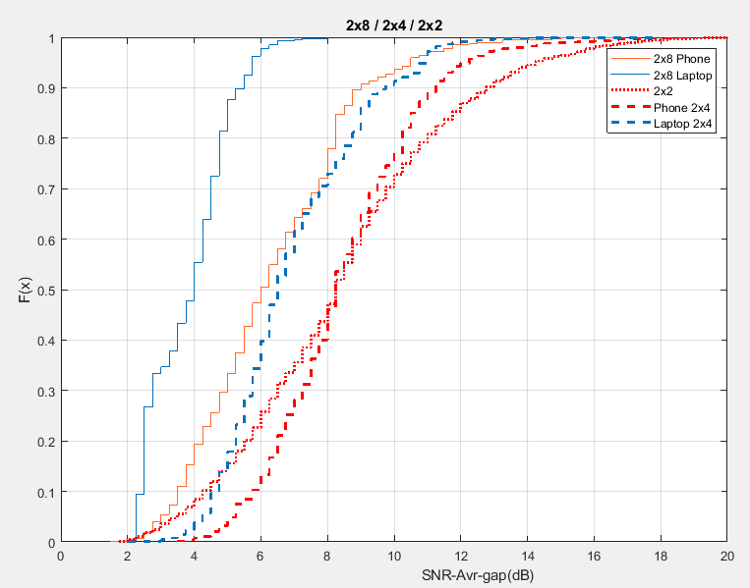
Issue in the field – open loop rate adaptation for Bfed traffic
Open loop rate adaptation is not friendly to the unequal SNR between different SS in Bfed channel.
Sims and measurement setup:
SNR_Avr_gap = Average SNR_SS1 / Average SNR_SS2 in dB.
80MHz channel is used in sims and field measurements.
The field measurements are conducted on:
Off-the-shelf APs (11ax supported) with 4 and 8 antennas;
Off-the-shelf laptop and smart phones (11ax supported) with 2 antennas;
HE compressed SU Bfing report are captured and dumped out for statistics.
Observations:
Average SNR gap decreases with: 1) larger nTx; 2) larger antenna spacing (Low correlation between antennas).
50% value of the gap for 2x4 channel is ~7.5dB (2-3 MCS gaps).
Sims
Measurements

Slide 6
How to fix the unbalanced streams?
Spec agnostic solution:
Instead of feed back
$$SVD\left(H\right)→V_{BF}=\left[\begin{matrix}V_{1} & V_{2}\end{matrix}\right],$$
Feed back
$V_{rot}=$ $V_{BF}∗R, where R=\left[\begin{matrix}\cos{θ} & \sin{θ} \\ \sin{θ} & −cos{θ}\end{matrix}\right]$.
UEQM in 11n.
Not in the scope of this contribution.
 |  |  |  |  | Sensitivity(dB@10% PER) |  |  | Gap (dB) ChDNLoS
Nrx | Ntx | Bw(MHz) | MCS | Nss | SVD | Rot A | Rot B | Rot A-SVD | Rot B-SVD
2 | 2 | 20 | 0 | 2 | 15.577 | 10.488 | 10.421 | -5.089 | -5.156
2 | 2 | 20 | 4 | 2 | 28.996 | 23.342 | 25.048 | -5.654 | -3.948
2 | 2 | 20 | 7 | 2 | 37.109 | 33.399 | 34.715 | -3.71 | -2.394
2 | 2 | 20 | 9 | 2 | 41.577 | 38.743 | 41.030 | -2.834 | -0.547
2 | 2 | 20 | 11 | 2 | 47.637 | 45.756 | 47.617 | -1.881 | -0.02
2 | 4 | 80 | 0 | 2 | 7.984 | 4.737 | 4.850 | -3.247 | -3.134
2 | 4 | 80 | 4 | 2 | 20.886 | 17.361 | 18.488 | -3.525 | -2.398
2 | 4 | 80 | 7 | 2 | 28.716 | 25.383 | 26.473 | -3.333 | -2.243
2 | 4 | 80 | 9 | 2 | 32.771 | 30.966 | 32.094 | -1.805 | -0.677
2 | 4 | 80 | 11 | 2 | 38.266 | 36.805 | 37.863 | -1.461 | -0.403
2 | 8 | 160 | 0 | 2 | 3.468 | 1.641 | 1.862 | -1.827 | -1.606
2 | 8 | 160 | 4 | 2 | 15.414 | 12.796 | 13.440 | -2.618 | -1.974
2 | 8 | 160 | 7 | 2 | 22.963 | 20.491 | 21.643 | -2.472 | -1.32
2 | 8 | 160 | 9 | 2 | 27.520 | 26.229 | 26.879 | -1.291 | -0.641
2 | 8 | 160 | 11 | 2 | 33.028 | 32.348 | 32.927 | -0.68 | -0.101
Sim Assumptions:
Sounding: 4x LTF in NDP
Feedback: SU feedback, Codebook: 1, Nc = 2, Ng = 4.
Bfed Data: BW = 20, 80, 160MHz; Pld = 4096 Bytes; LDPC code.
Rot A: R is calculated tone by tone on the fly;
Rot B: $R=\left[\begin{matrix}1 & 1 \\ 1 & −1\end{matrix}\right]∗\frac{1}{\sqrt{2}}$
MMSE/ML Adaptive equalizer.
Observations:
The standard agnostic solutions provides considerable gain;
Gain of 2Tx > Gain of 4Tx > Gain of 8Tx;

Slide 7
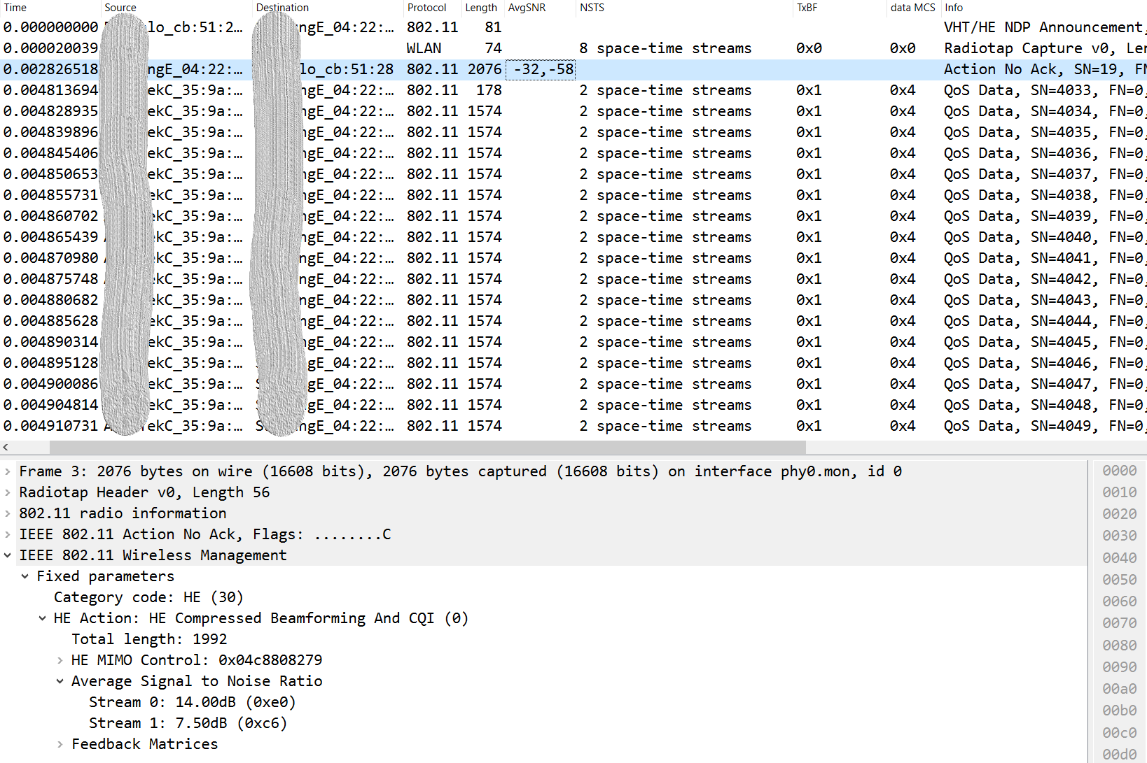
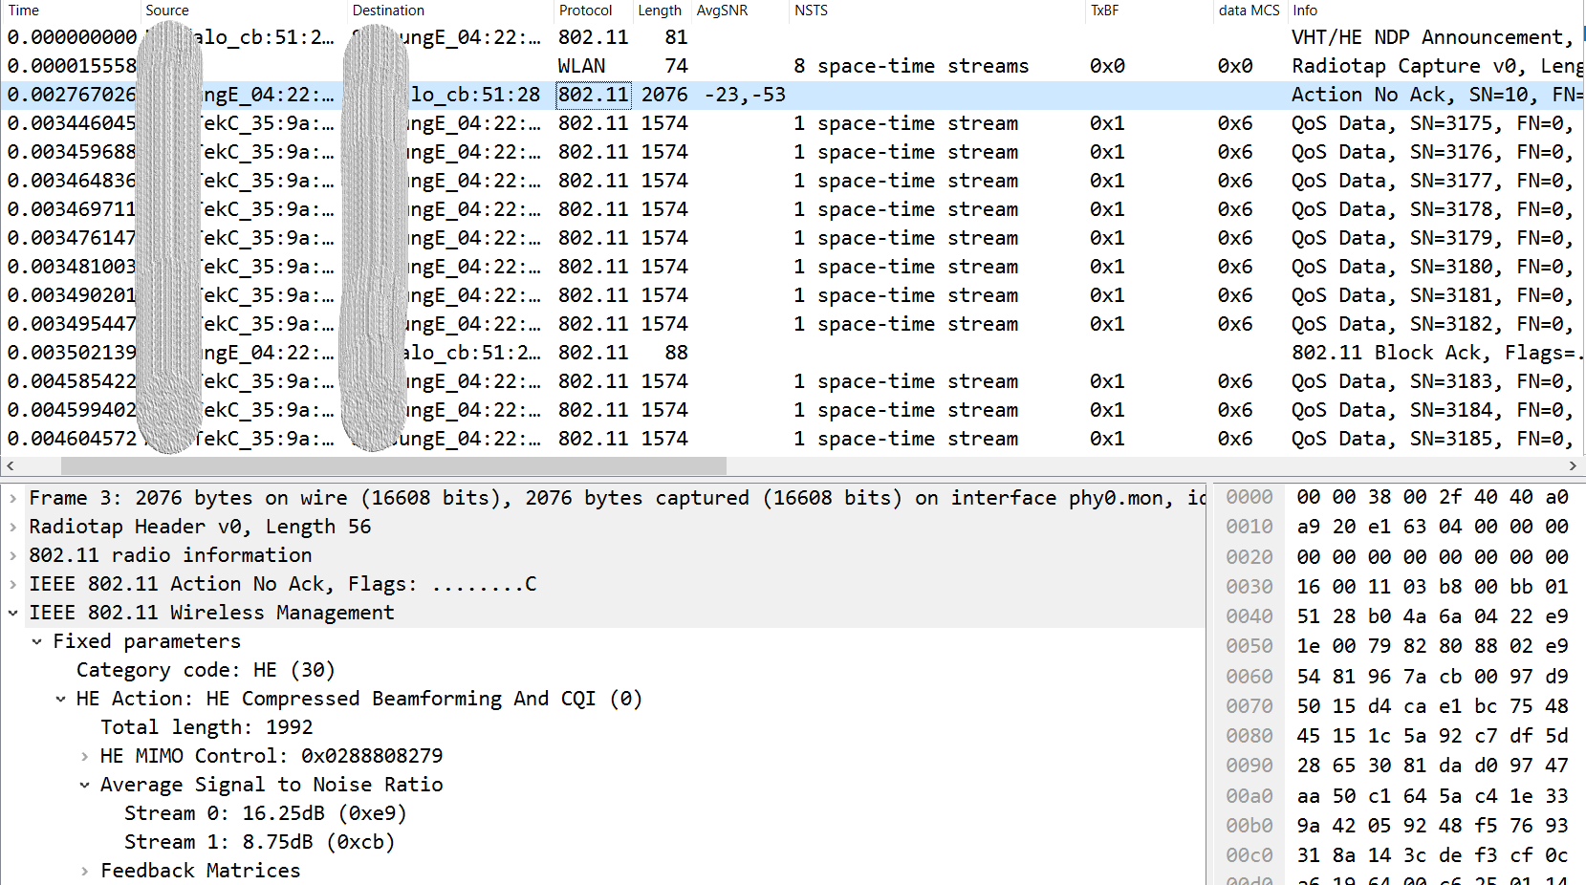
May not work as expected…
AP’s rate adaptation algorithm dynamically chose 1SS or 2SS regardless of the feedbacks.

Slide 8
Cont’d
STA optimize the feedback assuming Nc = 2
feedback ${V_{rot}=V}_{BF}∗R$ instead of $V_{BF}$ (SVD)
AP has no knowledge on STA’s optimization and may chose the 1st column of $V_{rot}$.
postSNR degrades if AP use 1SS and STA feed back $V_{rot}$:
${H_{eff_SVD}=U∗S∗{\left[V_{1} V_{2}\right]}^{H}∗V_{1}}_{}=U_{1}∗s_{1}→{PostSNR}_{svd}=\frac{s_{1}^{2}}{N_{0}}$
$H_{eff_rot}=U∗S∗{\left[V_{1} V_{2}\right]}^{H}∗{(V}_{1}∗\cos{θ}+V_{2}∗\sin{θ)=U∗S∗\left[\begin{matrix}\cos{θ} \\ \sin{θ}\end{matrix}\right] }→{PostSNR}_{rot}= \frac{s_{1}^{2}\cos^{2}{θ+s_{2}^{2}\sin^{2}{θ}}}{N_{0}}$
${PostSNR}_{rot}$ <= ${PostSNR}_{svd}(baseline)$. “=” is true only If $θ=0$.
 |  | Sensitivity(dB@10% PER) |  |  | Gap (dB) ChDNLoS
MCS | Nss | SVD | Rot A | Rot B | Rot A- SVD | Rot B-SVD
0 | 1 | 1.512 | 2.991 | 1.676 | 1.479 | 0.164
1 | 1 | 1.641 | 5.049 | 2.604 | 3.408 | 0.963
2 | 1 | 3.065 | 7.896 | 4.891 | 4.831 | 1.826
3 | 1 | 4.853 | 10.149 | 6.941 | 5.296 | 2.088
4 | 1 | 8.267 | 13.769 | 10.648 | 5.502 | 2.381
5 | 1 | 11.549 | 17.298 | 14.007 | 5.749 | 2.458
6 | 1 | 13.210 | 18.879 | 15.598 | 5.669 | 2.388
7 | 1 | 15.168 | 20.823 | 17.577 | 5.655 | 2.409
8 | 1 | 18.369 | 24.652 | 20.842 | 6.283 | 2.473
9 | 1 | 20.476 | 26.705 | 22.940 | 6.229 | 2.464
10 | 1 | 23.711 | 29.277 | 25.989 | 5.566 | 2.278
11 | 1 | 26.280 | 32.144 | 28.425 | 5.864 | 2.145
Sim assumptions:
2x4, 80MHz;
STA assume Nc = 2 and feedback ${V_{rot}=V}_{BF}∗R;$
AP chose the 1st column of $V_{rot}$for 1ss transmission.
Observations:
Depends on the value of $θ$ in the rotation matrix, obvious sensitivity loss is observed.

Slide 9
Another issue in the field – open loop rate adaptation
Other than BA and RSSI, transmitter doesn’t have much information to predict what’s happening in the receiver side.
Receiver may experience different interferences which are not aware of by the transmitter. Such as: short term in-device interference, OBSS and incumbents.
Simply chose a lower MCS may not be the best way to mitigate the interference.
Receiver may experience channel variations which cannot be followed timely by the open loop rate adaptation algorithm.
BA based statistics could be slow to catch up the channel variations.

Slide 10
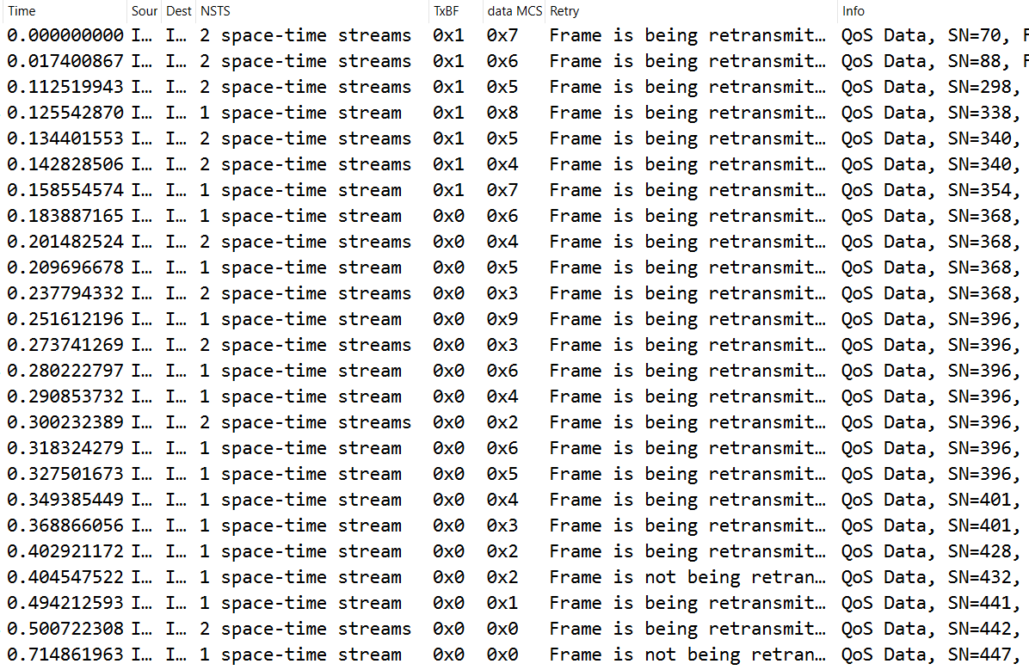
Open loop rate adaptation with ACI (1/2)
Adding ACI:
Capture Setup @ 5GHz:
DUT: 20MHz receiver @channel 52;
Interferer: 80MHz transmitter @channel 36(P20).
Devices are off-the-shelf with 11ax supported.
Real-world channel contention (not measured in shield room).
Full buffer traffic in DUT and Interferer.
TID = 0.
Notes:
DUT stabilize around MCS0 1SS when ACI is present and stabilize at MCS8 2SS when ACI is removed.
Packets shown in the figures are just samples of all the captures to explain the rate adaptation progress.
Eliminating ACI:

Slide 11
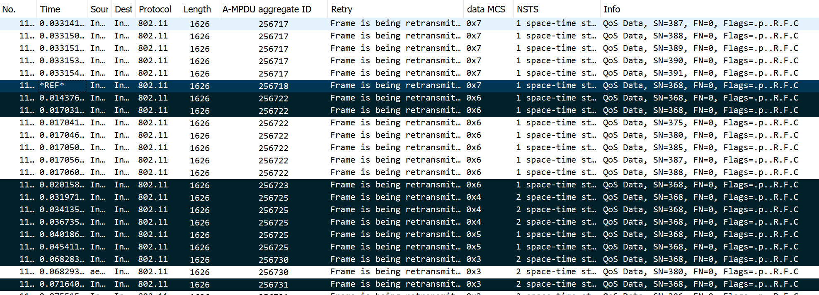
Open loop rate adaptation with ACI (2/2)
Observations:
Open loop rate adaptation gradually ramp up/down MCSs till stable rate is achieved;
When ACI is added, the transmitter is aggressive in rate selection;
MCS ramp down very slow;
Introduces tremendous retransmission -> large latency.
When ACI is removed, the transmitter is very conservative in rate selection.
MCS ramp up very slow -> Tpt waste.

Slide 12
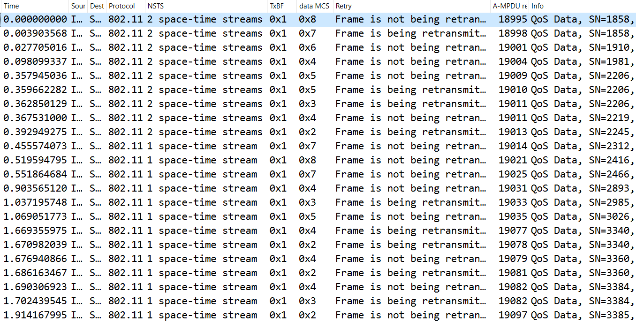
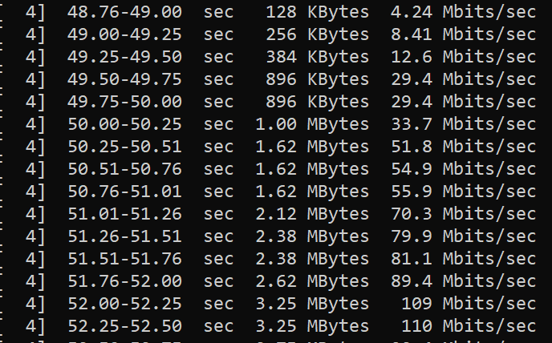
Open loop rate adaptation with channel variation
Increase pass loss:
Decrease pass loss:
Observations:
Analogous behavior as the scenario of ACI is observed;
Transmitter struggles to maintain higher rate aggressively even when channel degrades -> Retransition is triggered frequently.
Transmitter is conservative to increase rate when channel condition recovers.

Slide 13
Way forward and summary
ELA (enhanced link adaptation) can be developed to provide timely and appropriate feedback to the transmitter.
The feedback will mitigate the aforementioned real-world issues
Improve beamforming performance;
Mitigate latency deterioration and throughput waste.
The feedback can be extended to:
Directly recommend an action to the transmitter and aid transmitter’s decision.
Leverage the multiple links in MLO operation.
Simplify the implementation of beamformed channel smoothing.
Suggest to consider ELA as a candidate feature in the next generation.

Slide 14
Reference
[1] 11-20-1005-01-00be-yet-another-fast-link-adaptation-attempt.
[2] 11-19-2120-00-00be-link-adaptation-improvement.
[3] 11-20-0083-00-00be-impacts-of-mcs-set-expansion-on-11be-link-adaptation.
[4] 11-17-0328-06-00ax-link-adaptation-feedback-for-combating interferences.

