Slide 1
Bluetooth in 6 GHz - January 2023 Update
Date: 2023-01-18
Authors:
Notes:
September 2012

Slide 2
Abstract
A November 2022 presentation discussed the Bluetooth industry need for additional unlicensed (license-exempt) spectrum to deal with 2.4 GHz band congestion in the light of 5 billion new devices a year, and to support continued innovation. As this would require sharing the 6 GHz band (and probably part of the 5 GHz band), working with the Wi-Fi industry and 802.11 (and ETSI) standards development is the best approach for a painless transition.
This is an update on Bluetooth SIG actions and plans.
Notes:
September 2012
doc.: IEEE 802.11-09/0301r1
March 2009
Stephen McCann, RIM
Page 2

Slide 3
Agenda
Bluetooth in the 6 GHz Band
How working with the Wi-Fi industry helps both industries
Bluetooth SIG coalition plan
FCC-50-21 R&O and FNPRM support for Bluetooth and Wi-Fi C2C

Slide 4
Bluetooth in the 6 GHz Band
Bluetooth is currently shipping over 5 billion devices per year; 7 per year billion by 2026
  Congestion in the 83.5 MHz of spectrum in the 2.4 GHz band not only limits technology innovation but may eventually make critical application less reliable; reminiscent of the Wi-Fi story
Global (or nearly global) unlicensed spectrum is extremely limited, much of it with sensing and/or central control requirements that Bluetooth cannot utilize while maintaining its low-cost, small silicon footprint advantage
  Dynamic Frequency Selection
  Geolocation Database access
  Country Determination Capability (possible in combined Wi-Fi/Bluetooth devices)
A limited 5 GHz band segment and the vast 6 GHz band are the only viable options
  5725 – 5850 MHz in China open for unlicensed use
6 GHz band regulatory changes are required for Wi-Fi Client-to-Client operation and Bluetooth

Slide 5
FCC 6 GHz Issues
FCC Part 15.407
  (d) (5) In the 5.925-7.125 GHz band, client devices, except fixed client devices, must operate under the control of a standard power access point, indoor access point or subordinate devices; Subordinate devices must operate under the control of an indoor access point. In all cases, an exception exists for transmitting brief messages to an access point when attempting to join its network after detecting a signal that confirms that an access point is operating on a particular channel. Access points and subordinate devices may connect to other access points or subordinate devices. Client devices are prohibited from connecting directly to another client device.
This is not ideal for Wi-Fi C2C
FCC 20-51 R&O and FNPRM is still being negotiated

Slide 6
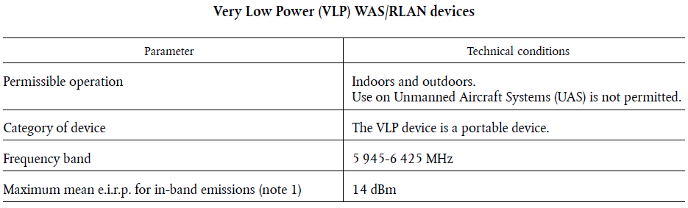
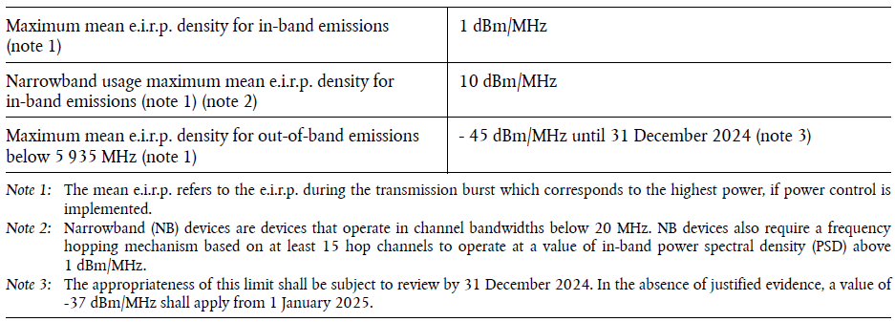
COMMISSION IMPLEMENTING DECISION (EU) 2021/1067 of 17 June 2021

Slide 7
How Is This Good for Wi-Fi?
Currently, the FCC 6 GHz band unlicensed rules require VLP devices to be connected to an indoor access point
  Client-to-Client (C2C) Wi-Fi operation is limited
  Bluetooth does not operate in a fixed AP mode
EU regulations, with equivalent incumbents, do not require this
Where can the Bluetooth industry help?
  Support 6 GHz band FNPRM changes
  Support EN 303 687 changes in V1.2.x
  Support new CEPT SE45 studies without disrupting existing studies
Many Wi-Fi companies also have a Bluetooth business

Slide 8
The Bluetooth SIG Plan
Create an industry coalition of Bluetooth companies to drive regulatory and standards changes
  Including companies with both Wi-Fi and Bluetooth businesses
Collaborate with Wi-Fi industry to drive needed changes
Work with SDOs to develop optimum spectrum sharing methods and drive regulatory/standards to codify them
Detailed plan to be developed working together

Slide 9
References
COMMISSION IMPLEMENTING DECISION (EU) 2021/1067 of 17 June 2021 on the harmonised use of radio spectrum in the 5 945-6 425MHz frequency band for the implementation of wireless access systems including radio local area networks (WAS/RLANs)
  https://eur-lex.europa.eu/legal-content/EN/TXT/HTML/?uri=CELEX:32021D1067&from=EN

