Slide 1
MFP and sensing
Date: 2023-01-12
Authors:
Name | Affiliation | Address | Phone | Email
Chaoming Luo | OPPO |  |  | luochaoming@oppo.com
Chaoming Luo (OPPO)

Slide 2
Introduction
This contribution proposes how to use MFP (management frame protection) in sensing.

Slide 3
Analysis: MFP with exceptions
For associated STA, there are cases allowing to transmit non-Robust Action frames even if MFP is negotiated:
CBF (Compressed Beamforming frame) of category HT. (never define Robust version)
TWT Operations when dot11ProtectedTWTOperationsImplemented is false. (protected TWT Operations Support field in the RSNXE)
an EDCA based ranging measurement exchange in Sub-7GHz. (for legacy compatibility)
An passive ranging measurement exchange. (technically could not be secured)
For unassociated STA, there are also cases allowing to transmit Public Action frames (one of non-Robust Action frames) even if MFP is negotiated:
RSTA with URNM-MFPR-X20 = 1 allows unprotected ranging measurements for 20Mhz bandwidth. (for 20Mhz IoT devices)
an EDCA based ranging measurement exchange in Sub-7GHz. (for legacy compatibility)
An passive ranging measurement exchange. (technically could not be secured)
Chaoming Luo (OPPO)

Slide 4
Proposal
Challenge of MFP in sensing:
Using protected sensing frames may require a separate queue in buffer, which may require more cache. Also new replay counter adds implementation complexity.
A typical implementation may use a similar implementation as the BFRP TF and CBF, which does not do encryption.
Proposal:
Suggest to relax MFP a little bit, allow the sensing initiator to config using Sensing Measurement Report and SBP report of Public Action frames even when MFP is negotiated.
SN-MFPR-XR(Sensing Negotiation Management Frame Protection Required Exempt Report): 1 for exemption; 0 for no exemption.
Chaoming Luo (OPPO)

Slide 5
Proposal – Cont.
AP always set SN-MFPR-XR to 0;
If a sensing application requires protected report, initiator sets ‘protected report’ in MS request to 1, and STAs that set SN-MFPR-XR = 1 cannot participate in this MS. (as in the left figure)
If a sensing application accepts unprotected report, initiator sets ‘protected report’ in MS request to 0, and STAs that set SN-MFPR-XR = 1 can participate in this MS. (as in the right figure)
Chaoming Luo (OPPO)

Slide 6
SP 1
Do you agree with the following?
For unassociated STAs, 11bf adds one field in the RSNXE
USNR-MFPR (Unassociated Sensing Negotiation and Report Management Frame Protection Required) field (1 bit)
Y/N/A
Chaoming Luo (OPPO)

Slide 7
SP 2
Do you agree with the following?
11bf allows the sensing initiator to config using Sensing Measurement Report and SBP report of Public Action frames even if MFP is negotiated (i.e., MFPC=1 for both end of a RSNA link).
11bf adds one field in the RSNXE: SN-MFPR-XR(Sensing Negotiation Management Frame Protection Required Exempt Report) field (1 bit):
1: may use Public version
0: shall use Robust version
Y/N/A
Chaoming Luo (OPPO)

Slide 8
Reference
[1] Draft P802.11REVme_D2.0
[2] Draft P802.11az_D7.0
Chaoming Luo (OPPO)

Slide 9
Backup: MFP for associated
12.6.19 Protection of robust Management frames
12.6.3 RSNA policy selection in an infrastructure BSS
Chaoming Luo (OPPO)

Slide 10
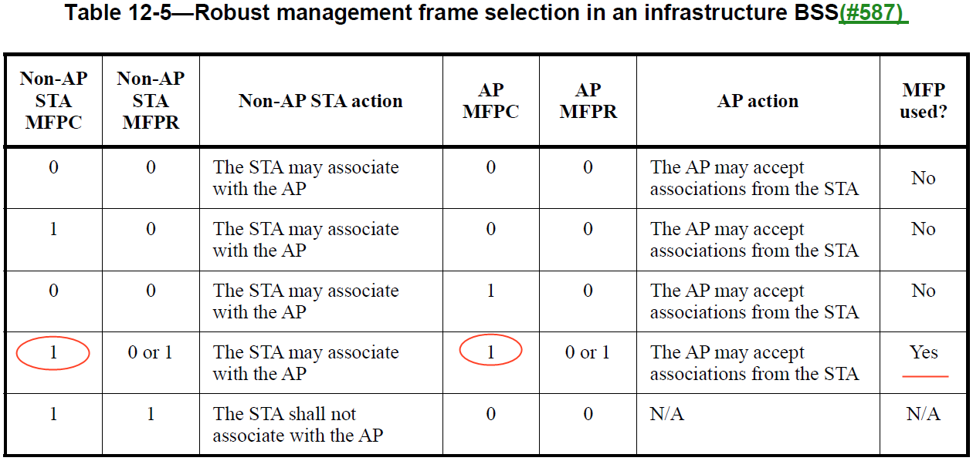
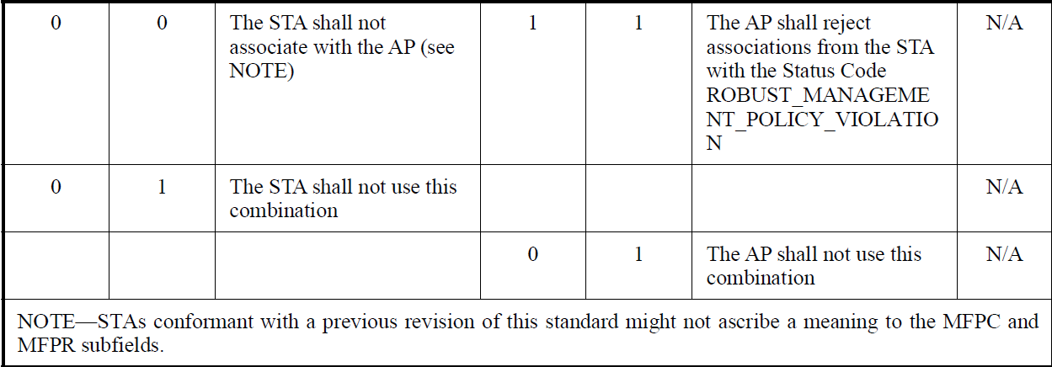
Backup: MFP for associated
12.6.3 RSNA policy selection in an infrastructure BSS
Chaoming Luo (OPPO)

Slide 11
Backup: MFP for unassociated
Chaoming Luo (OPPO)

Slide 12
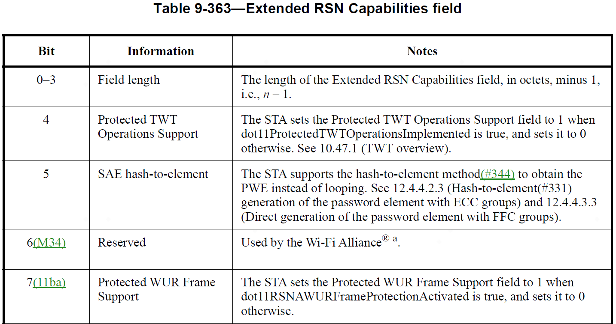
Backup: RSNXE in 11me
Chaoming Luo (OPPO)

Slide 13
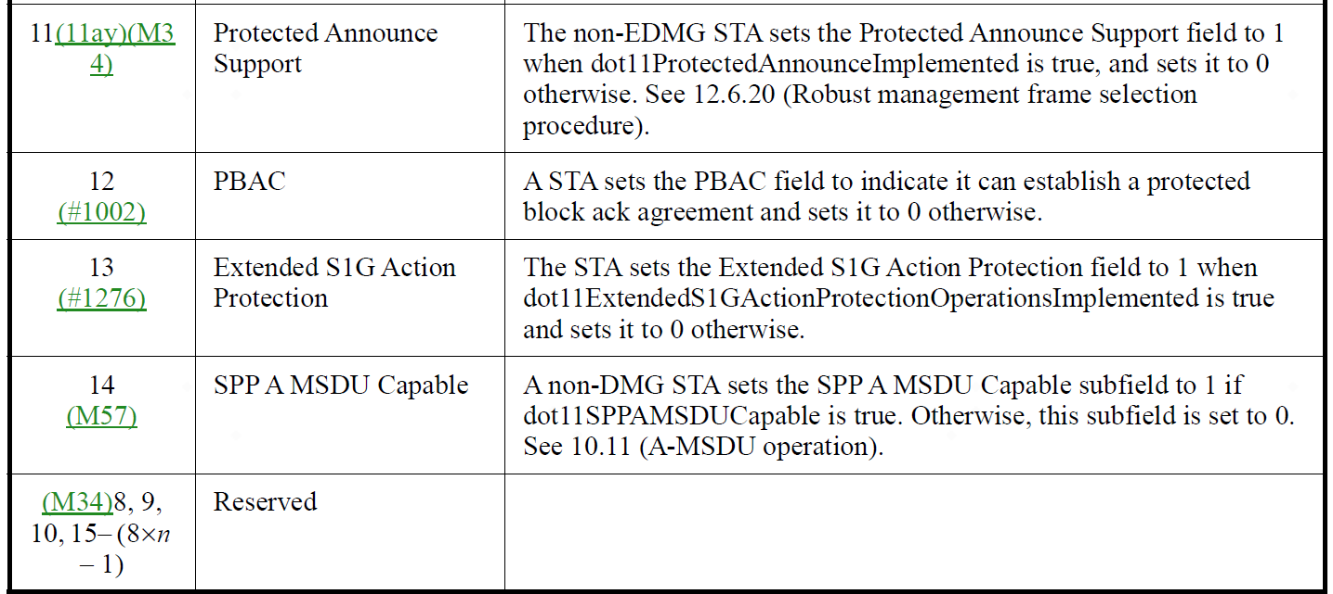
Backup: RSNXE in 11me – Cont.
Chaoming Luo (OPPO)

Slide 14
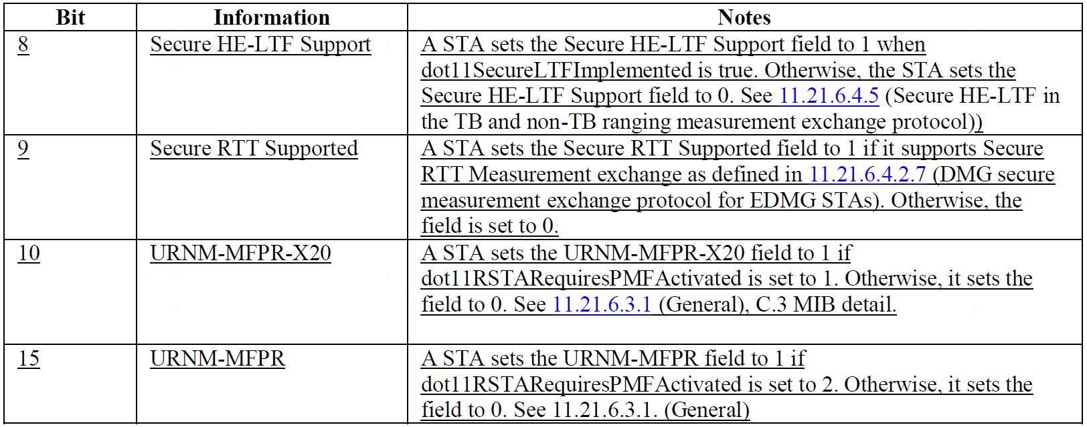
Backup: RSNXE in 11az
Chaoming Luo (OPPO)

