Slide 1
MFP and sensing
Date: 2022-12-13
Authors:
Name | Affiliation | Address | Phone | Email
Chaoming Luo | OPPO |  |  | luochaoming@oppo.com
Chaoming Luo (OPPO)

Slide 2
Introduction
This contribution proposes how to use MFP in sensing.

Slide 3
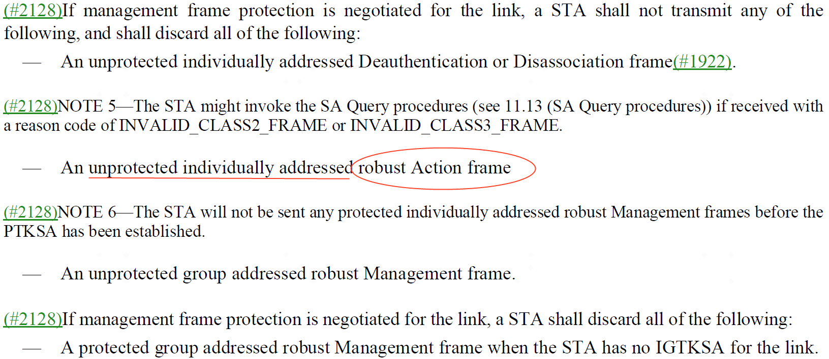
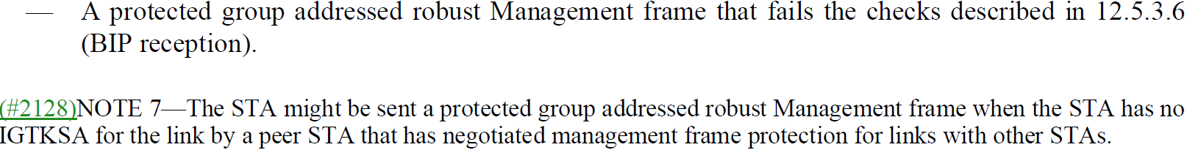
Recap: MFP
12.6.19 Protection of robust Management frames
Chaoming Luo (OPPO)

Slide 4
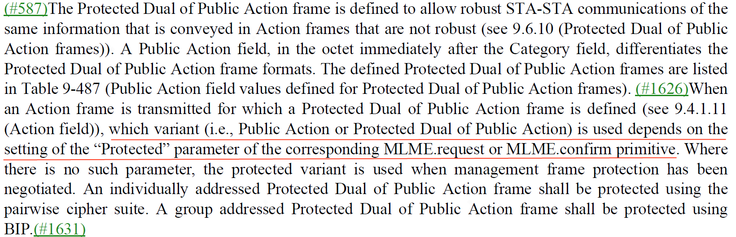
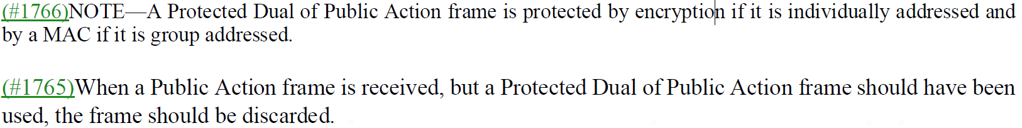
Recap: MFP-Cont.
12.6.20 Robust management frame selection procedure
Chaoming Luo (OPPO)

Slide 5
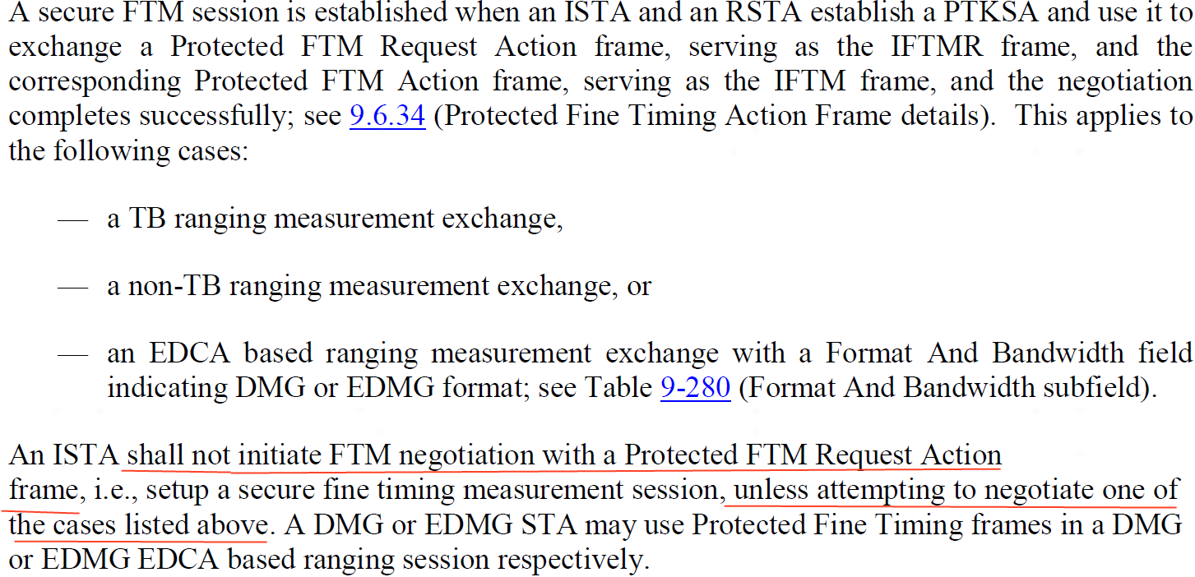
Recap: MFP-Cont.
11.21.6.3 FTM procedure negotiation
Chaoming Luo (OPPO)

Slide 6
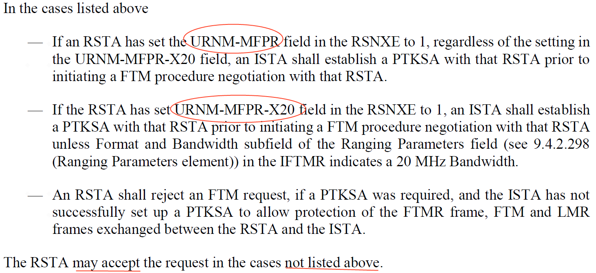
Recap: MFP-Cont.
11.21.6.3 FTM procedure negotiation
Chaoming Luo (OPPO)

Slide 7
Recap: MFP with exceptions
For associated STA, there are cases allowing to transmit non-Robust Action frames even if MFPR is set to 1:
  CBF (Compressed Beamforming frame).
  TWT Operations when dot11ProtectedTWTOperationsImplemented is false.
  an EDCA based ranging measurement exchange in Sub-7GHz.
  An passive ranging measurement exchange.
For unassociated STA, there are also cases allowing to transmit Public Action frames (one of non-Robust Action frames) even if MFP is required:
  RSTA with URNM-MFPR-X20 = 1 allows unprotected ranging measurements for 20Mhz bandwidth.
  an EDCA based ranging measurement exchange in Sub-7GHz.
  An passive ranging measurement exchange.
Chaoming Luo (OPPO)

Slide 8
Proposal
Challenge of MFP in sensing:
  Using protected sensing frames may require a separate queue in buffer, which may require more cache. Also new replay counter adds implementation complexity.
  A typical implementation may use a similar implementation as the BFRP TF and CBF, which does not do encryption.
Proposal:
  Suggest to relax sensing a little bit, allow the sensing initiator to config using Sensing Measurement Report and SBP report of Public Action frames even when MFPR=1.
Chaoming Luo (OPPO)

Slide 9
SP 1
Do you agree with the following?
  For associated STAs, 11bf allows the sensing initiator to config using Sensing Measurement Report and SBP report of Public Action frames even if MFPR=1.
  For unassociated STAs, 11bf add two fields in the RSNXE
    USNR-MFPR (Unassociated Sensing Negotiation and Report Management Frame Protection Required) field (1 bit)
    USN-MFPR-XR (Unassociated Sensing Negotiation Management Frame Protection Required Exempt Report) field (1 bit)
  Y/N/A
Chaoming Luo (OPPO)

Slide 10
Reference
[1] Draft P802.11REVme_D2.0
[2] Draft P802.11az_D7.0
Chaoming Luo (OPPO)

Slide 11
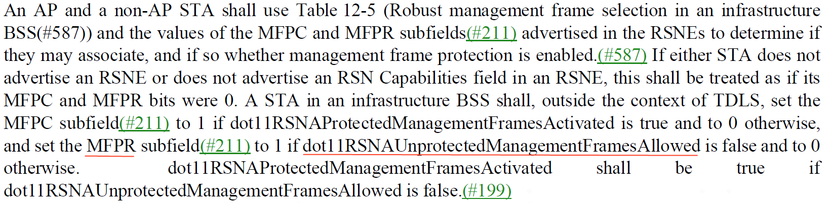
Backup: MFP for associated
Chaoming Luo (OPPO)

Slide 12
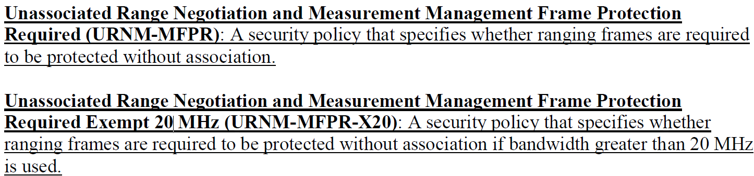
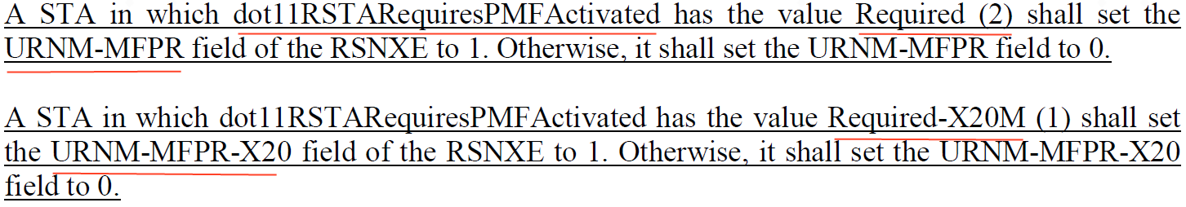
Backup: MFP for unassociated
Chaoming Luo (OPPO)

Slide 13
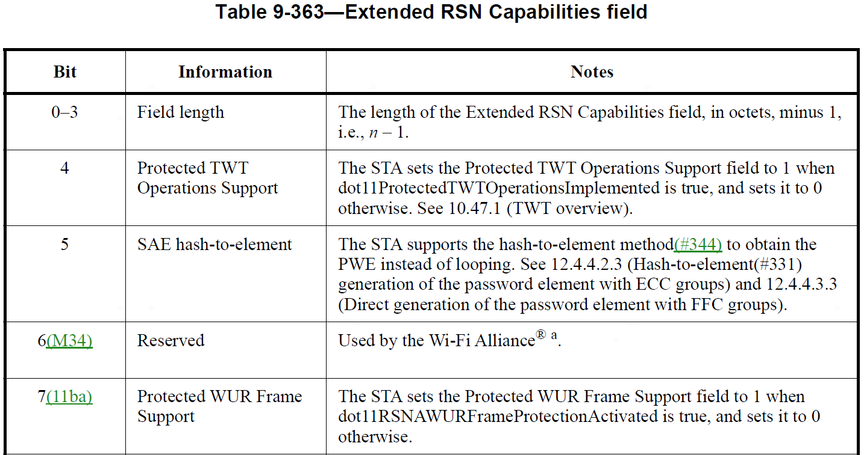
Backup: RSNXE in 11me
Chaoming Luo (OPPO)

Slide 14
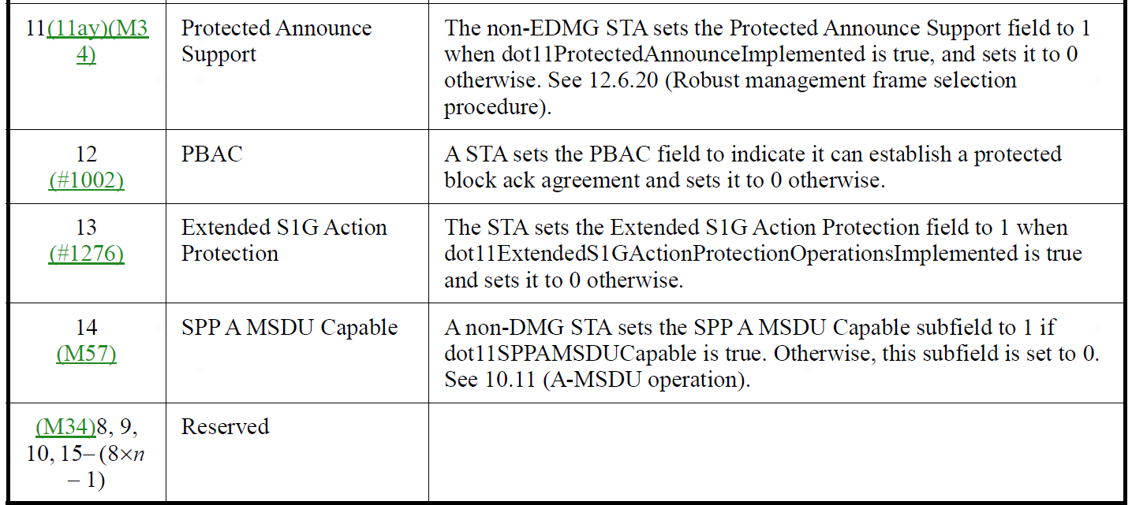
Backup: RSNXE in 11me – Cont.
Chaoming Luo (OPPO)

Slide 15
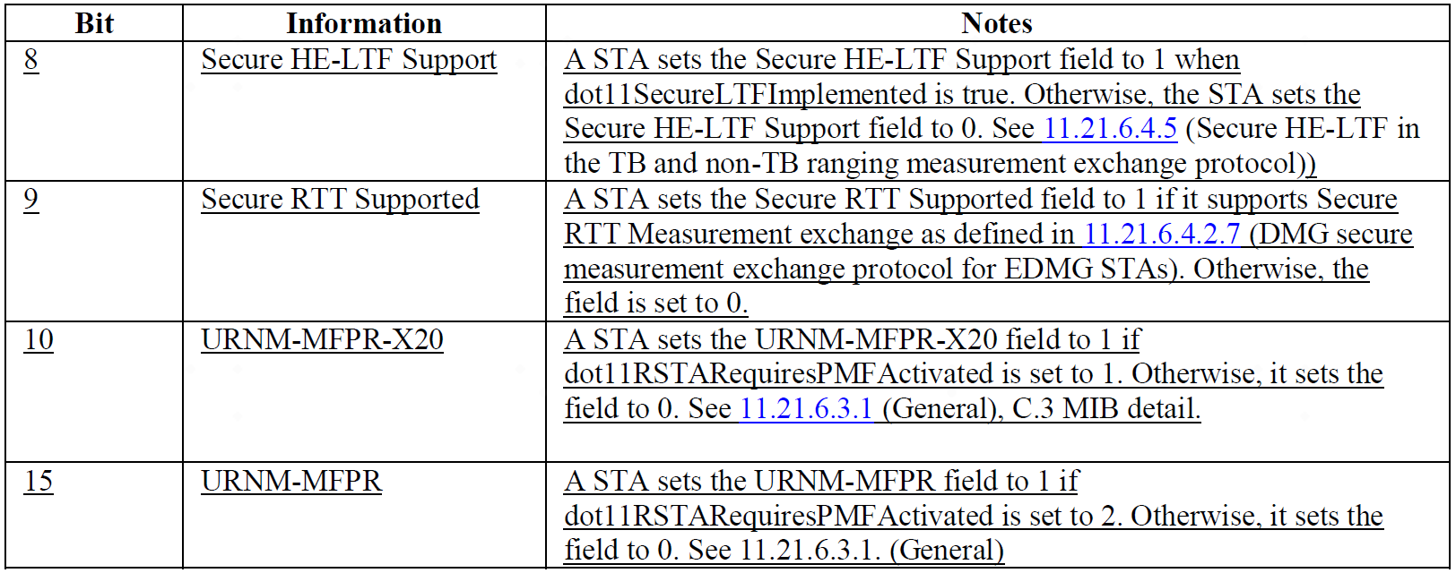
Backup: RSNXE in 11az
Chaoming Luo (OPPO)

