Slide 1
Operation Procedure for AMP device in WLAN
December 2022
Doc.: IEEE 802.11-22/2151r0
Date: 2022-11-11
Authors:
Name | Affiliation | Address | Phone | Email
Yinan Qi | OPPO |  |  | v-qiyinan@oppo.com
Weijie Xu |  |  |  | xuweijie@oppo.com

Slide 2
Outline
December 2022
Doc.: IEEE 802.11-22/2151r0
Background of energy harvesting
Energy harvesting: operation procedure, etc.

Slide 3
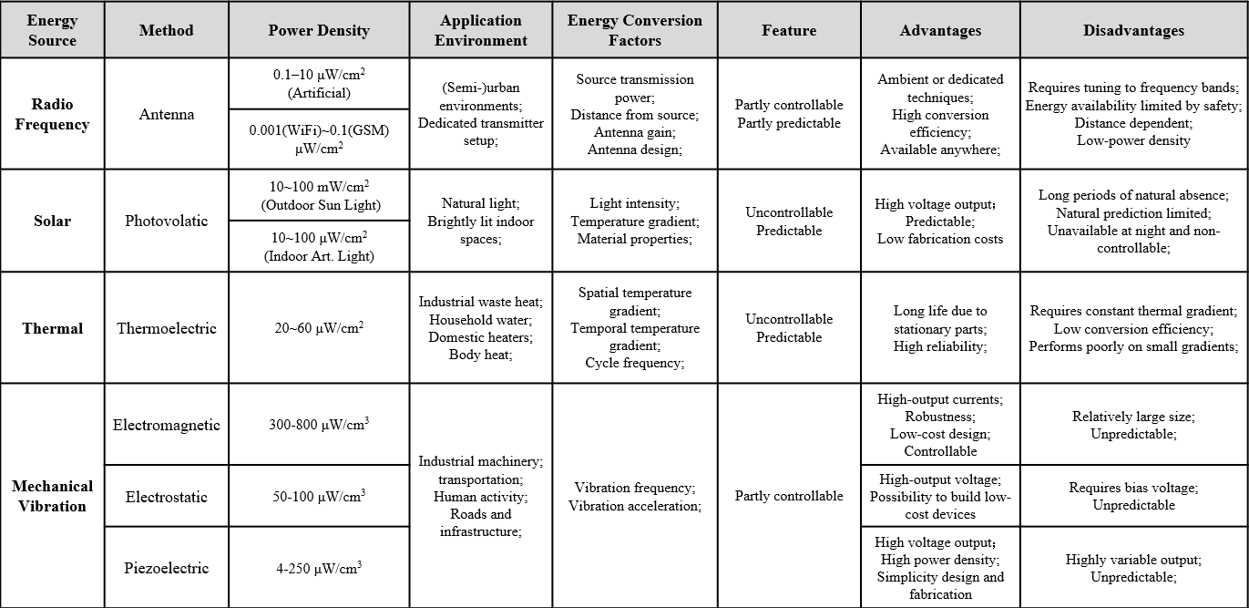
December 2022
Doc.: IEEE 802.11-22/2151r0
Background
[1] IEEE 802.11-22/1562r3, Draft Technical Report on support of AMP IoT devices in WLAN
Slide 3
Yinan Qi (OPPO)

Slide 4
December 2022
Doc.: IEEE 802.11-22/2151r0
Operation Procedure
Solar
Two categories: with/without energy storage capability
With energy storage capability
Operate during day and night
Device activated periodically during daytime and energy storage charged periodically during daytime with period P_{D}
Device activated periodically, possibly with longer period with P_{N}, during night
Flexible configuration can be applied to keep the energy storage is not completely drained.
Stored Energy
Day
Night
Device Power
P_{D}
P_{N}
t
Slide 4
Yinan Qi (OPPO)

Slide 5
December 2022
Doc.: IEEE 802.11-22/2151r0
Operation Procedure
Solar
Without energy storage
Only operate during daytime
Device activated periodically during daytime and sleep during night
Other power sources, e.g., thermal, vibration
Follow the same power profile characteristics
Energy source available time, e.g., daytime for solar
Energy source unavailable time, e.g., night for solar
Device Power
Day
Night
t
Slide 5
Yinan Qi (OPPO)

Slide 6
December 2022
Doc.: IEEE 802.11-22/2151r0
RF Power Source
Features
Higher reliability
Possible individual power link
Consistent or periodic power transmission
On-demand power transmission, e.g., on-demand sensor data reporting
Procedure
Power source transmits power signal
Energy harvester harvests the RF power
Energy storage is charged
Main parts of AMP device, e.g., sensors, communication modules, are activated
Power signal can be enhanced via , e.g., padding
Power Source
Periodic Power Tx
On-demand Power Tx
Stored Energy
Device Power
P_{D}
t
Slide 6
Yinan Qi (OPPO)

Slide 7
Summary
December 2022
Doc.: IEEE 802.11-22/2151r0
This submission discusses following aspects of energy harvesting
Operation procedures of AMP devices for different power sources, e.g., solar, thermal, etc.
Operation procedure for RF power sources powered AMP devices

Slide 8
Reference
December 2022
Doc.: IEEE 802.11-22/2151r0
IEEE 802.11-22/1562r3, Draft Technical Report on support of AMP IoT devices in WLAN

