Slide 1
User-friendly WPA3 Passwords
Date: 2022-12-08
Authors:
Name | Affiliations | Address | Phone | Email
Jeff Hansen | SoundVision Technologies | 192 N Old Hwy 91, Hurricane, UT 84737 USA | +1-801-243-7561 | jeff@soundvisiontech.com

Slide 2
Abstract
SAE has removed the ability for a single SSID to accept multiple passwords and route users based solely on the password used. This ability has long been used within WPA2-PSK to route different types of devices/users to their appropriate networks.
MAC-based and SAE Password identifiers do not solve the problem because they require knowledge of the MAC/Identifier before SAE authentication commences.
This proposal adds Password and Password-identifier hashes to the SAE commit exchange. This allows a Station to hint to the AP which password will be used, while offering the user varying degrees of privacy and security. It also eliminates PII privacy concerns with using password identifiers.

Slide 3
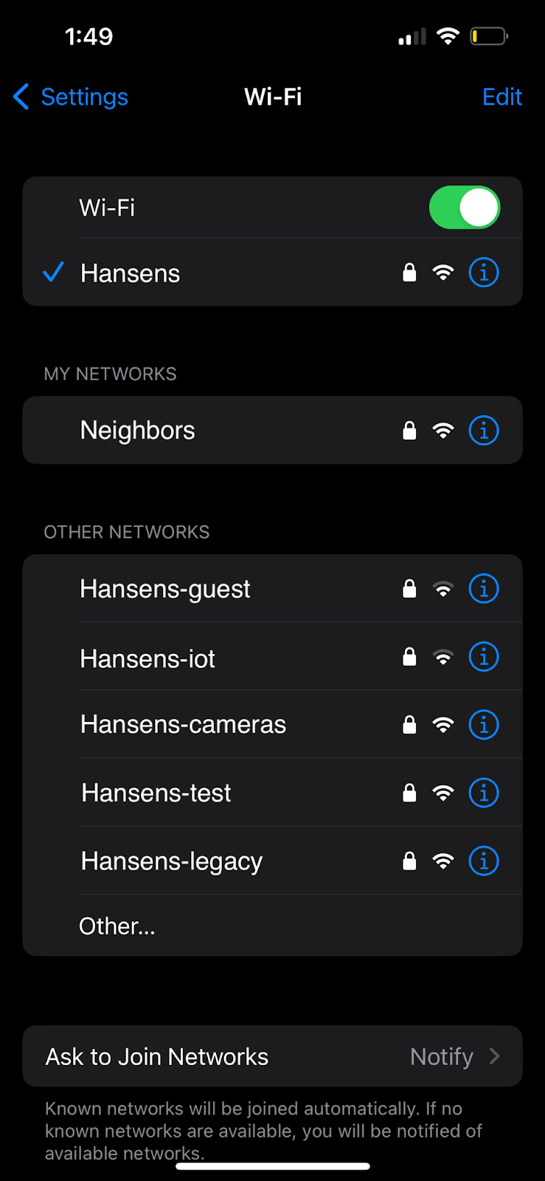
Why is this a big deal?
SAE encourages the provisioning of many various SSIDs for various purposes. This clutters the air with unnecessary beacons and degrades the user experience for users who may not understand which network they should connect to.
Which network do I use??

Slide 4
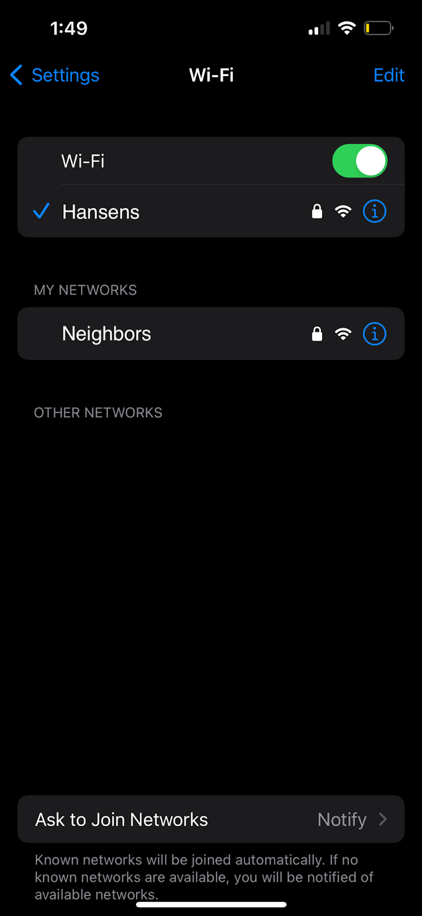
Why is this a big deal?
WPA2-PSK has had the ability to route different users and devices based solely on the password used.
This eliminates the need to have many purpose-specific SSIDs.
Much better!

Slide 5
Technical Proposal
A small portion of SHA512(BSSID+password) (and/or password identifier) will be included in the SAE commit message to indicate which password the STA is committing to.
This allows the AP to search its configured passwords, and commit appropriately to the user’s desired password.
The hash “portion” can be a very small number of bits, even 0 bits by default, to maintain status quo. For those networks that have a very small number of passwords (less than 4), even 4 bits of the hash is sufficient in most cases for the AP to detect which password the STA has committed to.
The admin interface can even warn the admin of hash collision before deployment, as well as allow the admin to increase the number of bits desired.

Slide 6
Potential Issues
It is true that allowing multiple passwords enables easier tracking of specific individuals or groups by disseminating specific passwords to those individuals/groups.
However, this is (and has been) a legitimate use case in many environments, and the standard should be adjusted to allow admins to encourage as much or as little privacy as users are comfortable with.
In STA User Interfaces, a privacy warning could be added to networks that have non-zero hash bits. The severity of the privacy warning can go up as the number of desired hash bits gets larger.
As far as security implications, the security benefits of SAE alone should outweigh the ability to filter available passwords based on the small number of hash bits shared.

Slide 7
Other options
Use password identifier as the password hash
Requires less changes on AP side
AP should still indicate how many hash bits it desires
Don’t include BSSID, or include something else in hash

Slide 8
Thank you!
Questions?

