Slide 1
mmWave Phase Feedback
Date: 2022-12-06
Authors:
Name | Affiliation | Address | Phone | Email
Kevin Tsunghan Tsai | Mediatek Inc | 2840 Junction Ave, San Jose, CA 95134, USA |  | kevin.tsai@mediatek.com
Dennis Liu |  |  |  | dennis.liu@mediatek.com
Shuling (Julia) Feng |  |  |  | julia.feng@mediatek.com

Slide 2






Introduction
Vital sign det. includes breathing rate and heart rate detection and can be used in many health applications
Vital sign is one of 11BF use cases [1]
  Health case - remote diagnostics measurements
  of breathing rate, heart rate etc.
AP: Initiator
feedback
feedback
feedback
STA1
STA2
STA3
detection
detection
detection

Slide 3
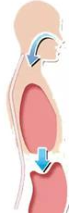












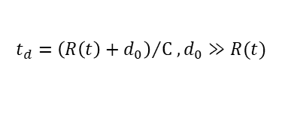
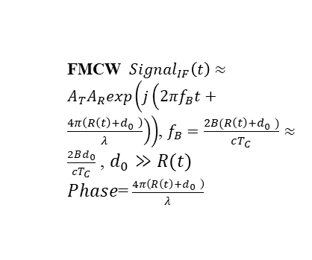





Vital Signs Detection
Chest up and down is a small distance variation
  Small distance variations cause signal traveling different distances and result in phase variations at target bin
  Hence, we propose to add target bin phase as a report type for vital sign detection
Distance
exhale
$$distance=R\left(t\right)+d_{0}$$
$$d_{0}$$
$$∆_{d}$$
$$Δθ$$
inhale
$$t_{d}={\left(R\left(t\right)+d_{0}\right)}/{C ,d_{0}≫R(t)}$$
time
Freq
$$t_{d}$$
$$t_{d}$$
$$t_{d}$$
$$t_{d}$$
TX chirp
RX chirp
FMCW
time
Find the variation period of target bin can get breathing rate
  FMCW ${Signal}_{IF}\left(t\right)≈$ $A_{T}A_{R}exp\left(j\left(2πf_{B}t+\frac{4π\left(R\left(t\right)+d_{0} \right)}{λ}\right)\right)$, $f_{B}=\frac{2B(R\left(t\right)+d_{0} )}{cT_{C}}≈$ $\frac{2Bd_{0}}{cT_{C}}$ , $d_{0}≫R(t)$
  $Phase$= $\frac{4π\left(R\left(t\right)+d_{0} \right)}{λ}$
frame0
frame1
frame2
frame3
Phase of $f_{B}$ bin
Mag.
Phase= $\frac{4π\left(d_{0}+∆_{d}\right)}{λ}$
Mag.
Mag.
Mag.
exhale
Phase= $\frac{4π\left(d_{0}\right)}{λ}$
Phase= $\frac{4π\left(d_{0}−∆_{d}\right)}{λ}$
Phase= $\frac{4π\left(d_{0}\right)}{λ}$
$$θ_{0}$$
$$∆_{θ}$$
velocity
velocity
velocity
velocity
inhale
$θ_{0}$= $\frac{4π\left(d_{0}\right)}{λ}$,$∆_{θ}$= $\frac{4π\left(∆_{d}\right)}{λ}$
$$f_{B}$$
Range
$$f_{B}$$
Range
$$f_{B}$$
Range
$$f_{B}$$
Range
time

Slide 4
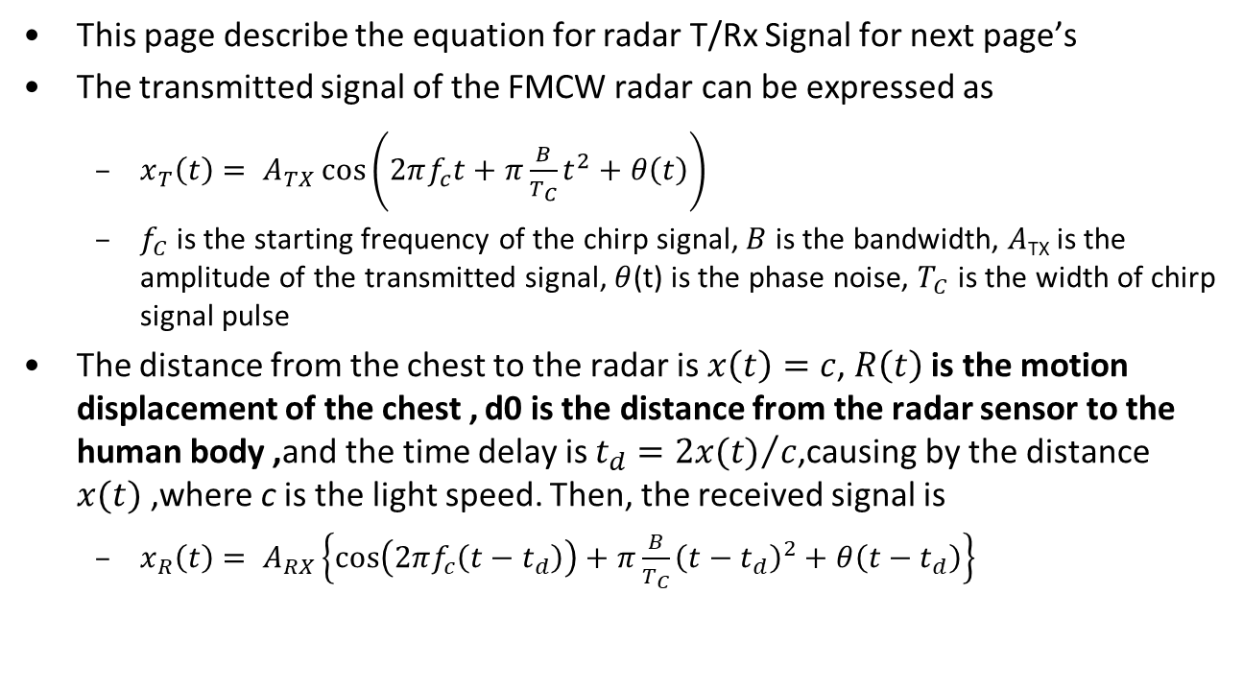
mmRadar for Breathing/Heartbeat[2]
This page describe the equation for radar T/Rx Signal for next page’s
The transmitted signal of the FMCW radar can be expressed as
  $x_{T}\left(t\right)= A_{TX}\cos\left(2πf_{c}t+π\frac{B}{T_{C}}t^{2}+θ\left(t\right)\right)$
  $f_{C}$ is the starting frequency of the chirp signal, $B$ is the bandwidth, $A$_{TX} is the amplitude of the transmitted signal, $θ$(t) is the phase noise, $T_{C}$ is the width of chirp signal pulse
The distance from the chest to the radar is $x\left(t\right)=c$, $R\left(t\right)$is the motion displacement of the chest , d0 is the distance from the radar sensor to the human body ,and the time delay is $t_{d}={2x(t)}/c$,causing by the distance $x(t)$,where c is the light speed. Then, the received signal is
  $x_{R}\left(t\right)= A_{RX}\left\{\cos\left(2πf_{c}\left(t−t_{d}\right)\right)+π\frac{B}{T_{C}}{\left(t−t_{d}\right)}^{2}+θ\left(t−t_{d}\right)\right\}$

Slide 5
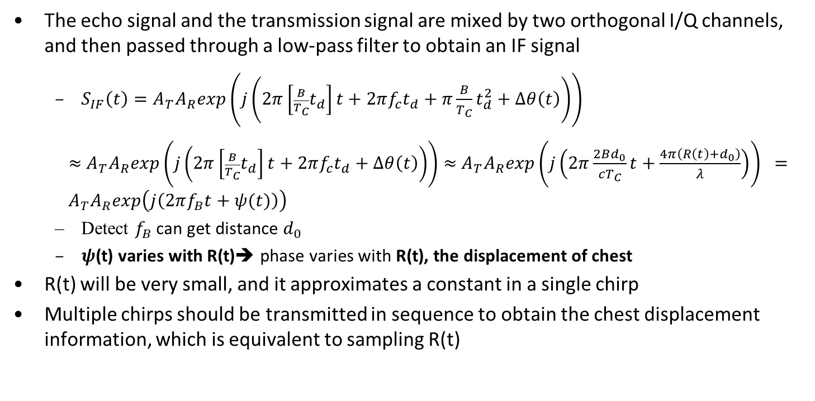
mmRadar for Breathing/Heartbeat[2]
The echo signal and the transmission signal are mixed by two orthogonal I/Q channels, and then passed through a low-pass filter to obtain an IF signal
  $S_{IF}\left(t\right)=A_{T}A_{R}exp\left(j\left(2π\left[{\frac{B}{T_{C}}t}_{d}\right]t+2πf_{c}t_{d}+π\frac{B}{T_{C}}t_{d}^{2}+Δθ\left(t\right)\right)\right)$
  $≈$ $A_{T}A_{R}exp\left(j\left(2π\left[{\frac{B}{T_{C}}t}_{d}\right]t+2πf_{c}t_{d}+Δθ\left(t\right)\right)\right)$ $≈$ $A_{T}A_{R}exp\left(j\left(2π\frac{2Bd_{0}}{cT_{C}}t+\frac{4π\left({R\left(t\right)+d}_{0}\right)}{λ}\right)\right) ={ A}_{T}A_{R}exp\left(j\left(2πf_{B}t+ψ(t)\right)\right)$
  Detect $f_{B}$ can get distance $d_{0}$
  $ψ$(t) varies with R(t)➔ phase varies with R(t), the displacement of chest
R(t) will be very small, and it approximates a constant in a single chirp
Multiple chirps should be transmitted in sequence to obtain the chest displacement information, which is equivalent to sampling R(t)

Slide 6
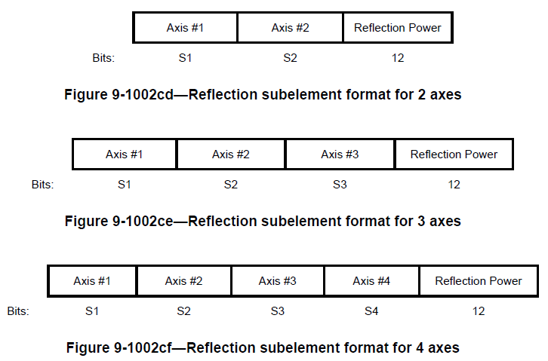
Vital Sign Report
Phase report has not yet been defined in 11bf mmWave image report or target report
  Vital sign detections can be obtained by FFT operations on phases of target range bins during a Range-Doppler like processing.
Image Report
Target Report
    9.4.2.329.4 DMG Sensing Targets Report Data subelement
NO | Feedback inform
1 | Range in mm
2 | Range Span
3 | Azimuth in 360/2048 degree
4 | Azimuth Span
5 | Elevation in 360/2048 degree
6 | Elevation Span
7 | Radial Velocity in mm/sec
8 | Azimuth Velocity in (360/2048 degree)/sec
9 | Elevation Velocity in (360/2048 degree)/sec

Slide 7
mmRadar for Breathing/Heartbeat
Breathing Detection test
  Using phase variation to calculate breathing rate
Breathing rate~=17 per min
FFT

Slide 8
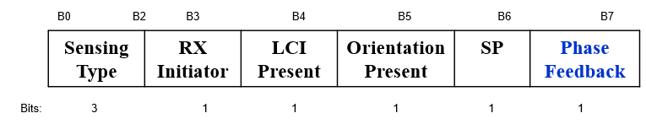
Signaling
During sensing measurement setup, let responder know to feedback phase
  Extend original option with phase or use Reserved bit in Measurement Setup Control field format
  Table 9-401w—Report Type subfield definition(#84)
Value | Description
0 | No report
1 | CSI
2 | DMG Sensing Image Direction
3 | DMG Sensing Image Range-Doppler
4 | DMG Sensing Image Range-Direction
5 | DMG Sensing Image Doppler-Direction
6 | DMG Sensing Image Range-Doppler Direction
7 | DMG Sensing Image Direction Phase
8 | DMG Sensing Image Range-Doppler Phase
9 | DMG Sensing Image Range-Direction Phase
10 | DMG Sensing Image Doppler-Direction Phase
11 | DMG Sensing Image Range-Doppler Direction Phase
12 | Target
9-255 | Reserved
Figure 9-1002bm—Measurement Setup Control field format

Slide 9
Signaling
An indicator to enable report phase or not
    Figure 9-1002cb—DMG Sensing Image Report Data element format
    Figure 9-1002cc—Axis & Phase Present field format
Subelement ID | Length | Data Block SN | Axis Present | Reflection Power Bias | Reflection Power Slope
Octets: 1 1 1 1 1 1
Number of Reflection Subelements | Reflection Subelements | Reserved
Octets: 3 variable variable
B0 B1 B2 B3 B4 B5 B7
Range Axis Present | Doppler Axis Present | Receiver Beam Index Present | Transmitter Beam Index Present | Reflection Phase Present | Reserved
Bits: 1 1 1 1 1 3

Slide 10
Phase Report for Vital Sign Detection
Refer to Azimuth/Elevation angle report, using (360/2048) ° resolution
Axis #1 | Axis #2 | Reflection Power | Reflection Phase
Bits: S1 S2 12 11
Figure 9-1002cd—Reflection subelement format for 2 axes
Axis #1 | Axis #2 | Axis #3 | Reflection Power | Reflection Phase
Bits: S1 S2 S3 12 11
Figure 9-1002ce—Reflection subelement format for 3 axes
Axis #1 | Axis #2 | Axis #3 | Axis #4 | Reflection Power | Reflection Phase
Bits: S1 S2 S3 S4 12 11
Figure 9-1002cf—Reflection subelement format for 4 axes

Slide 11
Summary
Vital sign detection is one of 11BF use cases
Propose to add phase report in (E)DMG report elements for vital sign detection
  Add phase report in image report or target report

Slide 12
SP1
Do you agree to add the following to 11bf SFD:
  The 11bf amendment shall add an option to report Phase in image report
    Y
    N
    Abstain

Slide 13
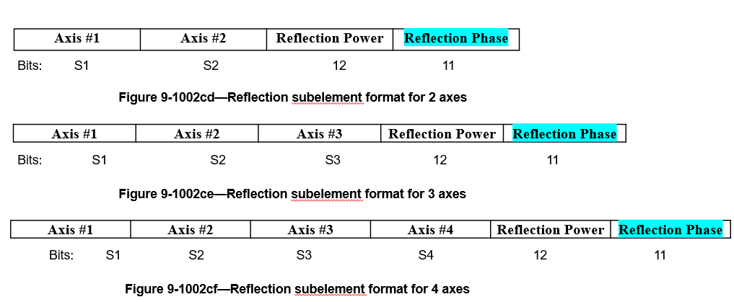
SP2
Do you agree to add the following to 11bf SFD:
  Add one option field “Reflection Phase” in Reflection subelement format , the number of bits is 11bits
    Y
    N
    Abstain

Slide 14
Reference
[1] 11-20-1712-01-00bf-wifi-sensing-use-cases
[2] Y. Wang, W. Wang, Mu Zhou, A. Ren, Z. Tian, “Remote Monitoring of Human Vital Signs Based on 77-GHz mm-Wave FMCW Radar”, Sensors, 2020

