Slide 1
mmWave Phase Feedback
Date: 2022-12-06
Authors:
Name | Affiliation | Address | Phone | Email
Kevin Tsunghan Tsai | Mediatek Inc | 2840 Junction Ave, San Jose, CA 95134, USA |  | kevin.tsai@mediatek.com
Dennis Liu |  |  |  | dennis.liu@mediatek.com
Shuling (Julia) Feng |  |  |  | julia.feng@mediatek.com

Slide 2






Introduction
Vital sign det. includes breathing rate and heart rate detection and can be used in many health applications
Vital sign is one of 11BF use cases [1]
  Health case - remote diagnostics measurements
  of breathing rate, heart rate etc.
AP: Initiator
feedback
feedback
feedback
STA1
STA2
STA3
detection
detection
detection

Slide 3
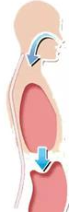













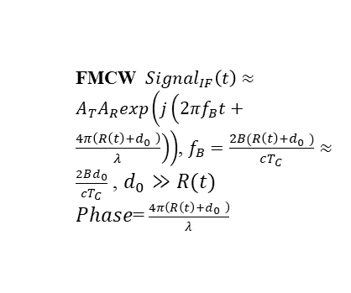





Vital Signs Detection
Chest up and down is a small distance variation
  Small distance variations cause radar signal travel different distances and result in phase variations at target bin
  Hence, we propose to add target bin phase as a report type for vital sign detection
Distance
exhale
$$distance=R\left(t\right)+d_{0}$$
$$d_{0}$$
$$∆_{d}$$
$$Δθ$$
inhale
$$t_{d}={\left(R\left(t\right)+d_{0}\right)}/{C ,d_{0}≫R(t)}$$
time
Freq
$$t_{d}$$
$$t_{d}$$
$$t_{d}$$
$$t_{d}$$
TX chirp
RX chirp
FMCW
time
Find the variation period of target bin can get breathing rate
  FMCW ${Signal}_{IF}\left(t\right)≈$ $A_{T}A_{R}exp\left(j\left(2πf_{B}t+\frac{4π\left(R\left(t\right)+d_{0} \right)}{λ}\right)\right)$, $f_{B}=\frac{2B(R\left(t\right)+d_{0} )}{cT_{C}}≈$ $\frac{2Bd_{0}}{cT_{C}}$ , $d_{0}≫R(t)$
  $Phase$= $\frac{4π\left(R\left(t\right)+d_{0} \right)}{λ}$
frame0
frame1
frame2
frame3
Phase of $f_{B}$ bin
Mag.
Phase= $\frac{4π\left(d_{0}+∆_{d}\right)}{λ}$
Mag.
Mag.
Mag.
exhale
Phase= $\frac{4π\left(d_{0}\right)}{λ}$
Phase= $\frac{4π\left(d_{0}−∆_{d}\right)}{λ}$
Phase= $\frac{4π\left(d_{0}\right)}{λ}$
$$θ_{0}$$
$$∆_{θ}$$
velocity
velocity
velocity
velocity
inhale
$θ_{0}$= $\frac{4π\left(d_{0}\right)}{λ}$,$∆_{θ}$= $\frac{4π\left(∆_{d}\right)}{λ}$
$$f_{B}$$
Range
$$f_{B}$$
Range
$$f_{B}$$
Range
$$f_{B}$$
Range
time

Slide 4
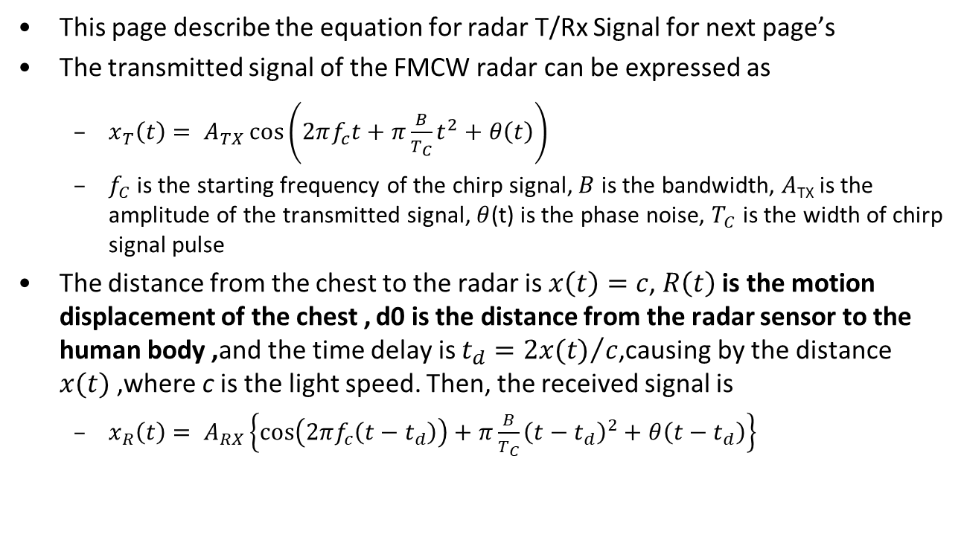
mmRadar for Breathing/Heartbeat[2]
This page describe the equation for radar T/Rx Signal for next page’s
The transmitted signal of the FMCW radar can be expressed as
  $x_{T}\left(t\right)= A_{TX}\cos\left(2πf_{c}t+π\frac{B}{T_{C}}t^{2}+θ\left(t\right)\right)$
  $f_{C}$ is the starting frequency of the chirp signal, $B$ is the bandwidth, $A$_{TX} is the amplitude of the transmitted signal, $θ$(t) is the phase noise, $T_{C}$ is the width of chirp signal pulse
The distance from the chest to the radar is $x\left(t\right)=c$, $R\left(t\right)$is the motion displacement of the chest , d0 is the distance from the radar sensor to the human body ,and the time delay is $t_{d}={2x(t)}/c$,causing by the distance $x(t)$,where c is the light speed. Then, the received signal is
  $x_{R}\left(t\right)= A_{RX}\left\{\cos\left(2πf_{c}\left(t−t_{d}\right)\right)+π\frac{B}{T_{C}}{\left(t−t_{d}\right)}^{2}+θ\left(t−t_{d}\right)\right\}$

Slide 5
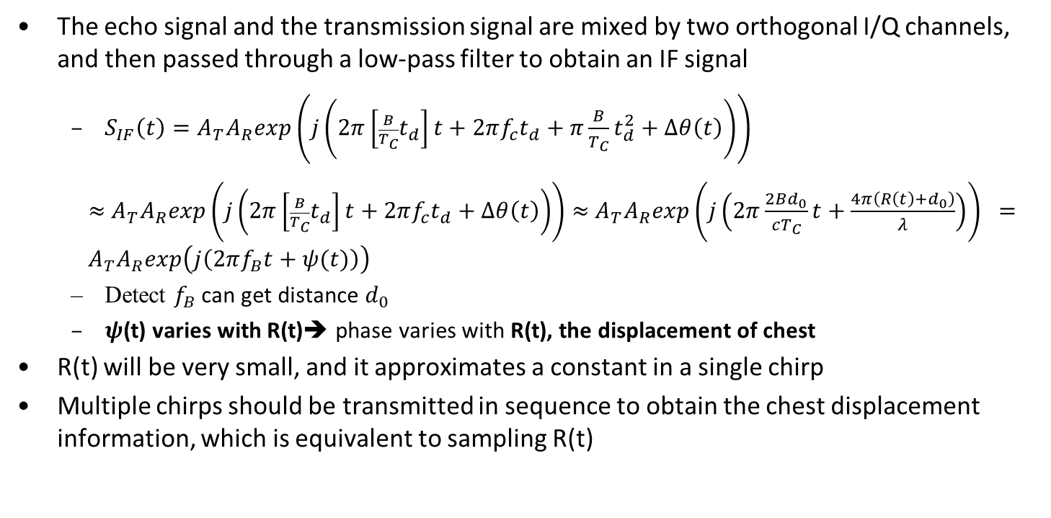
mmRadar for Breathing/Heartbeat[2]
The echo signal and the transmission signal are mixed by two orthogonal I/Q channels, and then passed through a low-pass filter to obtain an IF signal
  $S_{IF}\left(t\right)=A_{T}A_{R}exp\left(j\left(2π\left[{\frac{B}{T_{C}}t}_{d}\right]t+2πf_{c}t_{d}+π\frac{B}{T_{C}}t_{d}^{2}+Δθ\left(t\right)\right)\right)$
  $≈$ $A_{T}A_{R}exp\left(j\left(2π\left[{\frac{B}{T_{C}}t}_{d}\right]t+2πf_{c}t_{d}+Δθ\left(t\right)\right)\right)$ $≈$ $A_{T}A_{R}exp\left(j\left(2π\frac{2Bd_{0}}{cT_{C}}t+\frac{4π\left({R\left(t\right)+d}_{0}\right)}{λ}\right)\right) ={ A}_{T}A_{R}exp\left(j\left(2πf_{B}t+ψ(t)\right)\right)$
  Detect $f_{B}$ can get distance $d_{0}$
  $ψ$(t) varies with R(t)➔ phase varies with R(t), the displacement of chest
R(t) will be very small, and it approximates a constant in a single chirp
Multiple chirps should be transmitted in sequence to obtain the chest displacement information, which is equivalent to sampling R(t)

Slide 6
Vital Sign Report
Vital signs or target bin phase have not yet been defined in 11bf mmWave target report
  Vital sign detections may be obtained by FFT operations on phases of target range bins during a Range-Doppler like processing.
  The processing result is different from the Range-Doppler bitmap report defined in current 11bf mmWave.
    SPEC 9.4.2.326.4 DMG Sensing Targets Report Data subelement
NO | Feedback inform
1 | Range in mm
2 | Range Span
3 | Azimuth in 360/2048 degree
4 | Azimuth Span
5 | Elevation in 360/2048 degree
6 | Elevation Span
7 | Radial Velocity in mm/sec
8 | Azimuth Velocity in (360/2048 degree)/sec
9 | Elevation Velocity in (360/2048 degree)/sec

Slide 7
mmRadar for Breathing/Heartbeat
Breathing Detection test
  Using phase variation to calculate breathing rate
Breathing rate~=17 per min
FFT

Slide 8
Summary
Vital sign detection is one of 11BF use cases
Propose to add (E)DMG report elements for vital sign detection
  Add phase or vital sign(breathing rate or heart rate) feedback in target report

Slide 9
Reference
[1] 11-20-1712-01-00bf-wifi-sensing-use-cases
[2] Y. Wang, W. Wang, Mu Zhou, A. Ren, Z. Tian, “Remote Monitoring of Human Vital Signs Based on 77-GHz mm-Wave FMCW Radar”, Sensors, 2020

