Slide 1
S1G Energy Limited operation
Date: 2022-12-05
Authors:
Name | Affiliation | Address | Phone | email
David Halasz | Morse Micro |  |  | dave.halasz@morsemicro.com

Slide 2
Abstract
IEEE 802.11ah introduced Energy Limited STAs operation. Energy Limited STAs operation can be useful for AMP-assisted IoT device[1] operation. This submission is a review of Energy Limited STAs operation.

Slide 3
Energy Limited STAs operation
Energy Limited STAs operation was introduced to address some timing issues for STAs operating with small batteries[2]. Two timers were introduced for EL operation.
ELMaxAwakeTimer : Maximum duration of an RX or TX event
ELRecoveryTimer : Amount of time needed before next RX or TX event can occur.

Slide 4
Indication of Energy Limited STAs operation
Energy Limited STA can send EL Operation element in Probe Request, TDLS Setup Request, TDLS Setup Response, (Re)Association Request and EL Operation frame[3].

Slide 5
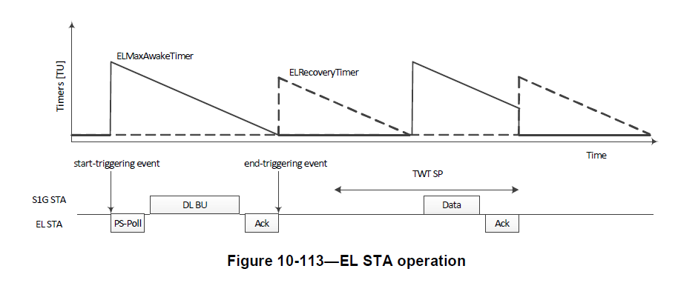
Energy Limited STAs operation
An AP limits transmission exchange time to ELMaxAwakeTimer.
After an EL STA has performed a transmission exchange, the AP will not initiate another transmission to the EL STA for ELRecoveryTimer

Slide 6
References
IEEE 802.11 22/1562r4 Draft Technical Report on support of AMP IoT devices in WLAN
IEEE 802.11 13/0304r0 Operation With Small Batteries
IEEE 802.11-2020

