Slide 1
TGbc Closing Report
Date: 2023-01-19
Authors:

Slide 2
Abstract
Closing report for IEEE 802.11 TGbc (Broadcast Services) for January 2023.

Slide 3
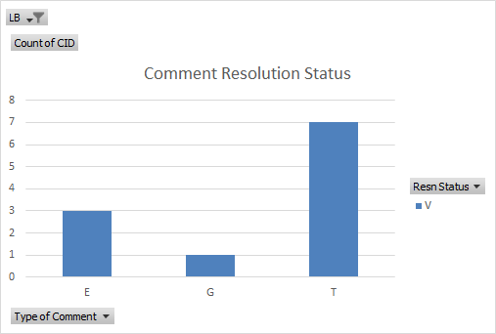
Meeting Goals & Accomplishments of the week
Goals for the week:
Resolve comments received from SAB
Accomplishments
Resolved and approved resolutions for all comments
Comment Resolution Committee Motions:
Motion passed to produce D6.0
Motion passed to start 20-day SA Recirculation ballot on D6.0
Comment database: 11-23/0081

Slide 4
TGbc schedule (unchanged)
January 2019 First meeting as a task group
June 2020 Call for comments on D0.1
November 2020 Initial WGLB (D1.0)
September 2021 D2.0 WG Recirculation LB
March 2022 D3.0 WG Recirculation LB
May intermediate version D3.1
June Form SAB Pool
July Editorial reviews completed: MEC & MDR on D3.1
D4.0 WG Recirculation LB
September 2022 WG request EC for unconditional approval to forward
draft D4.0 to SA ballot
Oct 4th EC telco EC approval to go to SA Ballot (unconditional)
Oct. 6th 2022 Initial SA Ballot (D4.0), Start of
March 2023 Second SA Ballot
July 2023 Third SA Ballot
September 2023 EC approval to RevCom
December 2023 RevCom/SASB approval

Slide 5
Plans for Next Meeting & Upcoming Telcos
Review and resolve comments received from SA Recirculation Ballot on D6.0
Prepare and approve report to EC to send P802.11bc to RevCom
Telcos
Tuesdays, 10:00h – 11.00h ET (1 hours)
Announced on WG-reflector
Will be cancelled if no matters are to be discussed before SA Recirc-Ballot / during ballot

Slide 6
References
Agenda for this week: 11-22/2029
Meeting / Chair’s Slide Deck: 11-22/2030
Meeting minutes: 11-23/0014
Snapshot Slide: 11-22/2031
Closing report: 11-22/2032
TGbc Motion Booklet: 11-18/2123
TGbc Selection Procedure: 11-19/0135
TGbc Functional Requirements: 11-19/0151
TGbc UseCase Document: 11-19/268

