Slide 1
Thoughts on 320 MHz Ranging NDP
Date: 2022-11-14
Authors:
Name | Affiliations | email
Steve Shellhammer | Qualcomm | shellhammer@ieee.org
Ali Raissinia |  | alirezar@qti.qualcomm.com
Yanjun Sun |  | yanjuns@qti.qualcomm.com
Bin Tian |  | btian@qti.qualcomm.com

Slide 2
Introduction
There are several areas where enhancements are needed to support 320 MHz Ranging in 802.11bk
Here we focus on the 320 MHz Ranging NDP
We begin by providing some background related to 11az and 11be
Then we share our thoughts on the 320 MHz Ranging NDP

Slide 3
Background – HE (TB) Ranging NDP
The Ranging NDP is an extension of the 11ax NDP
There is a (non-TB) Ranging NPD as well as a TB Ranging NDP
They are similar in structure with a different duration HE-STF

Slide 4
Background – HE (TB) Ranging NDP (cont.)
Ranging NDP supports HE-LTF Repetition Blocks
The number of Repetitions is specified in the NDPA
Secure ranging uses the repetitions in detection of attacks
Support only 2x LTFs with 1.6 µs GI
Ranging NDP uses HE-LTF for non-secure ranging and uses Secure HE-LTFs for secure ranging
Secure HE-LTFs have a zero GI

Slide 5
Background – 320 MHz EHT NDP
EHT supports two PPDU formats
The NDP is simplified version of the MU PPDU without the Data field
In the TB PPDU:
There is no EHT-SIG (Information sent in the Trigger Frame)
The EHT-STF is 8 µs versus 4 µs per symbol

Slide 6
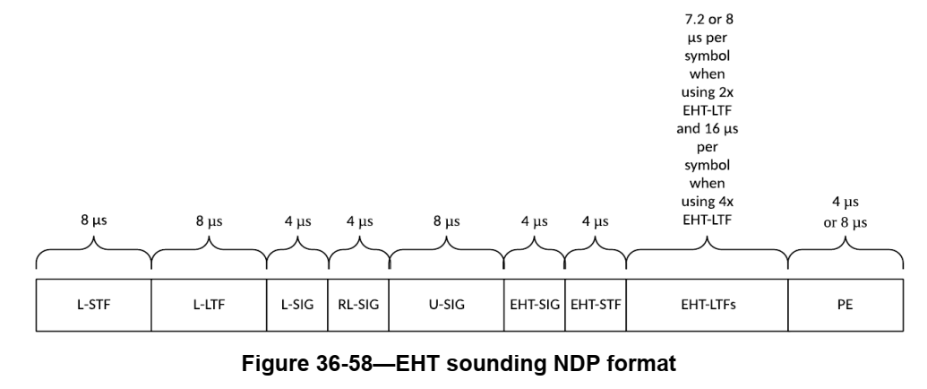
Background – 320 MHz EHT NDP (cont.)
Currently 11be only supports NDP based on MU PPDU
In addition to modifying the 320 MHz EHT NDP to support LTF Repetition Blocks, we will need a Ranging NDP based upon the EHT TB PPDU

Slide 7
EHT LTF Versions
IEEE 802.11az Ranging NDP uses 2x LTFs with 1.6 µs GI
Other LTFs are disallowed
Support for 2x LTF with 1.6 µs GI is mandatory in EHT for both MU PPDU and TB PPDU
Just like in 802.11az we can support only the 2x LTF with 1.6 µs GI for both non-TB and TB 320 MHz Ranging NDP

Slide 8
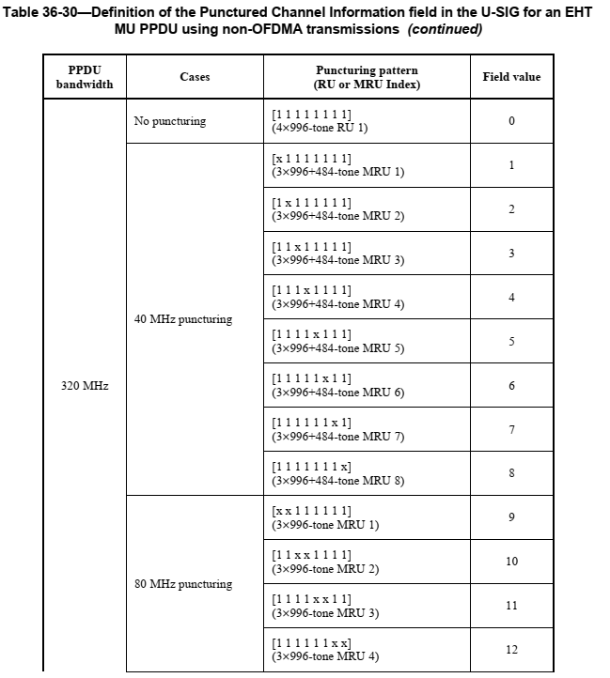
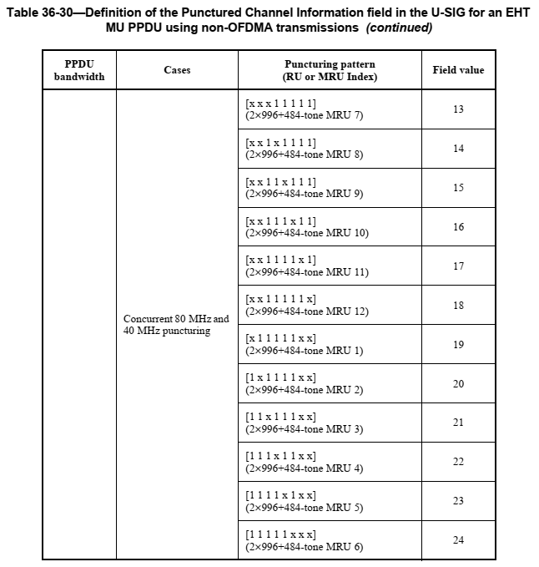
U-SIG Punctured Channel Info for non-OFDMA PPDU and NDP

Slide 9
Preamble Puncturing
In Ranging, it is desirable to have continuous spectrum
However, sometimes a BSS must be set up with puncturing such that the utilized spectrum is discontinuous
So, it is desirable to support these puncturing configurations
Also, if the Ranging algorithm works on continuous spectrum, it can use the portion of the spectrum which is continuous
Hence, we propose that the 802.11bk NDP supports all the EHT static preamble puncturing modes, the same as in 802.11be
We may want to make some of the puncturing modes optional

Slide 10
LTF Repetition Blocks (Non-Secure LTFs)
We can use the 320 MHz EHT LTFs for the Repetition Blocks
No change in the LTF sequence from EHT LTFs is required
Support up to 8 EHT-LTF Repetition Blocks, just like in 802.11az
The signaling of the number of repetitions can be handled in the NDPA and the Trigger frame

Slide 11
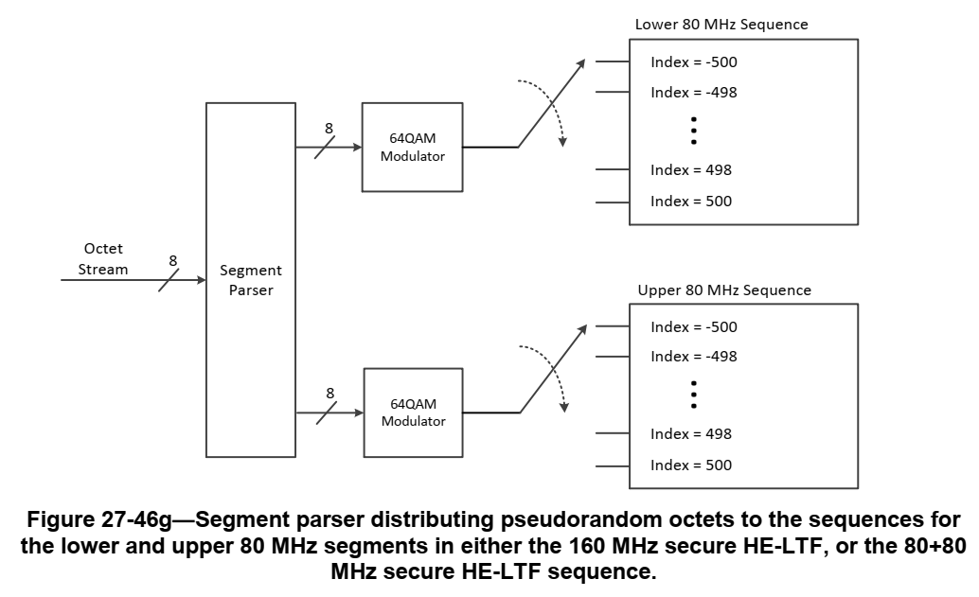
Secure LTFs
In 802.11az we used a segment parser for 160 MHz NDP
For 802.11bk we need to extend this for:
320 MHz
Support Preamble Puncturing

Slide 12
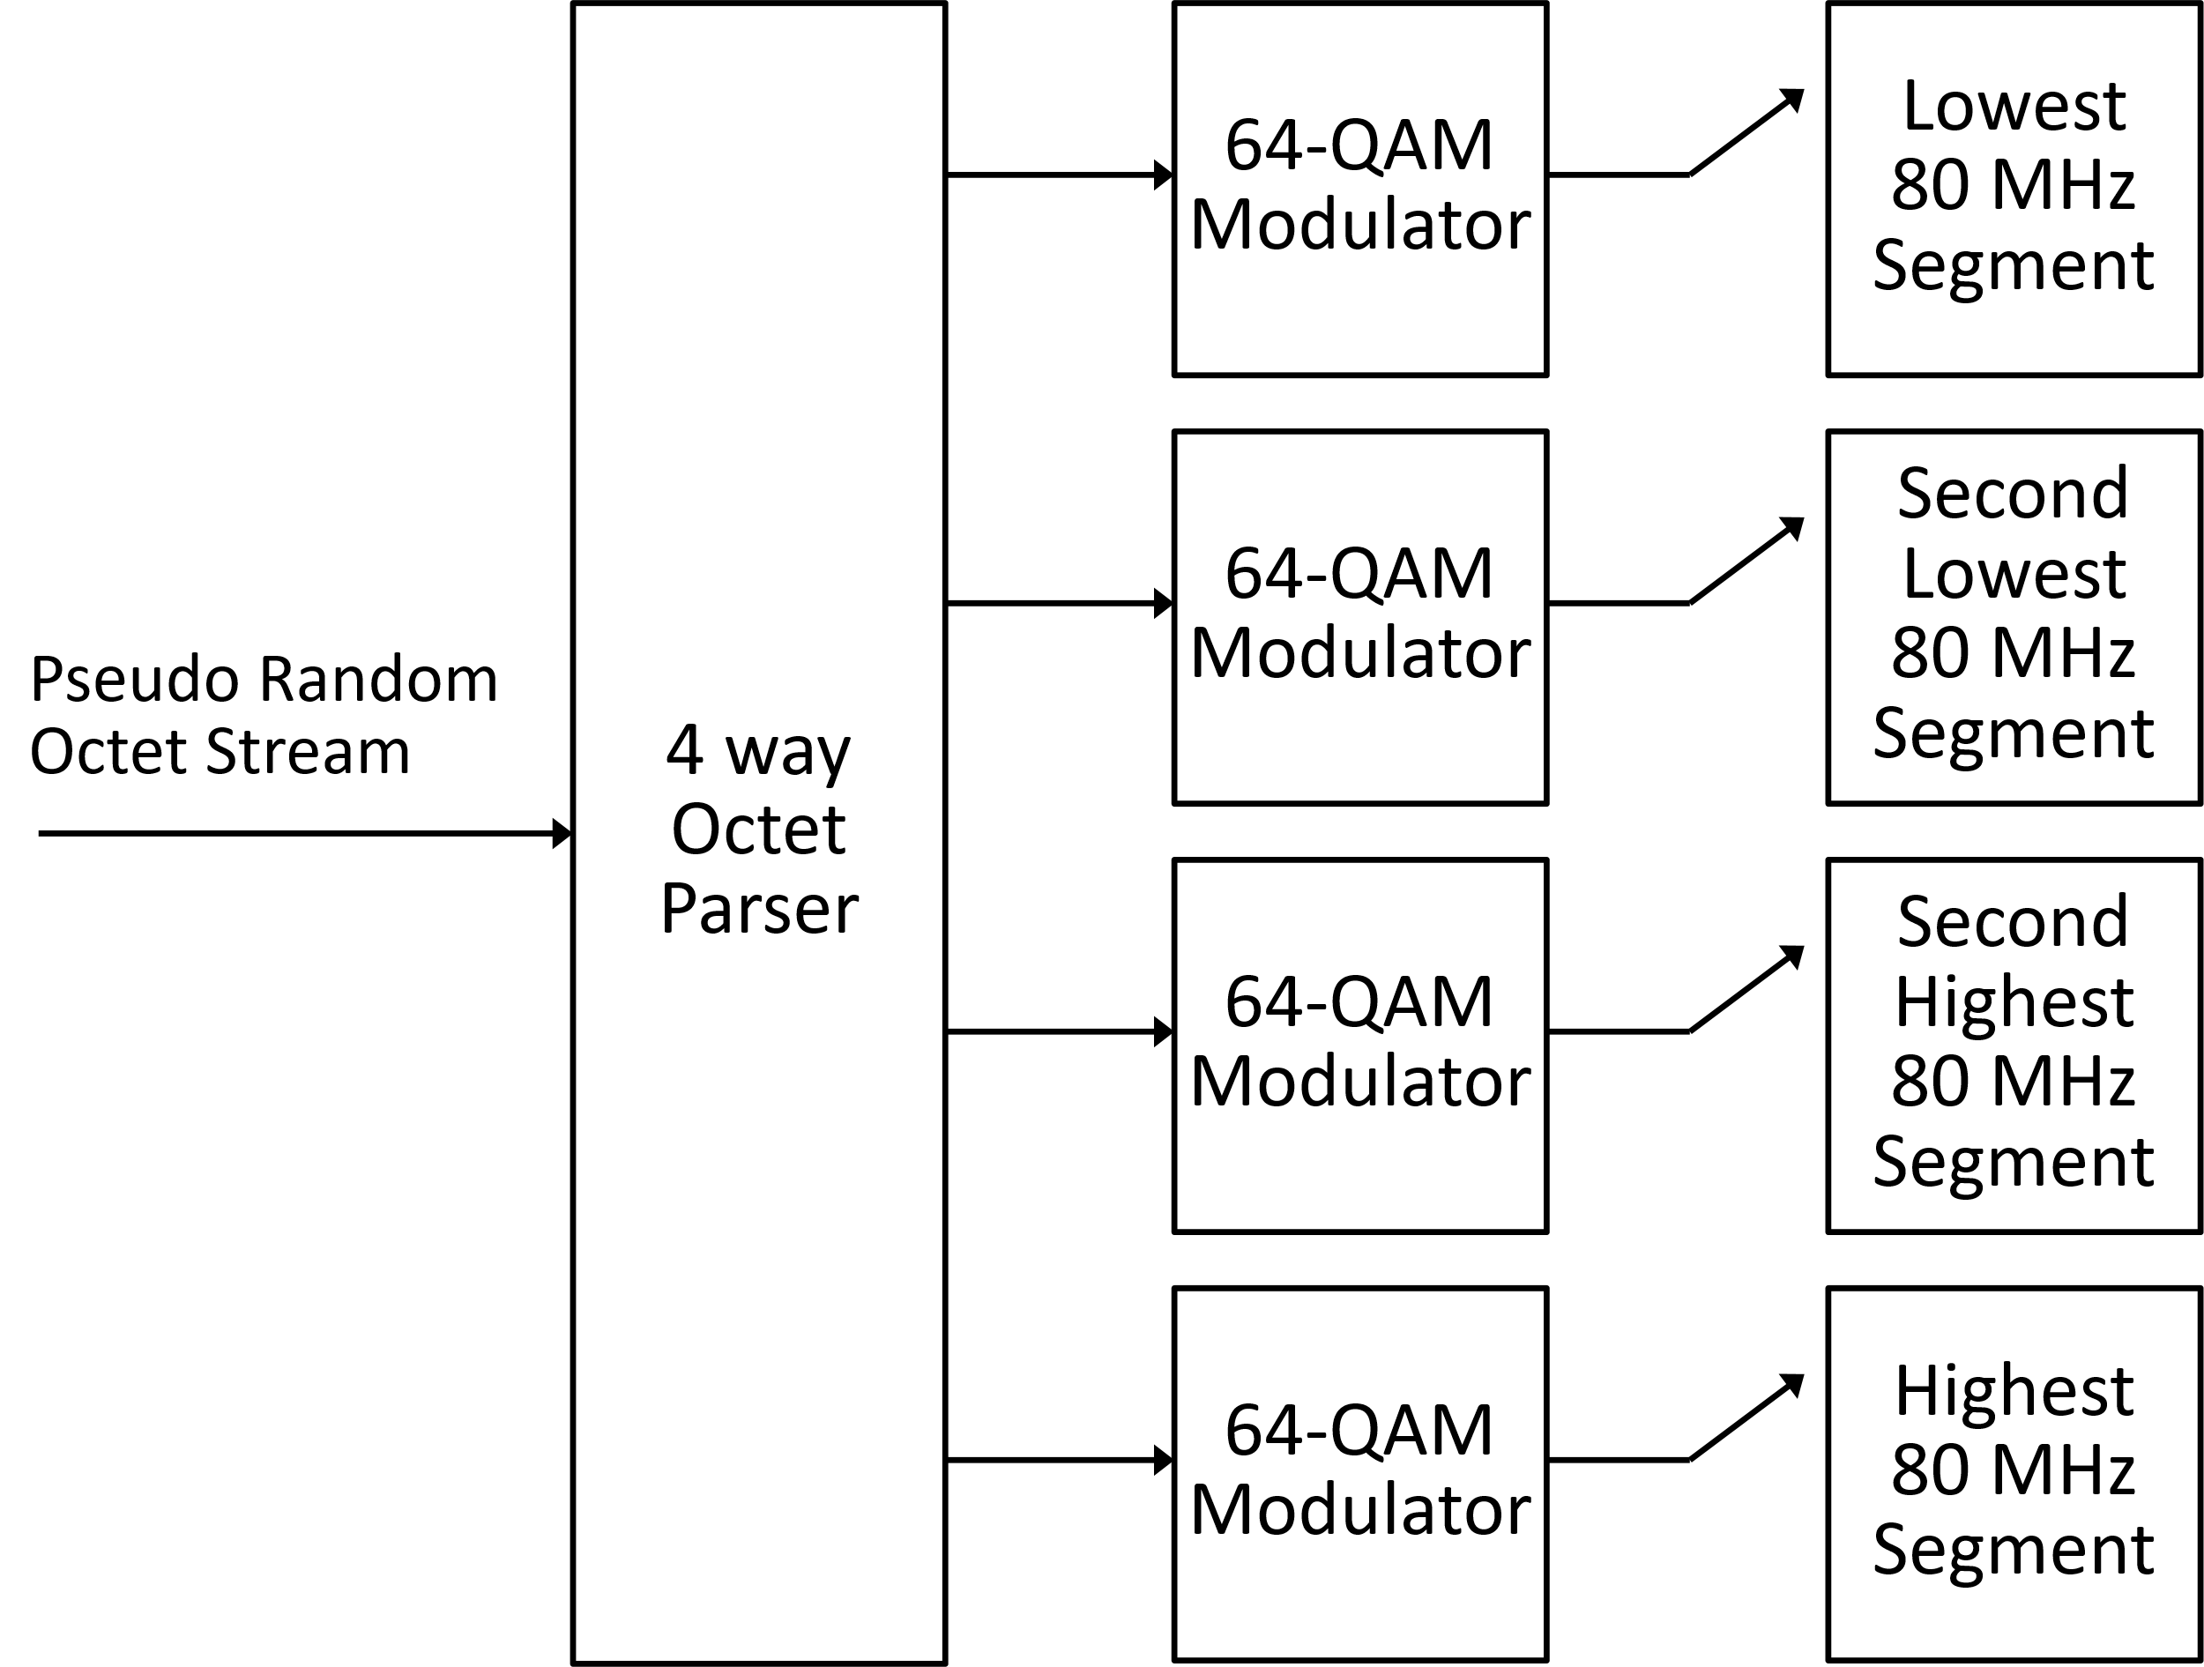
320 MHz Secure LTF (No Puncturing)
Natural Extension from 11az
Change from a 2-way Octet Parser to a 4-way Octet Parser

Slide 13
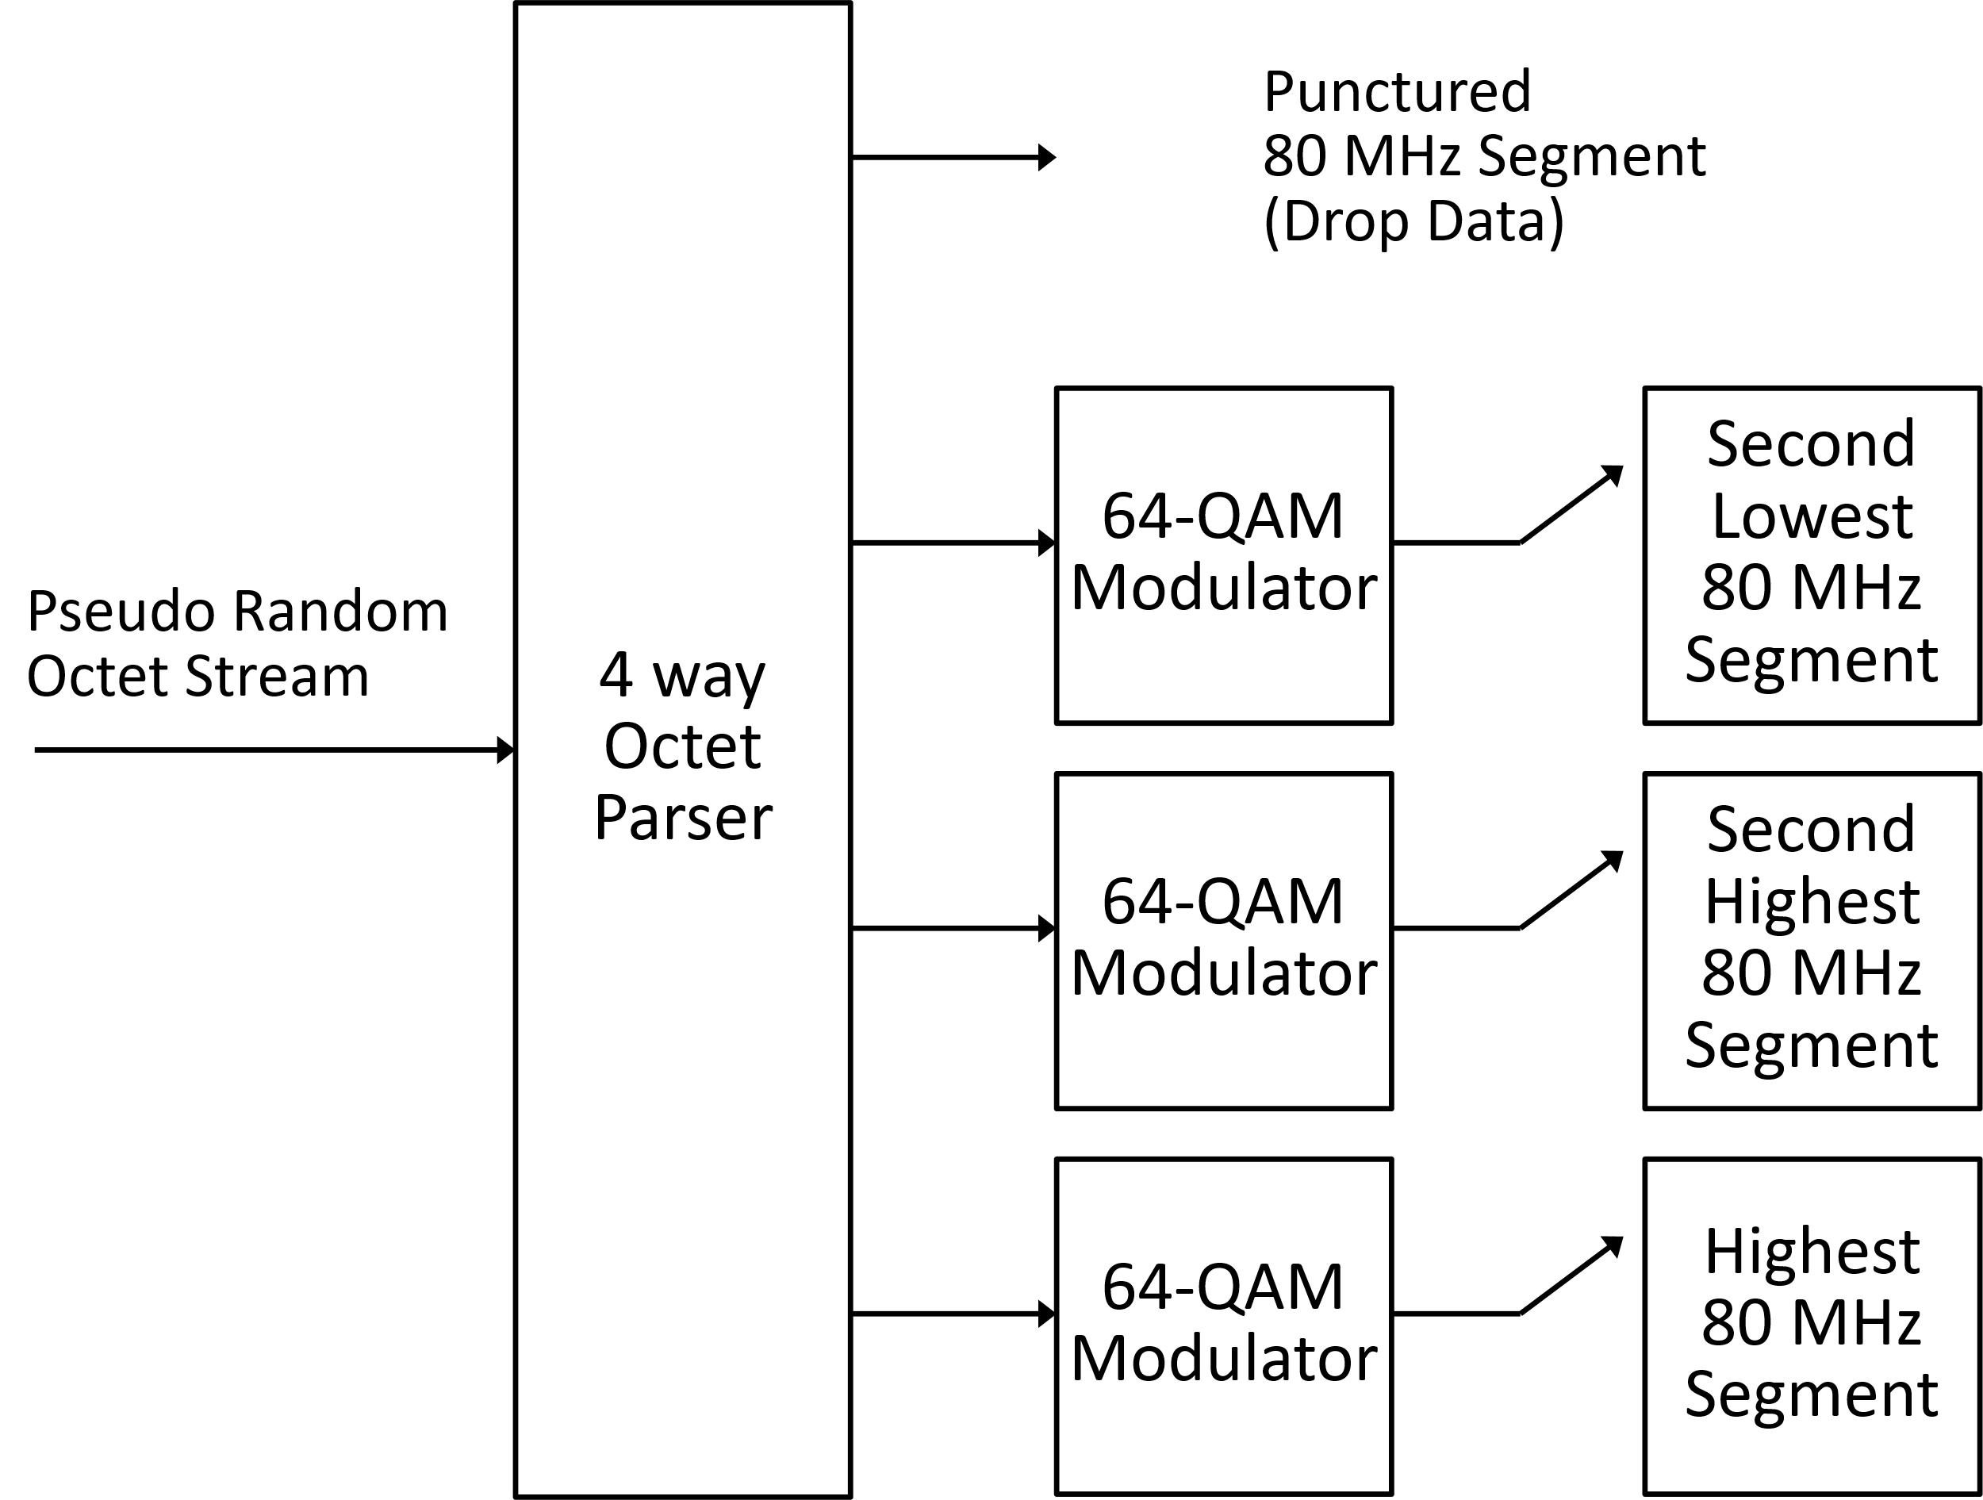
320 MHz Secure LTF (80 MHz Puncturing)
Here we stick with the 4-way parser
A 3-way parser would work in this case but not in the 40 MHz puncturing case
We just drop pseudo random octets we do not need
A few comments about enough pseudo random octets provided in the backup
It is the same process at transmitter and receiver, so tones are populated the same in both transmitter and receiver
Any of the four 80 MHz segments can be punctured

Slide 14
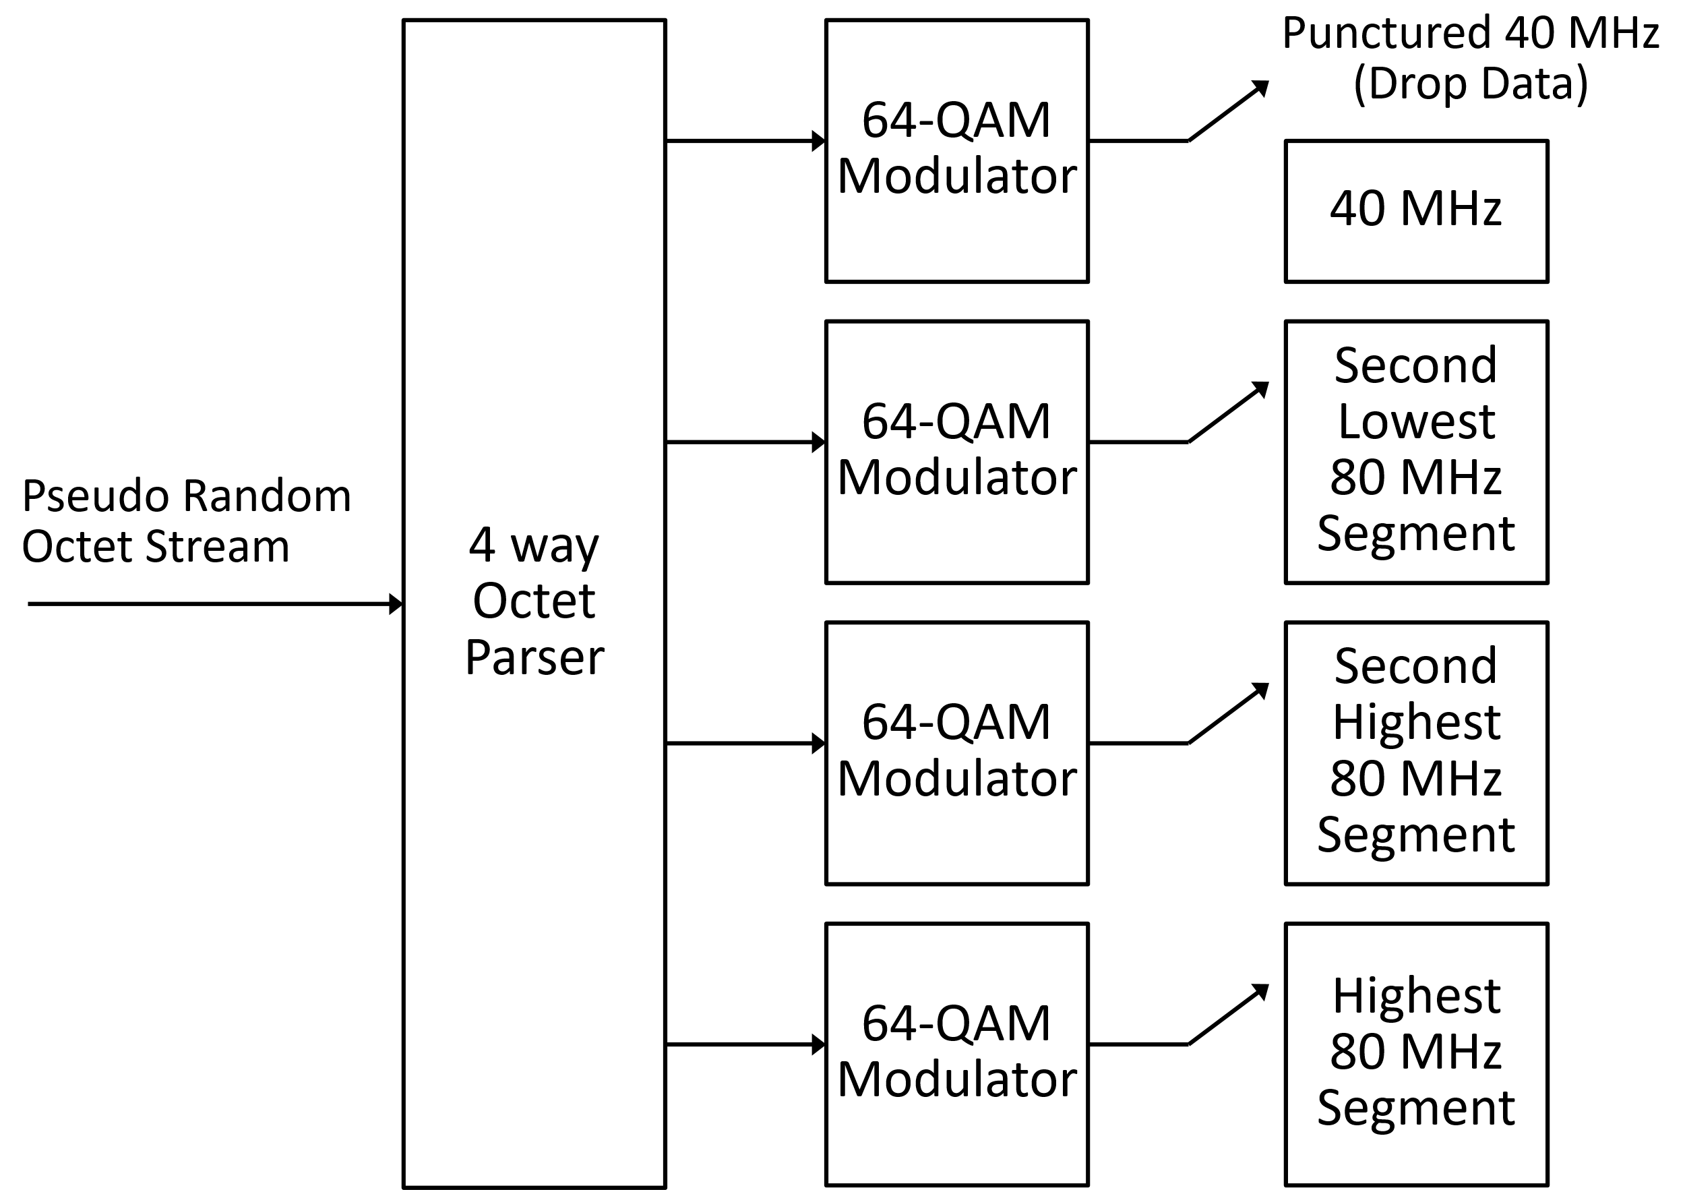
320 MHz Secure LTF (40 MHz Puncturing)
Here we see the advantage of sticking with the 4-way parser
We drop the octets that would have populated the tones of the first 40 MHz
No need to change the architecture
It is the same process at transmitter and receiver, so tones are populated the same in both transmitter and receiver
Any of the four 40 MHz segments can be punctured

Slide 15
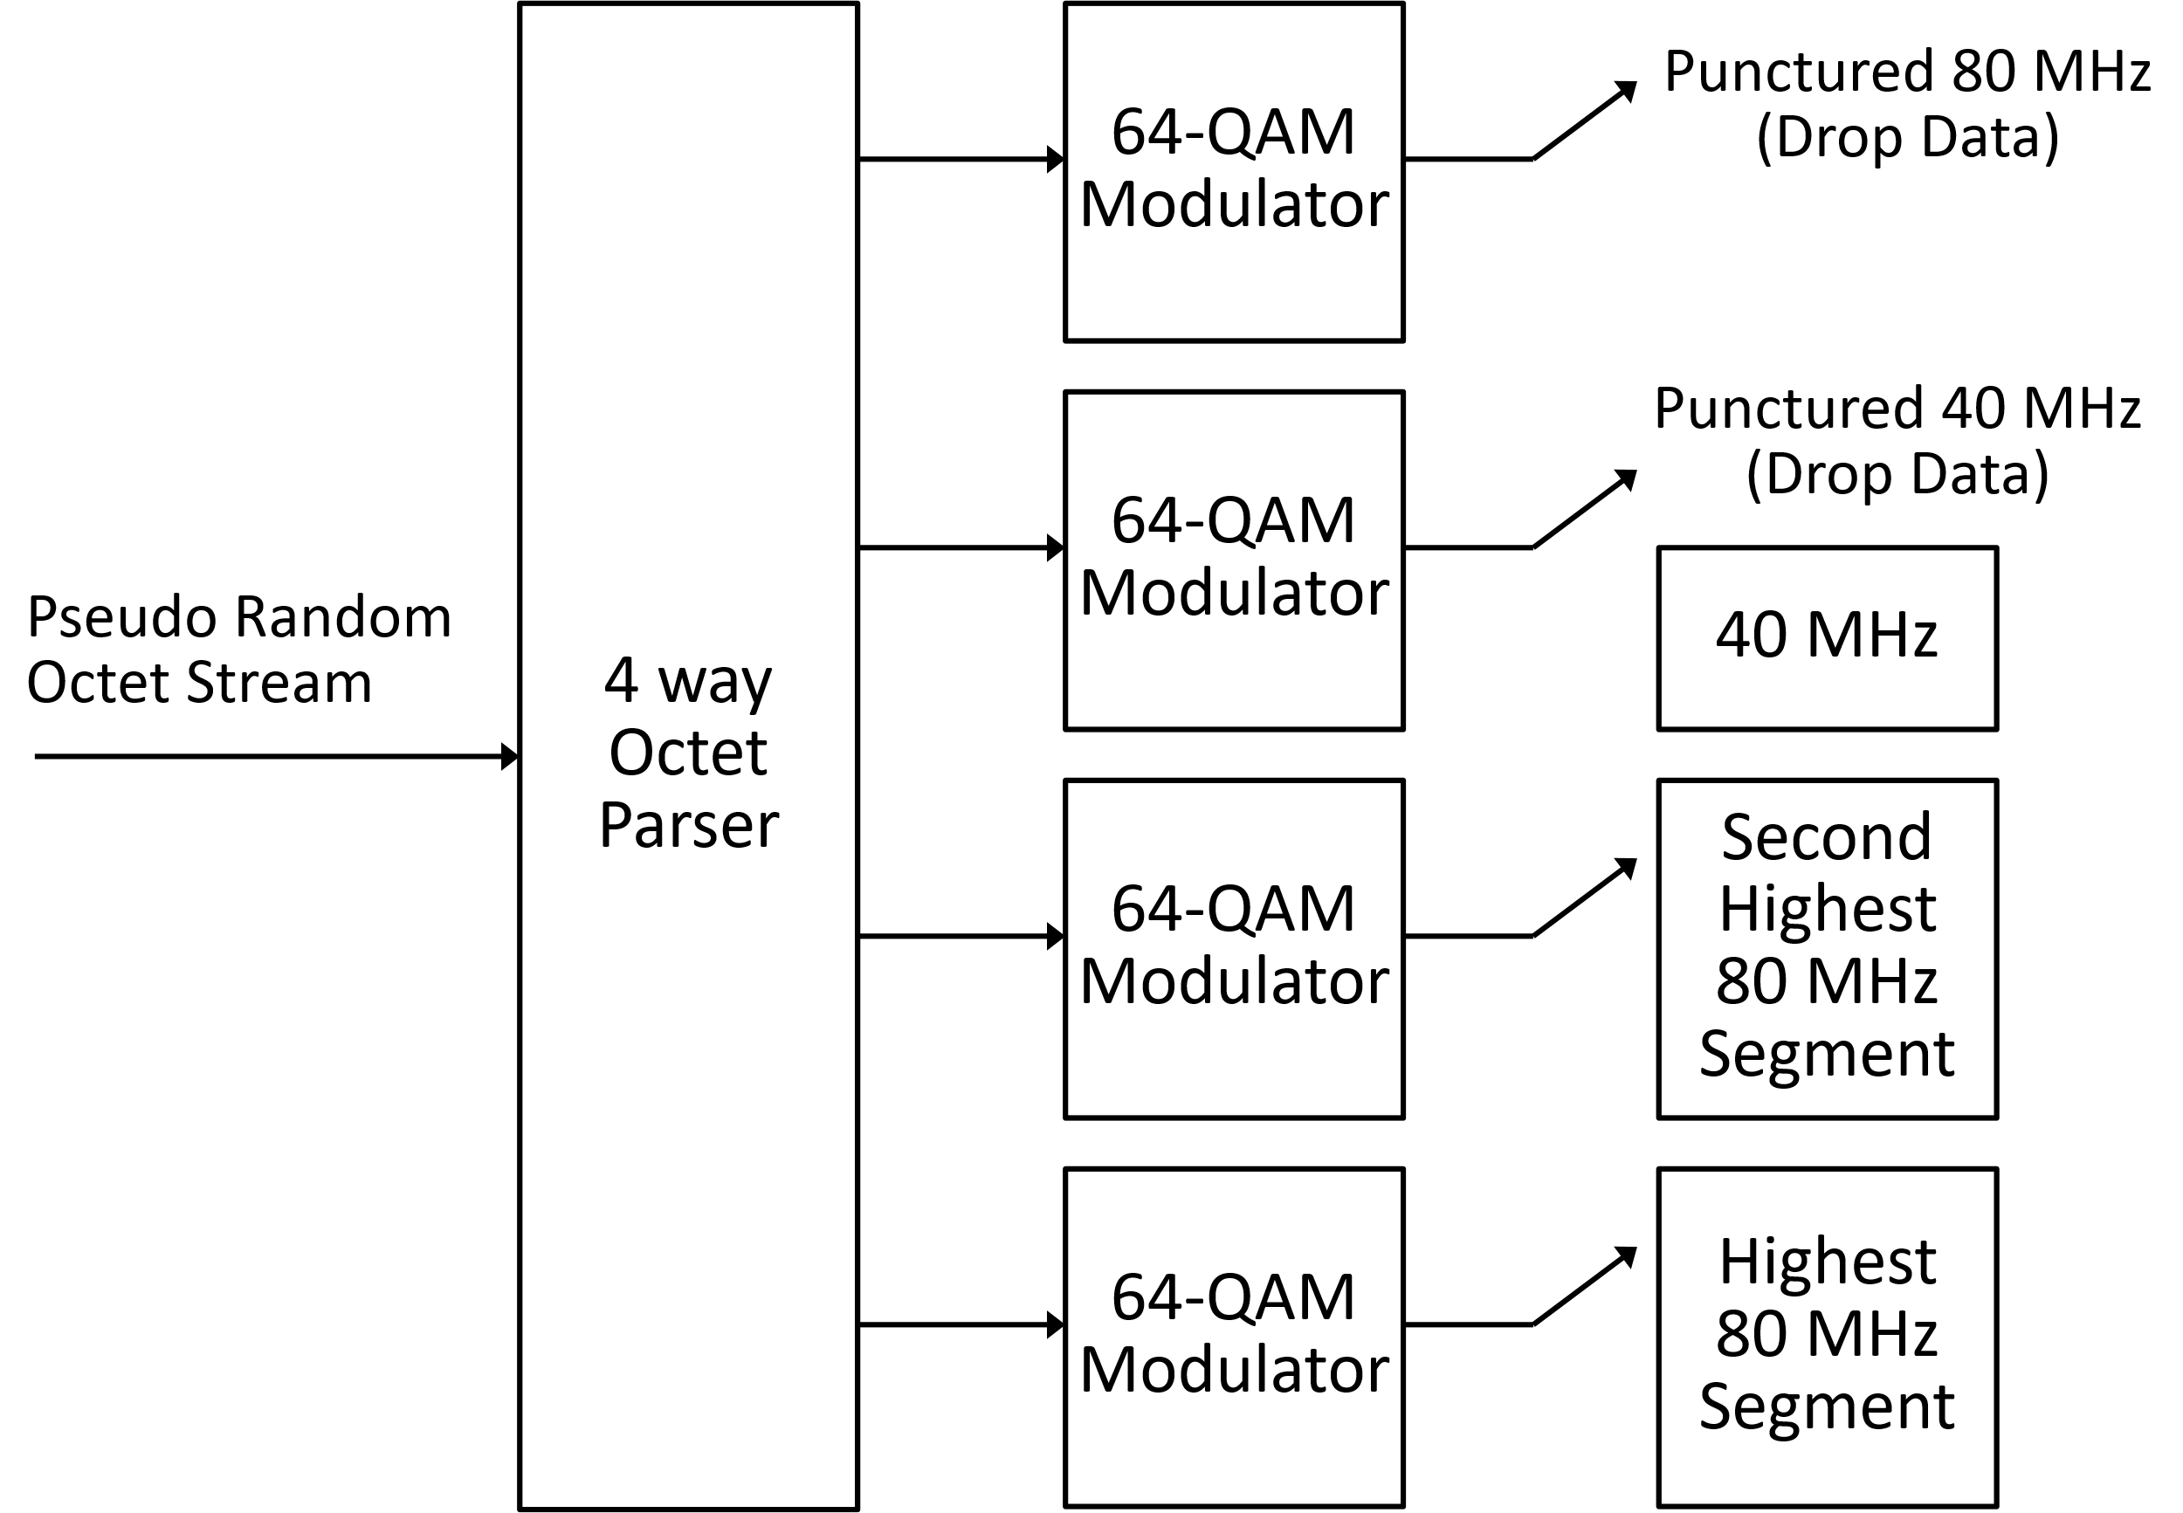
320 MHz Secure LTF (40 & 80 MHz Puncturing)
This architecture also works for the case of 40 & 80 MHz puncturing
Being able to drop pseudo random octets makes using the same architecture possible and simplifies the implementation

Slide 16
Signaling 320 MHz Ranging NDP in Preamble
In the 320 MHz non-TB Ranging NDP the intended receiver of the NDP knows from the NDP U-SIG bandwidth field and the preceding NDPA that this is a 320 MHz Ranging NDP
In the 320 MHz TB Ranging NDP the AP is the intended receiver
Since the AP solicited the NDP with the Trigger frame, it knows it will be receiving the 320 MHz TB Ranging NDP
It might be useful to signal in the preamble of the NDP that this is a Ranging NDP and not a traditional EHT NDP (as currently signaled in U-SIG)
Informs Third-Party STAs this is a Ranging NDP
Useful for Sniffers to ease parsing of PPDUs
Do this for both the non-TB and TB NDPs

Slide 17
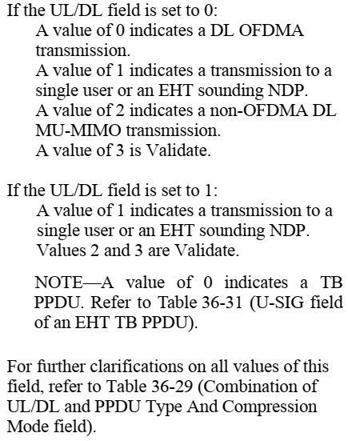
Indicating non-TB Ranging NDP in 320 MHz Preamble
The MU PPDU preamble will be used for the non-TB NDP
Currently there is a field which indicates if this is an NDP
This is the U-SIG PPDU Type And Compression Mode field (U-SIG-2 B0-B1)
We could set the “PPDU Type And Compression Mode” field to a value of two or three
There are also some reserved bits (Validate or Ignore) in the U-SIG
We can also consider using one of the reserved bits

Slide 18
Indicating TB Ranging NDP in 320 MHz Preamble
Currently there is not a TB EHT NDP
As mentioned earlier we would need to build this upon the EHT TB PPDU
The U-SIG is a little different in the TB PPDU
The PPDU Type And Compression Mode field is also present in the U-SIG of the TB PPDU
There are also some reserved bits (Validate or Ignore) in the U-SIG of the TB PPDU
So, we should be able to signal in the U-SIG of the TB PPDU that this is a 320 MHz Ranging NDP

Slide 19
Longer Packet Extension
The current packet extension (PE) in the Ranging NDP is 4 µs
Given that we are extending the bandwidth to 320 MHz we propose to increase the PE to 8 µs in the 320 MHz Ranging NDP
This provides the receiver some additional time for computations

Slide 20
Summary
Non-TB NDP uses EHT MU PPDU Preamble
TB NDP uses EHT TB PPDU Preamble
Support only the 2x LTF with 1.6 µs GI for both non-TB and TB 320 MHz Ranging NDP
Support all EHT Preamble Puncturing modes (as signaled in the U-SIG)
Add EHT LTF Repetition Blocks
Non-Secure LTFs can use the current 320 MHz EHT LTFs
A recommendation on how to extend Secure LTFs to 320 MHz, with puncturing, was provided
A recommendation for signaling the 320 MHz EHT Ranging NDP in the U-SIG was provided
We also proposed using an 8 µs PE in the 320 MHz Ranging NDP

Slide 21
Backup
Subclause 11.21.6.4.5.4 “Secure LTF octet stream generation” explains the number of pseudo random bits that can be generated before the sequence repeats
“The number of pseudorandom bits that can be generated without violating security guarantees of the scheme is $2^{39}$ without updating the key or reseeding the generator with additional entropy.”
Since these bits are used to generate a sequence of pseudo random octets, we can say that the pseudo random octet generate can generate $2^{36}$ pseudo random octets before the sequence repeats ($8=2^{3}$ bits in an octet)

