Slide 1
SINR-aware Spatial Reuse
Date: 13-Nov-22

Slide 2
Summary
Review of OBSS_PD
Apparent shortcomings of OBSS_PD
Discussion on how to address shortcomings

Slide 3
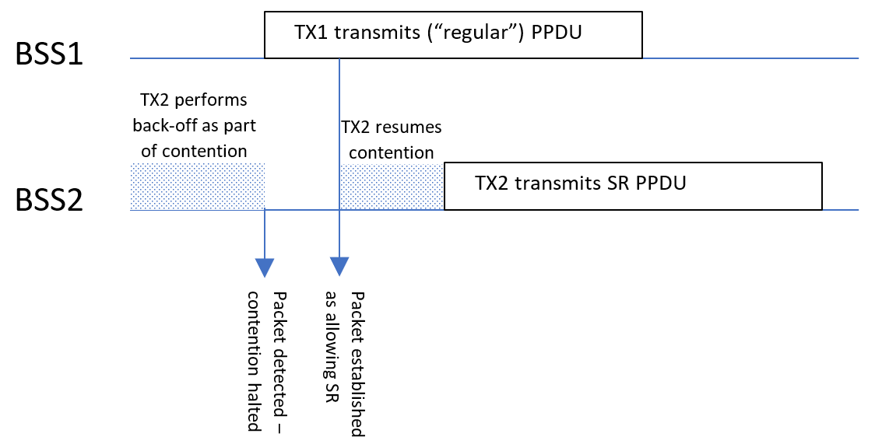
OBSS_PD Spatial Reuse - recap
BSS1 and BSS2 are overlapping BSS
BSS1 or BSS2 can ignore CCA thresholds if:
  Ongoing transmission is an OBSS (different color)
  Detected Rx power is within given limits
  SR Tx reduces power as prescribed by OBSS_PD mechanism

Slide 4
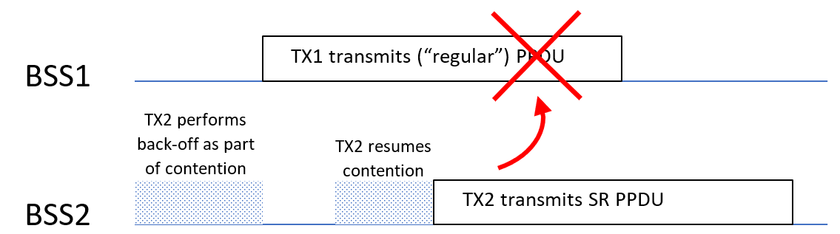
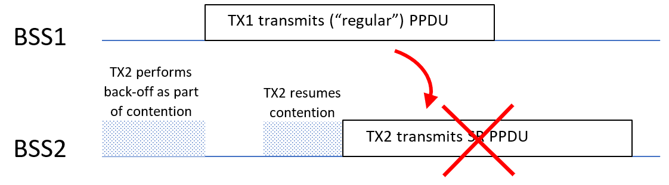
Issues with SR
Power backoff does not consider interference at the receiver
  Backoff is based on path loss between transmitters, not interference
  → SR PPDU could interfere with ongoing transmission
SR PPDU does not know interference form ongoing transmission
  → Interference from ongoing transmission could impair SR PPDU

Slide 5
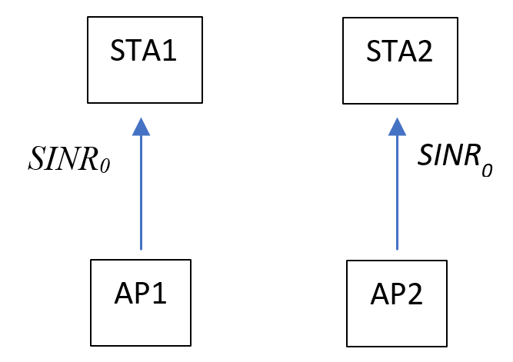
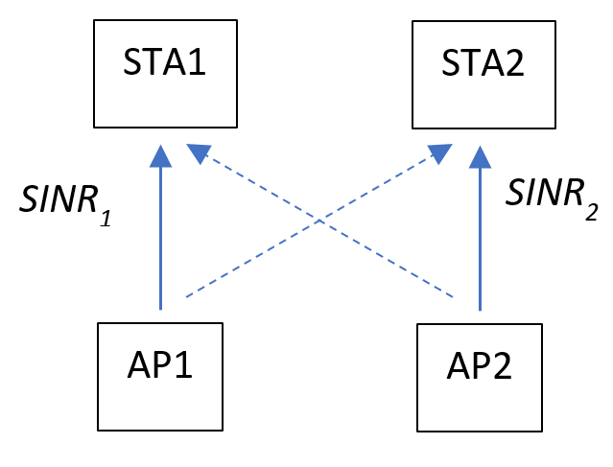
Is SR always beneficial?
Consider OBSS with and without concurrent transmission:
A simple criterion for using SR:
SINR₁ and SINR₂ include any back-off that may be done by AP1 or AP2

Slide 6
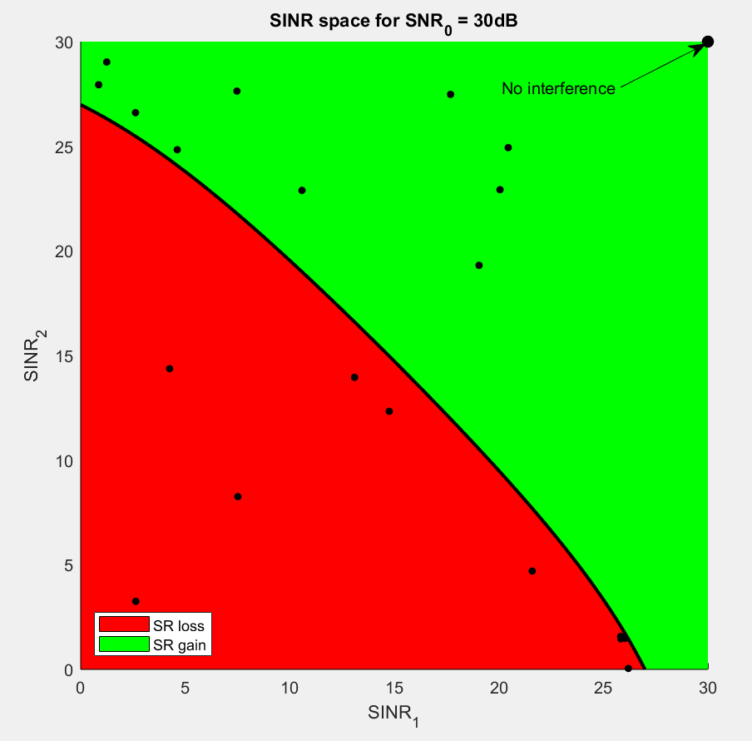
SR gain as function of SINR₁, SINR₂
SR provides higher capacity
SINR information is needed† to be able to make the right decision on using SR or not
  Not part of current OBSS_PD mechanism
† at both receivers
SR reduces capacity

Slide 7
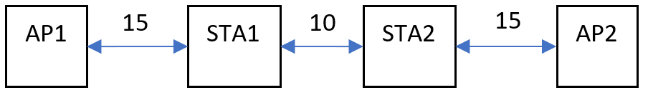
Simulations
Consider a “good” and “bad” SR scenario
“SINR-aware” Spatial Reuse means:
  Choose Tx power to avoid interference to ongoing transmission
  Choose MCS to optimize performance for know SINR
“Bad” case: STAs will experience high interference
“Good” case: STAs will not experience high interference

Slide 8
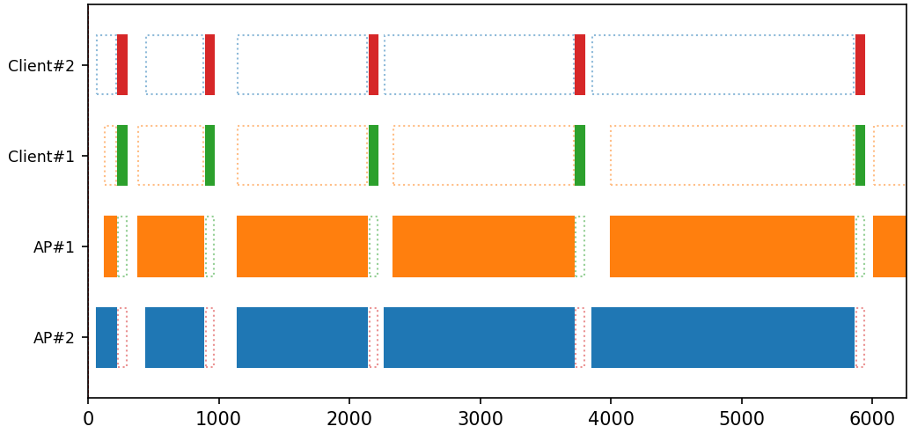
Simulation methodology
Discrete event simulation
Mimics traffic, CSMA, ACKs, retransmissions, collisions, …
MCS chosen as function of SNR

Slide 9
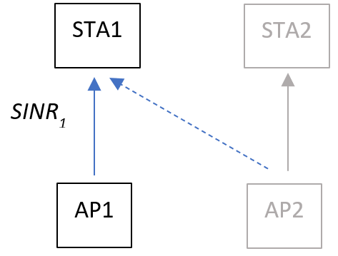
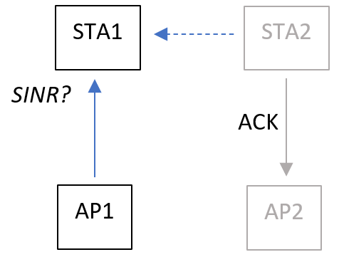
ACK in Spatial reuse
Interference is different during data transmission and ACK transmission
Avoid the change in interference level by terminating both transmissions at the same time
  Leading to ACKs being sent at the same time

Slide 10
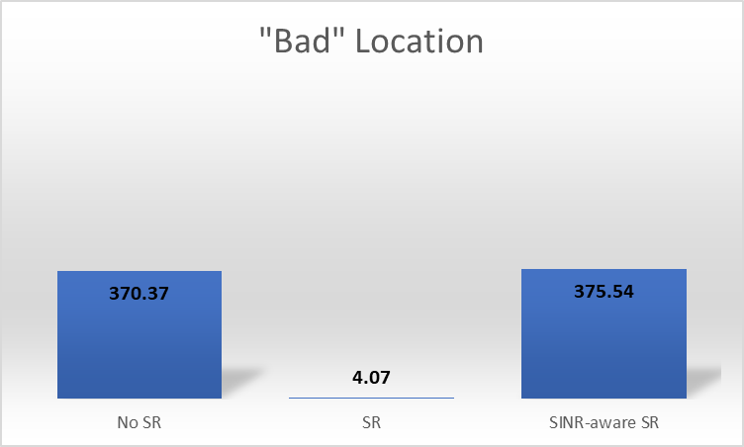
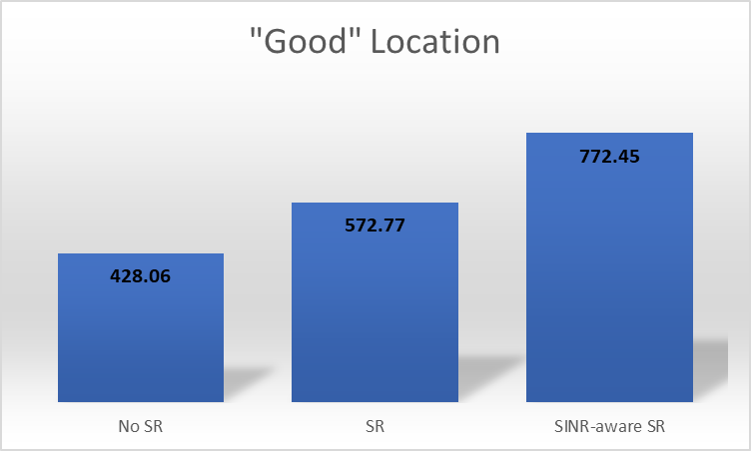
Simulation results
SR improves performance
SINR-aware SR allows higher power and optimized MCS
SR (when naively applied) destroys performance
SINR-aware SR mostly avoids concurrent transmissions

Slide 11
How to make SR “SINR-aware”?
Bi-directional protocol
→ Does not provide information of SINR at STA2

Slide 12
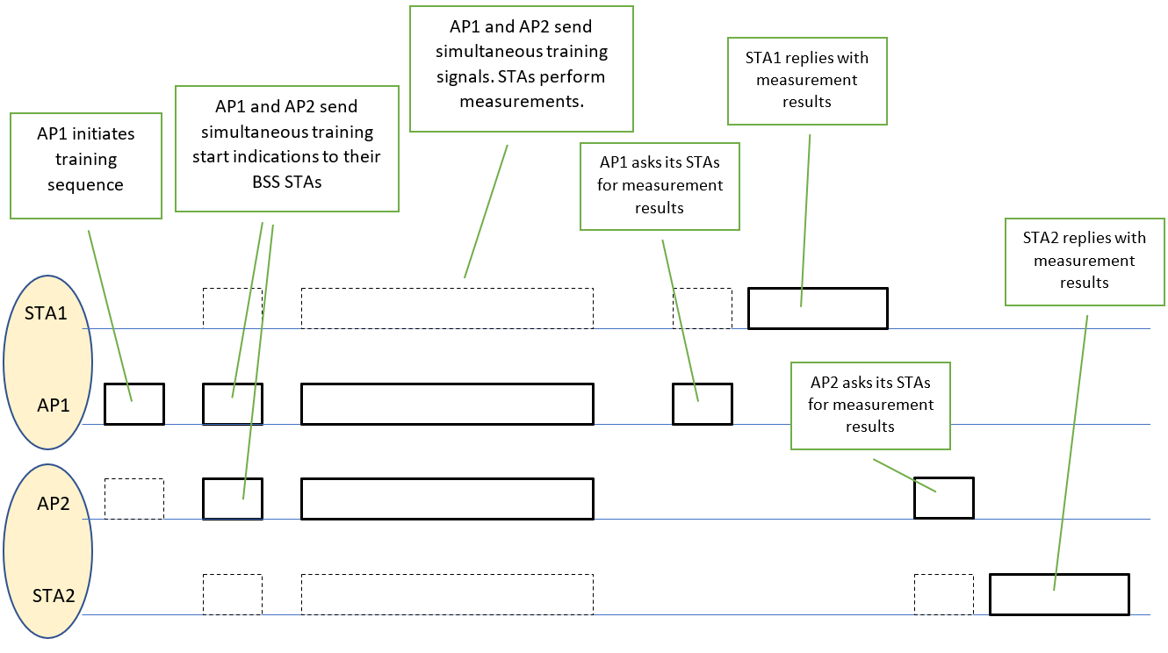
SINR Measurement and exchange
Provides transmitters with measured SINR
  Measure during concurrent transmission
  Needs appropriate updating
  Extra overhead

Slide 13
Conclusion
SR has potential to provide significant gains, but needs proper SINR awareness to be able to do so
  Or equivalent information (e.g., interference)
  Information needed for both receivers
Current SR (OBSS_PD) is unaware of mutual interference caused by concurrent transmissions
  Could significantly hurt performance
Existing coordinated SR protocol proposals do not address SINR awareness on the “SR link”
UHR can address SR improvements

