Slide 1
Further Thoughts on Virtual BSS
Date: 2022-11-09
Authors:

Slide 2
Introduction
Roaming from one BSS to another involves break before you make leading to gaps in service
Fast BSS Transition does provide a means to minimize the disruption, but still is non-zero
Virtual BSS (V-BSS) concept has been introduced [1-5] as a way to improve the transition of a STA from one AP to another without loss of connectivity
In this presentation, after a brief summary of the mechanism, some comments raised in the earlier presentation are discussed

Slide 3
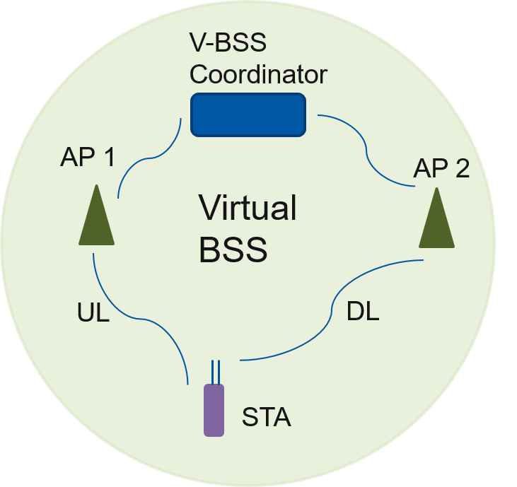
Virtual BSS
Infrastructure BSS with a group of APs coordinated by V-BSS Coordinator
V-BSS is a mechanism to allow a client to maintain connectivity with multiple APs without the need for roaming
V-BSS Coordinator and STA together select one or more APs with which a client can set up an ML link
Transparent data reception
Receive PPDUs from any AP in the VBSS that include data frames
Solve sticky STA problem.
Sticky STA is a STA that clings to the same AP despite better possibilities
V-BSS can use the MLO framework except that the APs are not collocated
V-BSS can be visualized as an instantiation of AP MLD/BSS
APs can be on same or different frequency/band
Each client will be a non-AP MLD
Single Block Ack and unicast encryption keys across all APs within a V-BSS
Communication between the APs and V-BSS Coordinator could be over a wired or wireless backhaul

Slide 4
Questions raised in the past
How is V-BSS different from MBSSID, 11be multi-AP and WFA AP?
In MBSSID all APs are co-located; in VBSS the APs are in different locations
In 11be, multi-AP is not defined other than AP MLD with collocated APs
In WFA multi-AP each STA is associated with one AP only (except if it roams, but this using non-transparent mechanisms)
Some elements may be common and can be brought into IEEE 802.11
It appears that all APs need to be on the same channel
APs are expected to be on different channels/bands and frequency reuse can be employed. The MLO framework allows APs to be on multiple channels

Slide 5
Questions raised in the past
How does addressing work?
3 address format just like in .11be – address translation will be done in the MLD
If multiples APs are on the same channel, then the STA chooses to receive broadcast frames from one AP based metrics either determined by the STA or the V-BSS Coordinator assignment
 | Address 1 | Address 2 | Address3
Uplink in Virtual BSS | AP | STA | Destination
Downlink in Virtual BSS | STA | AP | Source

Slide 6
References
[1] 11-19/1019r0, “Virtual BSS for Multi-AP Coordination”
[2] 11-19/1451r1, “Virtual BSS for Multi-AP Coordination Follow-up”
[3] 11-19/1972r1, “Operation of Virtual BSS for Multi-AP Coordination”
[4] 11-20/1247r2, “Making BSS transitions obsolete with multi-AP operations (Virtual BSS)”
[5] 11-22/1394r1, “Virtual BSS And Multi AP Transmissions”

Slide 7
802.11 Template Instructions 1/4
To properly identify your PowerPoint presentation as an IEEE 802.11 Submission there are 7 steps that you must complete, and 12 data fields that you must fill in.
Step 1. Obtain a document number (has the form yy/xxxx).
Step 2. Title slide: Fill in the presentation subject title text, the full date (in ISO 8601 format of YYYY-MM-DD), and the complete author(s) details (a total of 3 data fields).
Step 3. Abstract slide: Fill in the abstract text.
Step 4. Press “Office” button, Prepare / Properties. Fill in the 2 data fields:
Author field = first author's name
Title field = Title of presentation

Slide 8
802.11 Template Instructions 2/4
Step 5. Menu select View, Master, Slide Master, select the top master page (theme slide master). Place the document designator in the right hand side of the header.
Document designator example "doc.: IEEE 802.11-04/9876r0" , or
"doc.: IEEE 802.11-04/9876r2"
Step 6. Menu select Insert, Header and Footer (5 data fields):
Slide tab:
Date & Time, Fixed = venue date (as Month Year, e.g. January 2005)
Footer = first author, company
Notes tab:
Data and time, Fixed = venue date (as Month Year, e.g. January 2005)
Header = document designator (e.g. “doc.: IEEE 802.11-04/9876r0”)
Footer = first author, company
Click "Apply to all".
Step 7. Delete the four template instruction slides.

Slide 9
802.11 Template Instructions 3/4
PowerPoint Submission Preparation Summary:
Things to do: 7
Fields to fill in: 12

Slide 10
802.11 Template Instructions 4/4 Recommendations
a) Always create a new presentation using the template, rather than using someone else's presentation.
b) For quick and easy creation of new 802.11 submissions, place the 802.11 template files in the template folder area on your computer. Typical locations are:
c:\Program Files\Microsoft Office\Templates\802.11, or
c:\Documents and Settings\User Name\Application Data\Microsoft\Templates\802.11
To create a new submission from within PowerPoint, menu select File, New, then select the appropriate 802.11 template file.
c) When you update or revise your presentation, remember to check all 6 fields in steps 5 and 6 for the correct values.
rev: 2010-03-01

