Slide 1
UHR SG– WLAN in Data Centers
Authors:
Name | Affiliations | Address | Phone | email
Nadeem Akhtar | Arista Networks, Inc. |  | +91 97909 68633 | nadeem.akhtar@arista.com
Jatin Parekh | Arista Networks, Inc. |  | +91 98211 63119 | parekhj@gmail.com

Slide 2
Use Case
A typical datacenter (DC) has massive numbers of servers, switches and storage devices, mounted in rows of racks
Servers, switches etc in the DC are inter-connected with high-speed wired links.
Wi-Fi is often used to provide connectivity to personnel who are in the DC for regular maintenance activities.

Slide 3
Typical Requirements
Low to medium user density with handheld devices (laptops, tablets, phones); automation will introduce new types of clients like AGVs, robotsc.
Medium bi-directional throughput requirement per cell with low-latencies to support applications like audio-video conferencing
Users walk between racks on the DC floor and need uninterrupted coverage with seamless mobility
Requirements are not very different compared to an enterprise but the RF is very challenging!

Slide 4
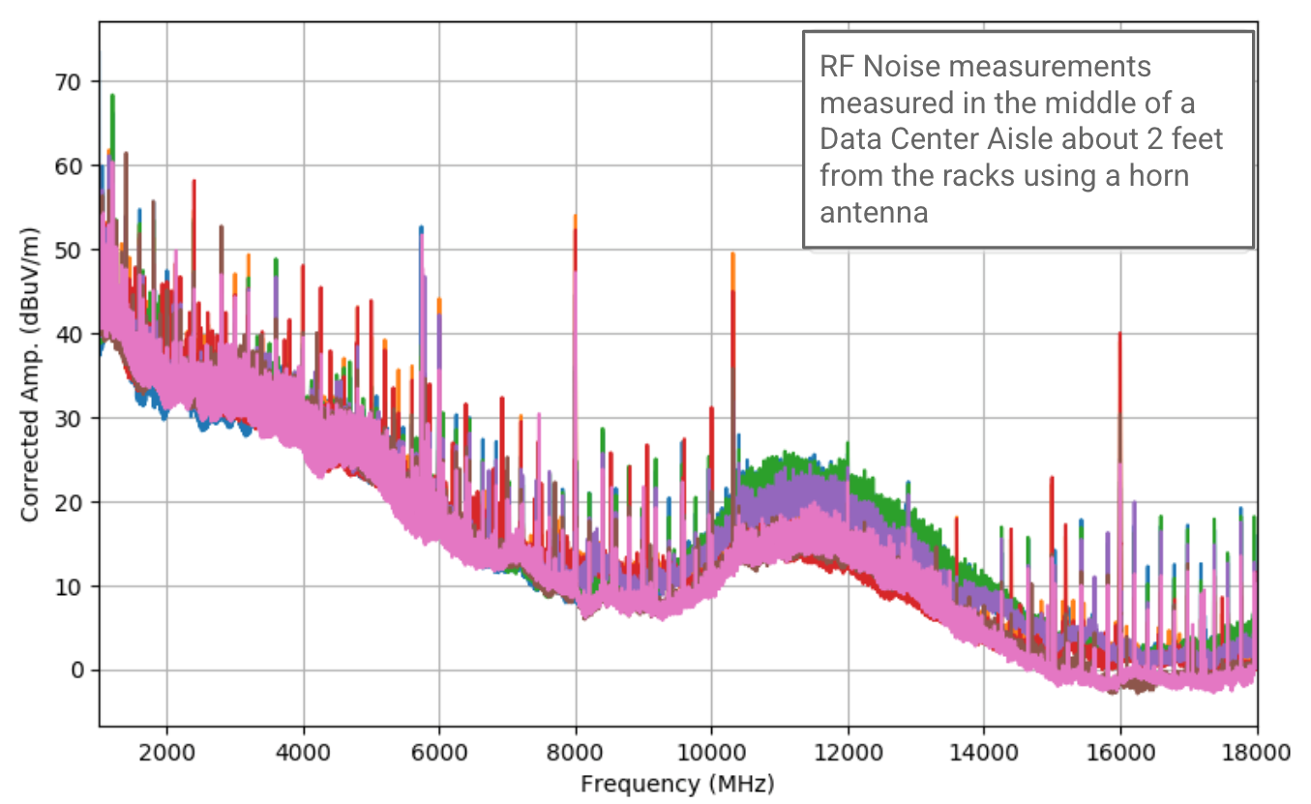
RF-related Challenges
The DC environment is characterized by very high noise floor, spanning a wide range of frequencies.
Noise Floor is above -70dBm in the Wi-Fi bands; situation is worse at the lower end of the spectrum
Very small cells are needed to ensure high SNR for clients
Ultra-dense deployment with high RSSI at cell-edge means clients don’t roam even after crossing cell boundary

Slide 5
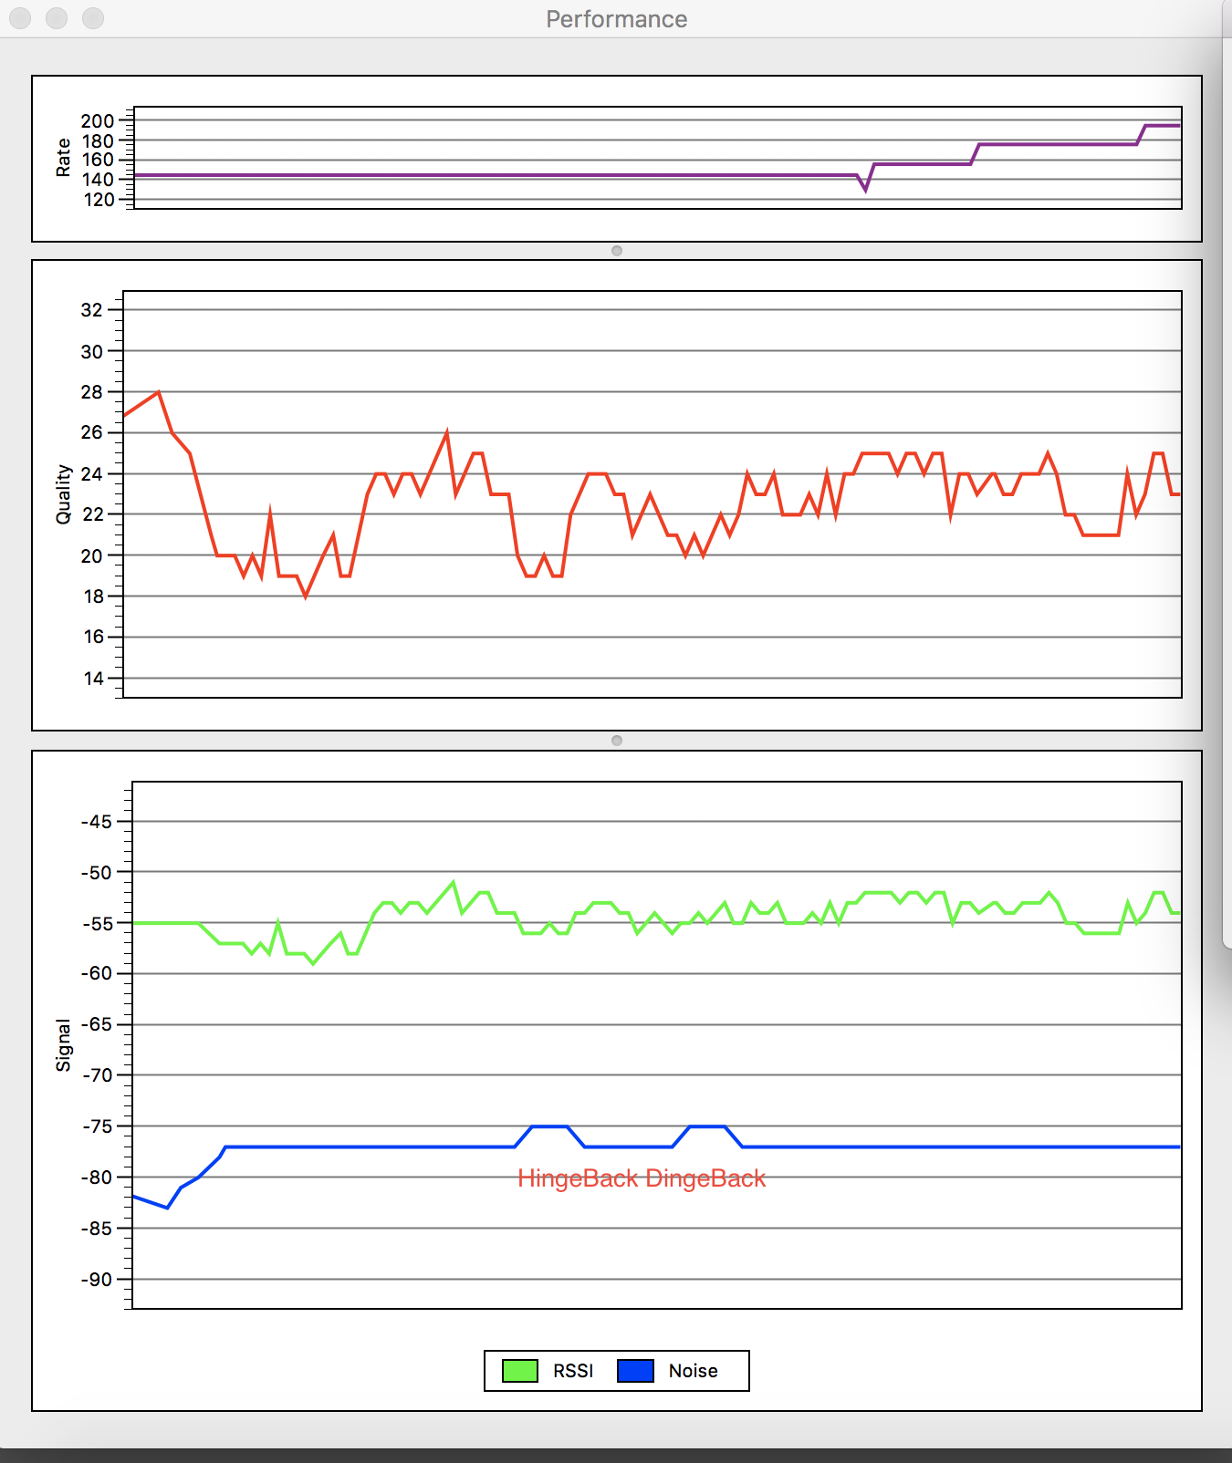
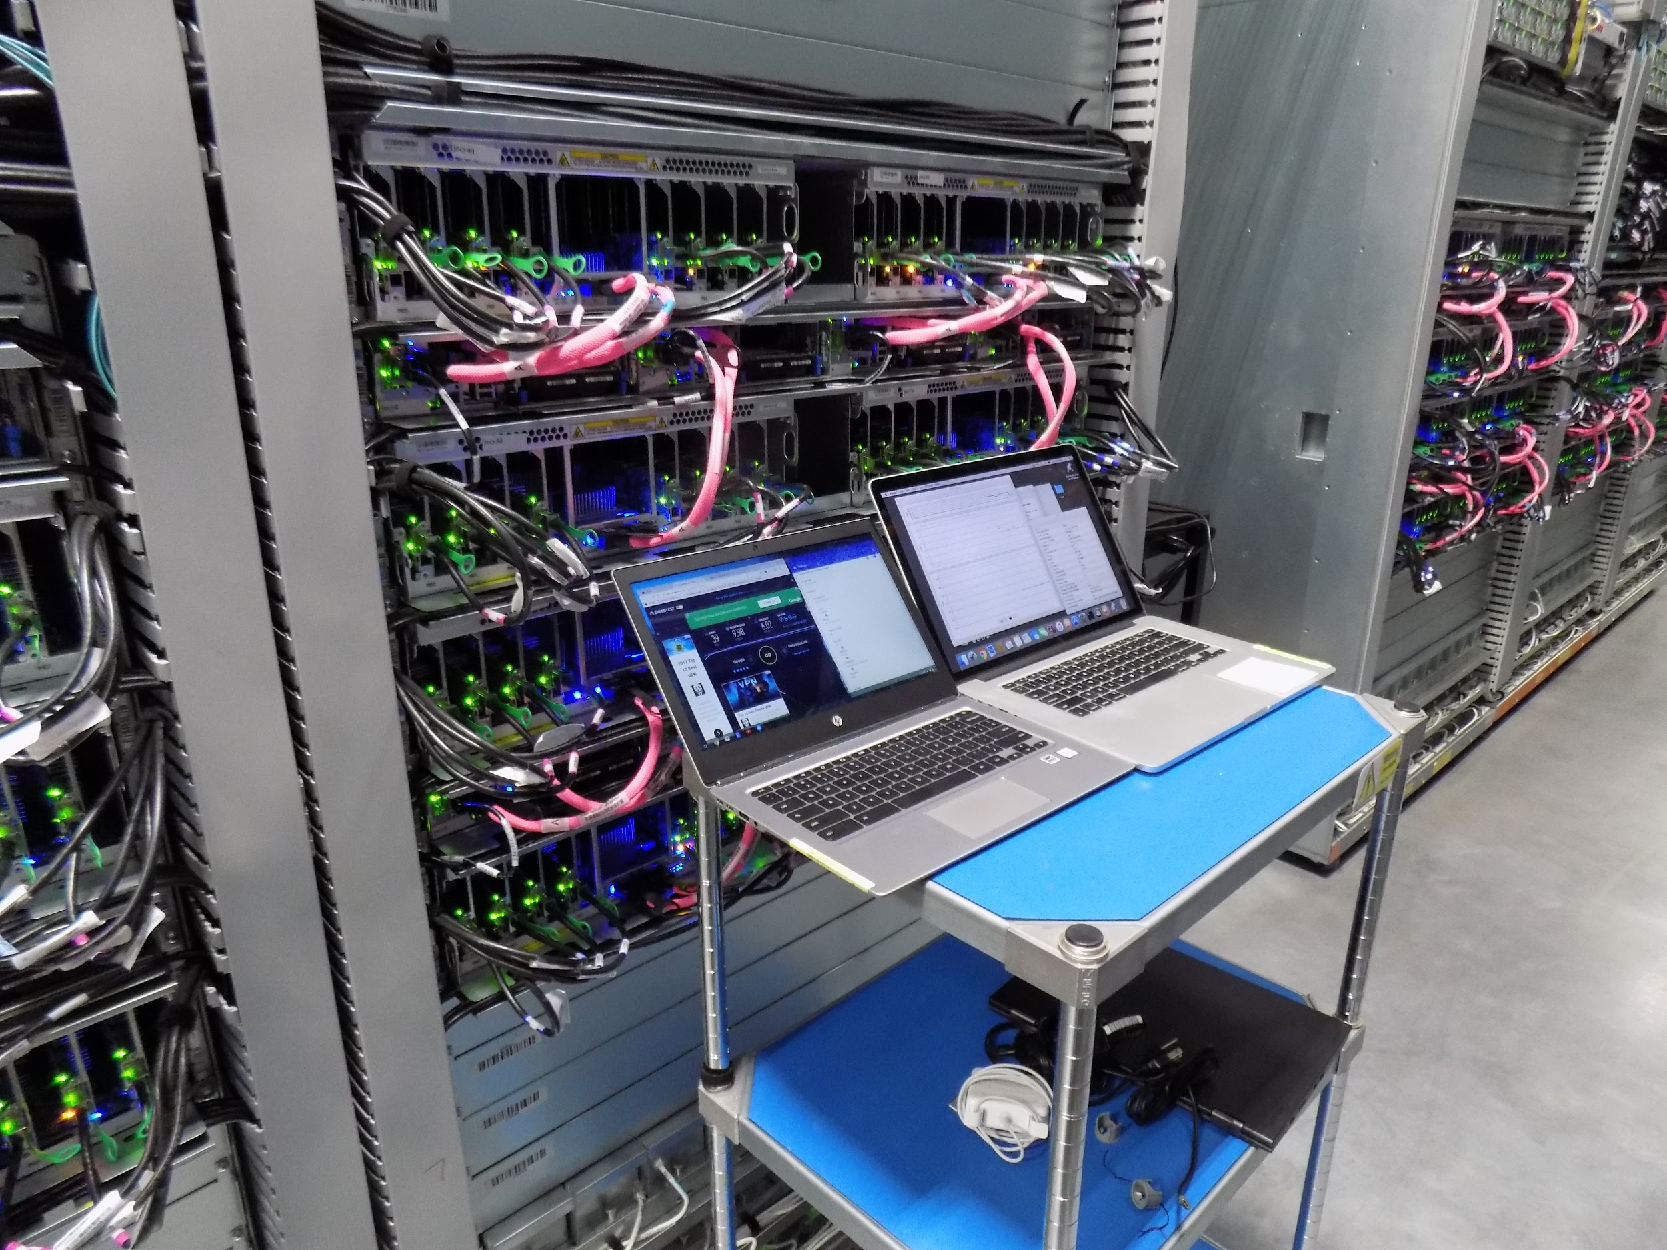
RF-related Challenges (contd.)

Slide 6
Technical Requirements
Highly reliable and robust connections even in the face of high noise floor.
Low-latency for real-time applications
Seamless connectivity as the user moves across cell boundaries in ultra-dense deployments

Slide 7
THANK YOU

